Slide 1
Nutrient Removal Project: Oxygen Requirements
History of Human Waste
Nutrient Removal Project
Dissolved oxygen measurements
Oxygen Transfer
DO probe
Pressure sensor
Temperature probe
Air
Stir bar

Slide 2
Excreta Disposal: Land Application
When population densities were low excreta disposal was an individual problem.
As cities grew it was no longer possible for individuals to practice “direct land application.”
Before 1800 city residents placed “night soil” in buckets along streets and workers emptied the waste into “honeywagon” tanks.
The waste was transported to rural areas for disposal on farm land. The honeywagon system preserved the essential feature of land application of the waste.
Nutrient Recycle

Slide 3
Toilets
Until about 1850 even the members of Congress were required to go outside and walk down Capitol Hill to privy facilities.
1850-1900: The flush toilet came into general use in the U.S. during the last half of the nineteenth century.
Introduction of the toilet coincided with ______ _____.
central heat

Slide 4
Night Soil vs. Sewers
Dutch engineer Charles Liernur advocated dry disposal. He claimed underground sewers would be the source of ________ _____ giving rise to sickness and death.
English engineer Baldwin Latham supported water carriage of excreta. Latham proceeded with the installation of a water carriage system for Croydon, where he was engineer of public works.
The water carriage system led to an immediate decrease in the death rate in the cities that installed it.
noxious gases
I’d like to see the data!
But what about the cities downstream?

Slide 5
Conversion of Storm Sewers to “Sanitary” Sewers
Toilets were connected to existing storm sewers
The storm drain systems discharged directly to streams, lakes, and estuaries without treatment
Treatment of wastewater only became an issue after the self-purification capacity of the receiving waters was exceeded and ________ __________ became intolerable
nuisance conditions
Notes:
What were the nuisance conditions?

Slide 6
Wastewater into Streams: Enter Environmental Engineering!
Drinking water treatment began to receive attention in the 1800s.
London, and cities on the Great Lakes found themselves draining their raw sewage into the same body of water from which they took their drinking water.
Chicago solved this problem by reversing the flow of the Chicago river and sending its waste through a canal to the Illinois River to the Mississippi.
English engineers tackled the problem by developing treatment techniques for both wastewater and drinking water.

Slide 7
Evolution of Treatment Goals
Solids (sedimentation)
BOD (activated sludge)
Nitrification (convert ammonia to nitrate)
Denitrification (convert nitrate to N₂)
Phosphorus (get bacteria to take up phosphorus so phosphorus can be removed with the sludge)

Slide 8
Nutrient Removal Project
The challenge: build an automated wastewater treatment plant that removes organic carbon from a synthetic feed
Batch or continuous feed
Maintain high cell concentrations using sedimentation
We need to monitor oxygen levels
We need air (oxygen)…

Slide 9
NRP Context… Can you control the oxygen concentration?
Suppose that you knew the desired rate of oxygen transfer into the reactor
How would you set the air flow rate?

Slide 10
Air Supply Design Questions
How much oxygen will be required by the wastewater?
How much air will need to be supplied?
Number of diffusers
Reactor configuration (shallow vs. deep)
How will we supply the air?
Peristaltic pump
Laboratory compressed air (100+ kPa source) with air flow controller
BOD
Q*BOD
Tradeoff cost and efficiency

Slide 11
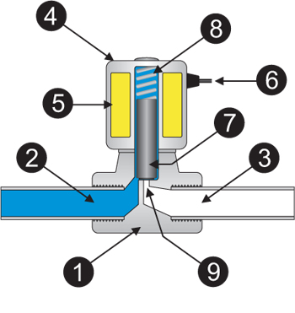
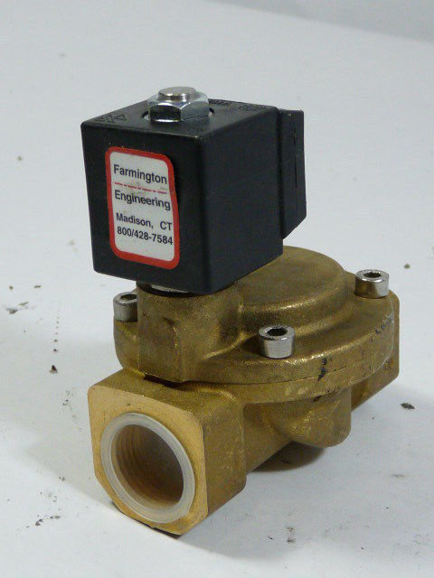
Diffuser Air Supply Design
If we use the laboratory air supply (100 kPa) for the NRP how could we regulate air flow?
We have computer controlled solenoid valves.
Electromagnet turns on and off
1. Valve Body | 4. Coil / Solenoid | 7. Plunger
2. Inlet Port | 5. Coil Windings | 8. Spring
3. Outlet Port | 6. Lead Wires | 9. Orifice
Notes:
Easy solutions
Variable duty cycle
A variable control without really knowing what you are setting
Great solution
Somehow measure the flow rate and control it
Airflow rate that doesn’t vary much

Slide 12

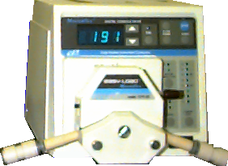
Nutrient Removal Project
BOD⁰
Biomass
4 h
Project Expectations
Project rationale (context)
Nitrogen Removal
Sequencing Batch Reactor Operation
Software that makes decisions
Research Ideas

Slide 13
Project Expectations
3 weeks of plant operation 4 hours per week outside of class
Data collection and data analysis used for plant control (evidence of good engineering)
Maintain good records of what you did and what you learned
Collaboration between teams is encouraged
What is success? – measure oxygen uptake rate as a function of time!
Cite source!
SBR design

Slide 14
SBR OPERATION for Activated Sludge
Add tap water
Add 20x concentrated waste
Aerate
Settle
Discharge Clean Supernatant
BOD⁰
Biomass
4 h

Slide 15
Plant Flow Rate
HRT of approximately 6 hours
MLVSS (mixed liquor volatile suspended solids)
3000 mg/L using clarifier
4 L tank therefore ___ L/day (per plant)
16
16 L/d * 6 weeks * 7 d/week * 8 plants = 5400 L

Slide 16
Suspended Solids Targets and Measurements
Key to reactor success is keeping adequate MLVSS in the reactor
Solids retention time is approximately 10 days
Target MLVSS of approximately 3 g/L
If reactor volume is 4 L then waste ___ g/day
Effluent concentration of solids needs to be very low
1.2

Slide 17
SBR Feed and Waste Volumes
What is the recycle volume?
What is the volume of waste (tap+concentrate)
What is the volume of tap water?
What is the volume of concentrated waste?
1.2 L
2.8 L
2.66 L
140 mL
X = 3 g/L
12 g
X_{r}=10 g/L
4 L
4 h
1 hr
6 hr

Slide 18
SBR States and Exit Decision Variables
4 h
State Exit decision variable
___________ ____________
___________ ____________
___________ ____________
___________ ____________
___________ ____________
Fill with water
Tank depth
Fill with waste
Time (peristaltic pump)
Aerate
Time or O₂ consumption
Settle
Time
Drain
Tank depth or Time

Slide 19
Synthetic Feed Composition
Stock 1 (100x)
refrigerator
Organic carbon
Nitrogen
Phosphate and pH
Stock 2
1000x
Metals
Stock 3
1000x
Not necessary for plant operation

Slide 20
Feed Characteristics
Completely soluble at feed concentration
325 mg/L COD (Chemical Oxygen Demand)
40.9 mg/L nitrogen

Slide 21
Organic Feed Lines
What will happen if the organic feed line holds a high concentration of organics at room temperature for several weeks?
Why might this be a problem? _____________________
How can you solve this problem? _____________________________
Clog the tubes and the valves
Purge organic feed line with tap water
Not necessary for 1 week of operation

Slide 22
Dissolved Oxygen Control
Suppose the fill cycle just ended
How could you set the initial aeration rate?
How could you correct the aeration rate?
What are some potential control strategies?
_____________________
_______________________
________________________________
Aerate at constant rate
On/Off aeration based on DO level
Variable aeration based on DO level
On-off controller is available as an external function

Slide 23
Project Constraints
1 peristaltic pump
6-24 V devices (Valves, stirrer)
1-110 V device can be turned on and off using a 24 V control
The 110 V device can be controlled by a 24 V control that also controls a valve
1 pH sensor, 1 DO sensor, 4 pressure sensors

Slide 24
This Week’s Objectives
Build a sequencing batch reactor that includes:
Aeration
Cycled valve in air line using accumulator
Stirring
Automated Empty/Fill-Dilute cycle
Configured sensors, set points, rules, and states

Slide 25
This Week’s Objectives (continued)
Add the DO probe
Run Plant in automatic mode
Run your plant with fake synthetic waste!
Manually add sodium sulfite to mimic oxygen demand and see how your plant responds to low oxygen levels
Eliminate all leaks!
Ready for waste Wednesday after break

Slide 26
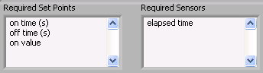
Duty Cycle Function
\\enviro\enviro\Software\Process Controller methods\math functions\duty cycle.vi
Note that the “on value” could also be calculated!
on value
on time
off time
time
How could you set up the process controller to measure oxygen uptake rate using this code?

Slide 27
Startup Checklist
Verify that all sensors are working
Replace DO membrane
Calibrate dissolved oxygen probe in saturated water
Fill reactor with mixed liquor from IWWTP activated sludge tank
Fill organic waste bottle with organic waste
Measure MLVSS (mixed liquor volatile suspended solids)
Begin in settle phase (make sure time is long enough)

Slide 28
Standard Operating Procedure (SOP)
What is in the data files?
All sensors
All variables
What is in the state log files?
Times, states, rule that caused state to change
How often must you add organic waste in the refrigerator?
Scrape sides of reactor to keep solids in suspension
Verify that fill and drain times are reasonable (no clogged valves)
Replace DO membrane (weekly)

Slide 29
PROCESS CONTROL SOFTWARE
Data Acquisition
Process Control
Make decisions based on data
Send command to ProCoDA hardware to Control valves, pumps, stirrers
Data logging to file (and variable set points)
Plot data on graph
Handle Operator Commands
With averaging!

Slide 30
Organize your Tasks
Goal is sequencing batch reactor with controlled aeration
What tasks must you accomplish?
How can you maximize your productivity?

Slide 31

Proportional Integral Derivative Control
P
I
D
K_{c} is controller gain (tuning parameter)
T_{I} is the integral time (tuning parameter)
T_{D} is the derivative time (tuning parameter)
Δε/Δt is the error rate of change (Note that this is the same as the dissolved oxygen concentration rate of change)
is the area under the curve of the error as a function of time.
u(t) is the airflow rate that the controller sets
The Error (ε) is the difference between the Process Variable and the desired Setpoint. The controller uses the proportional gain, K_{c}, the integral time constant, T_{i}, and the derivative time constant, T_{d}, to determine an Output which drives the Error to zero.

Slide 32
Proportional
Target DO
ε
DO
t

Slide 33
Proportional Integral
Target DO
DO
If T_{I} is too small will get oscillating behavior
t

Slide 34
Global Need for Better Nutrient Management
Coastal dead zones
Fish kills
Migratory routes blocked
Loss of diverse ocean ecosystems
Human Population
Agribusiness

Slide 35
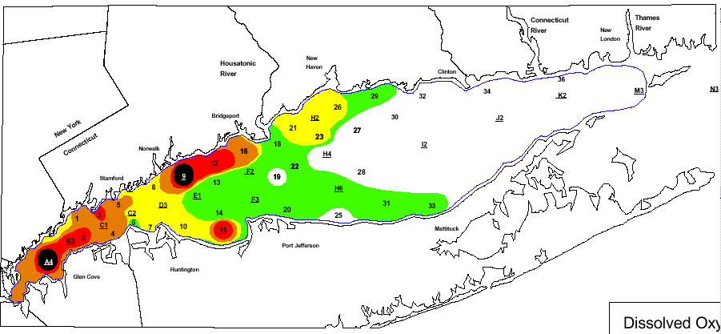
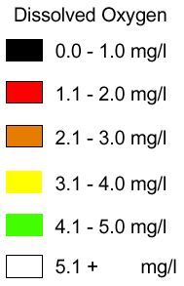
Long Island Sound: August 1998

Slide 36
Long Island Sound Study
The LISS adopted a plan in 1998 to reduce nitrogen loads from human sources in the Sound by 58.5%
The greatest human sources of nitrogen in the Sound are from wastewater treatment plants discharging into waters within the Long Island Sound watershed, or directly into the Sound itself
A major component of the nitrogen reduction plan includes the need for wastewater treatment upgrades that emphasize nitrogen removal
As a result of BNR upgrades to STPs, there has been a reduction of 19.2 percent in nitrogen loading to Long Island Sound from STPs in the 1990’s (10% reduction of total)
http://www.longislandsoundstudy.net/pubs/slides/soundhealth/ch2.pdf
Notes:
http://www.longislandsoundstudy.net/pubs/slides/soundhealth/ch2.pdf

Slide 37
Gulf of Mexico
The "Dead Zone", or hypoxic zone, is a 7,000 square mile expanse of oxygen-depleted waters that cannot sustain most marine life
Human activity has resulted in a significant increase in nitrogen flux
Nitrogen sources include
Industry
Municipal waste water treatment
Agriculture
Fertilizer
Livestock manure

Slide 38
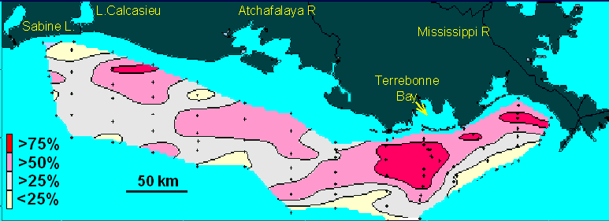
Bottom water hypoxia: Frequency of midsummer occurrence 1985-1999

Slide 39
Reducing the Footprint of a Growing Global Population
Conventional activated sludge process
Removes BOD (organic carbon to CO₂)
Nitrification
Removes TKN (organic nitrogen and ammonia to nitrite and nitrate)
TKN: Total Kjeldahl Nitrogen (______________)
Denitrification
Removes nitrite and nitrate by conversion to N₂ gas
reduced nitrogen

Slide 40
NITROGEN REMOVAL
Protect watersheds and coastal areas from eutrophication
Treatment of high nitrogen wastes
Agricultural runoff
Feedlot wastewater
Centrate from Wastewater Treatment Plants
Treatment of drinking waters that contain elevated nitrite and nitrate

Slide 41
Requirements for Nitrogen Removal
Electron Donor
Organic (heterotrophs)
Organic carbon (BOD) present in the waste
Methanol (often added when organic carbon is already depleted)
Inorganic (autotrophs)
H₂ or reduced sulfur (H₂ can be added using bubbleless membrane dissolution)
pH
Optimal range of 7-8
Denitrification produces strong base

Slide 42
Denitrification Reactions and Enzymes
Reaction Enzyme
Nitrate Reductase
Nitrite Reductase
Nitric Oxide Reductase
Nitrous Oxide Reductase
Overall process requires 5 electron equivalents per nitrogen

Slide 43
Role of Oxygen Concentration
Inhibition of nitrogen-reductase genes
Genes are repressed when oxygen concentration exceeds 2.5 – 5 mg O₂/L
Denitrifiers can produce reductase at relatively high O₂ concentration
Inhibition of nitrogen-reductase activity
Reaction inhibited when oxygen concentration exceeds a few tenths of a mg O₂/L
Denitrification can only occur if oxygen levels are very low somewhere in the reactor!

Slide 44
Reactor Designs for Denitrification
Activated Sludge
Biofilm Processes
One sludge
Biomass storage and decay
Classical pre-denitrification
Simultaneous nitrification with denitrification
Barnard Process
Sequencing Batch Reactor
Trick: Reserve some electron donor (organic carbon) for denitrification

Slide 45
Tertiary Denitrification using Activated Sludge
solids
hydraulic
SRT (5 d) >>HRT
High cell concentration increases reaction rate
Electron donor
No aeration!
Solids recycle

Slide 46
Biofilm Processes
Submerged fixed beds of rocks, sand, limestone, or plastic media
Fluidized beds of sand, activated carbon, and pellets of ion-exchange resin
Circulating beds of a range of lightweight particles
Membrane bioreactors (membrane supplies H₂ and is the attachment surface)
HRT can be less than 10 minutes!

Slide 47
Biomass Storage and Decay
biomass
Uses _______ as electron donor for denitrification
Slow kinetics of endogenous decay
Low BOD⁰
BOD⁰
Biomass
Low
TKN⁰
Some
Sludge recycle
Sludge waste

Slide 48
Classical Pre-Denitrification
Uses ____ as electron donor for denitrification
Requires high mixed liquor recycle (4Q_{plant})
BOD
Low BOD
Some BOD
BOD⁰
Low
TKN⁰
Some
Mixed liquor recycle
Sludge recycle
Sludge waste

Slide 49
Simultaneous Nitrification with Denitrification
BOD
Uses ____ as electron donor
Low oxygen levels permit denitrification
Can achieve 100% N removal!
BOD⁰
TKN⁰
Low BOD,
Sludge recycle
Sludge waste

Slide 50
Barnard Process
Greater than 90% removal of TKN!
Some BOD
BOD⁰
TKN⁰
3 h
11 h
Low BOD
Low
Some
3 h
1 h
Sludge recycle
Sludge waste

Slide 51
Barnard Sequencing Batch Reactor
Same process as Barnard carried out in a single tank
TKN⁰
BOD⁰
BOD⁰
TKN⁰
Biomass
3 h
3 h
2 h
0.33 h
0.67 h

