Slide 1




pH measurements
V
+
+
The probe, from chemistry to voltage to a number

Slide 2
pH probe
V
Buffered KCl solution
4 M KCl solution
Reference electrode
Silver/silver chloride electrode
+
Sensing electrode
+
+
+
+
+
+
+
+
+
+
+
+
Porous reference junction
+
+
+
+
+
+
+
+
+
+
+
+
+
+
+
+
+
+
+
+
+
+
+
+
+
+
+
+
+
+
+
+
+
Glass bulb (insulator) with anionic sites
+
+
+
+
+
+
+
+
+
+
+
+
+
+
+
+
+
+
+
+
+
+
+
+
+
+
+
+
+
+
+
+

Slide 3
Glass membrane (Insulator)
+
+
+
+
+
+
+
+
+
+
+
+
+
+
+
+
+
+
+
+
+
+
+
+
+
+
+
+
+
+
+
+
+
+
+
+
+
+
+
+
+
+
+
+
+
+
+
+
+
+
+
+
+
+
+
+
+
+
+
+
+
+
+
+
+
+
+
+
+
+
+
+
+
+
+
+
+
+
+
+
+
+
Reference Voltage Call it zero!
+
+
+
+
+
+
+
+
+
+
+
+
+
+
+
+
+
+
+
+
+
+
+
+
+
+
+
+
+
+
+
+
+
+
+
+
+
+
+
+
+
+
+
+
+
+
+
+
+
+
+
+
+
+
+
+
+
+
+
+
+
+
+
+
+
+
+
+
+
+
+
+
+
+
+
+
+
+
+
+
+
+
+
+
+
+
+
+
+
+
+
+
+
+
+
+
+
+
+
+
+
+
+
+
+
+
+
+
+
+
+
+
+
+
+
+
+
+
+
+
+
+
+
+
+
+
+
+
+
pH 4 solution (high H⁺)
Voltage across glass membrane
Solution voltage is 180 mV higher than reference!
We need a way to measure the solution voltage
+
+
+
+
+

Slide 4
pH Measurements
+
+
The porous frit provides electrical contact between the solution and the electrolyte
Must be in contact with the sample solution
Probe won’t work well if frit is clogged (fouled)
The voltage measurement requires a very high __________ circuit (high resistance) because a pH probe can’t produce much current
Gentle stirring keeps the solution next to the glass bulb from being depleted of protons
impedance

Slide 5
Difficult Measurements?
pH is difficult to measure in poorly buffered solutions
Distilled water
Rain
Between pKs of dilute buffers

Slide 6
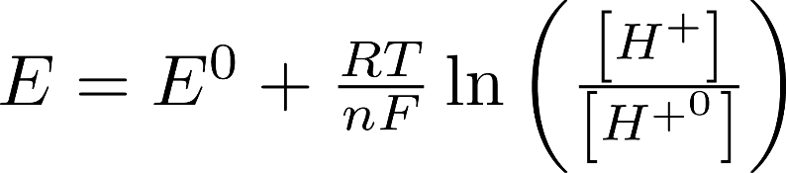
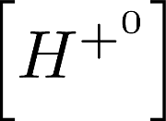

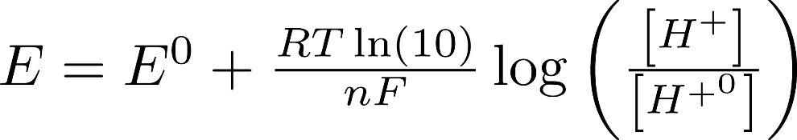



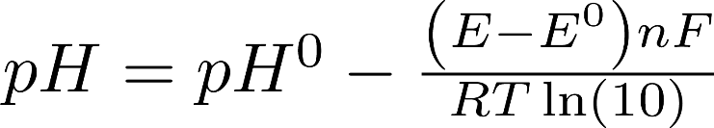

Nernst Equation: Voltage = f(pH)
Reference (known) [H+]
Voltage at
Faraday constant
Gas constant

Slide 7
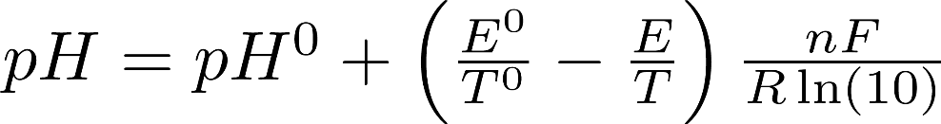
Nernst Equation

Slide 8
Slope vs. Temperature
Temperature compensation is important when temperature changes between samples!

Slide 9
pH Calibration
It would be possible to make a pH measurement without any calibration
Based on theoretical values
This is how the software recognizes buffers!
Calibration accounts for non-ideal probe behavior (fouling) as well as electronic measurement errors
It is important that buffers be used covering the range of pH measurements

Slide 10
The Challenge
0 to 3 known buffers used as standards
Temperature compensation optional
E | T | Buffer pH
pH
Current measurement (E, T)

Slide 11
Multiple Point Calibrations w/ Temperature Compensation
How would you use this information to calculate pH?
E (mV) | T (C) | Buffer pH
8 | 23 | 7
185 | 24 | 4
-170 | 20 | 10
pH
Current measurement (E, T)
Calculate E/T
Piecewise linear fit

