Slide 1
TE3001B: Robotics Foundation
Course description

Slide 2


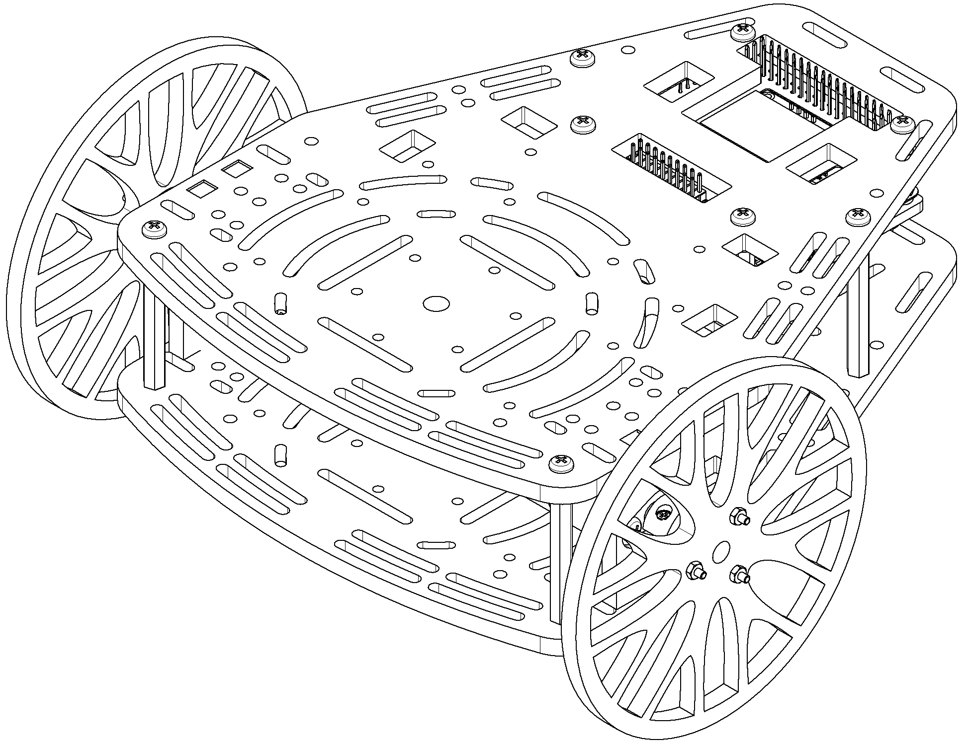
Introduction
This course, developed by Manchester Robotics ltd. (MCR2), introduces the basic concepts and general knowledge of the ROS environment to the user.
This course is divided into five session, carefully designed for the user to learn about the different aspects of ROS from topics and messages to control and simulation and simulation using ROS..
This course will be based on challenges to make the student aware of ROS basics and ROS communication with hardware.

Slide 3
General Requirements
These are the general requirements. A set of requirements for each session will be shown in the following slides. (Some items may be repeated)
Computer with access to Zoom (online classes).
Computer with Ubuntu 18.04 and ROS Melodic or MCR2 virtual machine (installation instructions in the presentation MCR2_VM_ROS).
Knowledge of Windows.
Basic knowledge of Ubuntu (recommended).
Basic understanding of robotics (recommended).
Access to Hackerboard and a MCR2 DC motor.
In case you have no access to the Hackeborad, can be replaced for an Arduino Mega, a L298n Motor Driver and a DC motor brushed with encoder (More information in Session 2 Slide)

Slide 4
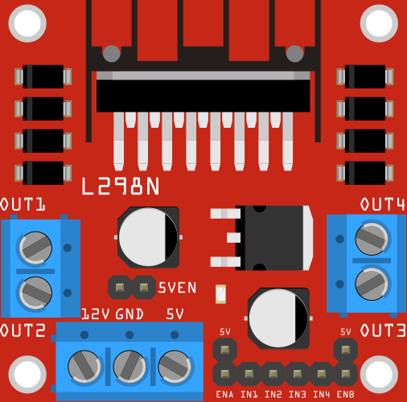
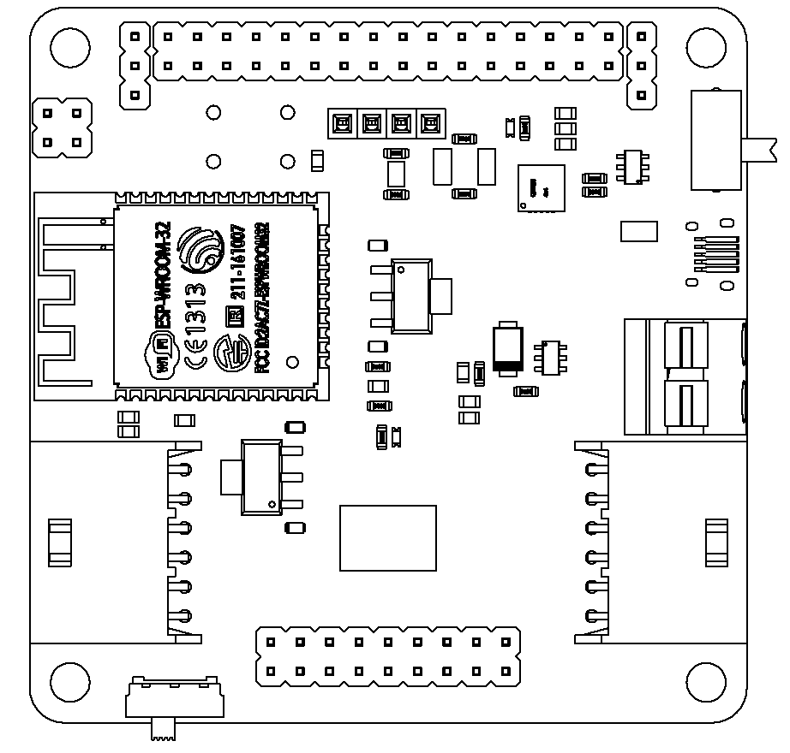
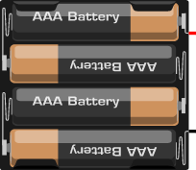
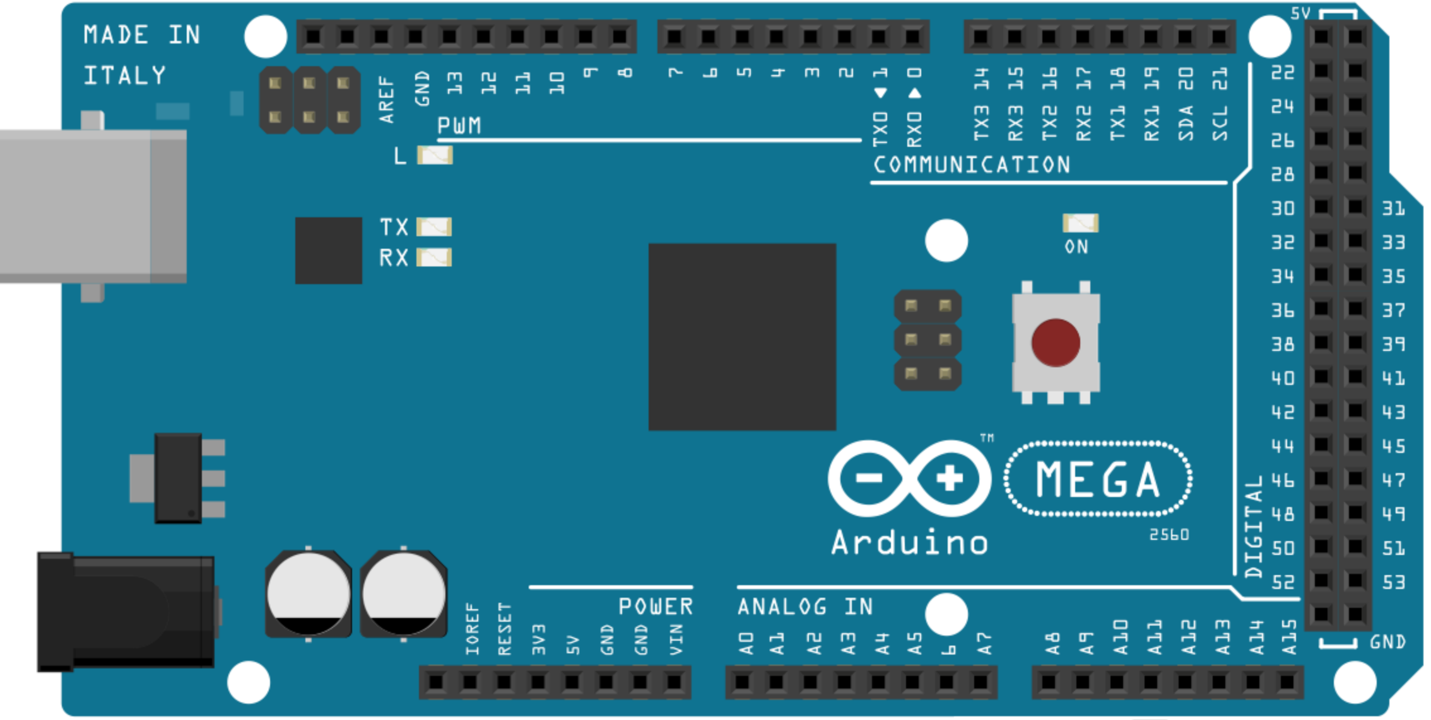
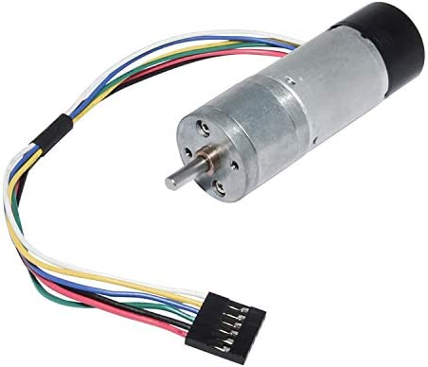
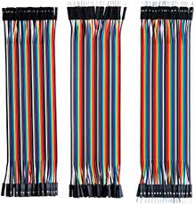
Motor Driver L298n (Steren)
Battery Pack 5 to 12 V
MCR2 Hackerboard
Arduino Mega
Battery Pack or Power bank 5 to 12 V
6VDC Brushed Motor (Puzzlebot motor or equivalent)
Dupont Wires (M-F, M-M)
6VDC Brushed Motor (Puzzlebot motor or equivalent)

Slide 5
Week 1: Introduction
Session 1:
Who we are? Introduction to MCR2.
Introduction to Robotics
Introduction to VM, Ubuntu
Session 2:
Introduction to ROS
Overview of the ROS Environment: Topics, messages, ROS.
Activity 1 (Talker and Listener)
Launch files
Activity 2: Launch Files
Q&A
Mini challenge: Generate a node that send a signal to another node to process it.
Requirements
Computer with access to Zoom.
Have Ubuntu 18.04 and ROS Melodic Installed (Full installation). Instructions on how to install Ubuntu and ROS can be found in the presentation MCR2_VM_ROS.
In case Ubuntu 18.04 cannot be installed, MCR2 offers a Virtual Machine with ROS preinstalled (installation instructions in the presentation MCR2_VM_ROS).

Slide 6
Week 2: ROS Practicalities
Session 1:
ROS Namespaces
ROS Parameter Server
Activity 1: Parametrise previous nodes
ROS Custom Messages
Session 2:
Control Basics: Continuous time only/ no theory just practicalities.
Q&A
Mini challenge: P/PI Controller from scratch to a 1st order simulated system.
Requirements
Requirements of Session 1.

Slide 7
Week 3: ROS-Hardware Communication
Session 1:
Motor Control Theory
ROS Serial
Arduino
ROS Serial/Arduino Communication.
Mini Challenge: Motor Speed regulation using ROS.
Session 2:
Q&A Session.
Requirements
Requirements of Session 1.
Installation of the Arduino IDE and the Rosserial package in the VM or Ubuntu (See instructions on Session2 MCR2_Arduino_IDE_Confirguration),
Access to Hackerboard and a MCR2 DC motor.
In case you have no access to the Hackeborad, the hardware can be replaced for an Arduino Mega, a L298n Motor Driver and a DC motor brushed with encoder.

Slide 8
Week 4: ROS Data Acquisition
Session 1:
Encoder Basic Theory
Mini Challenge: Acquire data from the encoders using Arduino.
Presentation of the Challenge: PID Controller using ROS and compare with simulation.
Session 2:
Q&A Session.
Requirements
Session 1 Requirements.
Session 3 Requirements.

Slide 9
Week 5: Final Challenge
Requirements
Session 1 Requirements.
Session 3 Requirements
Session 1:
Q&A Session.
Session 2:
Final Challenge Presentation.

