Slide 1
ROS Workshop
Course description

Slide 2


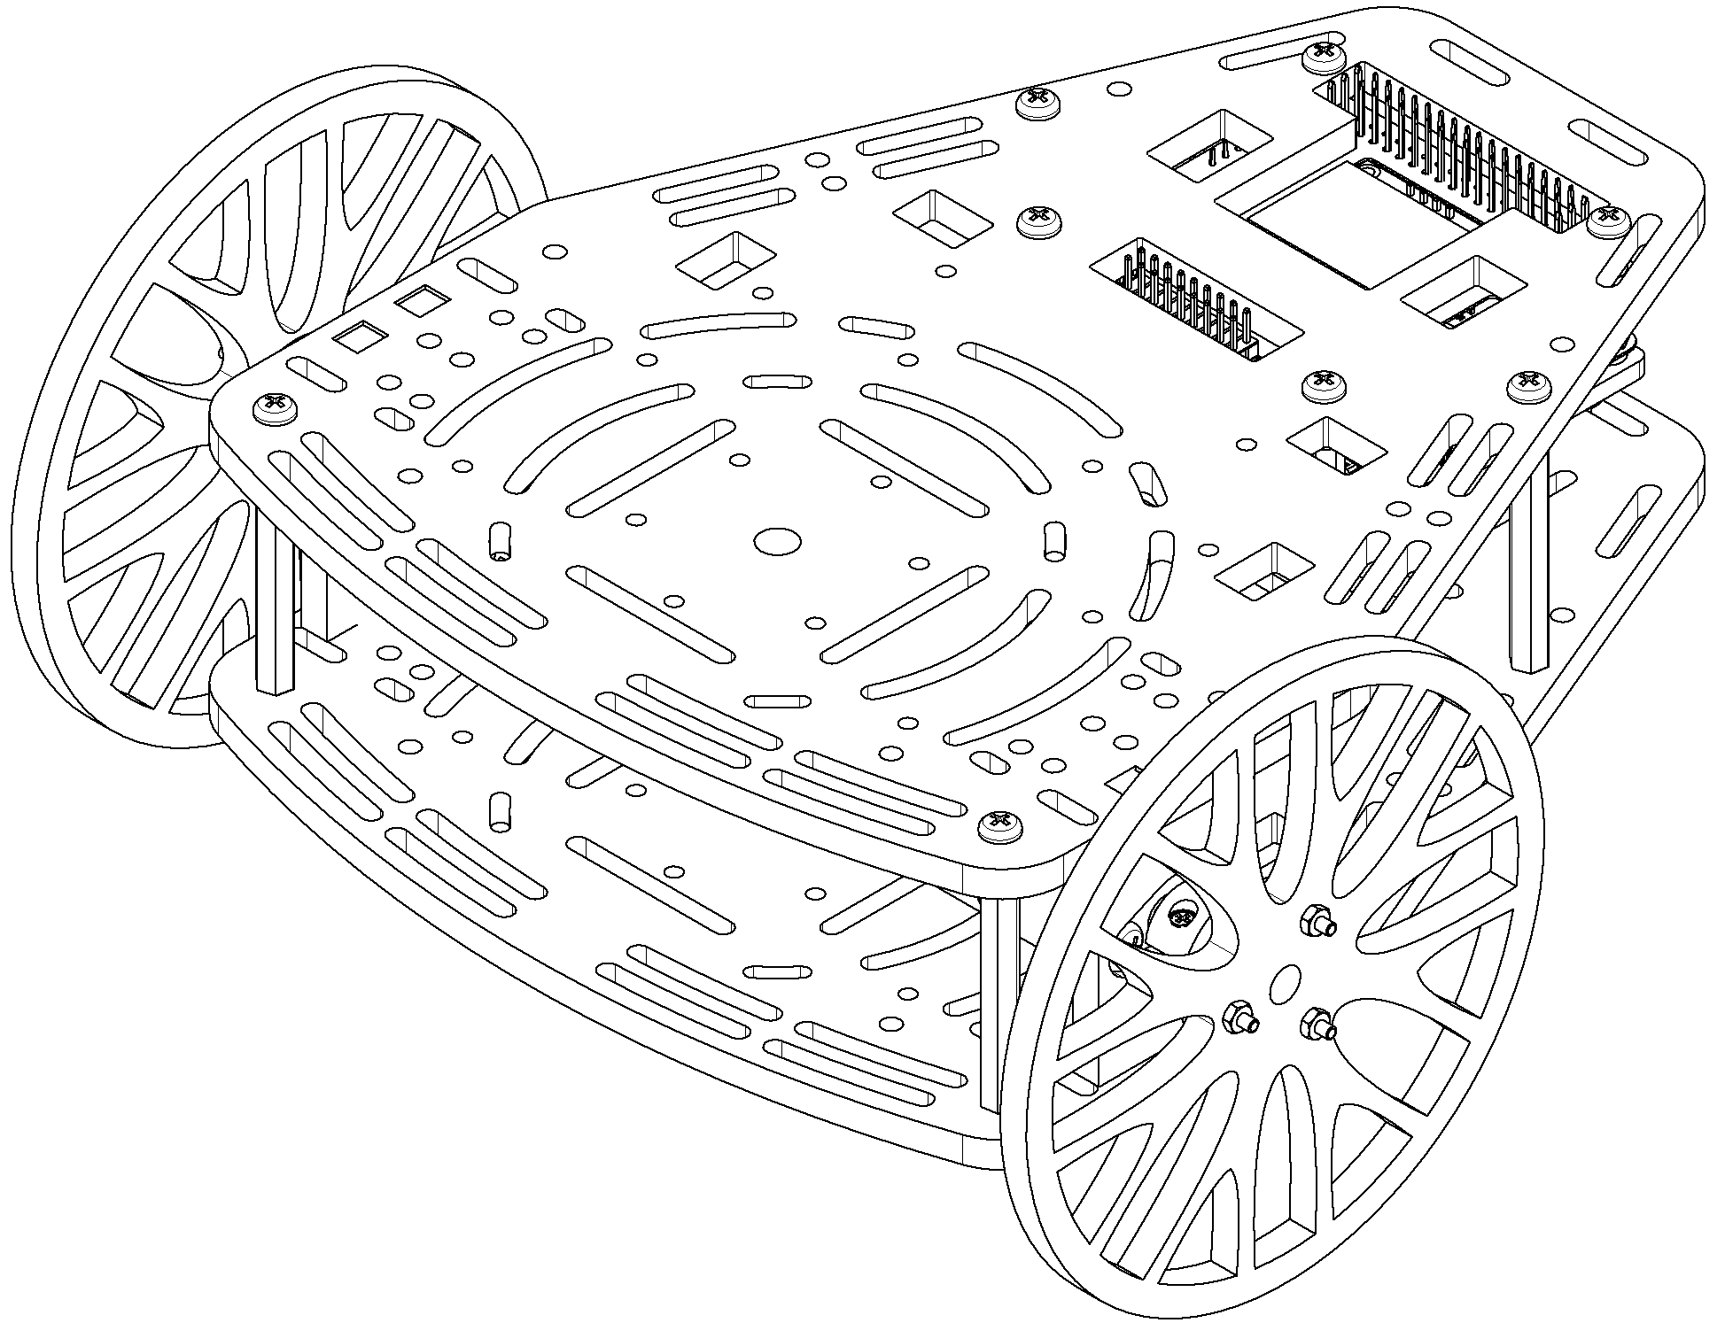
Introduction
This course, developed by Manchester Robotics ltd. (MCR2), introduces the basic concepts and general knowledge of the ROS environment to the user.
This course is divided into five session, carefully designed for the user to learn about the different aspects of ROS from topics and messages to control, simulation and AI using ROS.
During the course the student will interact with Manchester Robotics, learning platform the Puzzlebot. A mobile robotic platform designed to implement the different robotic algorithms (low level to high level) described throughout the course.

Slide 3
General Requirements
These are the general requirements. A set of requirements for each session will be shown in the following slides. (Some items may be repeated)
Computer with access to Zoom (online classes).
Computer with Ubuntu 18.04 and ROS Melodic or MCR2 virtual machine (installation instructions in the presentation MCR2_VM_ROS).
Knowledge of Windows.
Basic knowledge of Ubuntu (recommended).
Basic understanding of robotics (recommended).
Basic knowledge of Ubuntu (recommended).
Access to a Puzzlebot or an NVIDIA Jetson Nano with Manchester Robotics image.
Access to Hackerboard and a MCR2 DC motor.
In case you have no access to the Hackeborad, can be replaced for an Arduino Mega, a L298n Motor Driver and a DC motor brushed with encoder (More information in Session 2 Slide)

Slide 4
Session 1
Topics
Introduction to ROS
Overview of the ROS Environment.
Topics, messages, ROS.
Activity 1 (Talker and Listener)
Launch files
Q&A
Challenge
Requirements
Computer with access to Zoom.
Have Ubuntu 18.04 and ROS Melodic Installed (Full installation). Instructions on how to install Ubuntu and ROS can be found in the presentation MCR2_VM_ROS.
In case Ubuntu 18.04 cannot be installed, MCR2 offers a Virtual Machine with ROS preinstalled (installation instructions in the presentation MCR2_VM_ROS).

Slide 5
Session 2
Topics
ROS Namespaces
ROS Parameter Server
ROS Custom Messages
Activity 1: Parametrise previous nodes
Rosserial
Activity 2: Hello World (Arduino/Hackerboard ROS)
Q&A
Challenge
Requirements
Requirements of Session 1.
Installation of the Arduino IDE and the Rosserial package in the VM or Ubuntu (See instructions on presentation MCR2_Arduino_IDE_Confirguration).
Access to Hackerboard and a MCR2 DC motor.
In case you have no access to the Hackeborad, can be replaced for an Arduino Mega, a L298n Motor Driver module and a DC motor brushed with encoder. See next slide for components list.

Slide 6
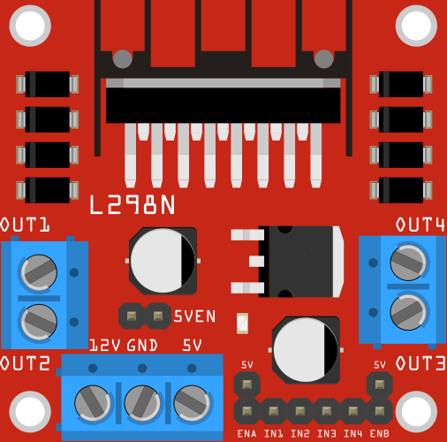
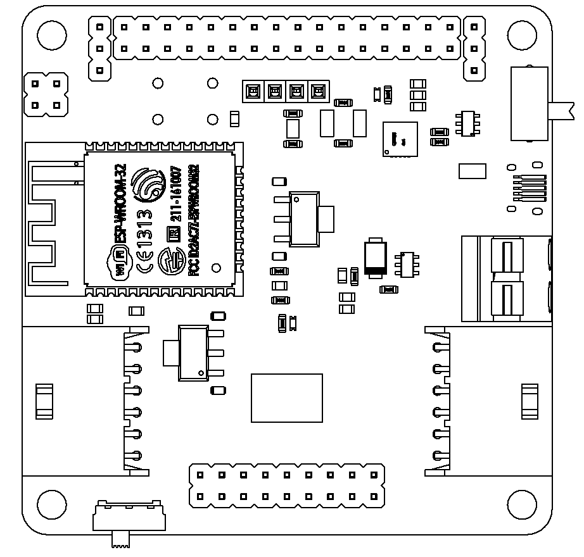
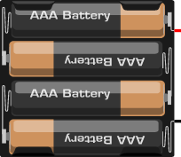
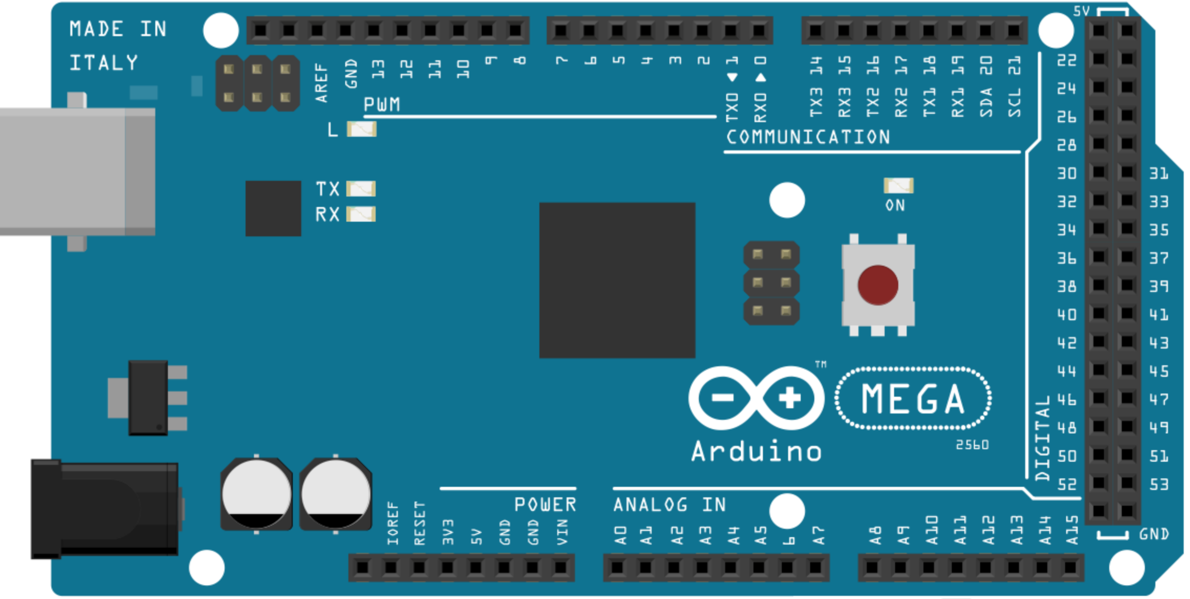
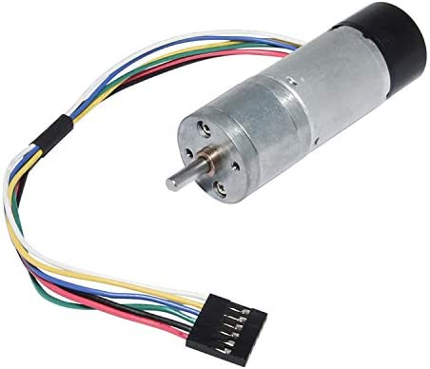
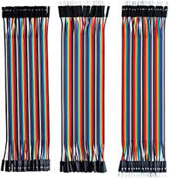
Motor Driver L298n (Steren)
Battery Pack 5 to 12 V
MCR2 Hackerboard
Arduino Mega
Battery Pack or Power bank 5 to 12 V
6VDC Brushed Motor (Puzzlebot motor or equivalent)
Dupont Wires (M-F, M-M)
6VDC Brushed Motor (Puzzlebot motor or equivalent)

Slide 7
Session 3
Topics
ROS Visualisation Tools
Robot Modelling
Activities
Puzzlebot Gazebo Simulation
Challenge
Requirements
Requirements of Session 1.

Slide 8
Session 4
Topics
Introduction to the Puzzlebot and NVIDIA Jetson
OpenCV introduction and outline
Interfacing with camera. Image pre and postprocessing
Guided activity
Image identification and recognition
Guided activity
Challenge
Requirements
Session 1 Requirements
Print the markers located on GitHub
Camera (webcam or external camera)
Check that OpenCV is installed, open a terminal and type:
python –c “import cv2; print(cv2.__version__)”
If the command returns a version #, that means OpenCV is installed
If not, then run the following commands in terminal:
sudo apt update
sudo apt install python-opencv
Finally, install the ROS package that is used to interface with OpenCV:
sudo apt install ros-melodic-cv-bridge

Slide 9
Session 5
Topics
Introduction to neural networks
What is a neural network?
What is a neuron
Designing a simple convolutional neural network for image classification
A brief walkthrough of google collab and the training code
A brief explanation of the dataset
Activity 1: Deploy a CNN into a ROS to perform image classification
Traffic sign detection vs Traffic sign classification
Jetson Inference: Of-the-shelf solutions for AI in ROS
A brief overview of the contents inside jetson-inference
Activity 2: Test one of the prebuild AI solutions in the jetson Nano and implement it In a ROS node
Region proposal networks: YOLOv5
Transfer learning
Overview of a Yolo annotated Dataset
Activity 3: Deploy the sign detection model in ROS
AI in edge devices, model optimisation for jetson Nano
Design pipeline
TensorRT and hadware acceleration
TF vs ONNX vs TensorRT
Challenge: Reactive navigation with traffic sign detection with Tensor RT

Slide 10
Session 5
Requirements
Jetson Nano
Google drive account
Build from source the jetson inference project using python 3: https://github.com/dusty-nv/jetson-inference/blob/master/docs/building-repo-2.md
Install Tensorflow 1.15
Install ONNX runtime
# Download pip wheel from location mentioned above
$ wget https://nvidia.box.com/shared/static/jy7nqva7l88mq9i8bw3g3sklzf4kccn2.whl -O onnxruntime_gpu-1.10.0-cp36-cp36m-linux_aarch64.whl
# Install pip wheel
$ pip3 install onnxruntime_gpu-1.10.0-cp36-cp36m-linux_aarch64.whl

