Slide 1
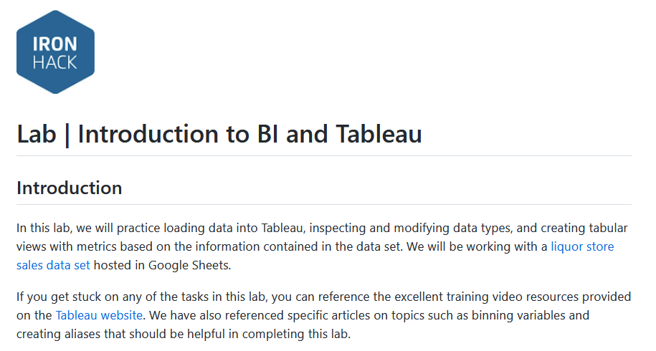

Slide 2
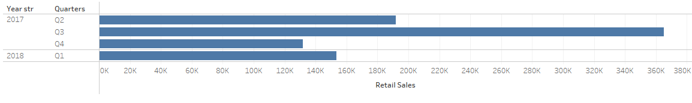
1. Total Retail Sales by Year/Quarter.

Slide 3
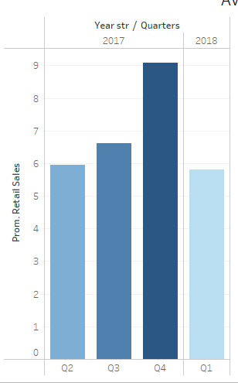

2. Average Retail Sales by Year/Quarter.

Slide 4
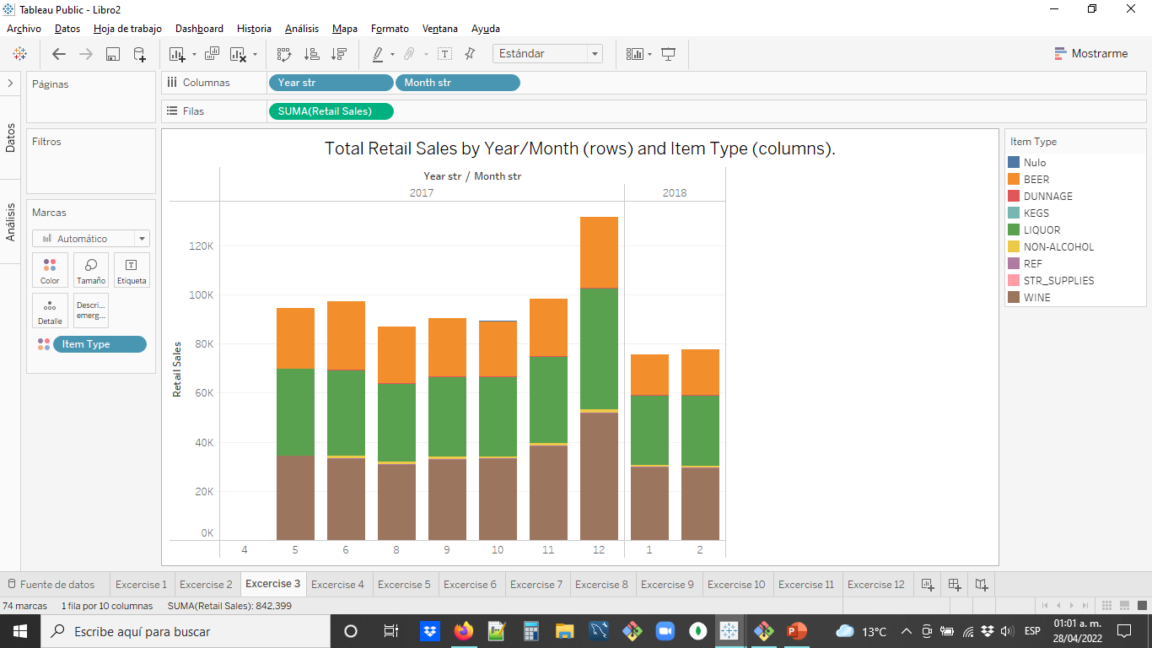
3. Total Retail Sales by Year/Month and Item Type.

Slide 5
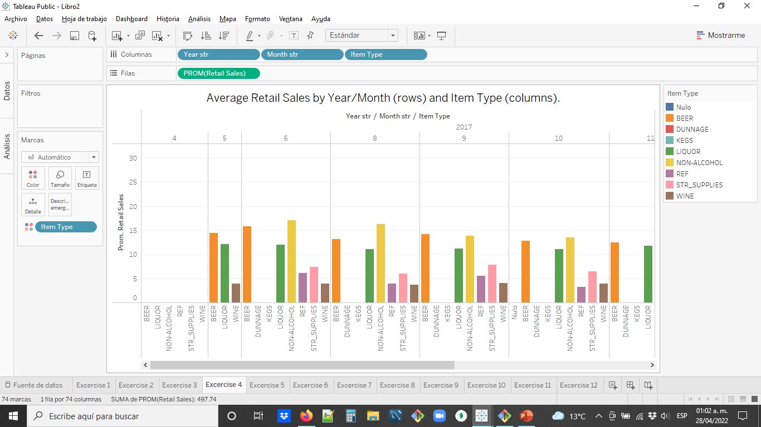
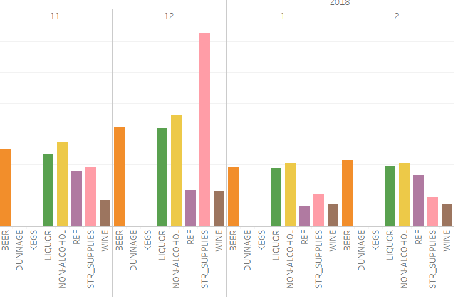
4. Average Retail Sales by Year/Month and Item Type.

Slide 6
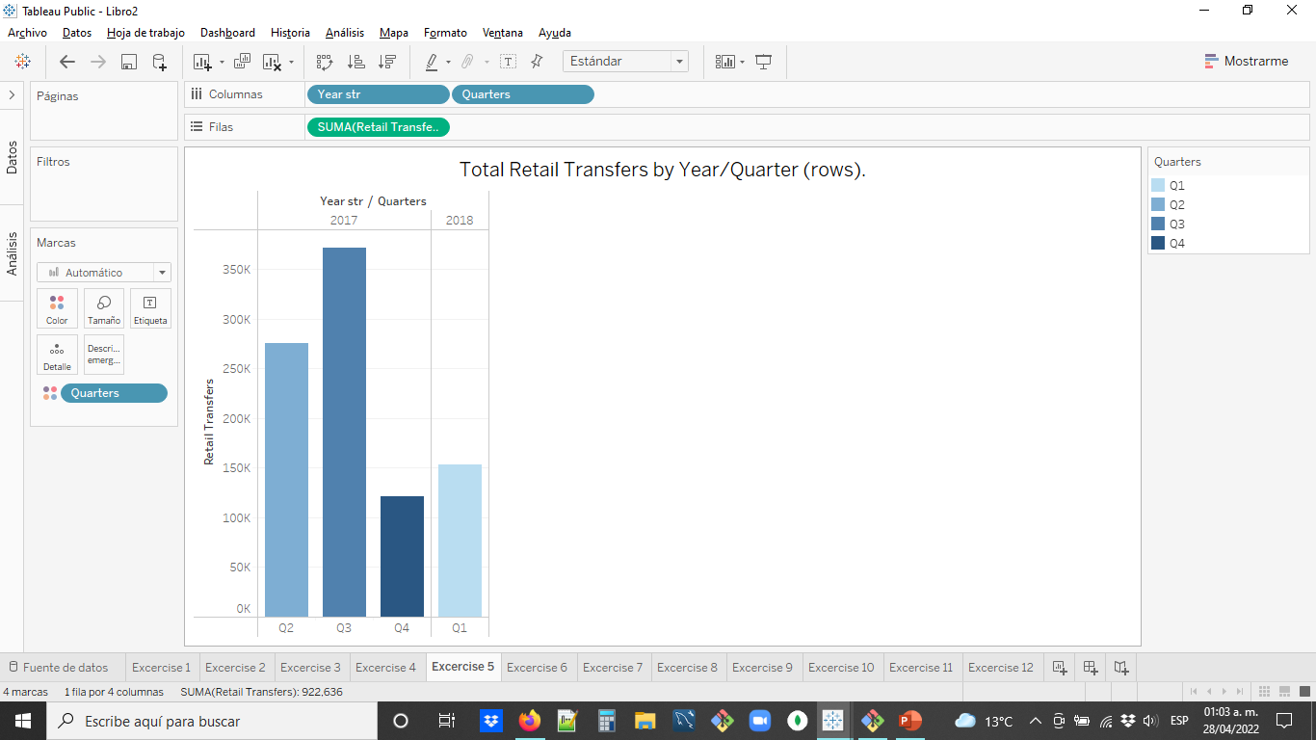
5. Total Retail Transfers by Year/Quarter.

Slide 7
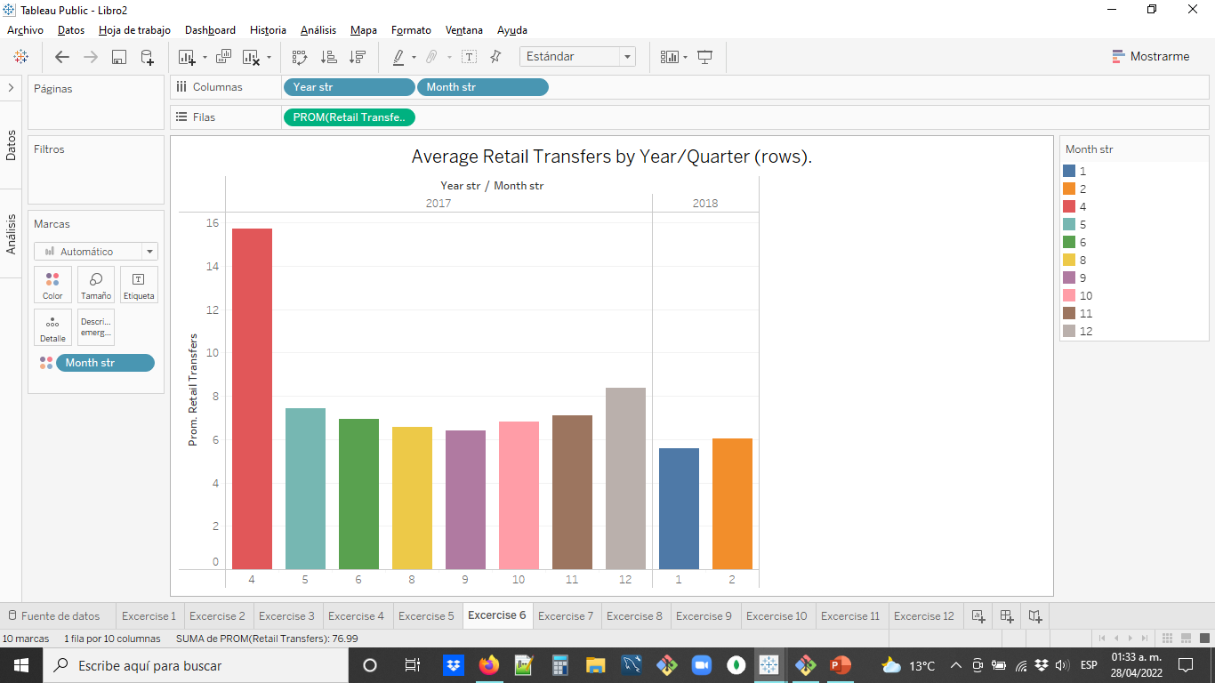
6. Average Retail Transfers by Year/Quarter.

Slide 8
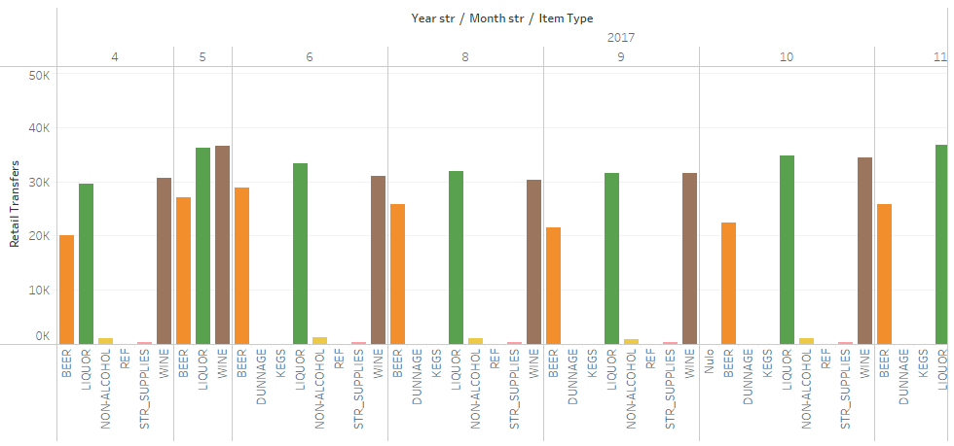
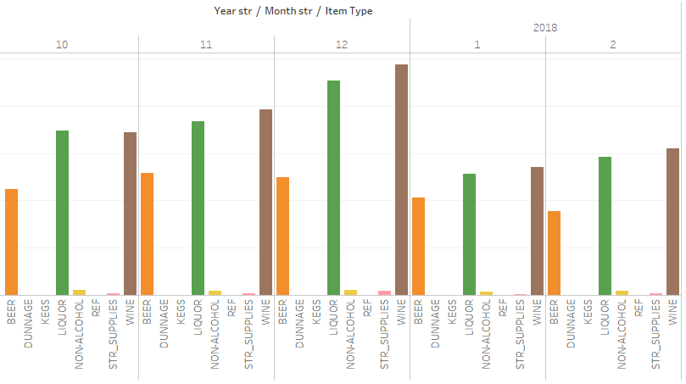
7. Total Retail Transfers by Year/Month and Item Type

Slide 9
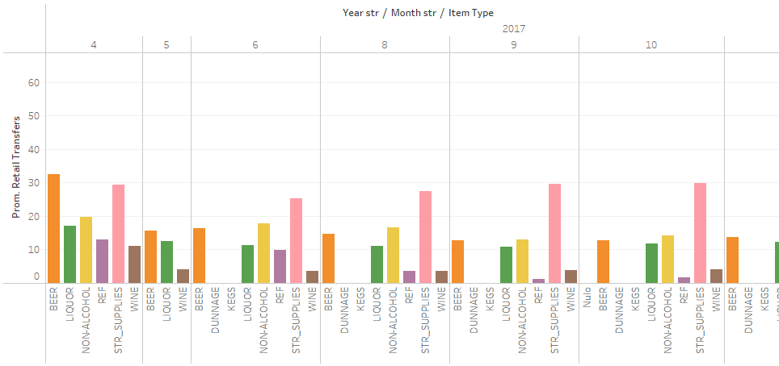
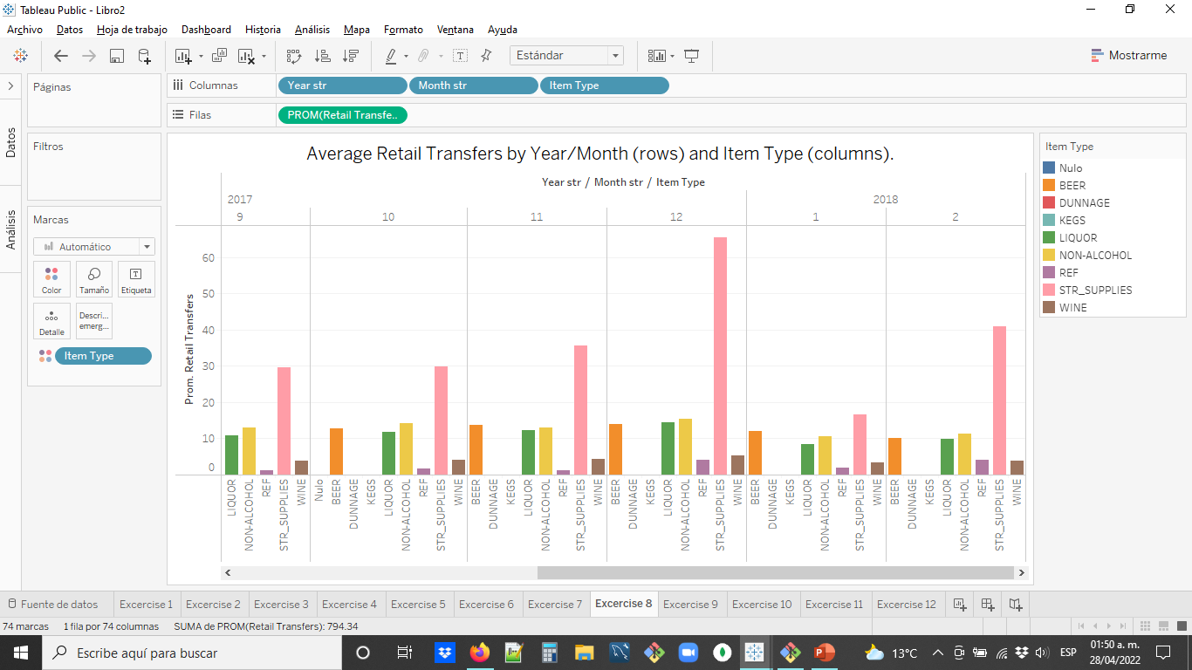
8. Average Retail Transfers by Year/Month and Item Type (2017)

Slide 10
8. Average Retail Transfers by Year/Month and Item Type (2018)

Slide 11
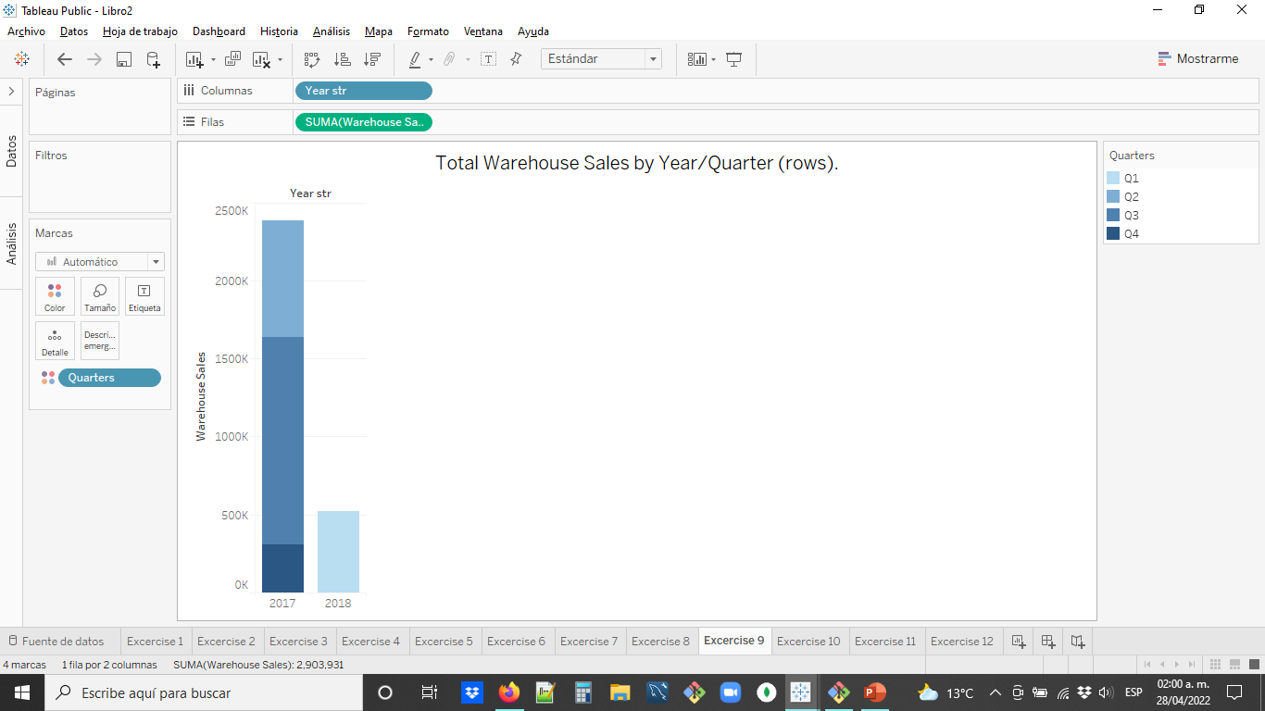
9. Total Warehouse Sales by Year/Quarter.

Slide 12
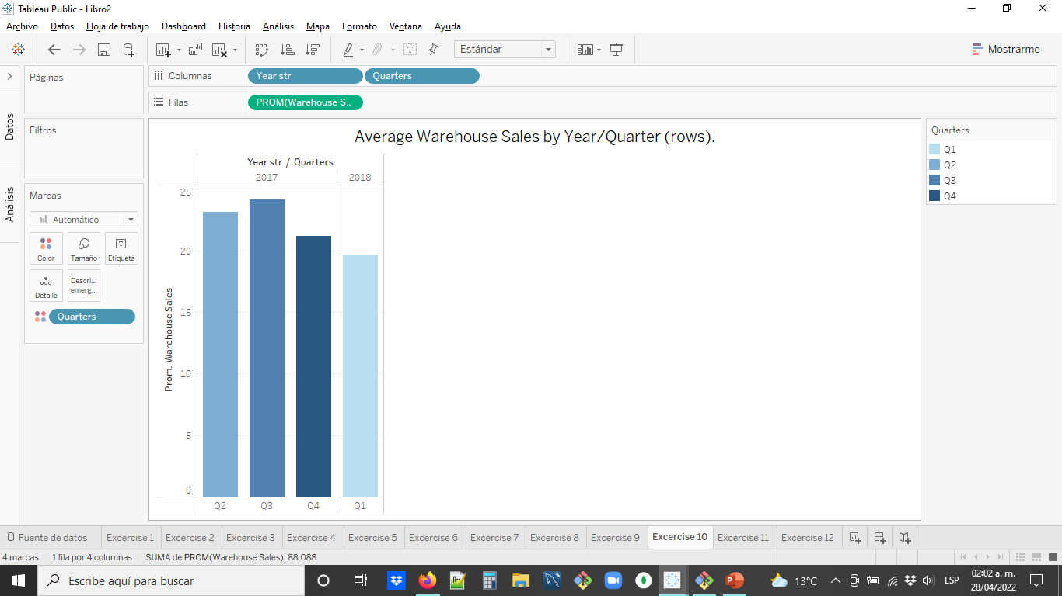
10. Average Warehouse Sales by Year/Quarter.

Slide 13
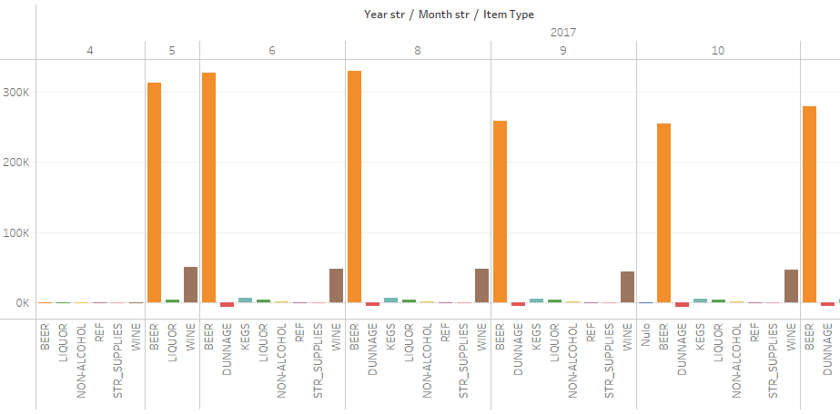
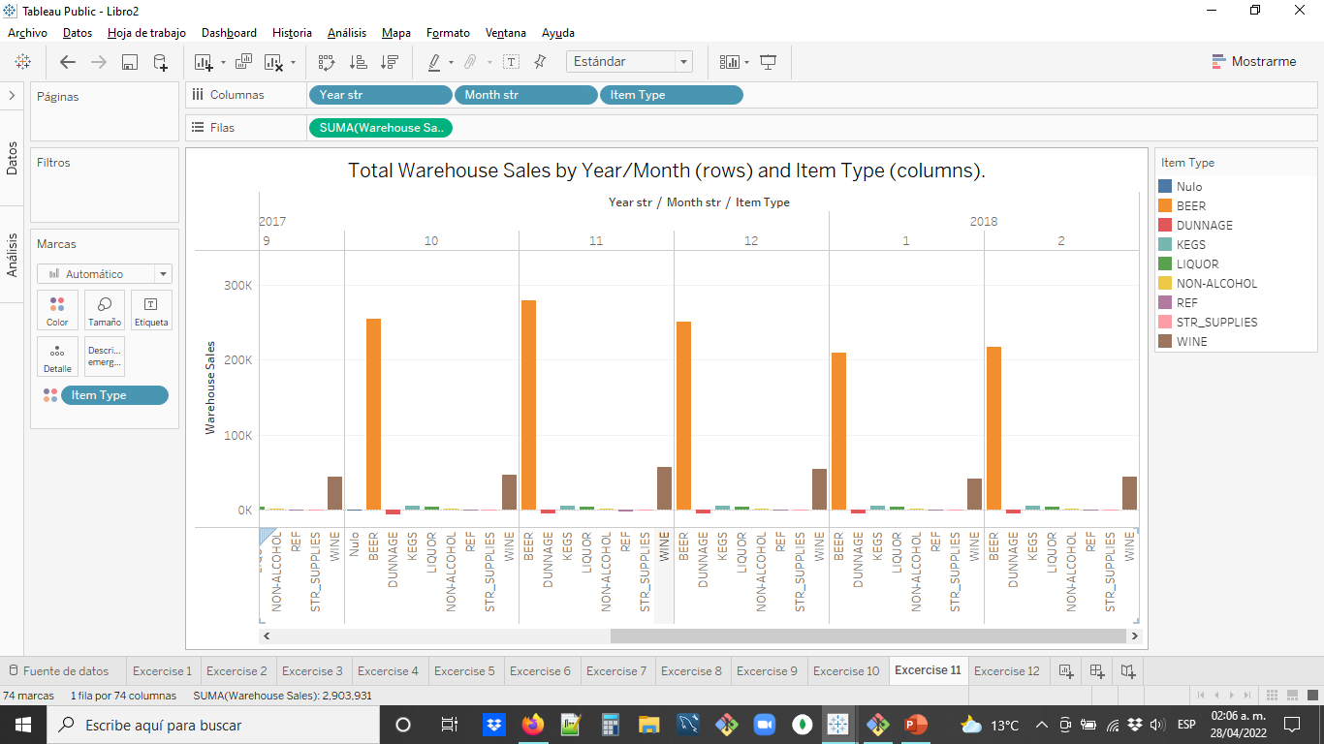
11. Total Warehouse Sales by Year/Month and Item Type (2017).

Slide 14
11. Total Warehouse Sales by Year/Month and Item Type (2018).

Slide 15
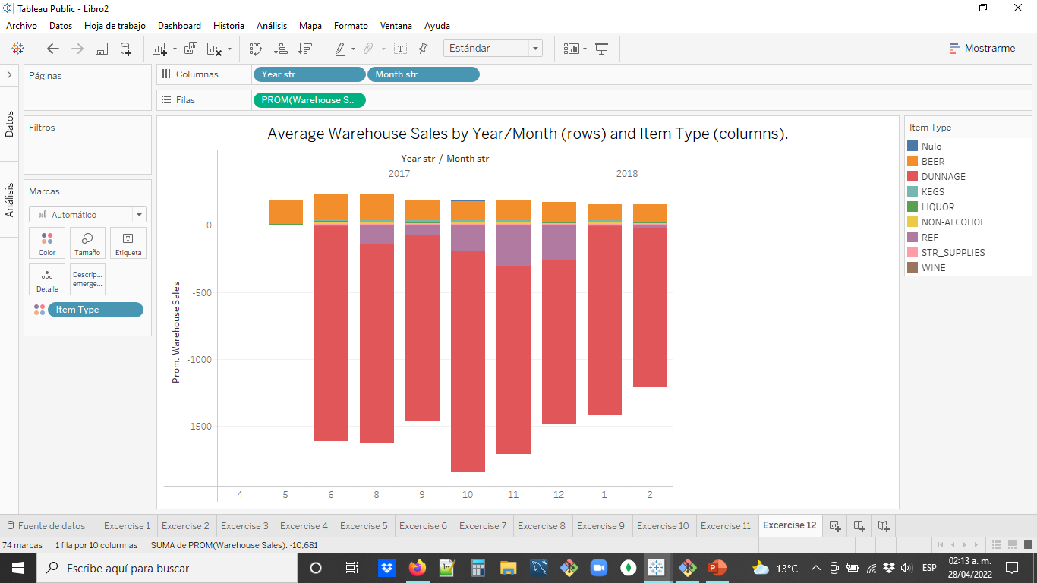
12. Average Warehouse Sales by Year/Month and Item Type.

