Slide 1
ADDIS
Aggregate Data Drug Information System
IMI GetReal Workpackage 4

Slide 2
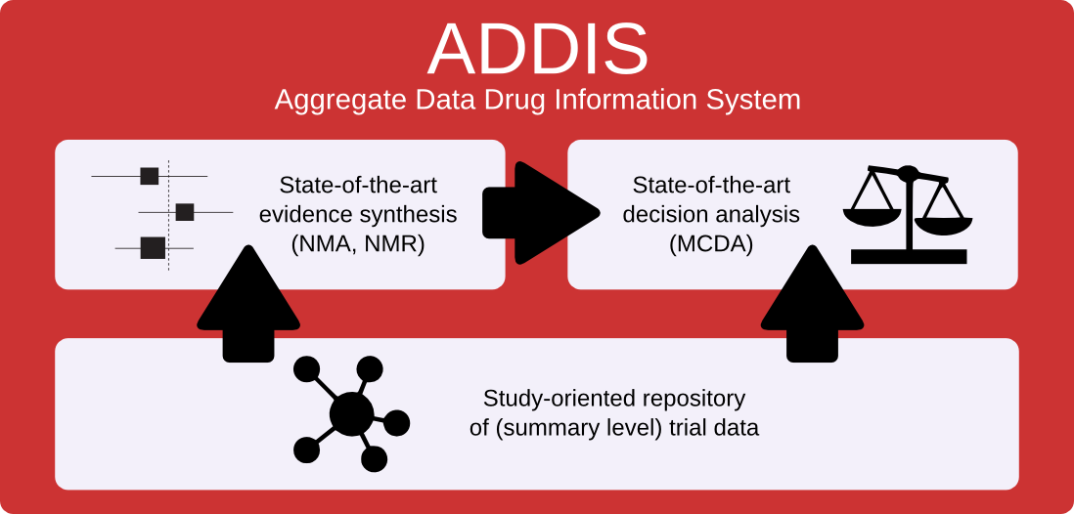

Slide 3
Welcome to ADDIS

Slide 4
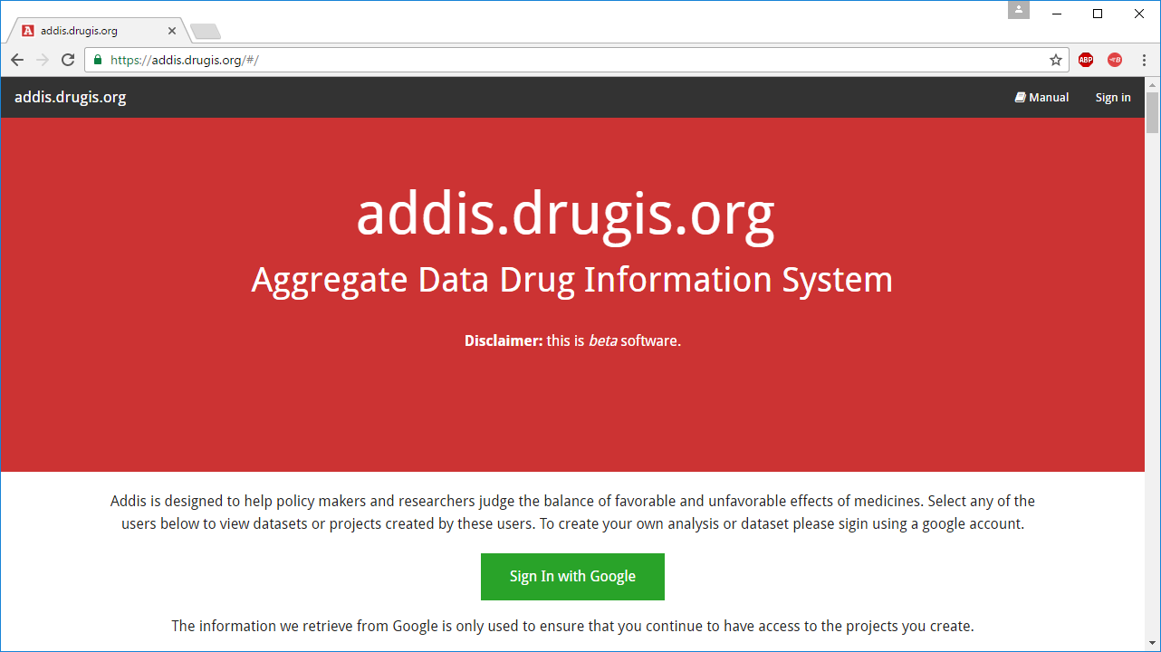

Slide 5
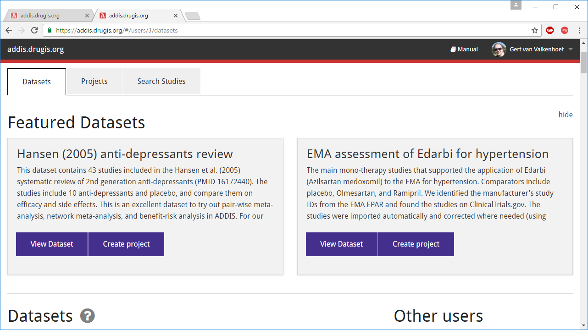

Slide 6
Manage data
Structured study design and results

Slide 7
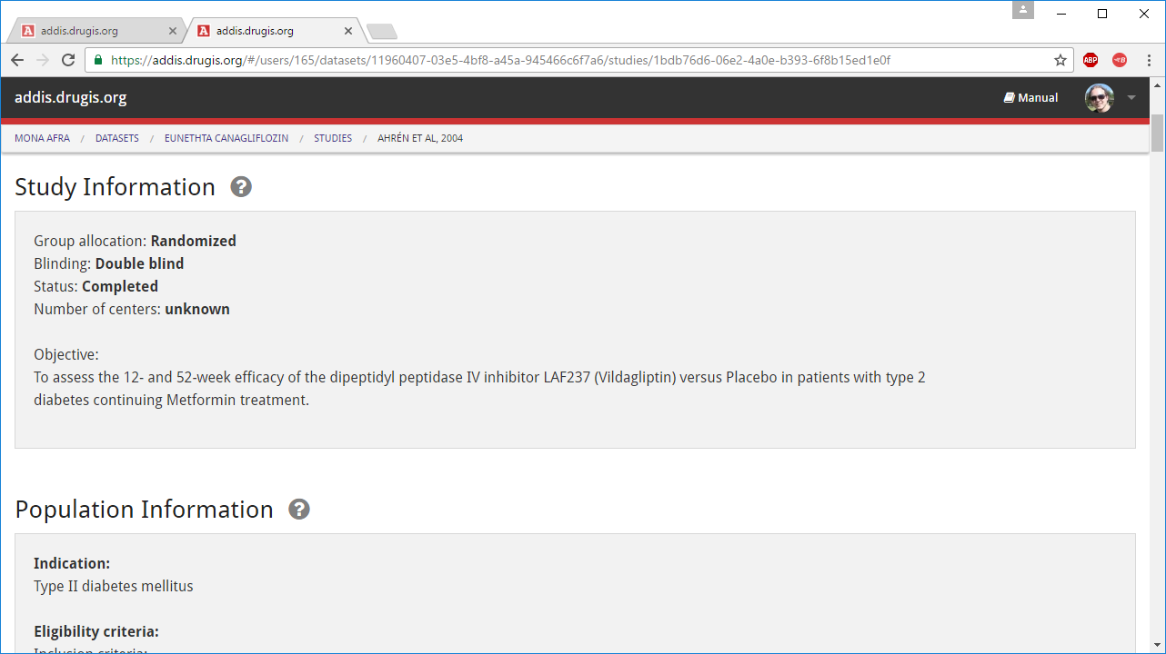

Slide 8
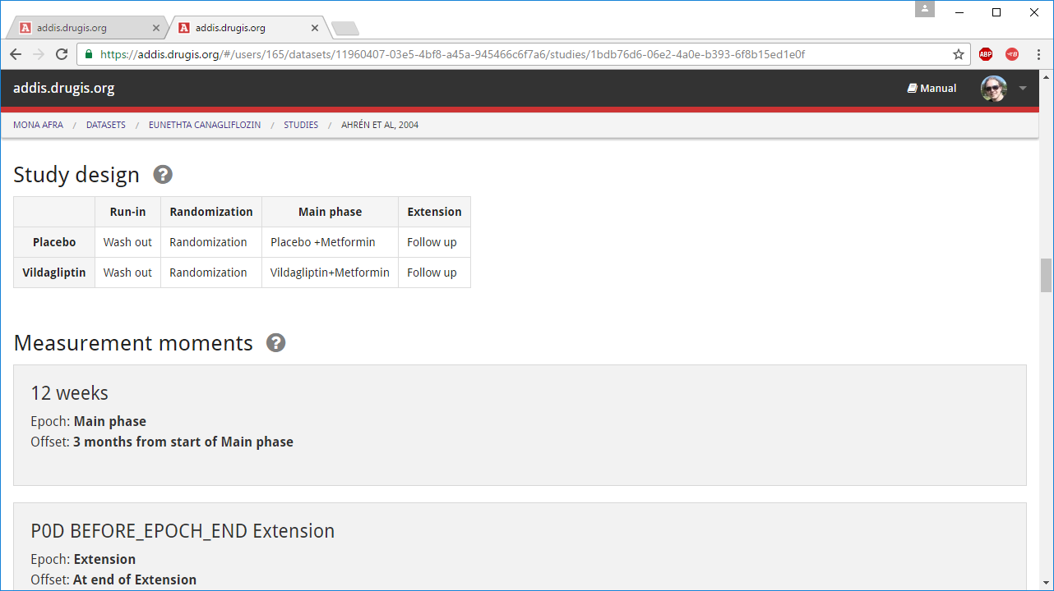

Slide 9
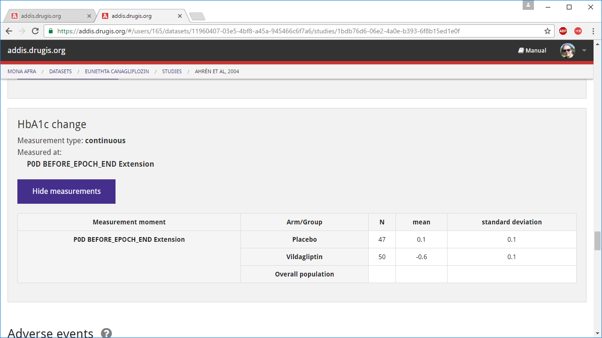

Slide 10
Share data
Copy studies between datasets and users

Slide 11
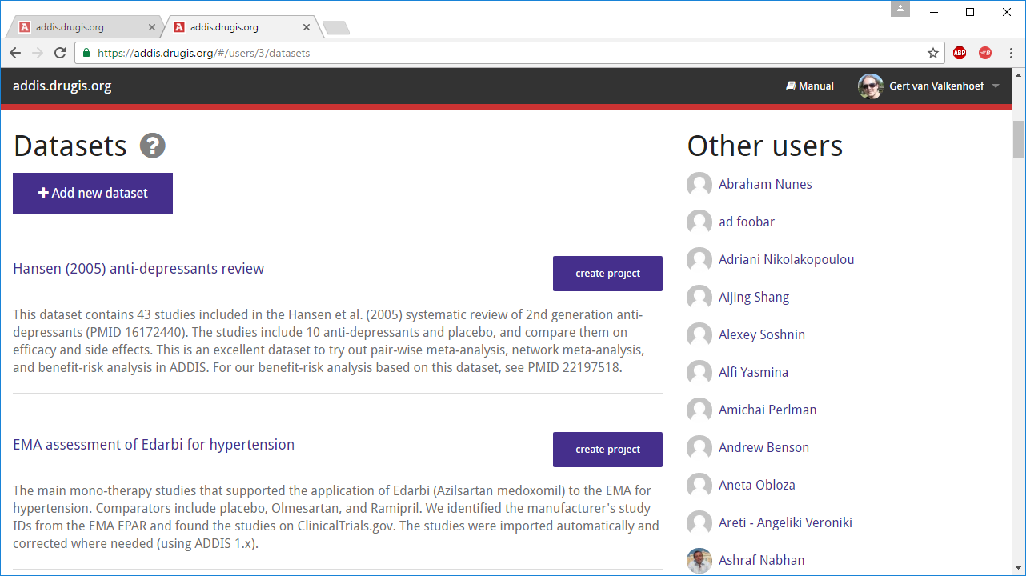

Slide 12
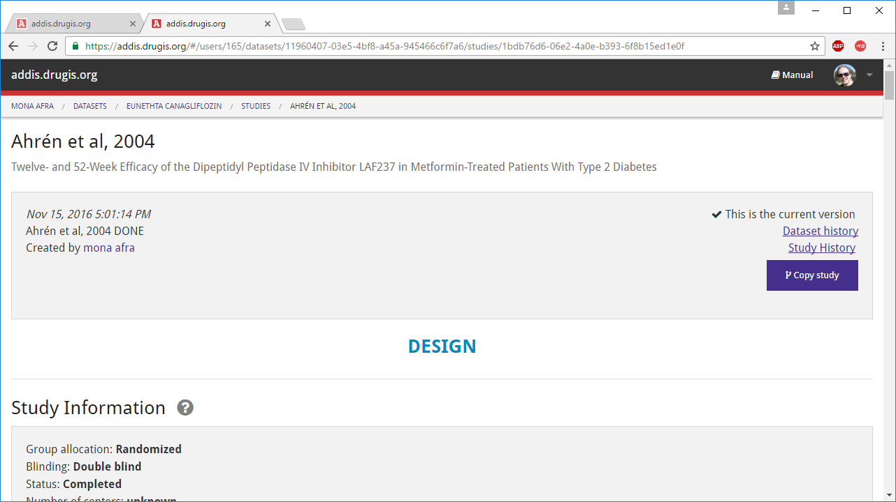

Slide 13
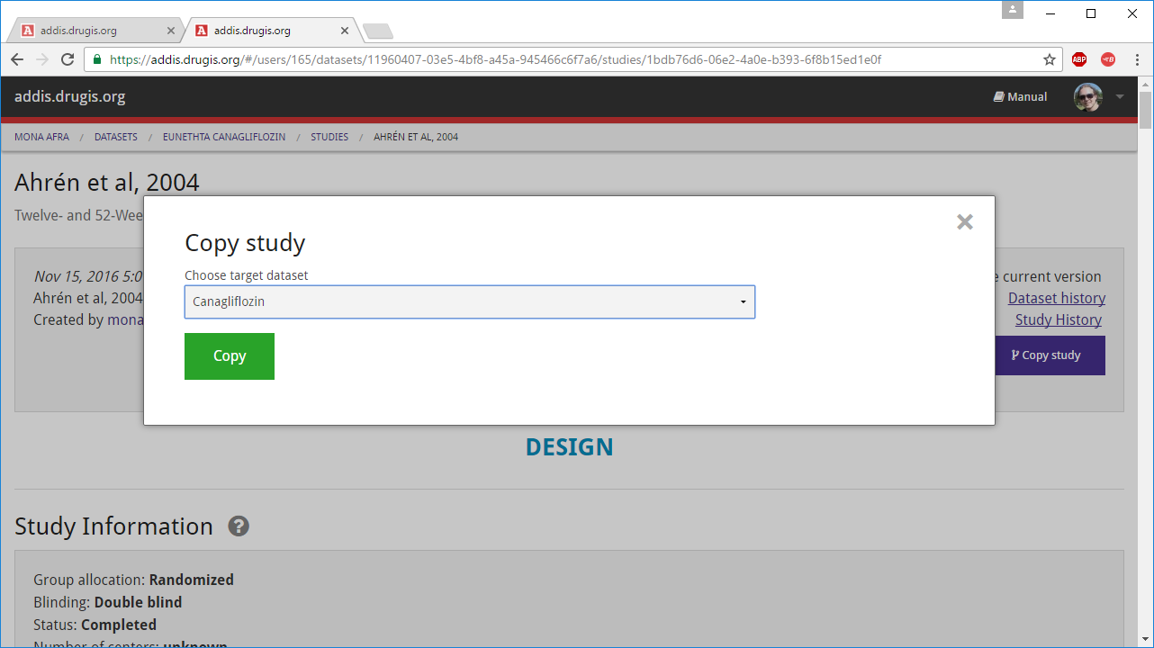

Slide 14
Import
Study design and results from ClinicalTrials.gov

Slide 15
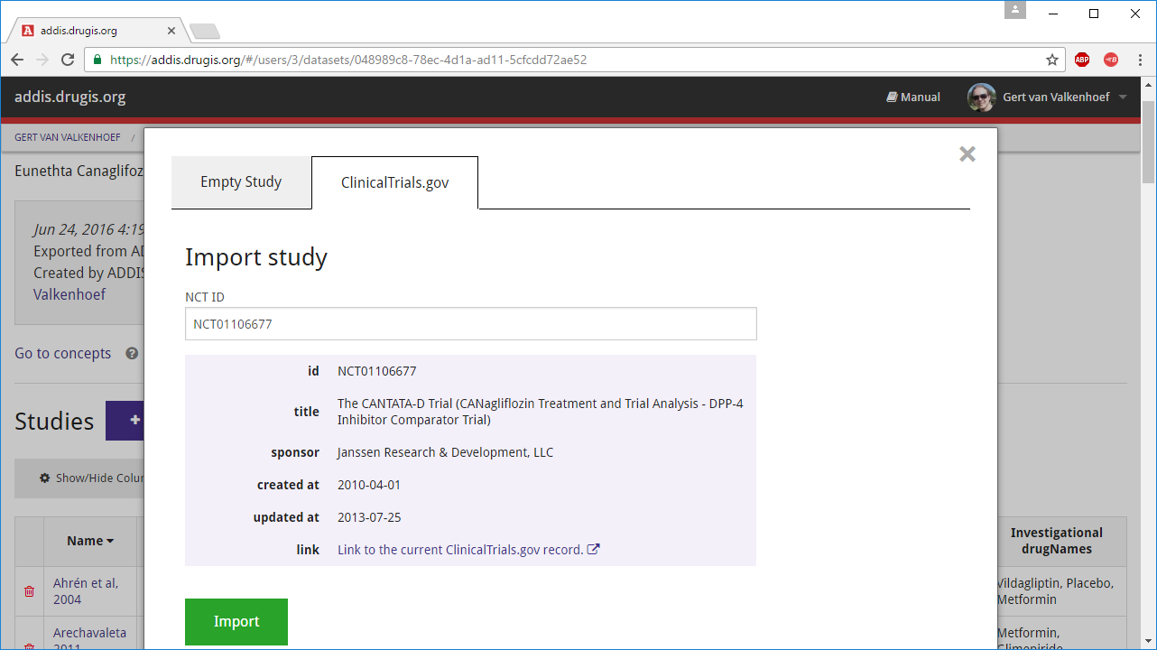

Slide 16
Full audit trail

Slide 17
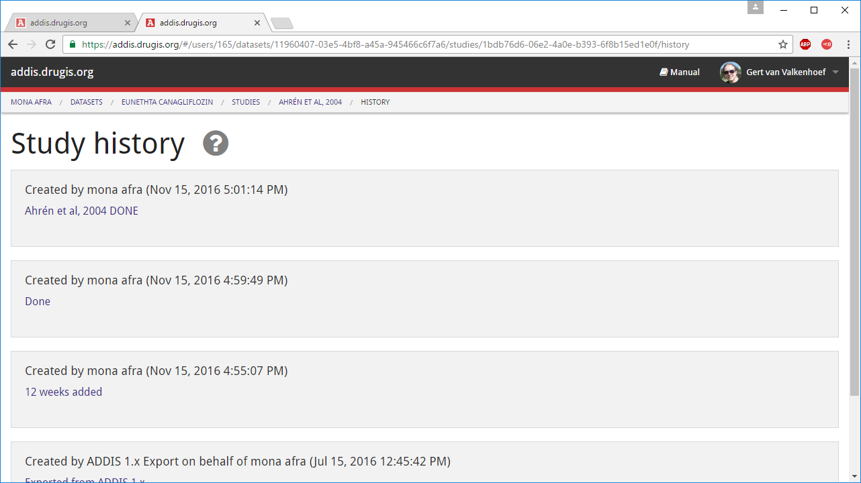

Slide 18
Harmonize

Slide 19
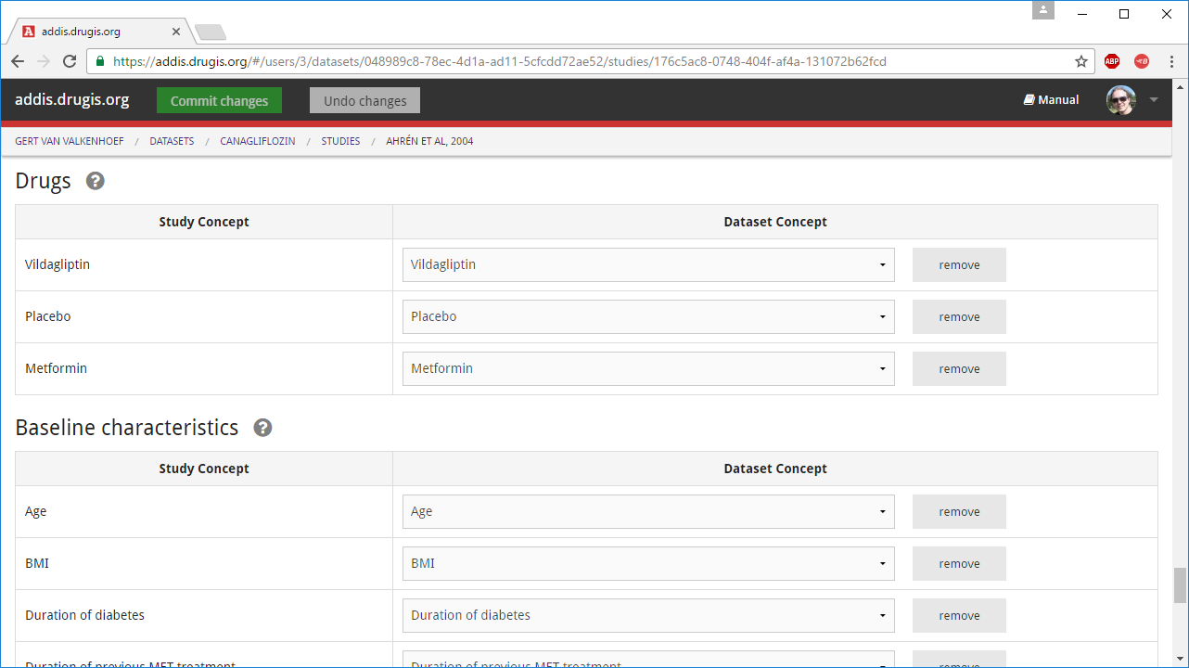

Slide 20
Filter

Slide 21
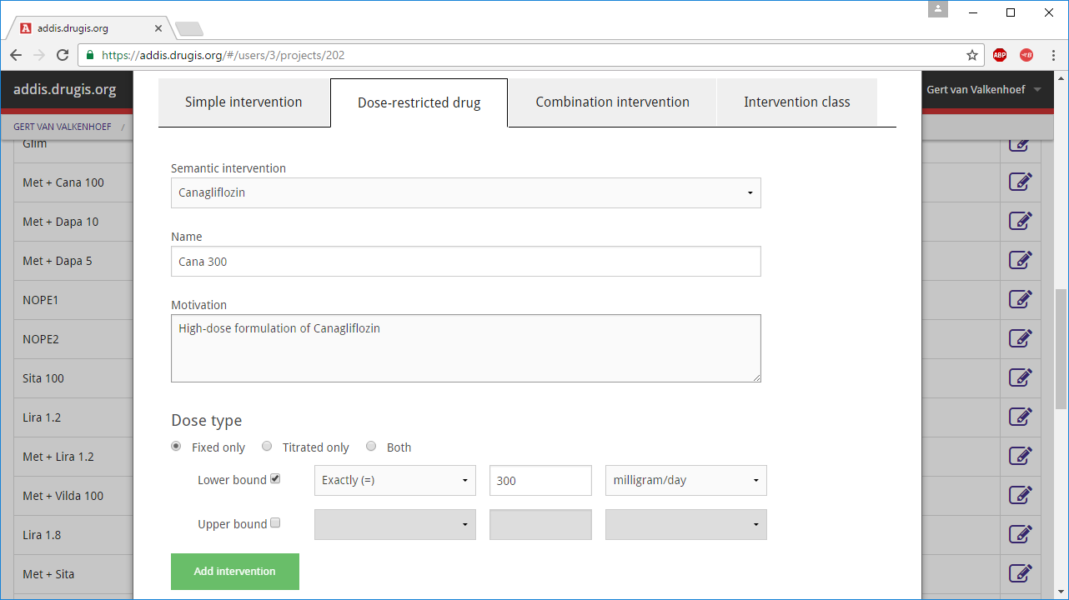

Slide 22
Find evidence

Slide 23
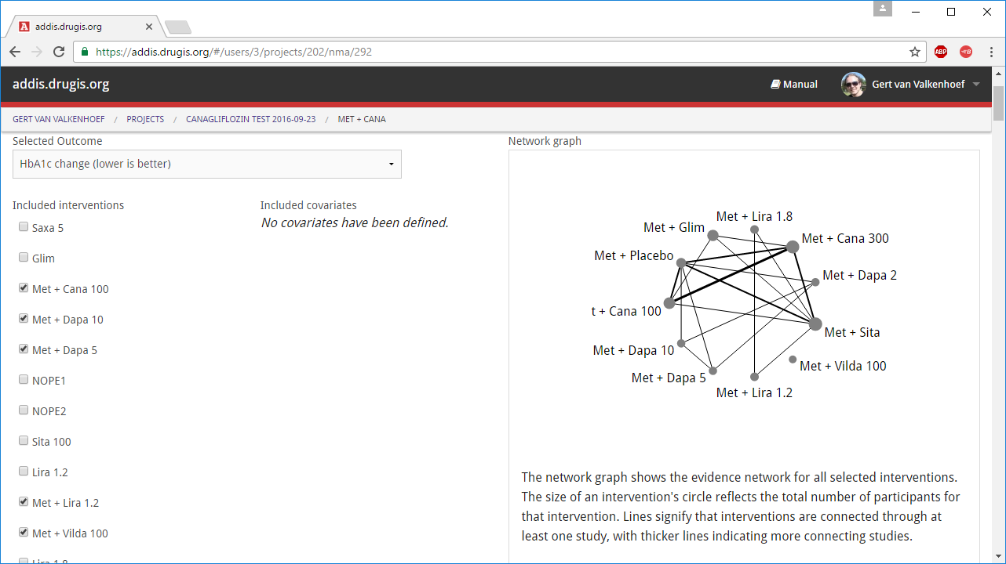

Slide 24
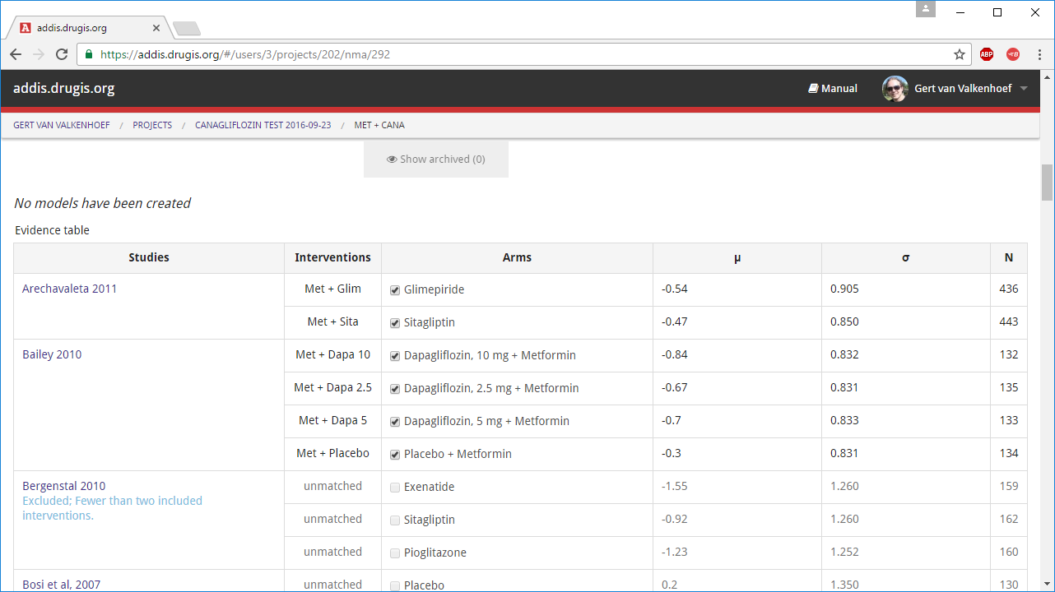

Slide 25
Network meta-analysis
Main results

Slide 26
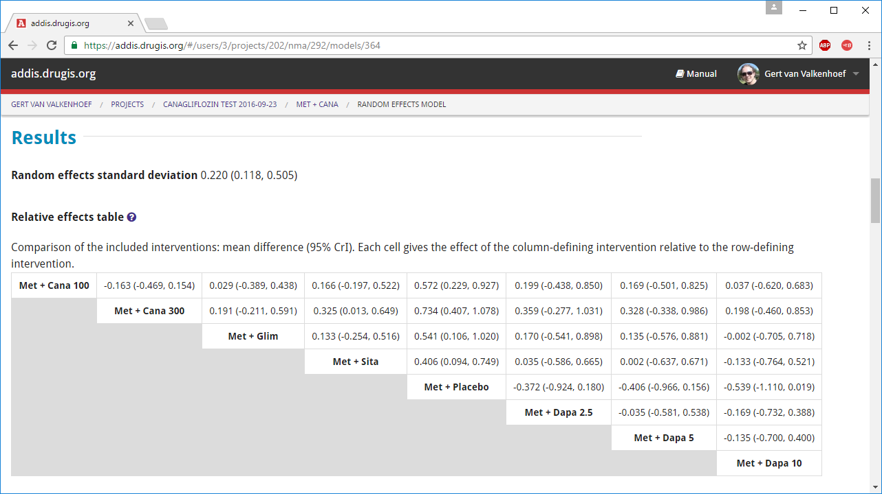

Slide 27
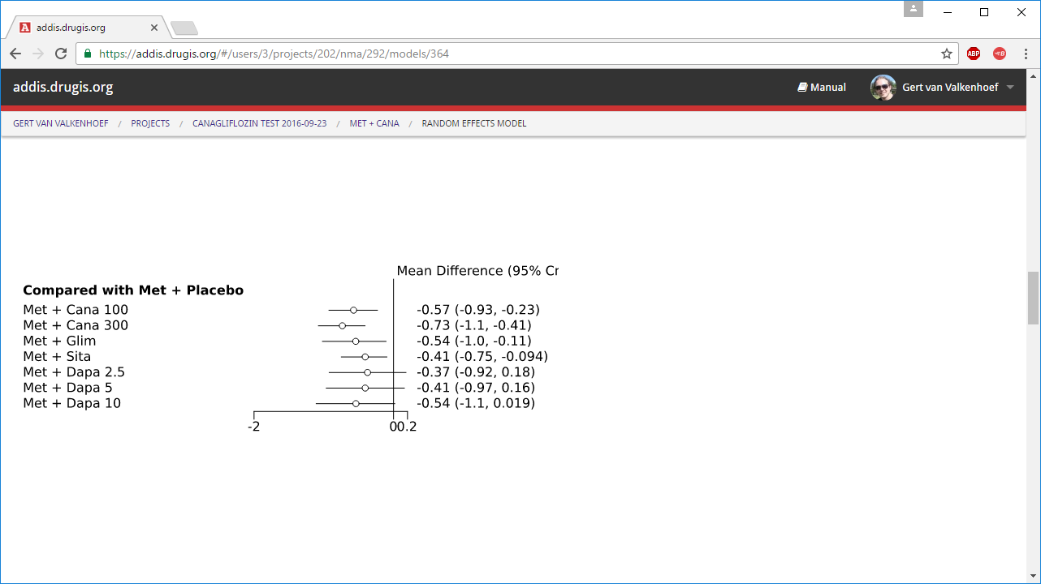

Slide 28
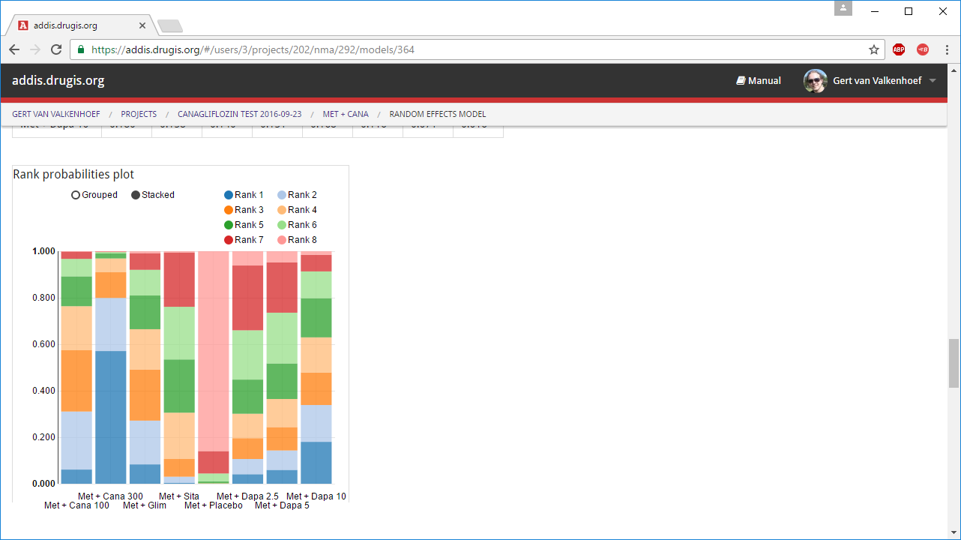

Slide 29
Network meta-analysis
Convergence diagnostics

Slide 30
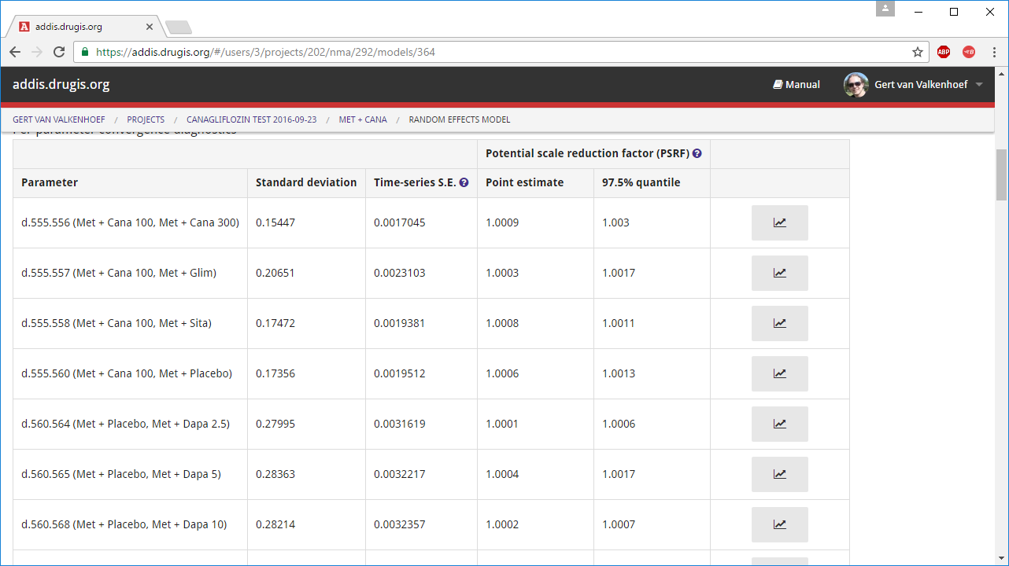

Slide 31
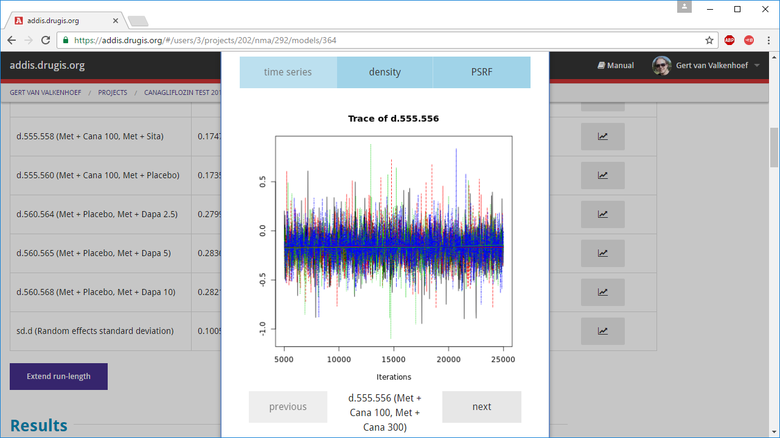

Slide 32
Network meta-analysis
Assessment of inconsistency

Slide 33
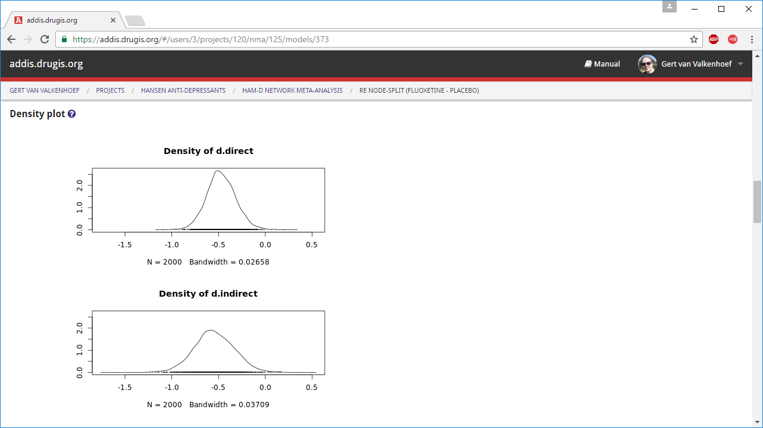

Slide 34
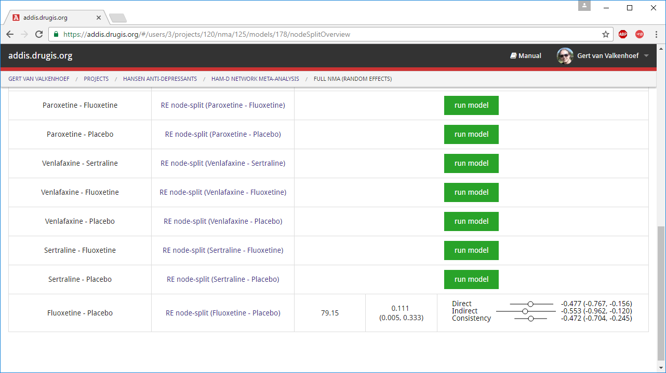

Slide 35
Design adjustment
Include observational data with randomized evidence

Slide 36
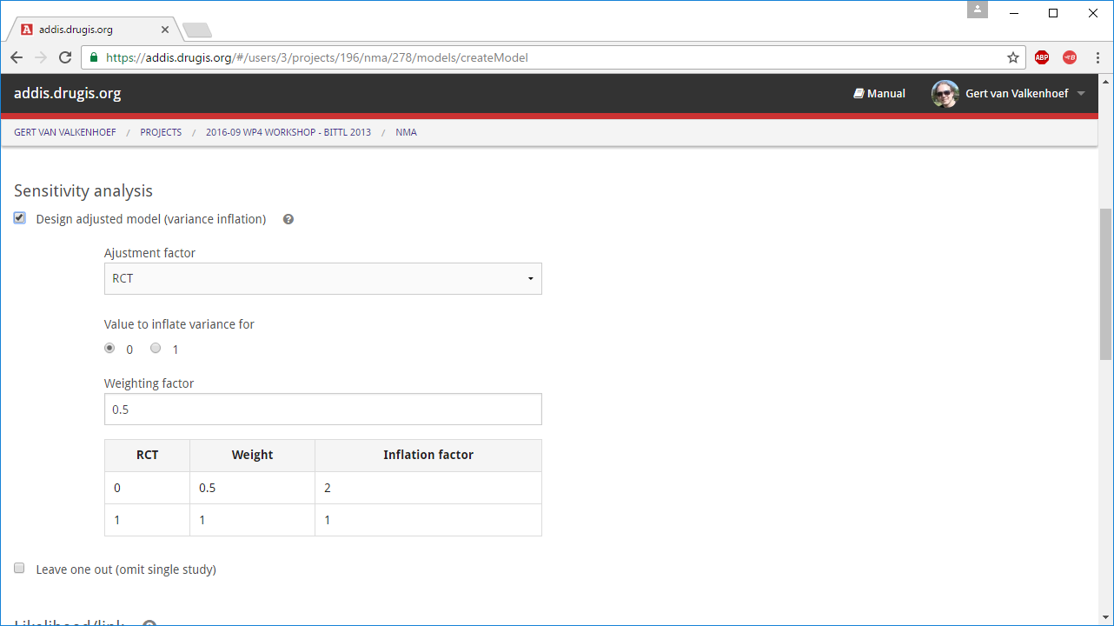

Slide 37
Network meta-regression
Adjust for study-level covariates

Slide 38
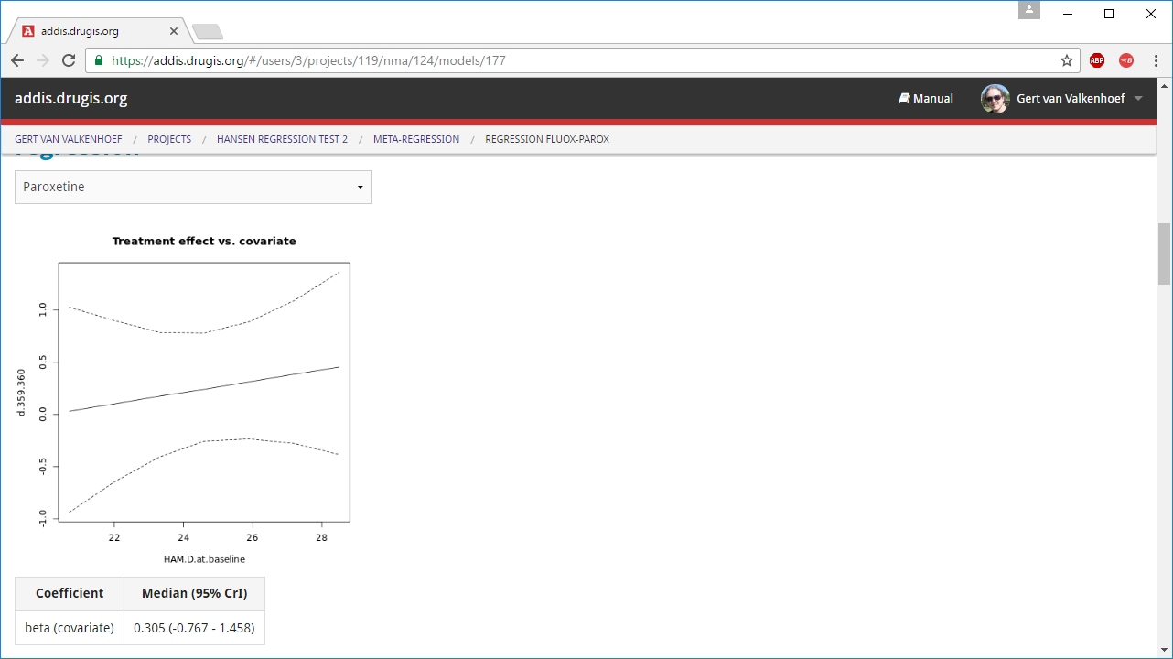

Slide 39
Sensitivity analysis
Assess the impact of individual studies in a leave-one-out analysis

Slide 40
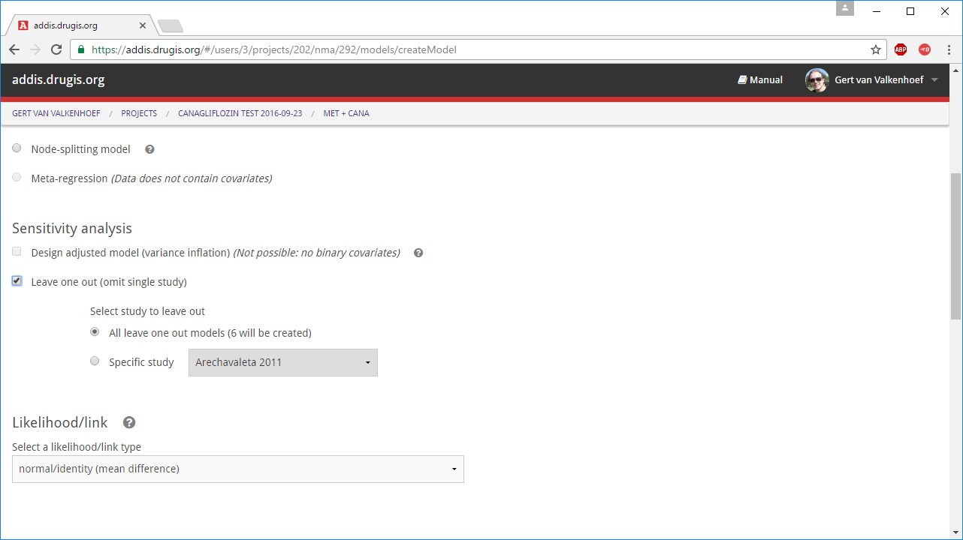

Slide 41
Benefit-risk analysis
Multiple criteria decision analysis (MCDA)
Based on evidence synthesis or single studies

Slide 42
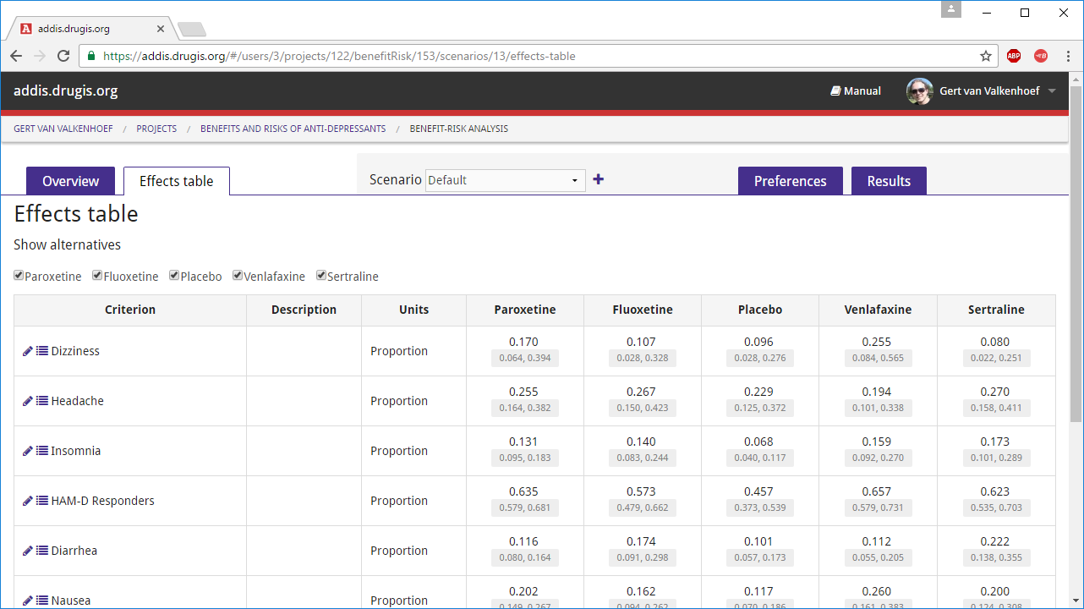

Slide 43
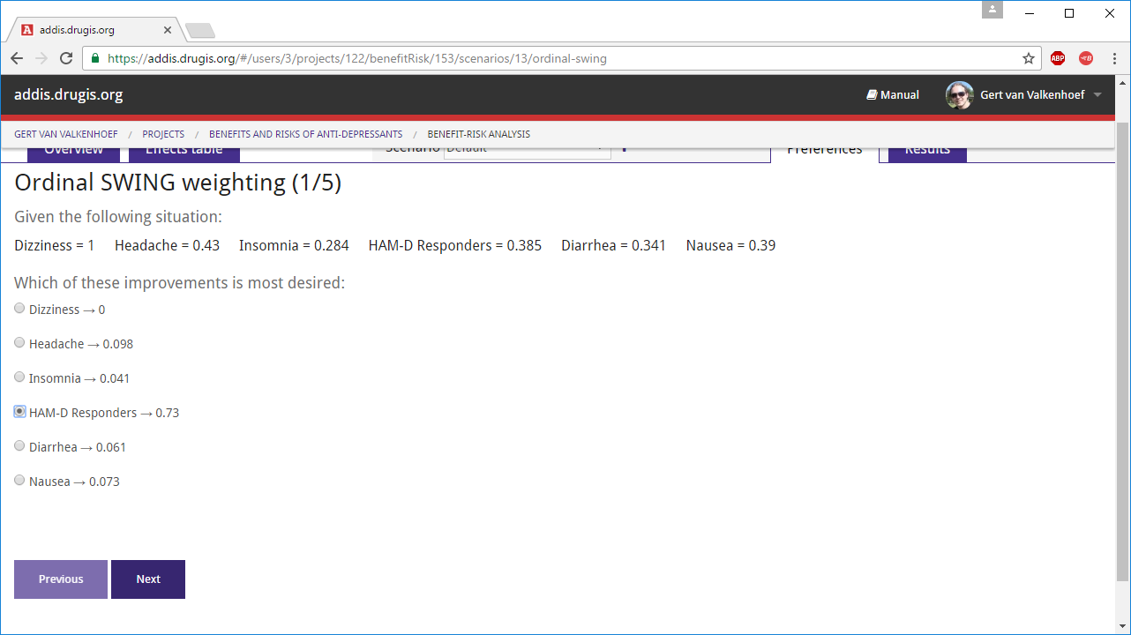

Slide 44
