Slide 1
Health Application presentation
Group c -
Callum Edwards, Laura haddy & Daniel Richards

Slide 2
What did EPIC ask from us?
To create an application that monitors the user’s life style and eating habits.
The functionality had to include:
Ability to create questions for the user to answer.
Ability for users to submit their answers to the questions
Ability for doctors and patients to message each other
Doctor should be alerted if the user hasn’t participated after a certain amount of time.

Slide 3
Demo

Slide 4
Providing the group were given more time…
If given more time, we would have liked to implement a means to record the answers to the surveys given by the patient.
In the future, we would also like to be able to implement other types of questions into the survey (Multiple choice, video, audio, etc.)

Slide 5
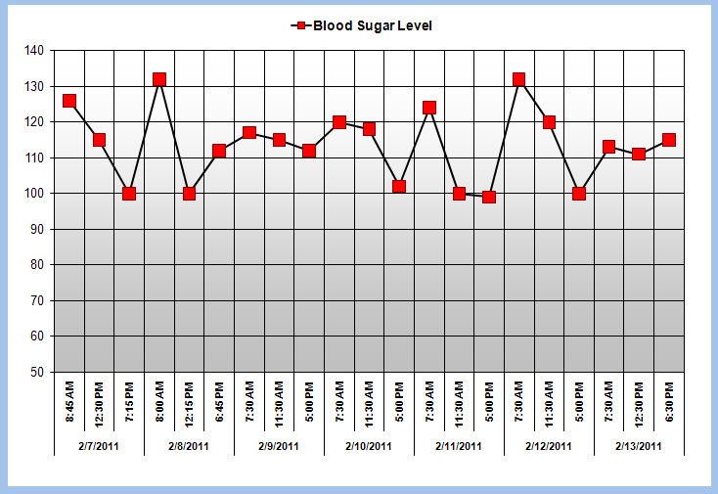
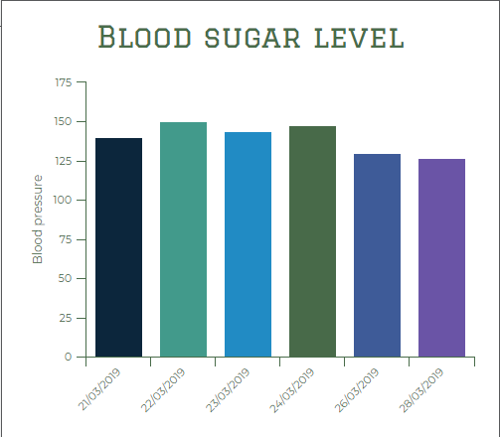
Providing the group were given more time…

Slide 6
Any Questions?

