Slide 1
Home
About
Projects
Blog
Contact
Slide 1
Slide 2
Slide 3
About me
Notes:
Each slides contains images of a Project and a brieve description of it.
It needs to cicle automatically while beign able to move them by hand using the dials in each side, or better yet, draggin

Slide 2
Home
About
Projects
Blog
Contact
Slide 1
Slide 2
Slide 3
My Image
About me
description
Bio
Learn More (link to About page)

Slide 3
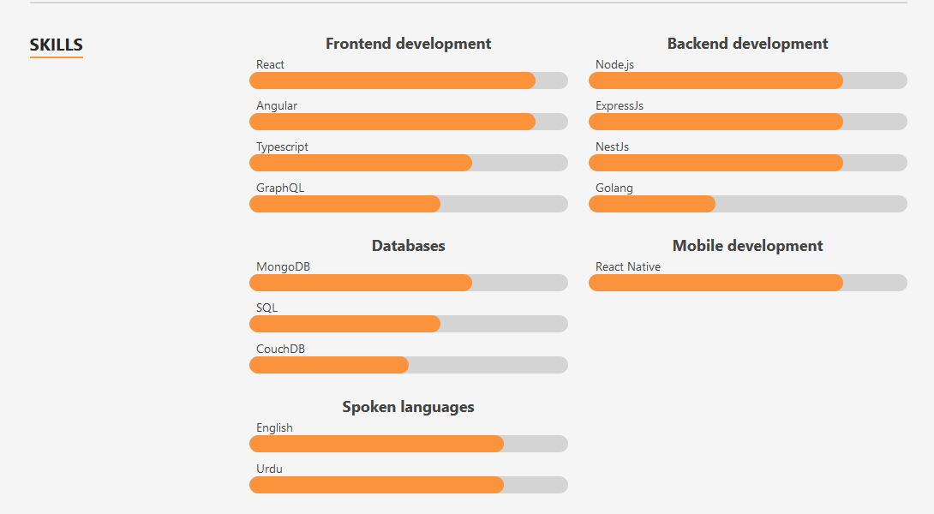
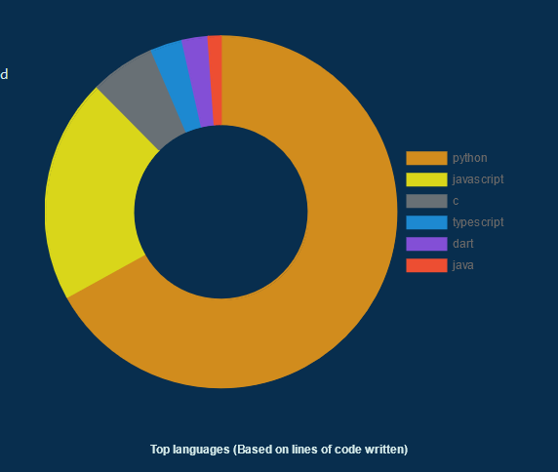
My Image
Home
About
Projects
About me
Blog
Contact
description
Bio
Learn More (link to About page)
Notes:
https://portfolio-n4sn.vercel.app/#about
https://www.aayushkurup.dev/about

Slide 4
Home
About
Projects
Blog
Contact
Here goes a CV, don’t know how it’s gonna look yet, but it Will be here
Button to download Resume

Slide 5
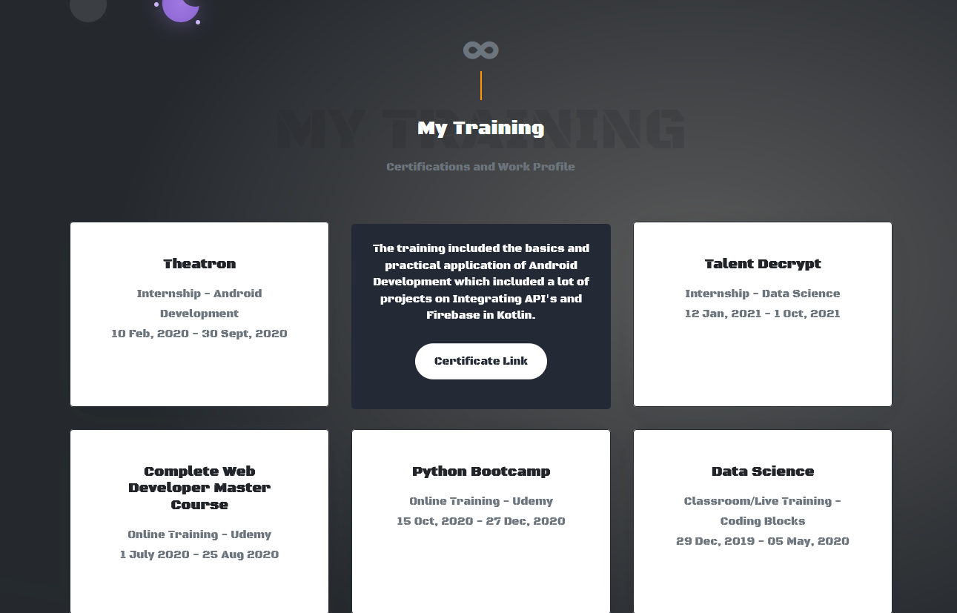
Here goes a CV, don’t know how it’s gonna look yet, but it Will be here
Home
About
Projects
Blog
Contact
Button to download Resume
Notes:
https://jayantgoel001.github.io/

Slide 6
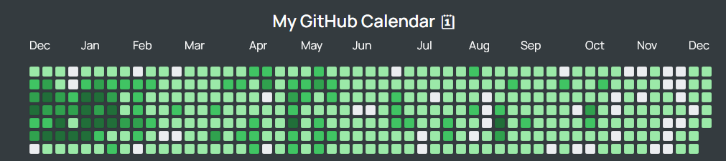
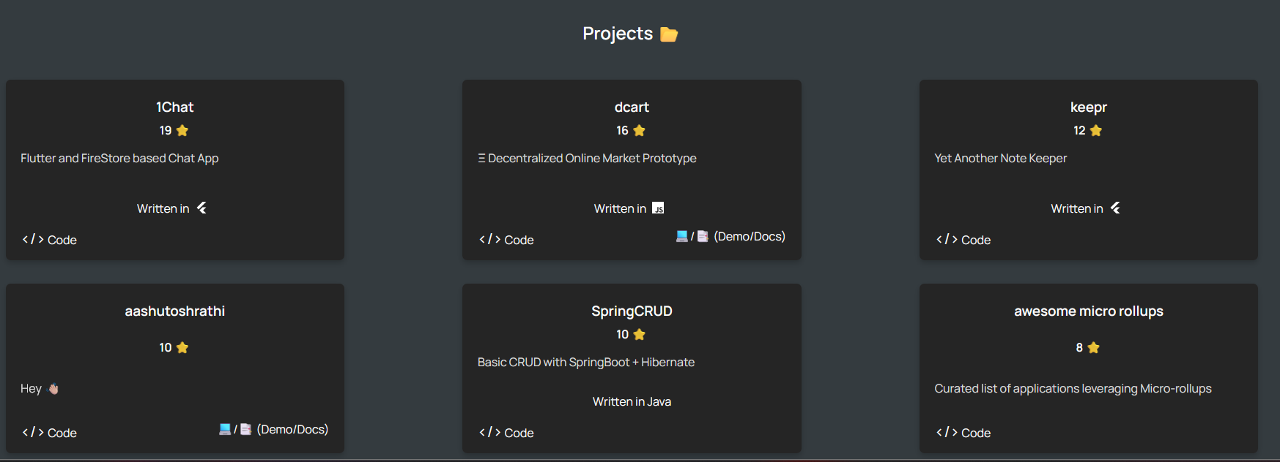
Home
About
Projects
Blog
Contact
Menu to select order and languajes
Notes:
https://aashutosh.dev/work/

Slide 7
Home
About
Projects
Blog
Contact
Menu to select order and languajes
Notes:
https://aashutosh.dev/work/

Slide 8
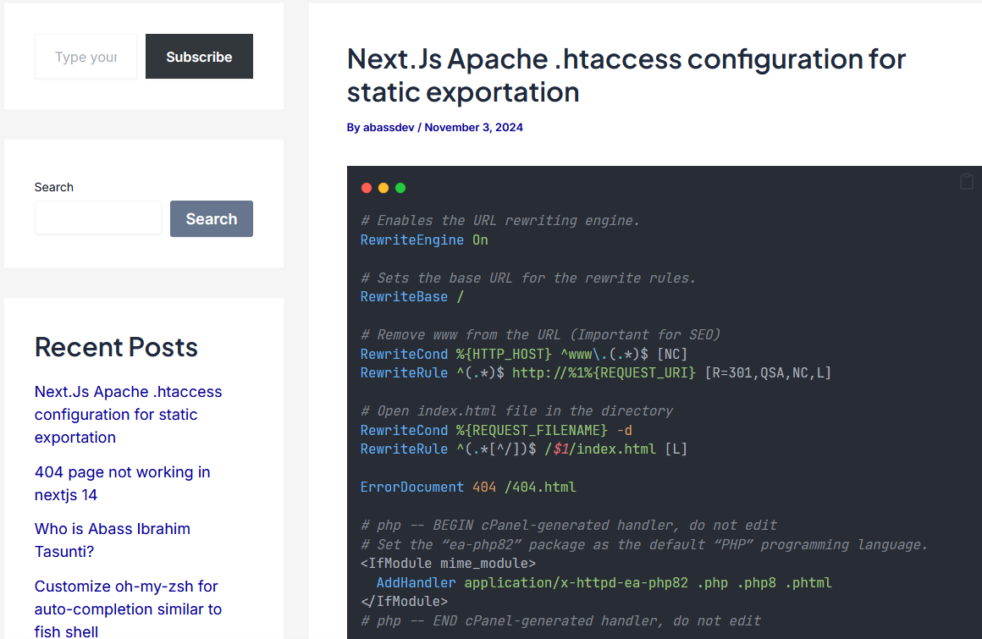
Home
About
Projects
Blog
Contact
Notes:
https://abassdev.com/blog/2024/11/03/next-js-apache-htaccess-configuration-for-static-exportation/

Slide 9
Home
About
Projects
Blog
Contact

Slide 10
Portfolios to get ideas
https://developerfolio.js.org/
https://abassdev.com/blog/2024/11/03/next-js-apache-htaccess-configuration-for-static-exportation/
https://aashutosh.dev/work/
https://portfolio-n4sn.vercel.app/#about
https://www.aayushkurup.dev/about
https://jayantgoel001.github.io/
Notes:
https://github.com/guilyx/awesome-github-pages-portfolios?tab=readme-ov-file
https://github.com/emmabostian/developer-portfolios

Slide 11
Ideas for projects ¿?
https://vinaysomawat.github.io/Resume-Builder/

