Slide 1



MLOps Project
Daniel – Data Scientist
Yossi – Data Engineer
Jonathan – Data Scientist

Slide 2
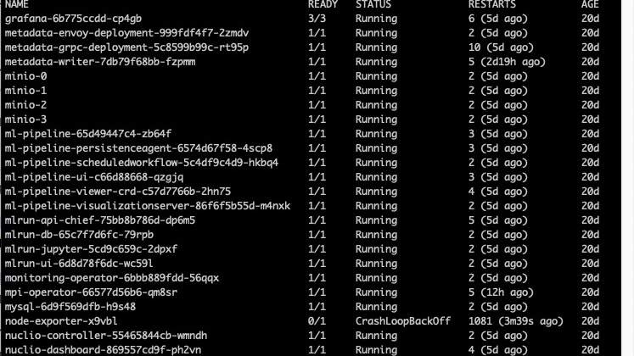
Iguazio
E2E MLOps platform
MLRun API

Slide 3
Our solution
Feature Selection
Outliers Removal
Bias Mitigation

Slide 4
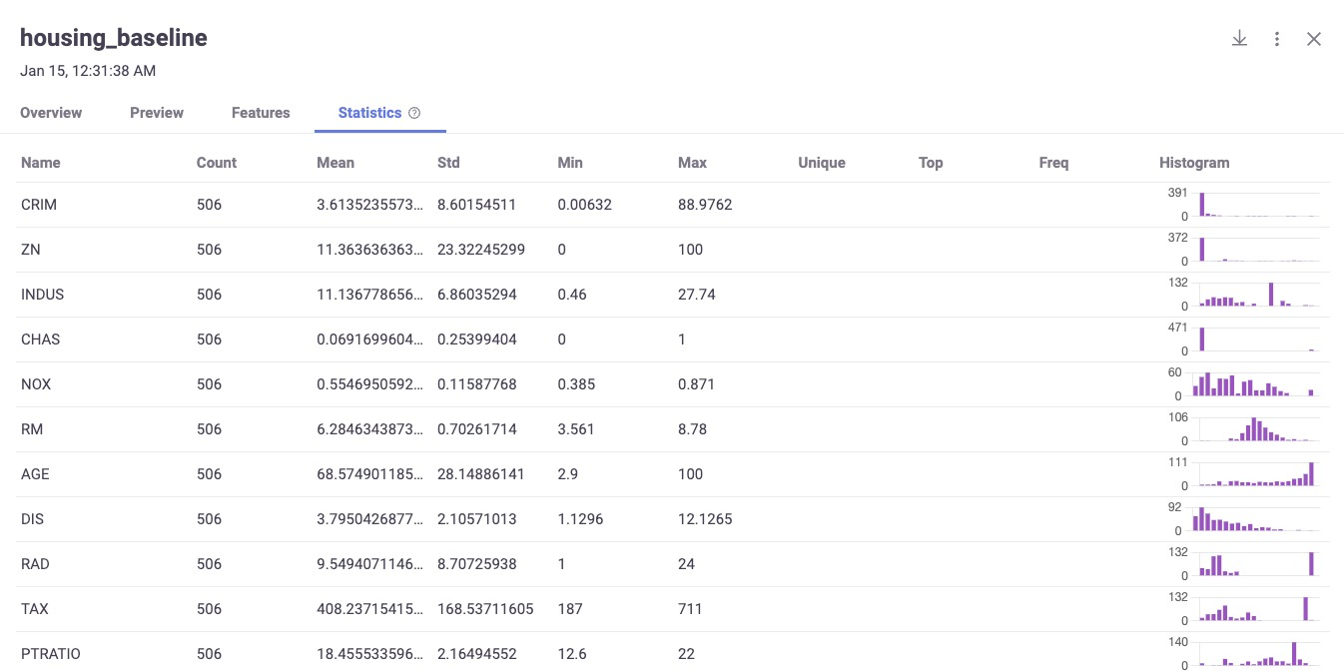
Datasets
Boston Dataset
The Boston dataframe has 506 rows and 14 columns
French Motor Dataset
Risk features and claim numbers were collected for 677,991 motor third-part liability policies (observed on a year)

Slide 5
Feature Selection – 1.13
We used sklearn.feature_selection on sample sets
1.13.1 Removing features with low variance
1.13.2 Univariate feature selection
1.13.3 Recursive feature elimination
1.13.4 Feature selection using SelectFromModel
1.13.5 Sequential Feature Selection
1.13.6 Feature selection as part of a pipeline

Slide 6
1.13.2 Univariate feature selection
SelectKBest
removes all but the k highest scoring features
RVs vs mutual information For regression: r_regression, f_regression, mutual_info_regression For classification: chi2, f_classif, mutual_info_classif

Slide 7
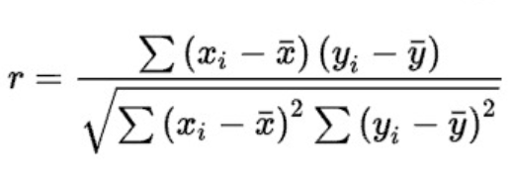
Univariate Feature Selection 1.13.2
R_regression
Compute Pearson’s r for each features and the target.
Pearson - covariance of the two variables divided by the product of their standard deviations.
The cross correlation between each regressor and the target is computed as:
F_regression
Univariate linear regression tests returning F-statistic and p-values
The cross correlation between each regressor and the target is computed using r_regression.
It is converted to an F score and then to a p-value.

Slide 8
Univariate Feature Selection 1.13.2
Mutual info regression
Estimate mutual information for a continuous target variable.
measures the dependency between the variables
F_regression
Compute the ANOVA F-value for the provided sample.

Slide 9
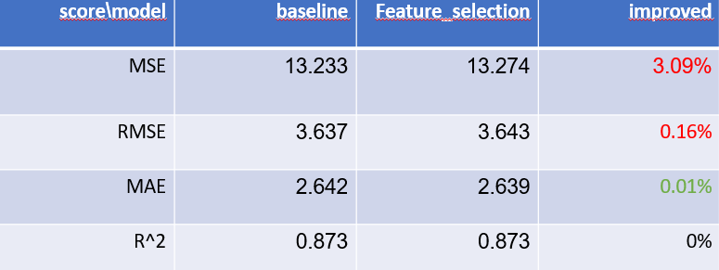
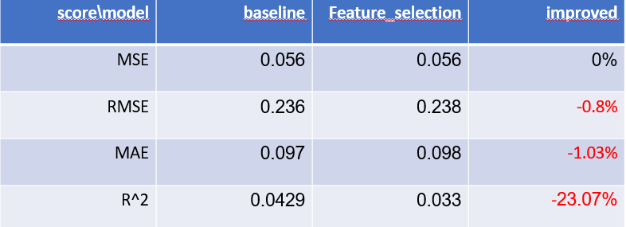
Results
Boston Dataset
French Motors

Slide 10
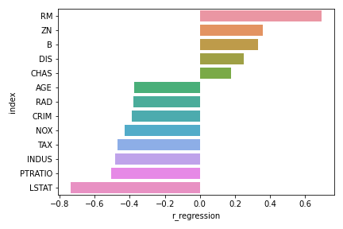
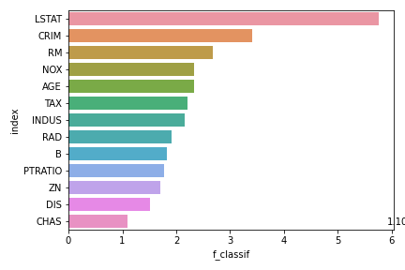
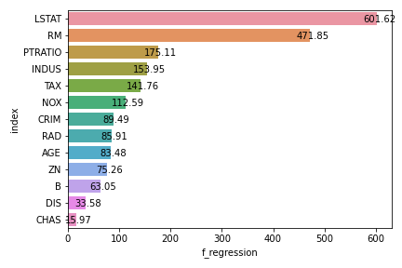
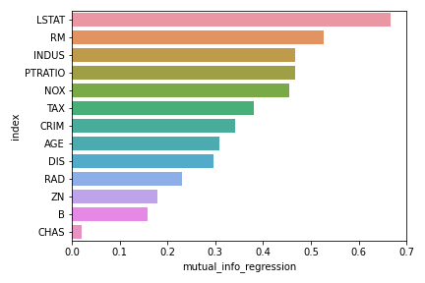
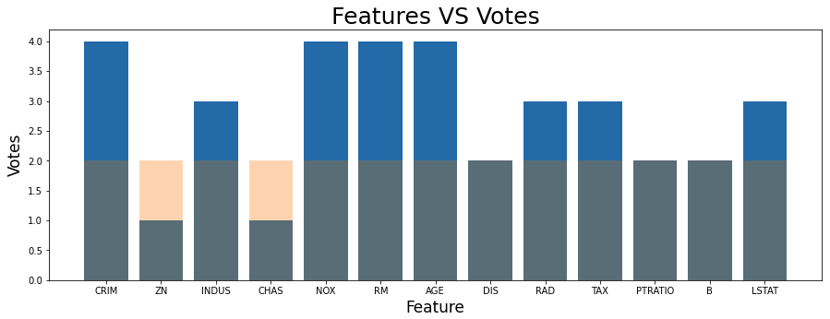
Boston Model’s Results – Cont.

Slide 11
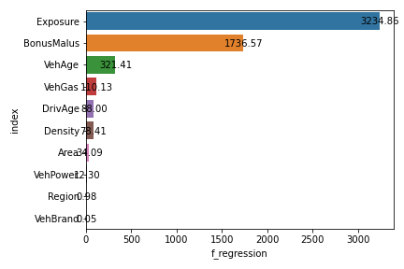
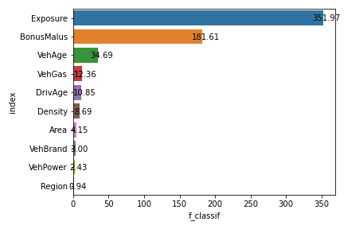
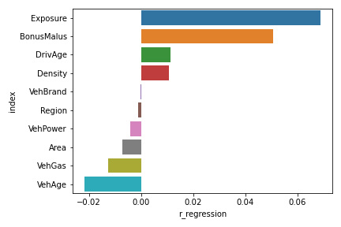
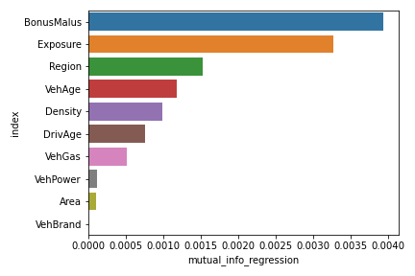
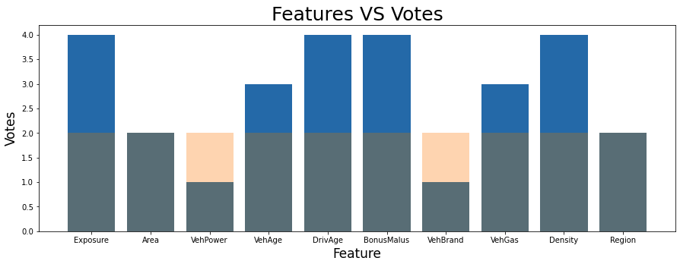
French Motors’ Model – Cont. Results – Cont.

Slide 12
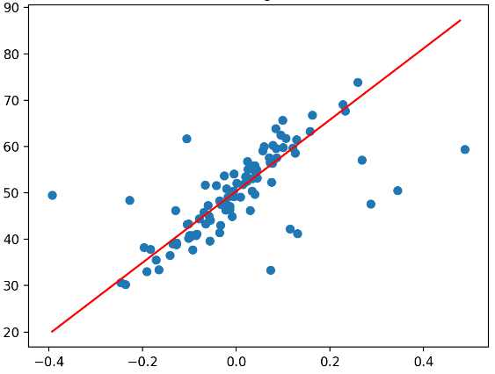
Outliers’ detection
Outliers - data points significantly different from most of the other data points in a dataset.
Detecting observations that may be considered anomalous given the sample distribution.
inlier - Any observation belonging to the distribution.
outlier - outlying point.

Slide 13
Outliers’ detection
Main causes for outliers:
Data entry or measurement errors
Sampling problems and unusual conditions
Natural variation

Slide 14
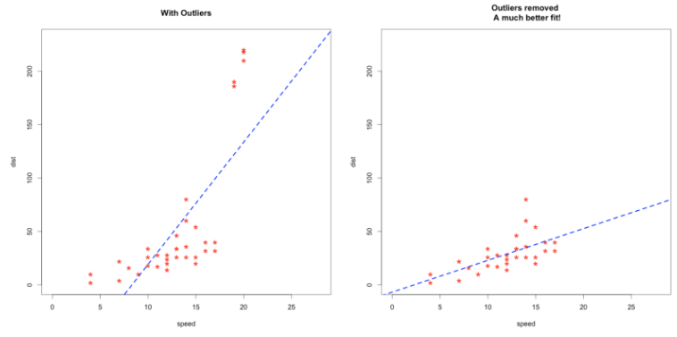
Outliers’ detection
Why should we remove them?
Causing problems when building
a predictive model.
Causing to achieve poorer results.
Approches in ML tasks:
Supervised
Semi-supervised
Unsupervised
Training data (unlabeled).
Identifies outliers during the fitting process.
Any new observations that do not belong to high-density regions are considered outliers.

Slide 15
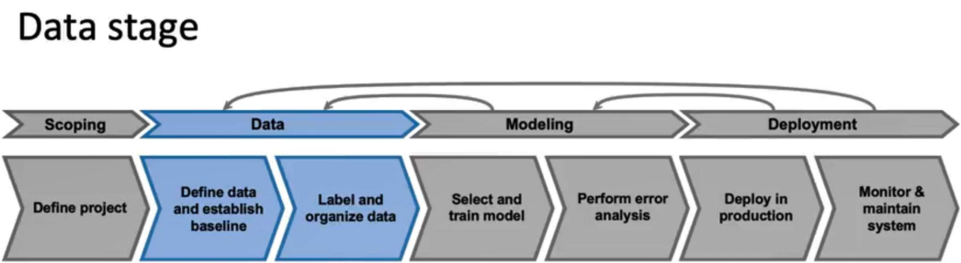
Outliers’ detection
Outliers' detection is a preprocessing technique, as well as
missing values detection
Normalization
Standardization
data formatting
data binning
dropping duplicates

Slide 16
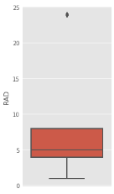
Outliers’ detection
How can we do it?
Using visualization.
Test the model on the training data.
Remove each data point detected as an outlier by more than X outlier’s detection algorithms.

Slide 17
Univariate outlier – a data point that consists of an extreme value on one variable
Methods:
Z-score
Interquartile range (IQR)
Multivariate outlier - a data point that consists of an extreme value on more than one variable
Methods:
Local outliers factor(LOF)
Angle based outliers detection(ABOD)
Outliers’ detection

Slide 18
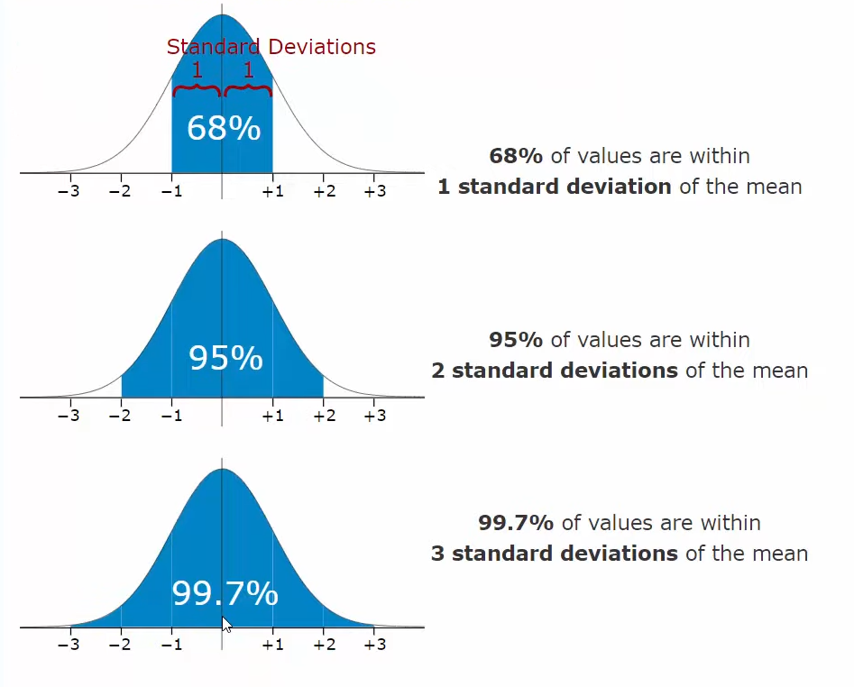
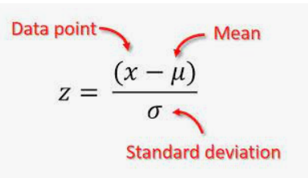
Z-score
Outliers are datapoint that is more than X times STDs from the mean (commonly 3 or 4).

Slide 19
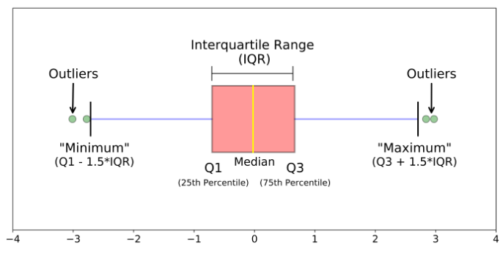
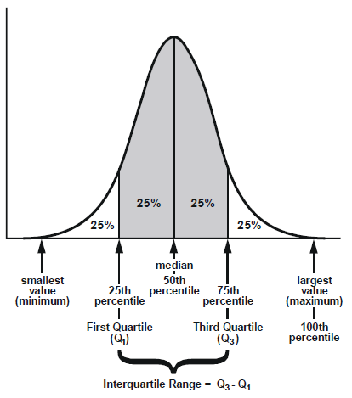
Interquartile range(IQR)
The IQR is a measure of the dispersion of a dataset.
Quartiles are values that divide a dataset into four equal parts
Arrange the values in numerical order and calculate:
Q1 = (n+1) * (1/4)
Q2(Median = (n+1) * (1/2)
Q3 = (n+1) * (3/4)
(Where n is the number of values in the dataset.)

Slide 20
Multivariate Outliers
Python Outlier Detection (PyOD),
Python toolkit for detecting outliers in multivariate data.
Contains more than 40 outlier detection algorithms.

Slide 21
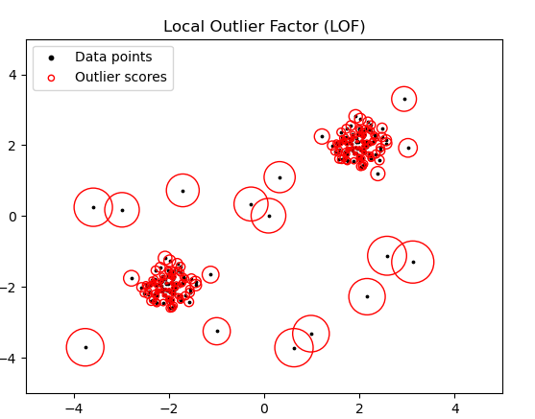
Local Outlier Factor
Examines the neighbors of a point.
Compares its density to the density of its neighbors(default 20).
Outlier is a point where its density is much smaller than its neighbors.
Use distance metric for the calculation

Slide 22
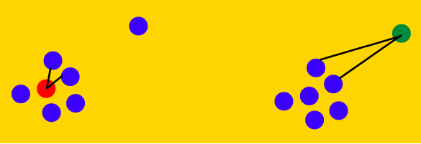
Angle-based Outlier Detection (ABOD)
Based on the angle formed by each three data points in multi-variate feature space.
The variance in the angular enclosure’s magnitude differs for outliers and the average points.
Inlier – high variance
Outlier – smaller variance
Hence such a measure helps us to cluster normal and outlier points differently.
Works well in high-dimensional space, unlike other distance-based measures that suffer from the “Curse of dimensionality.”
The distance between any two points in the high-dimension space is almost similar.
* the original algorithm calculates the angles between each datapoint to each pair, but it costs O(N^3).

Slide 23

Experiment
1. Perform outliers' detection on the training data by each method.
Each method returns the suspicious outliers.
2. Remove each data point detected as an outlier by more than three.

Slide 24
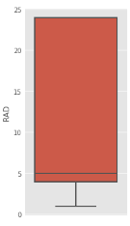
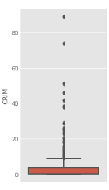
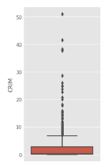
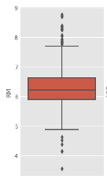
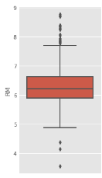
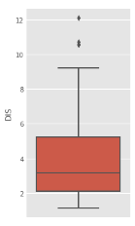
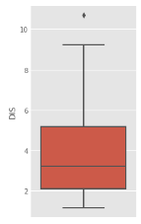
Results for Boston’ dataset

Slide 25
Boston Dataset Results
French Motors Dataset Results
Improvement | Outliers Removal | Baseline | Score\Model
3.4% | 12.777 | 13.233 | MSE
1.7% | 3.574 | 3.637 | RMSE
0.15% | 2.638 | 2.642 | MAE
0.4% | 0.877 | 0.873 | R^2
Improvement | Outliers Removal | Baseline | Score\Model
1.7% | 0.055 | 0.056 | MSE
1.2% | 0.233 | 0.236 | RMSE
5.1% | 0.092 | 0.097 | MAE
0 | 0.042 | 0.042 | R^2

Slide 26
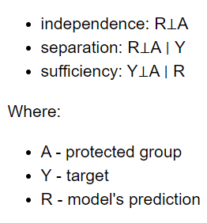

DALEX Module
The data comes from a world of biased decision, so is the data
A package for data analysis and exploration
It uses a “fairness” check for a given model and a dataset
Fair model is a model which is not biased towards any of the dataset’s features

Slide 27

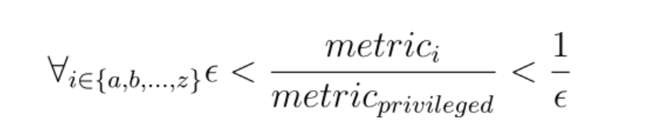
The Process
For each feature of the dataset:
Split the feature according to it’s median- to majority and minority subclasses
Giving the Dalex class the new split dataset, to check for bias
If a bias occurred, there are 2 methods:
Reweight
Resample

Slide 28
Reweight - Reweighting is a method for adjusting the weights of training samples to mitigate bias in a model. It does this by assuming that the majority group is independent of the target values and calculating new weights based on the expected probability of an event occurring.
Resample - Resampling is a method for mitigating bias in a model by selecting specific indices for the training pipeline. It can either under or oversample from a given group, assuming that the majority or minority group is independent of the target values.
In both methods we assume that the observations are independent with the y values, the reweighting method calculates the proportion between the expected probability to the empirical results and uses it as new weights, where the resample uses the proportion to oversample or undersample – based on the case.

Slide 29
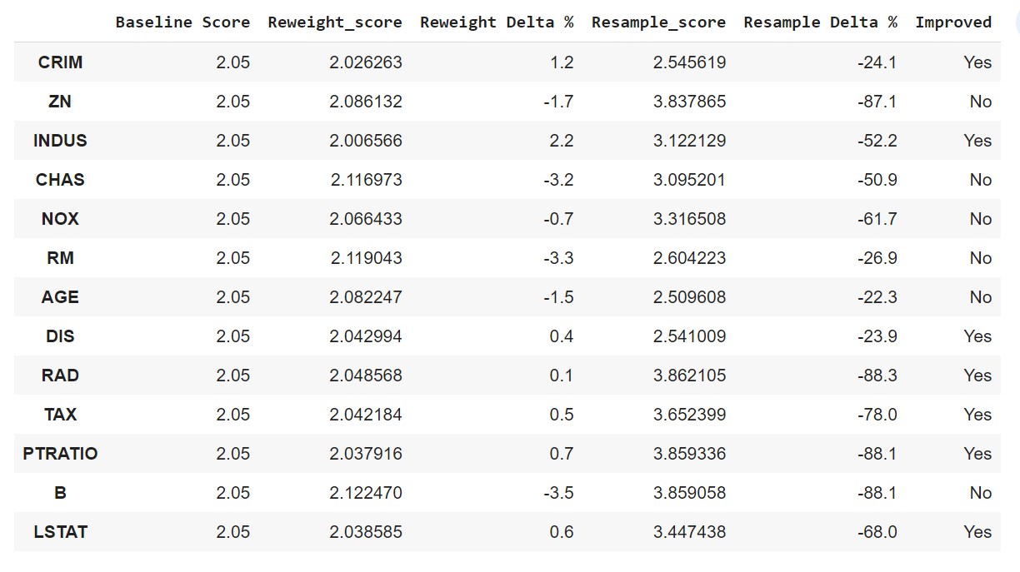
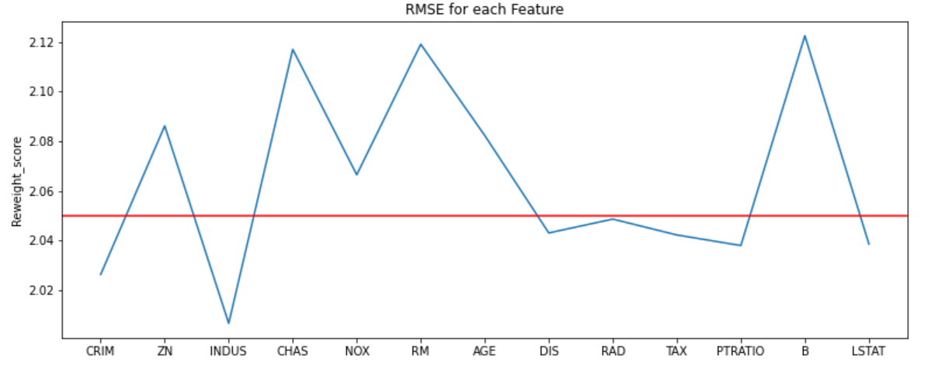
Boston’s Results

Slide 30
Boston Results - Dalex
Improvement | DALEX model | Baseline | Score\Model
7.4% | 12.25 | 13.233 | MSE
3.7% | 3.5 | 3.637 | RMSE
1.5% | 2.6 | 2.642 | MAE
1.13% | 0.882 | 0.873 | R^2

Slide 31
French Motor’s Dataset
Improvement | DALEX model | Baseline | Score\Model
0 | 0.056 | 0.056 | MSE
0.8% | 0.234 | 0.236 | RMSE
0 | 0.097 | 0.097 | MAE
7% | 0.039 | 0.042 | R^2

Slide 32
Results Final Boston’s Results
improved | Our Model | baseline | score\model
0.5% | 13.301 | 13.233 | MSE
0.2% | 3.647 | 3.637 | RMSE
1.9% | 2.693 | 2.642 | MAE
0.1% | 0.872 | 0.873 | R^2

Slide 33
Results Final French Motors’ Results
Improved | Our Model | baseline | score\model
0 | 0.056 | 0.056 | MSE
0.4% | 0.237 | 0.236 | RMSE
0 | 0.097 | 0.097 | MAE
7% | 0.039 | 0.042 | R^2

Slide 34
Future Work
Worse results? A future work of the following will probably cause better results:
Different Datasets for pipeline with higher dimensions / more features – Both datasets are preprocessed and clean, we may get better results on dirty and massive datasets
Different random seeds – Some solution are based on randomness, and might cause better or worse results
Different combinations of our solutions – Trying different order of solutions
Hyperparameters tuning in Dalex, outliers removal and feature selection

