Slide 1
END-TO-END ANALYTICS PROJECT
Customer Shopping
Behaviour Analysis
Uncovering spending patterns, customer segments & subscription
behaviour to guide strategic retail decisions
Python
SQL Server
Power BI
DAX
PowerPoint
Daniel Sampson · 2026

Slide 2
OVERVIEW
What We'll Cover
01
Business Problem
07
SQL Query Showcase
What challenge are we solving?
CTE & Window Function deep dive
02
Dataset Overview
08
Power BI — Overview Page
3,900 customers · 18 features
KPI Cards · Charts · Slicers
03
Project Pipeline
09
Power BI — Insights Page
End-to-end workflow diagram
Revenue · Season · Gender · Frequency
04
Python — EDA & Cleaning
10
Key Findings
Data preparation pipeline
9 critical insights from the data
05
SQL Analysis — Q1 to Q5
11
Recommendations
Revenue · Discounts · Ratings · Shipping · Subs
7 actionable business strategies
06
SQL Analysis — Q6 to Q10
Segmentation · Products · Age Revenue
Customer Shopping Behaviour Analysis · Daniel Sampson · 2025
2 / 13

Slide 3
PROBLEM STATEMENT
The Business Challenge
What questions needed answering?
The Situation
Key Business Questions
A retail business had 3,900 customer transaction records but lacked the analytical depth to act on them strategically.
Key challenges included a critically low 27% subscription rate, an unexplained zero-female-subscriber anomaly, unclear seasonal revenue patterns, and a discount strategy with no measurable ROI.
Which categories & seasons drive the most revenue?
Why is the subscription rate only 27%?
How does behaviour differ by gender & age group?
Which customer segments have the highest CLV?
Which products are most discount-dependent?
Customer Shopping Behaviour Analysis · Daniel Sampson · 2026
3 / 13
Are repeat buyers more likely to subscribe?

Slide 4
DATASET
Dataset Overview
3,900 retail customer transactions · 18 features · 4 product categories
3,900
18
37
4
Customer Records
Feature Columns
Missing Values
Product Categories
Active transactions
Across 3 groups
In review_rating only
Clothing · Footwear · Accessories · Outerwear
Feature Breakdown
Customer Demographics
Age · Gender · Location · Subscription Status
Purchase Details
Item Purchased · Category · Amount (£) · Season · Size · Color
Shopping Behaviour
Discount Applied · Previous Purchases · Frequency · Review Rating · Shipping Type · Payment Method
Engineered Features
age_group (quartile-binned via pd.qcut) · purchase_frequency_days (mapped to numeric days)
Customer Shopping Behaviour Analysis · Daniel Sampson · 2026
4 / 13

Slide 5
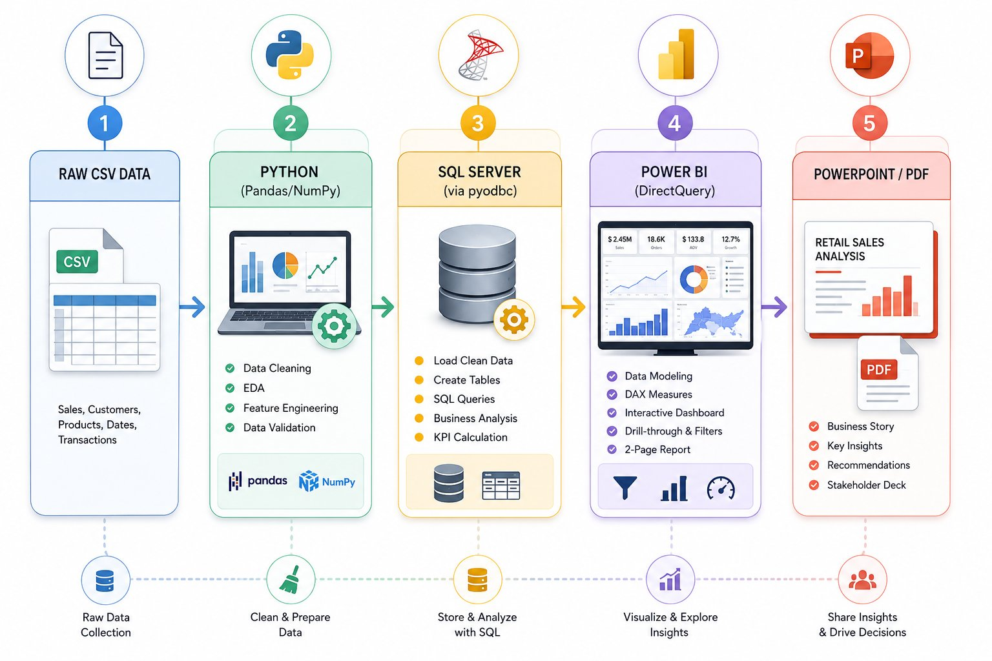
PROJECT PIPELINE
End-to-End Analytics Pipeline
Raw CSV → Python → SQL Server → Power BI → Power BI Service → PowerPoint
📌 Pipeline also includes Power BI Service (cloud publishing) for sharing and collaboration.
Customer Shopping Behaviour Analysis · Daniel Sampson · 2026
5 / 13

Slide 6
PYTHON
Data Preparation in Python
Cleaning · EDA · Feature Engineering · SQL Server Integration
01
Data Loading & Exploration
02
Missing Value Imputation
pd.read_csv() → df.info() → df.describe(include='all') → df.isnull().sum()
37 nulls in review_rating → filled with median per category using groupby().transform()
03
Column Standardisation
04
Redundancy Check
All columns → snake_case · purchase_amount_(usd) renamed · consistent across Python, SQL & Power BI
discount_applied == promo_code_used for 100% of rows → promo_code_used safely dropped
05
Feature Engineering
06
SQL Server Load
age_group via pd.qcut(q=4, labels=['Young Adult','Adult','Middle Aged','Senior'])
SQLAlchemy + pyodbc → engine → df.to_sql('customer_data', if_exists='replace') → Customer_Behaviour DB
Customer Shopping Behaviour Analysis · Daniel Sampson · 2026
6 / 13

Slide 7

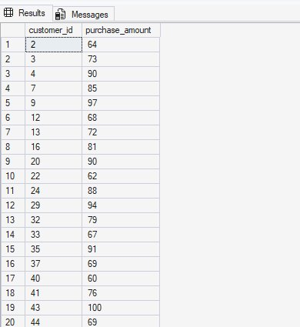
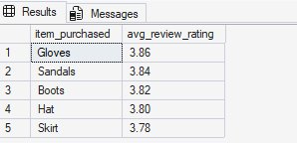


SQL RESULTS
SQL Business Questions — Part 1
Q1–Q5: Revenue · High-Spend Discounts · Product Ratings · Shipping · Subscriptions
Q1
Revenue by Gender
Q2
High-Spend Discount Users
Q3
Top 5 Products by Rating
Q4
Shipping Type Comparison
Q5
Subscribers vs Non-Subscribers
Customer Shopping Behaviour Analysis · Daniel Sampson · 2026
7 / 13

Slide 8
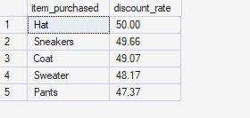

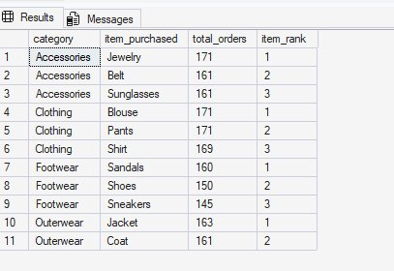

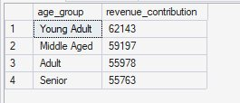
SQL RESULTS
SQL Business Questions — Part 2
Q6–Q10: Discount Dependency · Segmentation · Top Products · Repeat Buyers · Age Revenue
Q6
Discount-Dependent Products
Q7
Customer Segmentation (CTE)
Q8
Top 3 Products per Category (Window Fn)
Q9
Repeat Buyers & Subscriptions
Q10
Revenue by Age Group
Customer Shopping Behaviour Analysis · Daniel Sampson · 2026
8 / 13

Slide 9
SQL DEEP DIVE
Query Showcase
CTE · Window Functions · Subqueries — the most advanced queries in the project
Q7 — Customer Segmentation (CTE)
Q8 — Top 3 per Category (Window Function)
WITH segment_data AS (
SELECT
customer_id,
previous_purchases,
CASE
WHEN previous_purchases <= 1
THEN 'New'
WHEN previous_purchases
BETWEEN 2 AND 10
THEN 'Returning'
ELSE 'Loyal'
END AS customer_segment
FROM customer_data
)
SELECT
customer_segment,
COUNT(customer_id) AS total_customers,
SUM(previous_purchases) AS total_prev
FROM segment_data
GROUP BY customer_segment;
WITH item_count AS (
SELECT
category,
item_purchased,
COUNT(customer_id)
AS total_orders,
ROW_NUMBER() OVER(
PARTITION BY category
ORDER BY
COUNT(customer_id) DESC
) AS item_rank
FROM customer_data
GROUP BY
category,
item_purchased
)
SELECT
item_rank, category,
item_purchased,
total_orders
FROM item_count
WHERE item_rank <= 3;
Customer Shopping Behaviour Analysis · Daniel Sampson · 2026
9 / 13

Slide 10
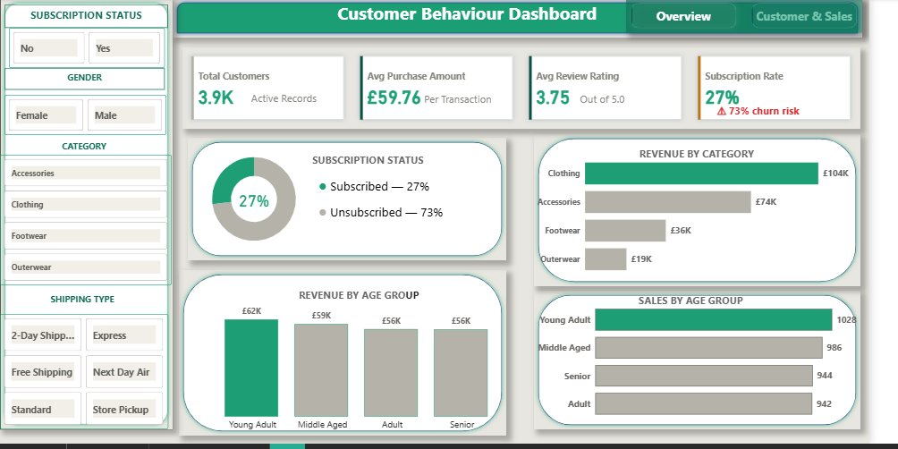
POWER BI DASHBOARD
Dashboard — Page 1: Overview
KPI Cards · Subscription Status · Revenue by Category · Revenue & Sales by Age Group · Slicers
3.9K customers · £59.76 avg · 3.75 rating · 27% subscription
⚠ 73% churn risk flagged directly on KPI card
Slicers: Subscription · Gender · Category · Shipping
Customer Shopping Behaviour Analysis · Daniel Sampson · 2026
10 / 13

Slide 11
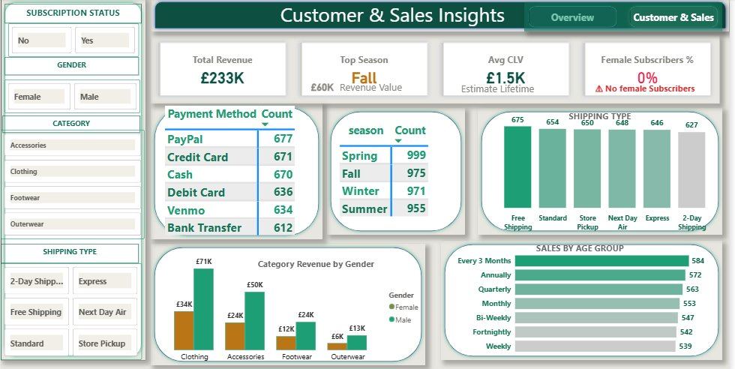
POWER BI DASHBOARD
Dashboard — Page 2: Customer & Sales Insights
Revenue by Season · Payment Method · Shipping Type · Category by Gender · Purchase Frequency
£233K total revenue · Fall top season · £1.5K avg CLV
0% female subscribers — flagged as critical KPI
Page navigation: Overview ↔ Customer & Sales buttons
Customer Shopping Behaviour Analysis · Daniel Sampson · 2026
11 / 13

Slide 12
KEY FINDINGS
What the Data Revealed
🔴 73%
⚠️ 0%
🏆 80%
Unsubscribed
Female Subscriptions
Loyal Customers
2,847 of 3,900 customers never converted
No female customer subscribed — critical blind spot
3,116 have 10+ previous purchases
💰 45%
🔁 72%
📦 £2
Clothing Revenue
Repeat Non-Subscribers
Express Premium
£104K of £233K total — single category dominates
Even loyal buyers avoid the subscription
Express users spend £2 more per transaction
🎯 839
🏷️ 50%
👥 £62K
High-Value Discount Users
Hat Discount Rate
Young Adult Revenue
Spent above average even while discounting
Highest discount dependency — margin risk
Leads all age groups — top segment
Customer Shopping Behaviour Analysis · Daniel Sampson · 2026
12 / 13

Slide 13
RECOMMENDATIONS
7 Actionable Business Strategies
Data-backed recommendations for immediate business impact
01
Fix the Subscription Programme
05
Re-evaluate Discount Strategy
Add exclusive benefits — early access, free shipping, personalised discounts. Target 2,847 unsubscribed customers.
Hat (50%), Sneakers (49.7%), Coat (49.1%) are discount-dependent. Reposition or bundle instead of eroding margins.
02
Address the Female Subscription Gap
06
Create Premium Tier for 839 High-Value Users
Zero female subscribers signals a product-market alignment failure. Launch a gender-targeted subscription trial.
Spent above average even with discounts — move into premium loyalty tier with high-value personalised offers.
03
Convert Returning → Loyal (701 customers)
07
Target Express Shipping Users
Milestone rewards after the 5th purchase. Structured loyalty ladder to move Returning into Loyal status.
Express users spend £2 more per transaction — upsell premium product lines and bundles to this segment.
04
Maximise Fall & Spring Campaigns
Concentrate product launches in Fall (£60K) and Spring — the two highest revenue seasons.
Thank you for viewing · Daniel Sampson · github.com/DanielSampson · linkedin.com/in/daniel-sampson-35b4b4366/
Customer Shopping Behaviour Analysis · Daniel Sampson · 2025
13 / 13

