Slide 1

Ontario Engineering Competition 2017 Programming
Charles Bergeron
Christopher Briglio
David Briglio
Daniel Sauvé

Slide 2
The Challenge
Create easy to use, autonomous power management and control system
Handle power outages and interruptions
Minimize costs and ensure quality services
Provide all information graphically

Slide 3
Features Of Our Program
Dynamic path calculation
Dijkstra's Algorithm for optimal path finding
Backup generator rerouting
Easily scalable backend due to config files

Slide 4
Initial Challenge Approach
Recognize major obstacles, priorities
GUI, path searching, metrics
Programming language selection
Java
Delegation of tasks
Deciding on path finding algorithm

Slide 5
Development Cycle
Research into specific problem solutions
End-to-End development cycle
Quick, AGILE team meetings to discuss progress and obstacles

Slide 6
Development Challenges
Path Searching Algorithm
Djikstras, Bellman Ford
Metrics
How to collect data as we traverse path

Slide 7
Development Challenges
GUI grid representation
Learn a new library, or rely on current skills
Reprioritize tasks
Focus on our strengths
Node Link representation
How to initialize?
Scaling both the backend and frontend

Slide 8
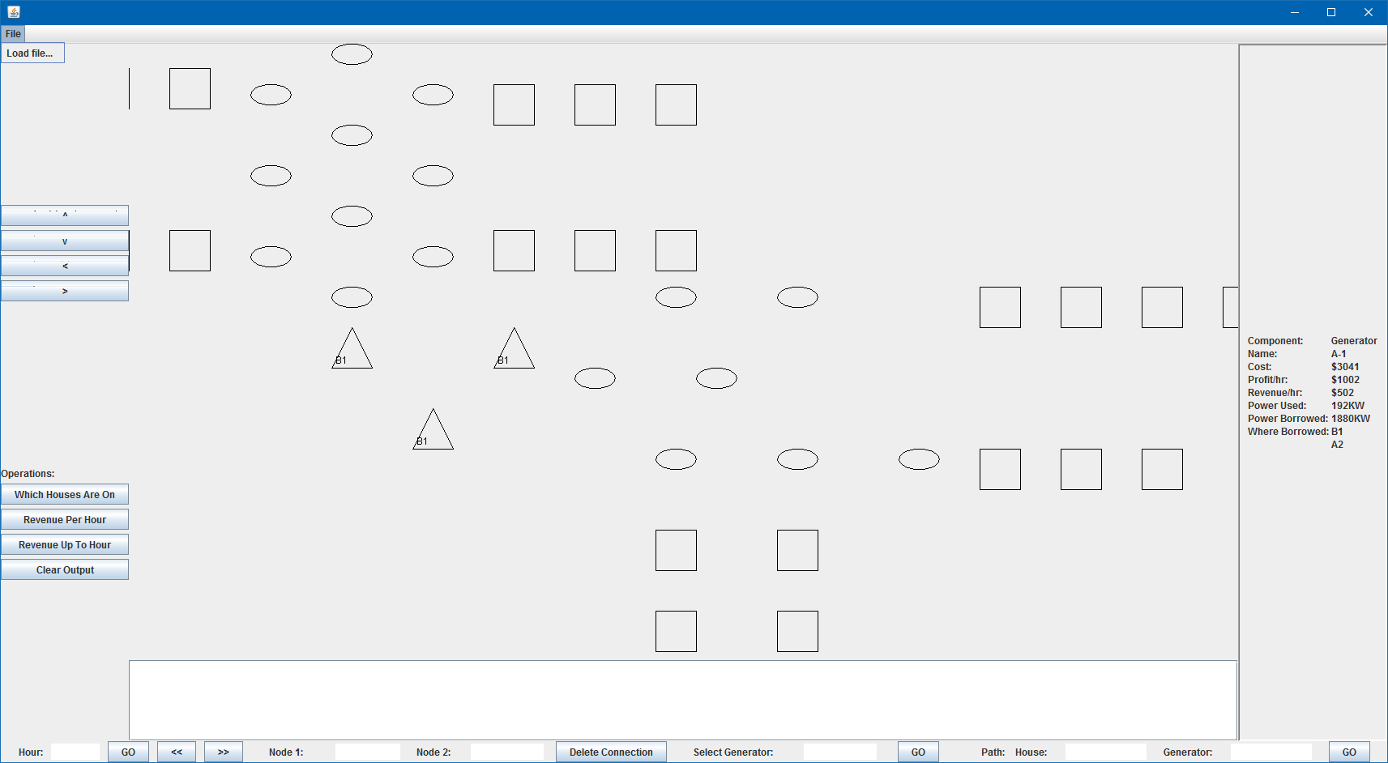

Slide 9
Documentation
Developer README
User Manual
UML Diagrams

Slide 10
Next Steps / Future Goals
Complete grid implementation in GUI
Add extra features

