Slide 1
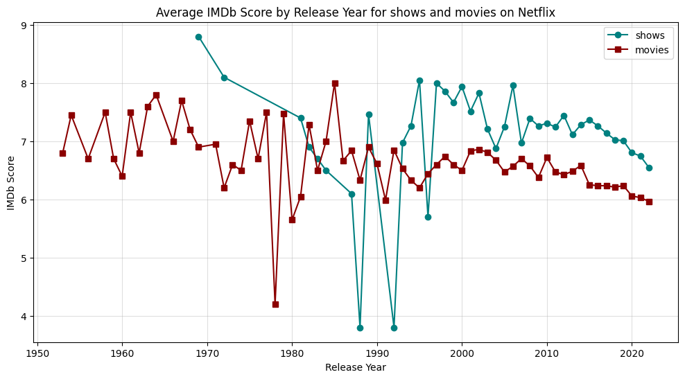
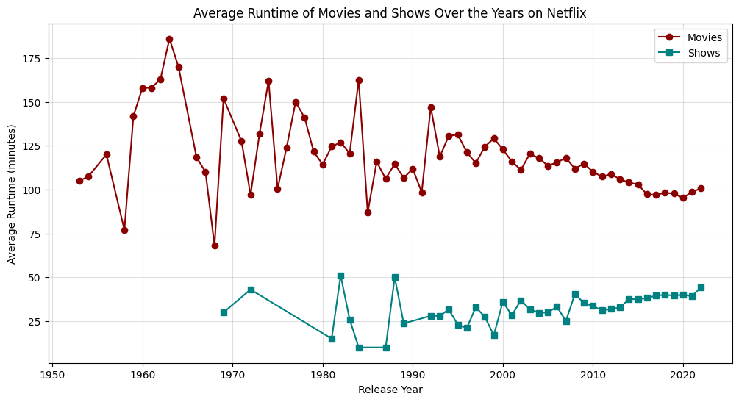
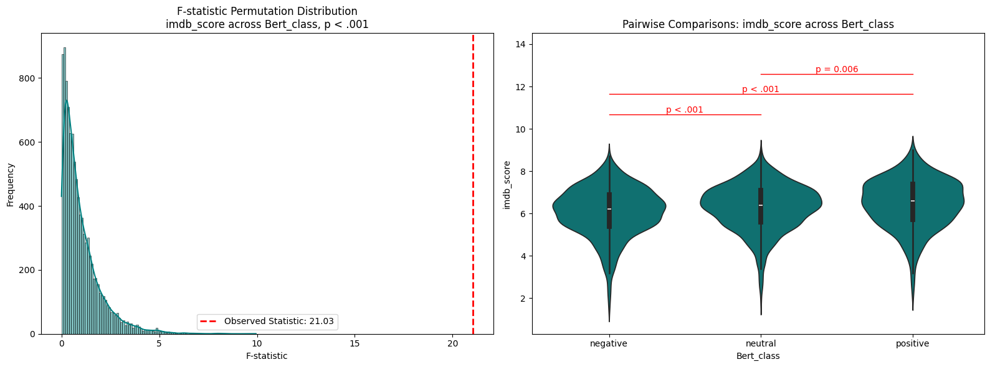
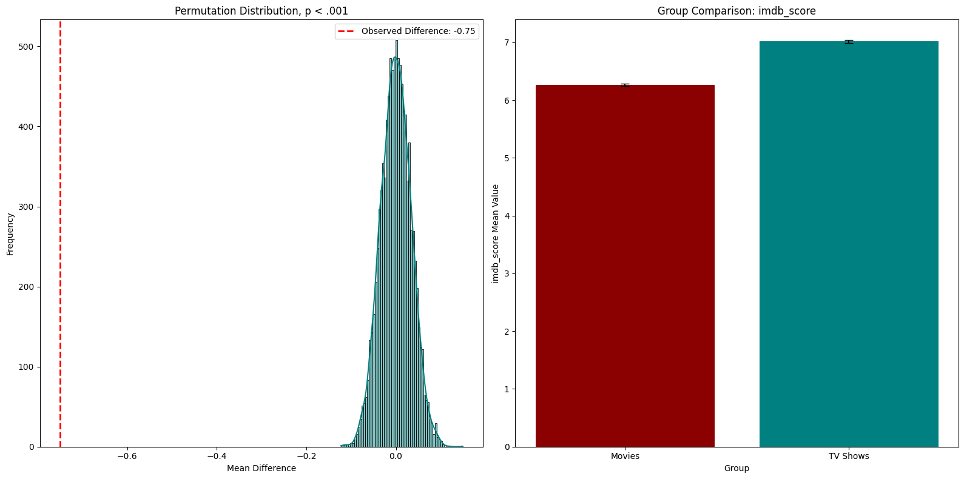

Group 23: Daniel Schipfer • Monika Windhager • Kaniz Fatema • Abdelrahman Ali
TU Graz University - Austria
Research Questions
Do Movies (a) or Shows (b) on Netflix with an older release year have better average IMDb ratings?
Do Movies (a) or Shows (b)* on Netflix with a more positive description get better IMDb ratings?
Do Movies or Shows on Netflix get better IMDb ratings (a) or more IMDb votes (b)* and do they differ in runtime (c)*?
Did the runtime of Movies (a) or Shows (b) that are on Netflix change over the years?
* you can find the answers to these and more research questions on GitHub
Movies: r = -0.43, p < 0.001. Starting from year 2000: r = -0.87, p < 0.001
Shows: r = 0.01, p = 0.956. Starting from year 2000: r = -0.68, p < 0.001
Data and Methods
The dataset used contains information about Netflix’s content as “Titles”, “Types”, “Release Year”, “Runtime”, “Votes”, and “Scores”.
Methods:
1. Pearson Correlation
2. PERMANOVA and Permutation Test
3. Sentiment Analysis using a BART model
Movies: r = -0.41, p < 0.001. Starting from year 2000: r = -0.93, p < 0.001
Shows: r = 0.37, p = 0.019. Starting from year 2000: r = 0.68, p < 0.001
Results
Conclusion
The IMDb score for movies and shows on Netflix is decreasing over the years – either movies or shows get worse or “hindsight bias”.
The runtime for movies is decreasing while the runtime for shows is increasing on Netflix.
More positive movies on Netflix achieve a slightly higher IMDb rating as neutral and negative movies (based on the sentiment of the movies description).
Shows achieve a higher IMDb score compared to movies on Netflix.

