Slide 1

Data Analysis & Visualisation
Informatik 1 – Assignment 2 – Group BG
Matriculation Number
01410690
11723440
51800280
Student
Fabian Müller
Daniel Schipfer
Thomas Walchhofer

Slide 2
Introduction
Imports / Packages
Pandas
Matplotlib
Data
“Risk factors for health” for alcohol consumption and daily calorie intake (OECD-Link)
“Income distribution” for gini coefficient (OECD-Link)
“Annual GDP” (OECD-Link)
GitHub repository
Notes:
First question done, fourth question done, second question -> altered towards sentiment analysis with keywords, third question would be interesting

Slide 3
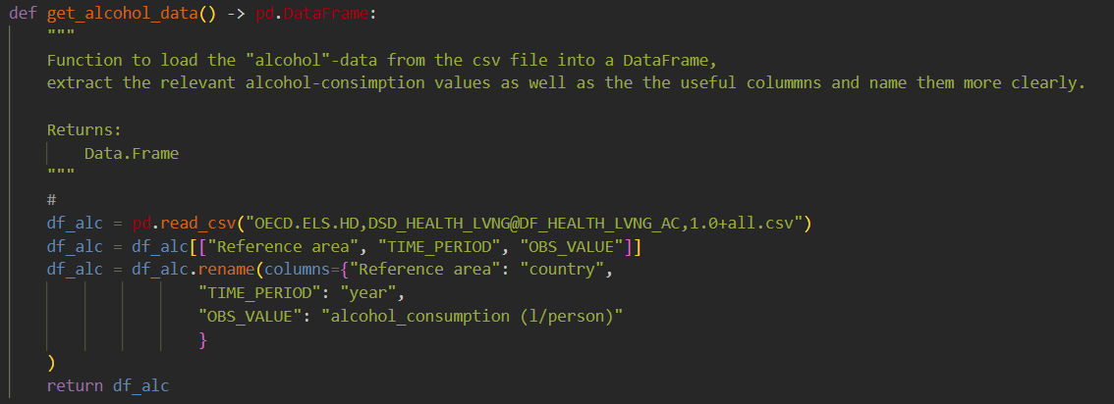
Data Gathering
Notes:
First question done, fourth question done, second question -> altered towards sentiment analysis with keywords, third question would be interesting

Slide 4
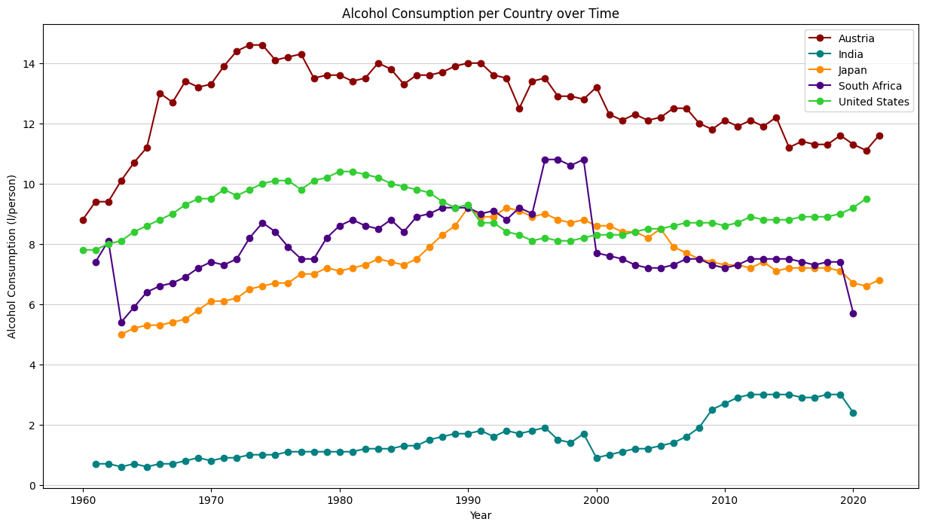
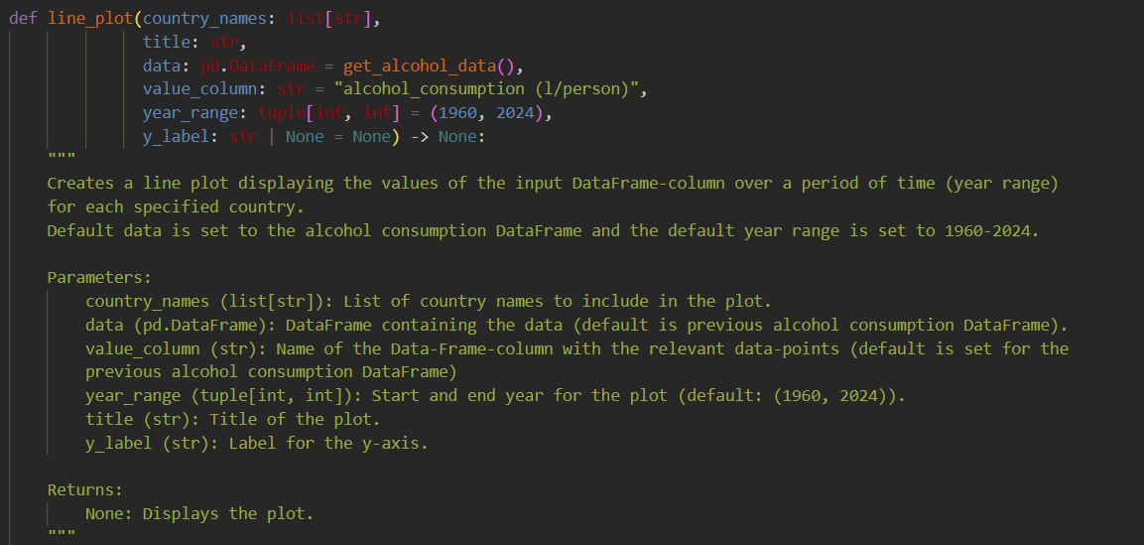
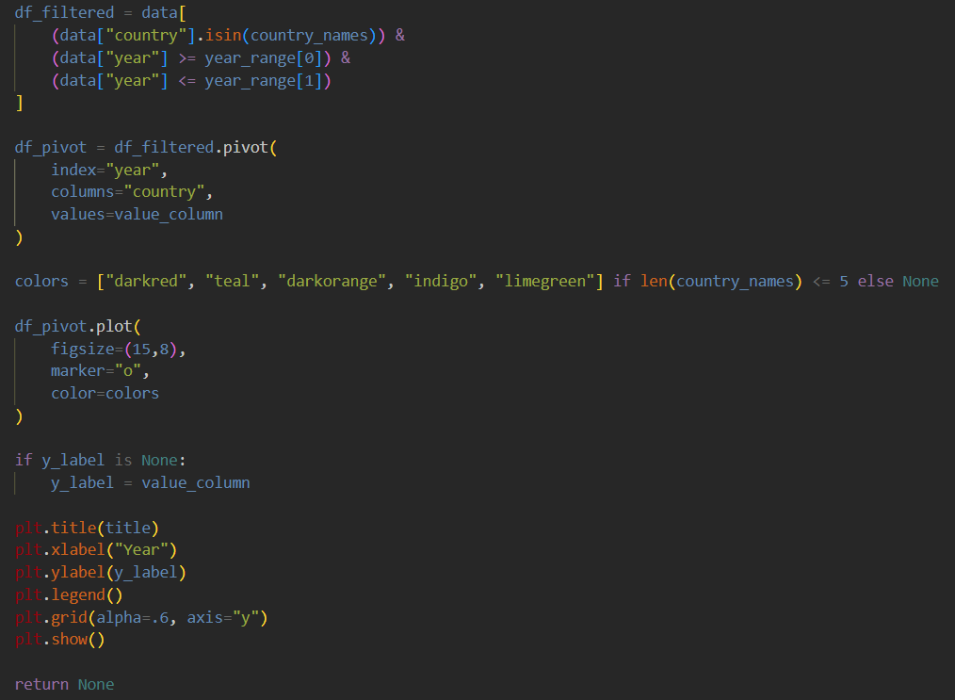
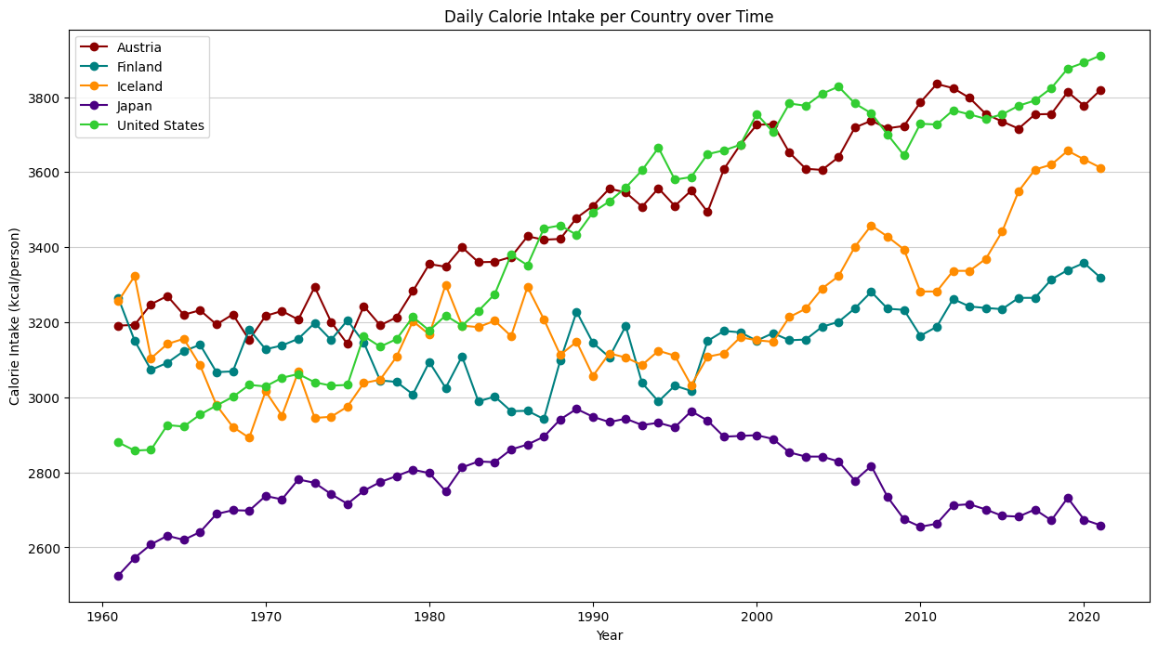
Data Visualisation & Analysis Line Plots

Slide 5
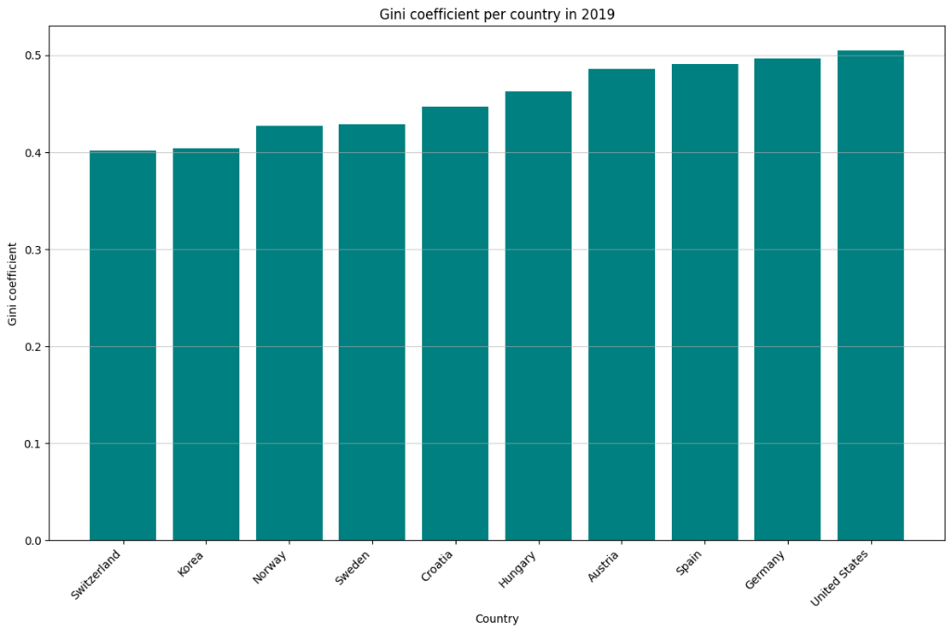
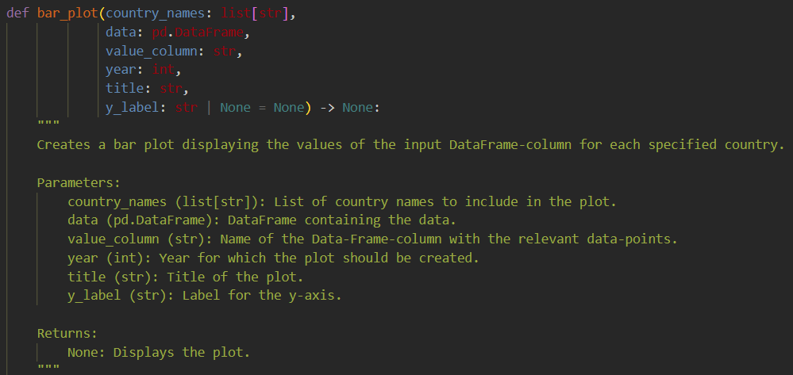
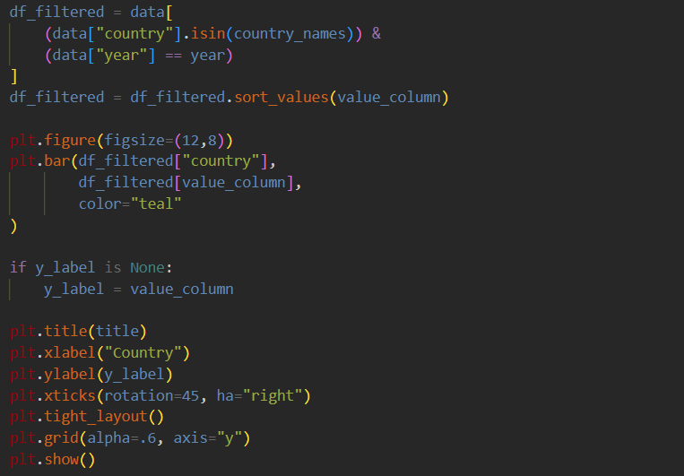
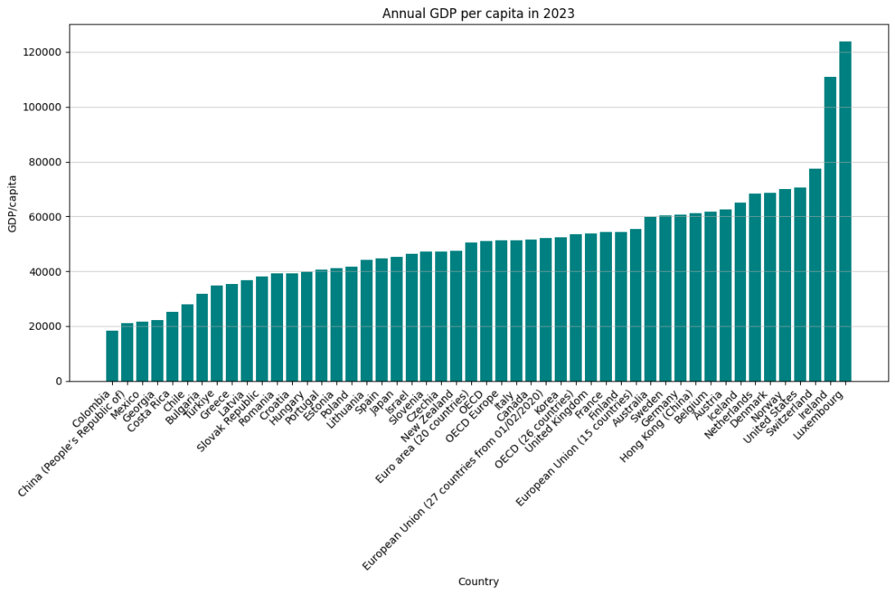
Data Visualisation & Analysis Bar Charts

Slide 6
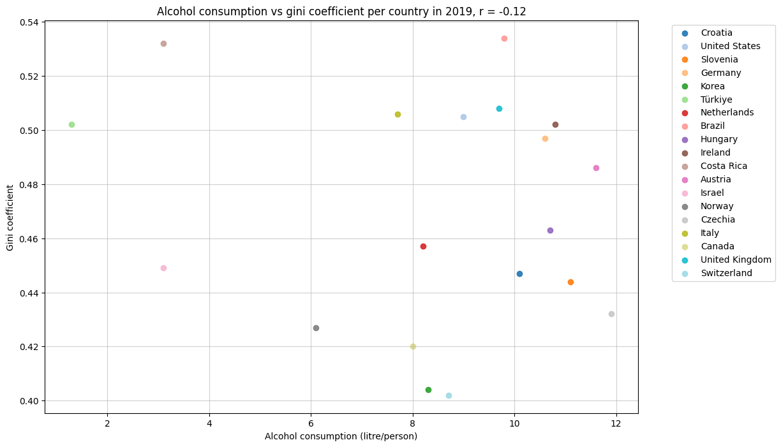
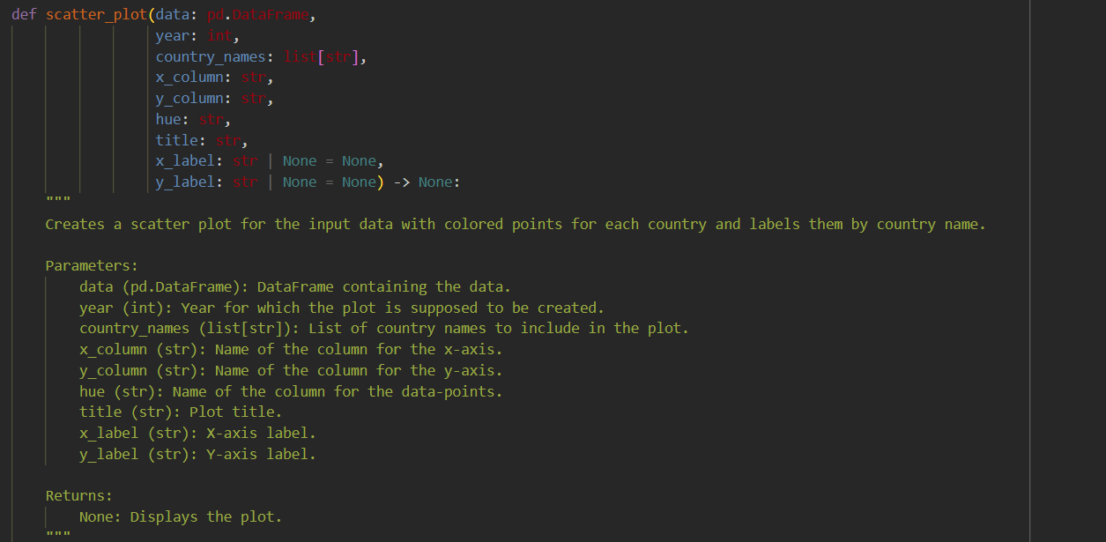
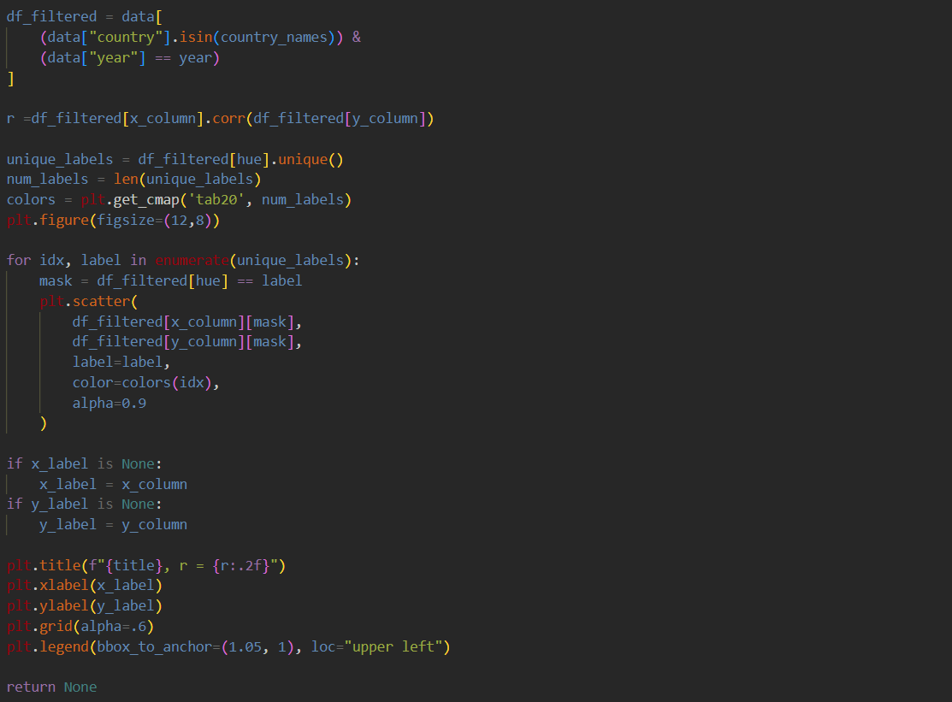
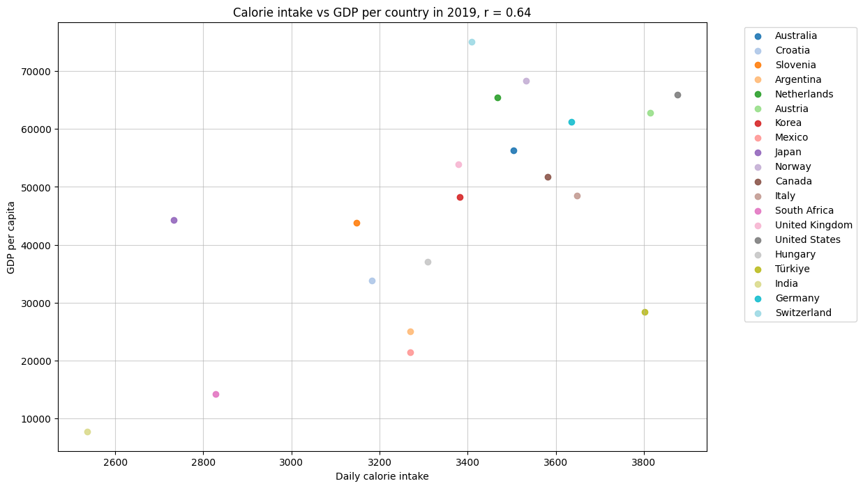
Data Visualisation & Analysis Scatter Plots

Slide 7
Conclusion
This analysis provided a comprehensive exploration of social and economic trends through visualizations.
The modular and reusable design of the code ensured flexibility and efficiency in handling diverse datasets.
The findings reveal some significant patterns, such as the relationship between GDP and calorie intake.
Future work could include deeper analyses, such as regression modeling for the relationship between the GDP per capita and daily calorie intake to gain further insight.
Notes:
First question done, fourth question done, second question -> altered towards sentiment analysis with keywords, third question would be interesting

