Slide 1

Data Analysis & Visualisation
Informatik 1 – Assignment 2 – Group BG
Matriculation Number
01410690
11723440
51800280
Student
Fabian Müller
Daniel Schipfer
Thomas Walchhofer

Slide 2

Introduction
Imports / Packages
Pandas
Matplotlib
Data
“Risk factors for health” (OECD-Link)
→ used for alcohol consumption and daily calorie-intake data
“Income distribution” (OECD-Link)
→ used for Gini-Coefficient
“Annual GDP” (OECD-Link)
GitHub repository
Notes:
First question done, fourth question done, second question -> altered towards sentiment analysis with keywords, third question would be interesting

Slide 3

Data Gathering
Separate Data-Loading-Function for each relevant Data-Set
Example (Alcohol-Consumption-Data):

Slide 4
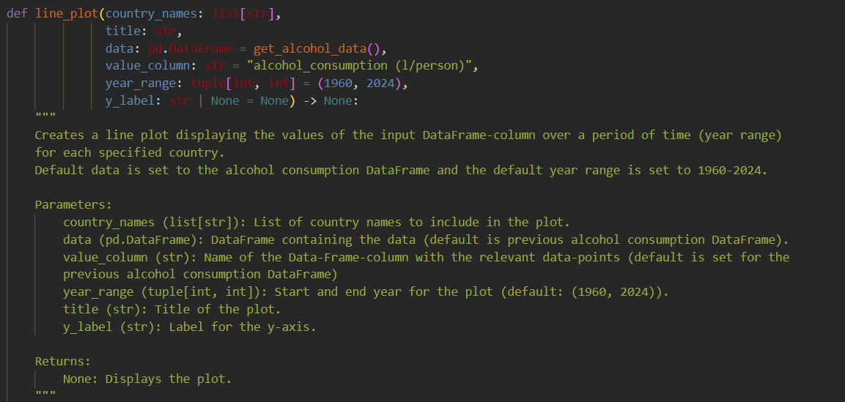
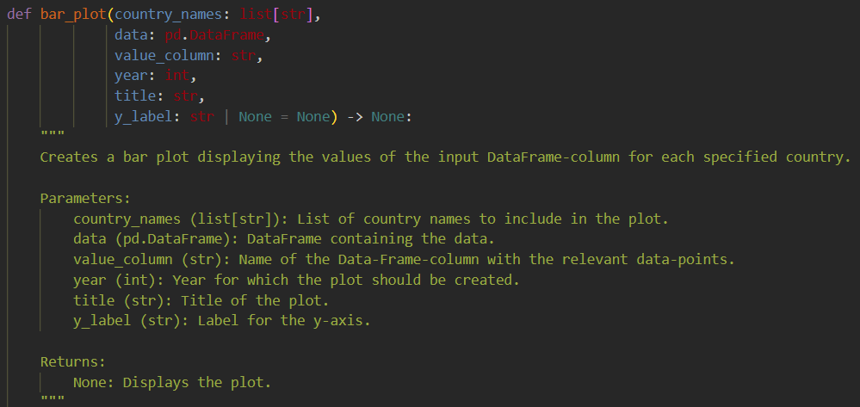
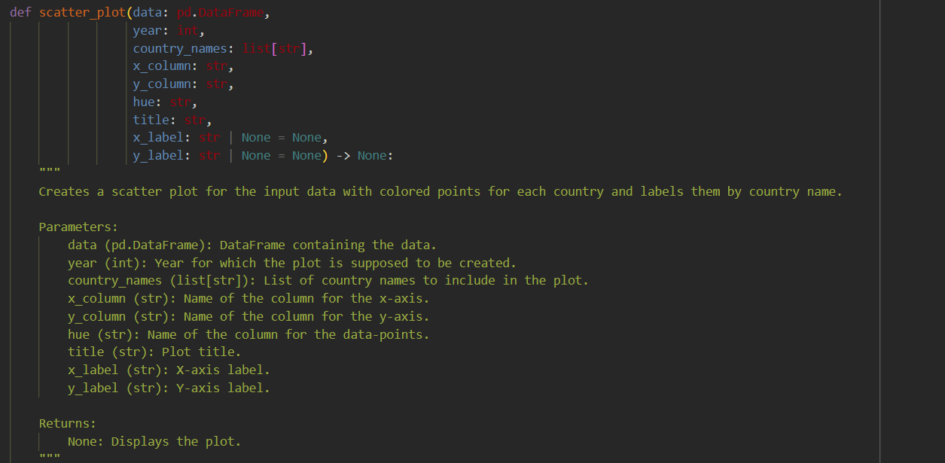



Data Analysis & Visualisation
Line Plot
Bar Chart
Scatter Plot

Slide 5
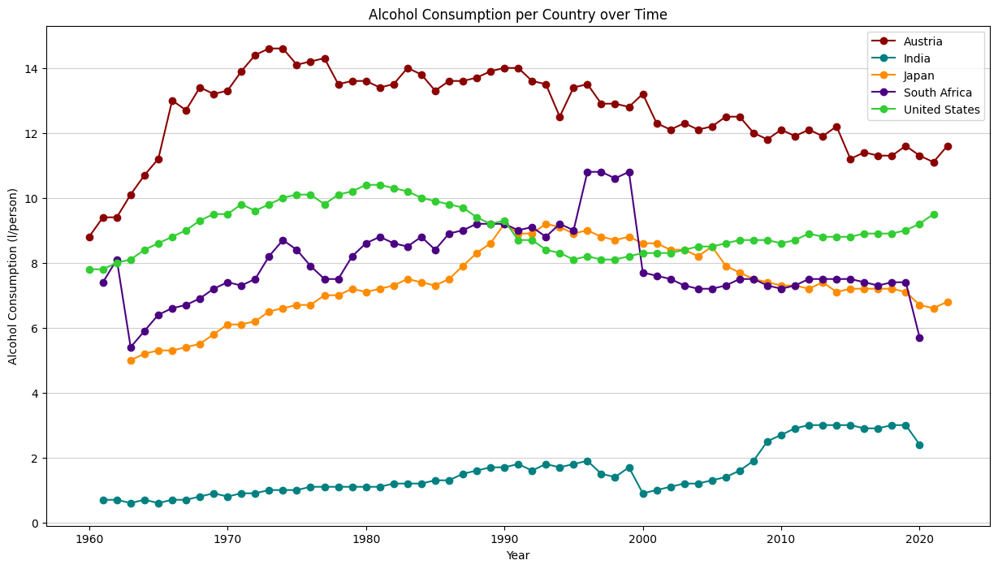
Alcohol Consumption over Time
Data
Alcohol consumption (liters per person) across Austria, United States, Japan, South Africa and India from 1960 to 2024.
Insights
Significant differences in alcohol consumption trends are visible:
Austria shows a consistently higher level of consumption than the other countries
India exhibits the lowest consumption. However, it has been increasing since the year 2000
The United States and Japan show fluctuating consumption patterns
Africa experienced a sharp decline in consumption between 1999-2000
Relevance
Highlights cultural and policy differences affecting alcohol consumption

Slide 6
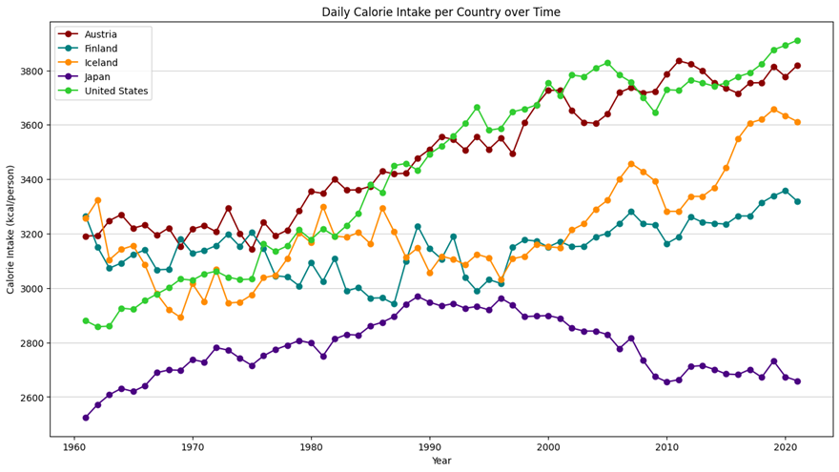
Daily Calorie Intake over Time
Data
Average daily calorie intake across Austria, Iceland, Finland, United States, and Japan.
Insights
While most countries exhibit a gradual increase in calorie intake over time, Japan maintains a relatively stable trend.
Relevance
Highlights the trend in daily calorie consumption across countries.

Slide 7
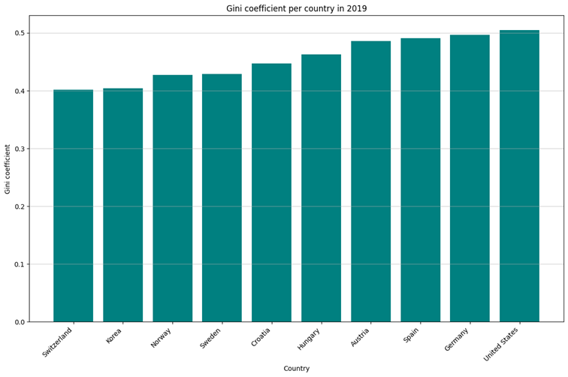
Gini Coefficient per Country
Data
Gini coefficients for income inequality across 11 countries.
Insights
Switzerland, Korea, Norway and Sweden exhibit lower Gini coefficients, indicating better income equality.
Conversely, countries like the United States and Germany have higher values indicating a higher income inequality.
Relevance
Demonstrates disparities in income distribution and potentially economic policy effectiveness.

Slide 8
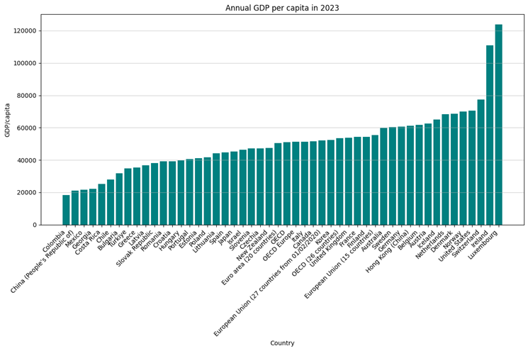
GDP per Capita
Data
Annual GDP per capita across a wide range of countries.
Insights
Countries such as Luxembourg and Switzerland stand out with the highest GDP per capita, reflecting strong economies.
Developing countries like Colombia and China show significantly lower values.
Relevance
Highlights the economic divide and varying levels of development.
GDP as a proxy for the standard of living.

Slide 9
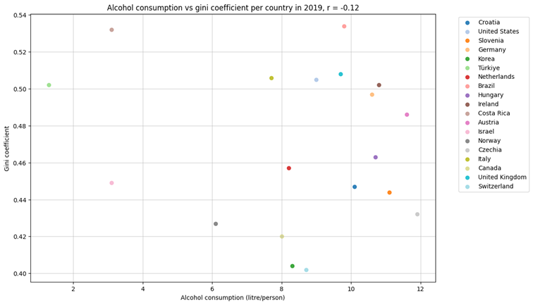
Alcohol Consumption vs. Gini Coefficient
Data
Alcohol consumption (liters/person) and Gini coefficients for income inequality.
Insights
No significant relationship was found between alcohol consumption and the gini coefficient of a country, r = -.12, p = .626 (for the calculation pearson correlation was used)
Visually this can be seen, because the data points appear randomly distributed across the x and y axis.
This suggests that alcohol consumption is not directly influenced by income inequality.
Relevance
This suggests that other factors that weren’t analyzed account for the difference between the alcohol consumption.

Slide 10
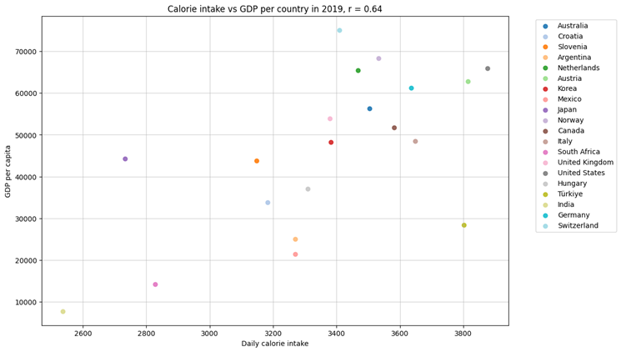
Calorie Intake vs GDP per Capita
Data
Daily calorie intake and GDP per capita for 26 countries.
Insights
Strong positive correlation shows that higher GDP often aligns with higher calorie intake, r = .64, p = .002 (for the calculation pearson correlation was used)
Countries that do better economically tend to consume more calories.
This could be due to the fact that people in economically worse countries might not be able to afford as much food as people from countries with better economic conditions.
A higher standard of living, represented by a higher GDP, most likely correlates with a higher calorie consumption.
The relationship appears to be linear. Linear regression could probably be used to model this data and make predictions.
Outliers, such as Japan, emphasize the influence of cultural and dietary habits
Relevance
This highlights the link between economic prosperity and food availability

Slide 11
Conclusion
This analysis provided a comprehensive exploration of social and economic trends through visualizations.
The modular and reusable design of the code ensured flexibility and efficiency in handling diverse datasets.
The findings reveal some significant patterns, such as the relationship between GDP and calorie intake.
Future work could include deeper analyses, such as regression modeling for the relationship between the GDP per capita and daily calorie intake to gain further insight.

