Slide 1
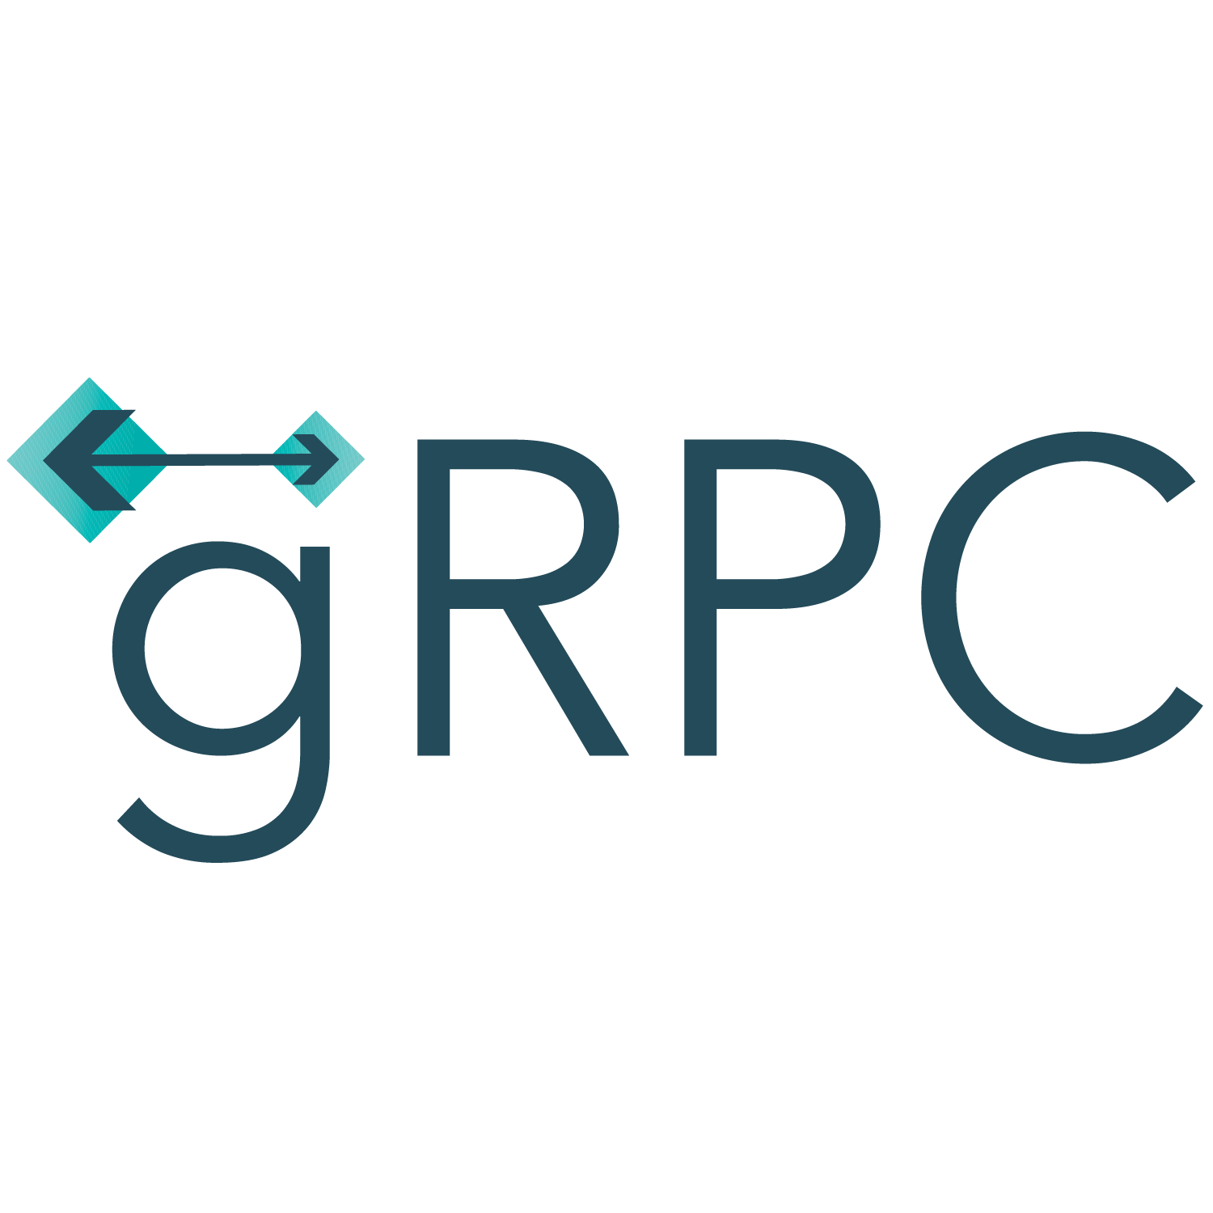
Daniel Schmerber

Slide 2

Agenda
What is gRPC
How does gRPC work
Comparison to Rest/Soap
Where gRPC is used
Demonstration
Inegration to Frameworks
Advantages and Challenges

Slide 3
What is gRPC
Google Remote Process Call / General Remote Process Call
Fast and efficient
Binary format
Supports Bidirectional Streaming

Slide 4
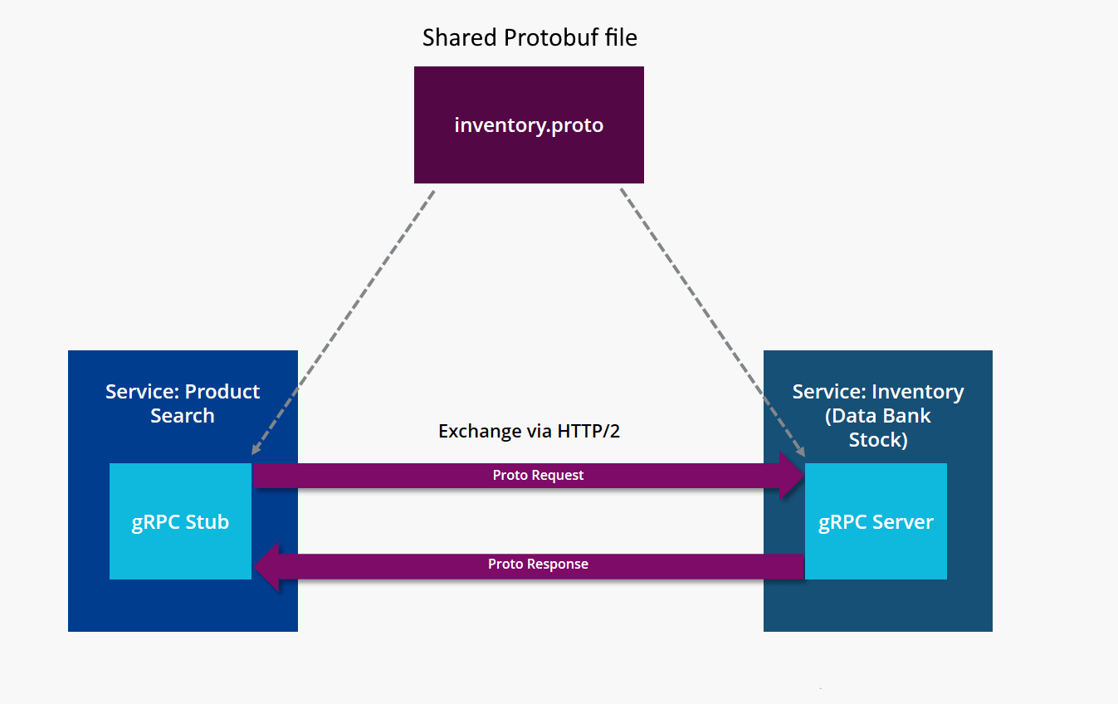
How gRPC works

Slide 5
Protobuf
Existed before gRPC
Based on schema files
Serializes objects into efficient binary format
Up to 90% Smaller than raw JSON
Up to 30% Smaller than zipped JSON

Slide 6
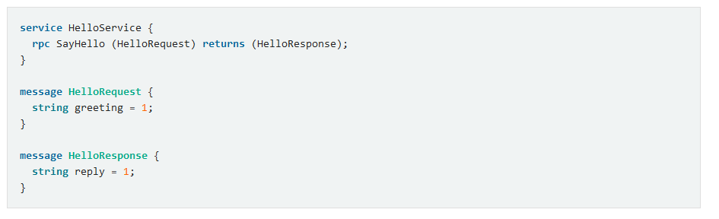
Protobuf
service : define Functions that can be called from the client
rpc : callable function
message: define datatypes

Slide 7
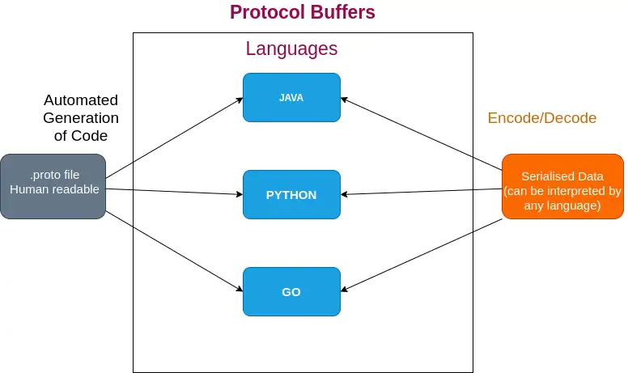
Code generation

Slide 8

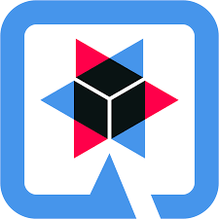
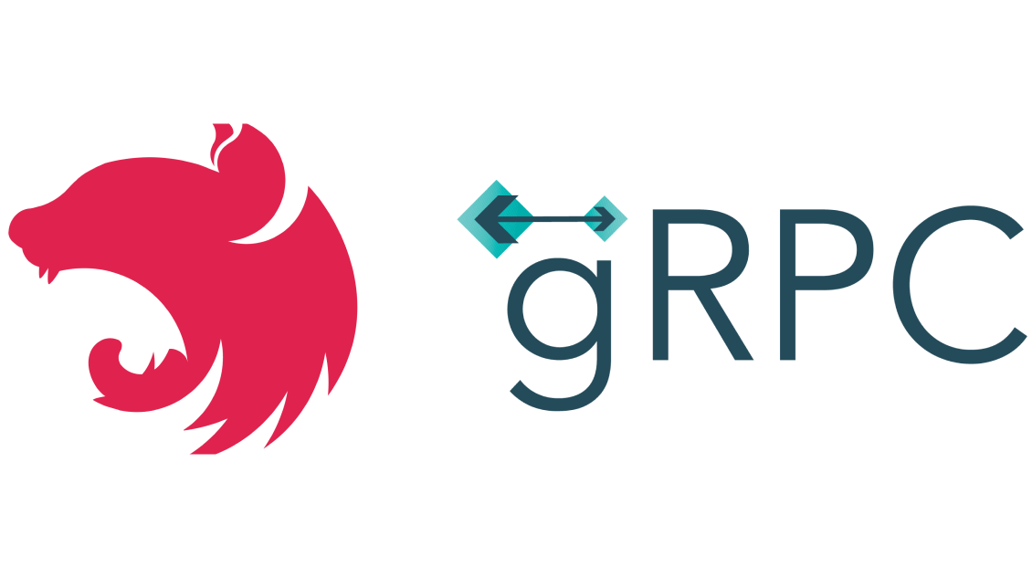
Integration
Most major Frameworks have support for gRPC!

Slide 9




Web?
No Support in major Web browsers!

Slide 10
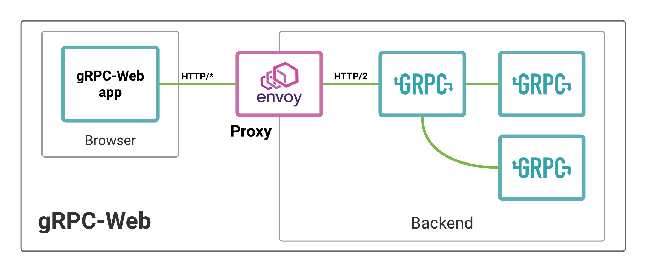
gRPC-Web

Slide 11
Comparison to Rest/Soap
Feature | gRPC | REST | SOAP
Serialization | Protocol Buffers | JSON / XML | XML
Speed | Fast | Moderate | Slow
Accessing Entities | Direct method calls to services Every function documented | RESTful URIs to access resources HTTP Verbs for different functions | Operations defined in XML Every function documented

Slide 12
Advantages
👍Fast
👍Type safe
👍Bidirectional
👍Code generation
👍Polyglot
👍Strong error handling

Slide 13
Disadvantages
👎 Not Human readable
👎 Currently no browser support
👎 Additional Complexity due to Protobuf
👎 Requires shared probuf files

Slide 14
Where gRPC is used
Microservices Architecture
Realtime-Communication
IoT Devices
Interprocess Communication

Slide 15
Where is gRPC used
Docker
Netflix
Dropbox
Google

Slide 16
Demonstration

