Slide 1
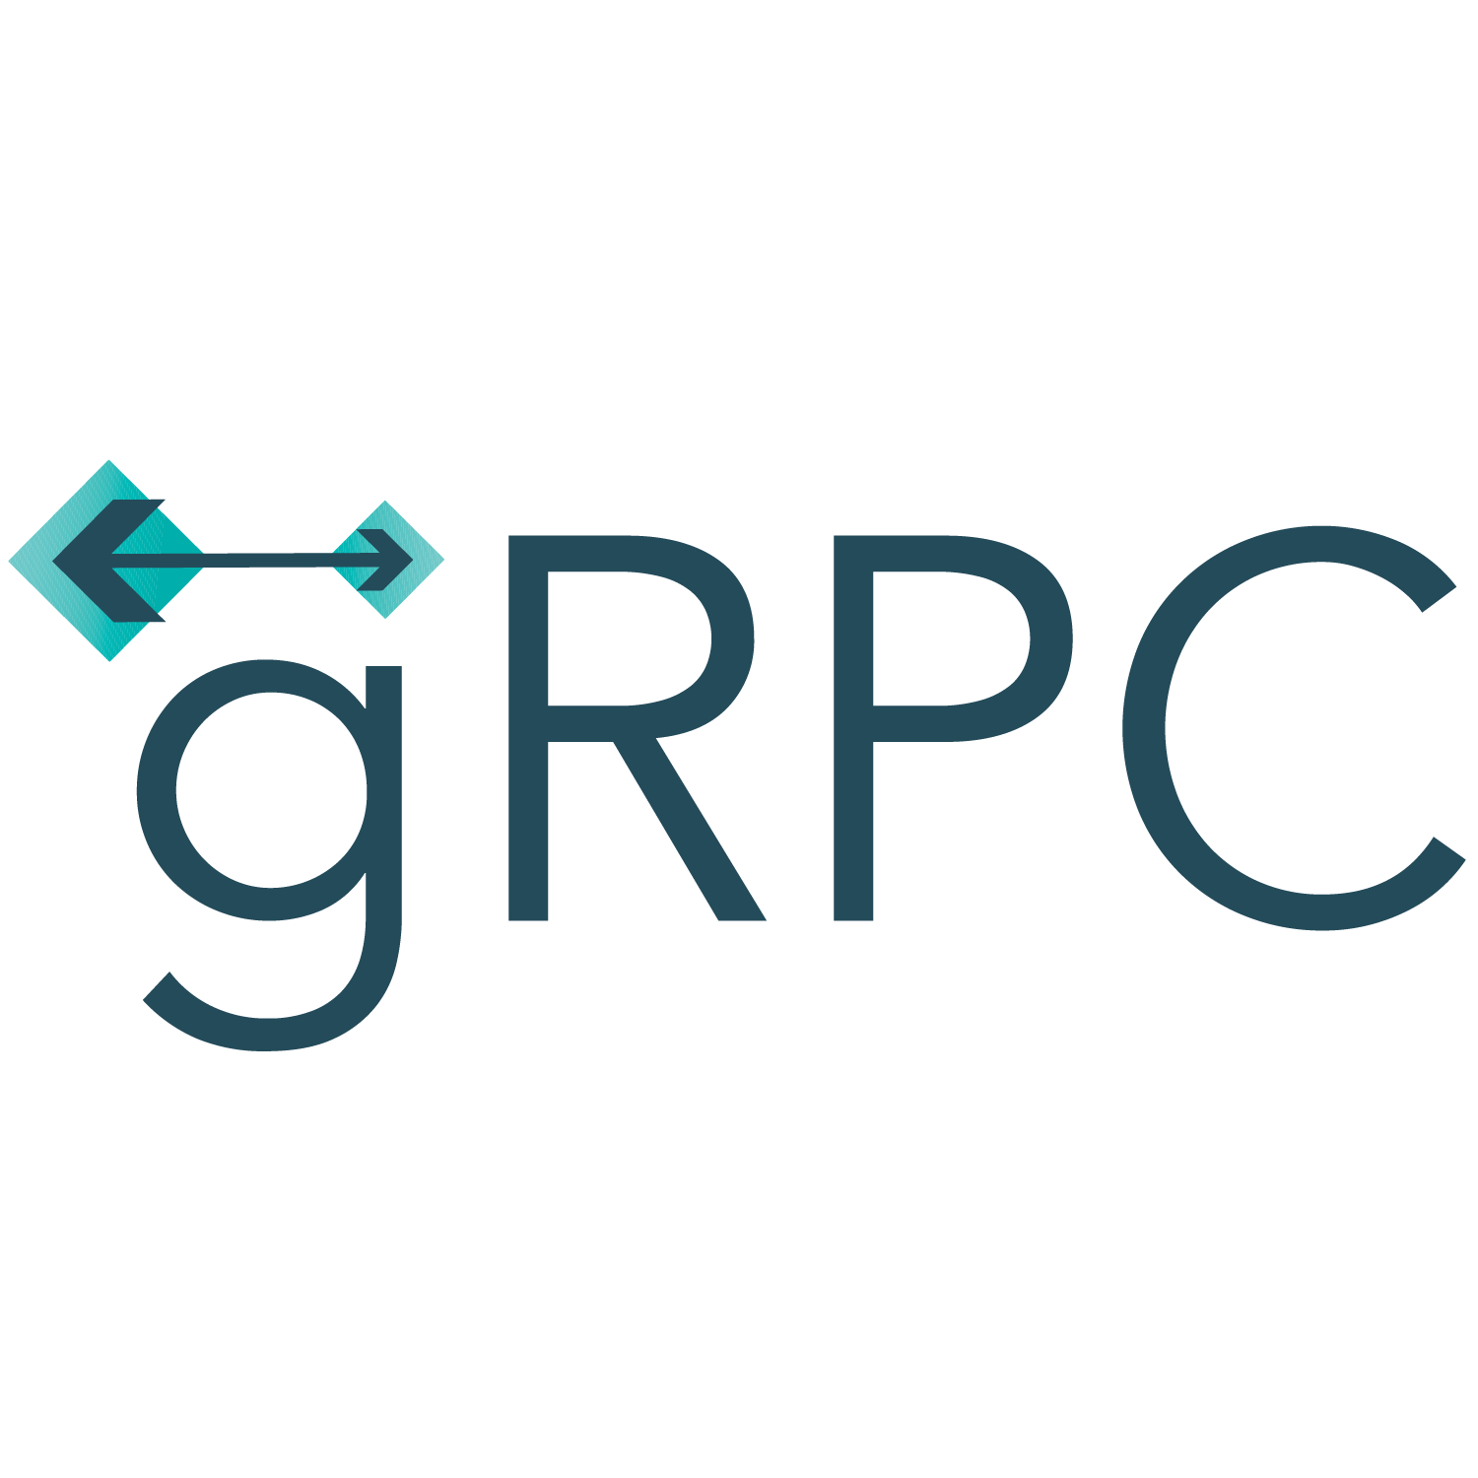
Daniel Schmerber

Slide 2

Agenda
What is gRPC
How does gRPC work
Comparison to Rest/Soap
Where gRPC is used
Demonstration
Integration to Frameworks
Advantages and Challenges

Slide 3
What is gRPC
Google Remote Process Call / General Remote Process Call
Fast and efficient
Binary format
Supports Bidirectional Streaming

Slide 4
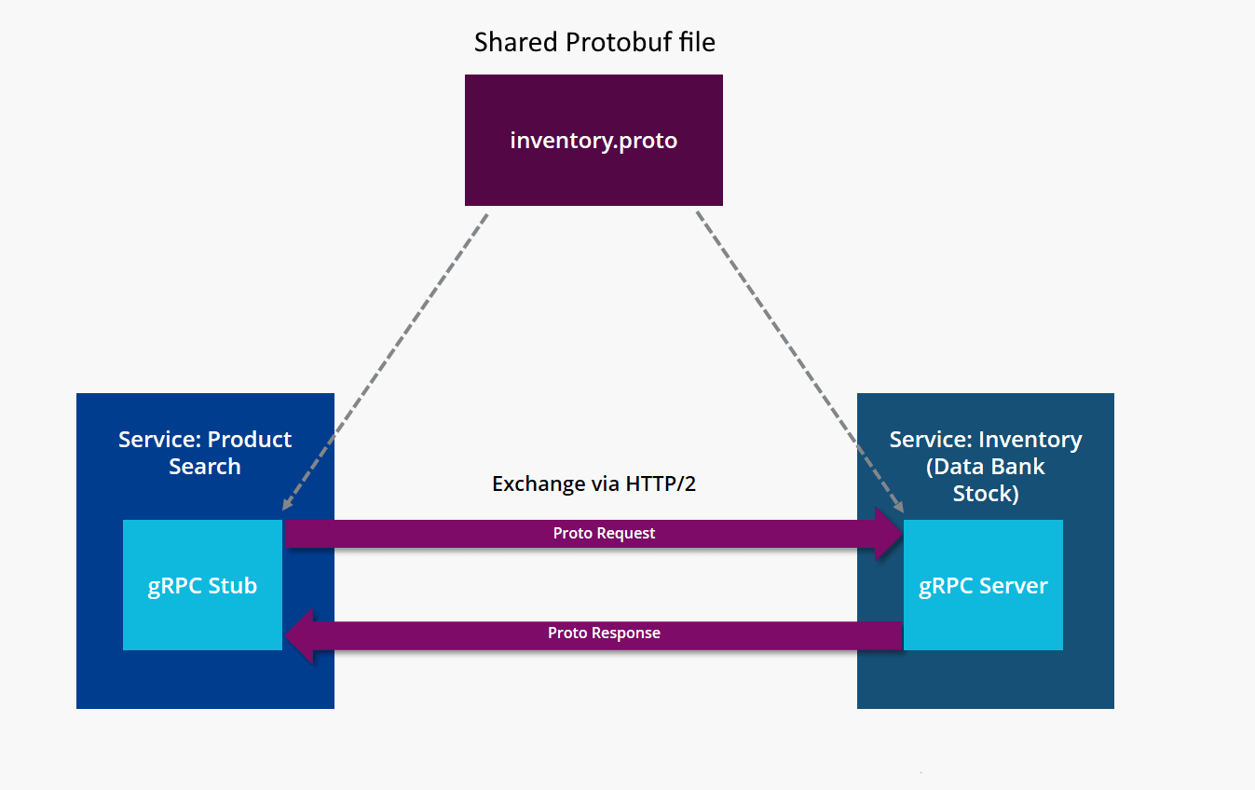
How gRPC works

Slide 5
How does gRPC work
No URIs! -> Protobuf file describes all callable functions and return types
Requests feel like calling „normal“ functions
Shared Protobuf file is required -> Host it on a public repository, or create a „normal“ Endpoint to fetch it

Slide 6
Protobuf
Existed before gRPC
Based on schema files
Serializes objects into efficient binary format
Up to 90% Smaller than raw JSON
Up to 30% Smaller than zipped JSON

Slide 7
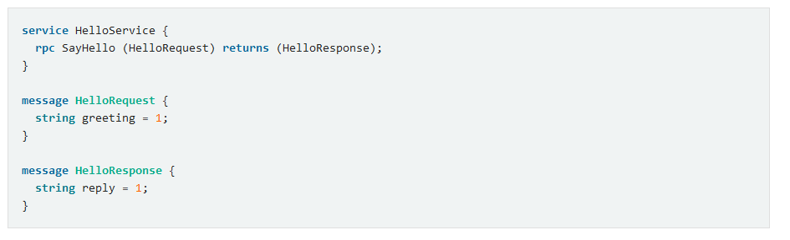
Protobuf
service : define Functions that can be called from the client
rpc : callable function
message: define datatypes

Slide 8
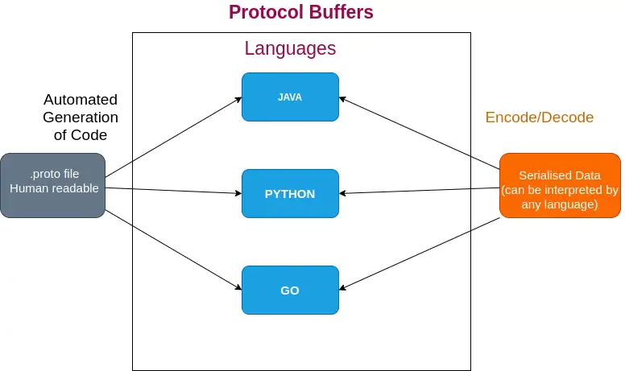
Code generation

Slide 9

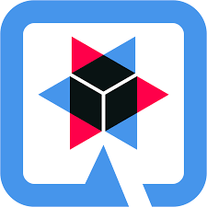
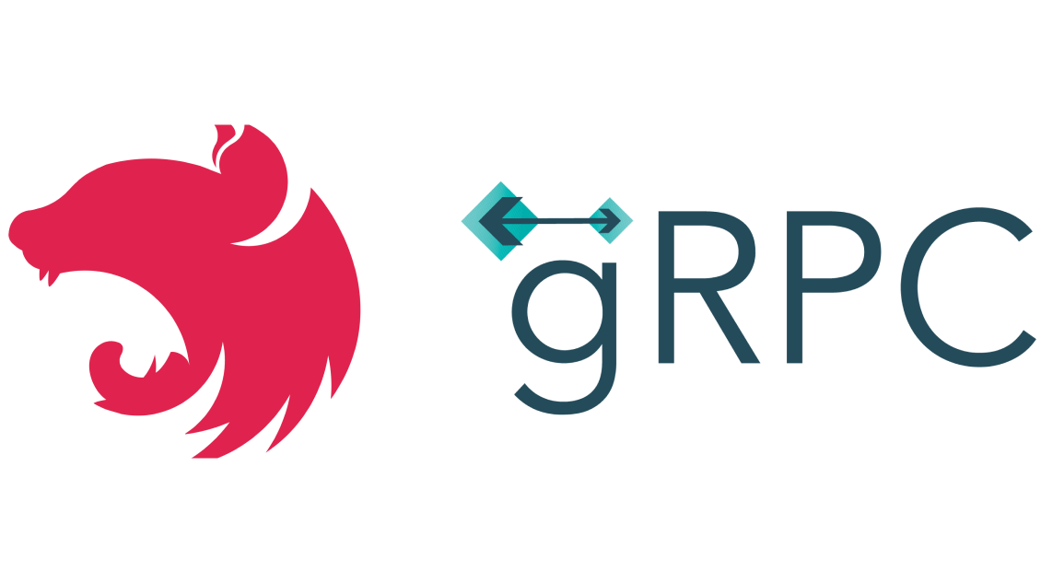
Integration
Most major Frameworks have support for gRPC!

Slide 10




Web?
No Support in major Web browsers!

Slide 11
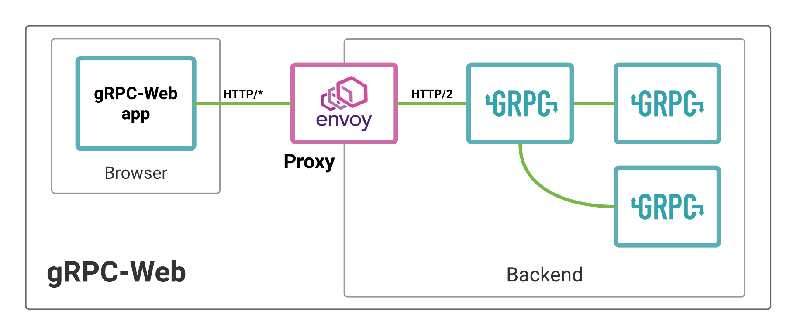
gRPC-Web

Slide 12
Comparison to Rest/Soap
Feature | gRPC | REST | SOAP
Serialization | Protocol Buffers | JSON / XML | XML
Speed | Fast | Moderate | Slow
Accessing Entities | Direct method calls to services Every function documented in Protobuf | RESTful URIs to access resources HTTP Verbs for different functions | Operations defined in XML Every function documented
Error Handling | Explicit Errorhandling in function calls | HTTP Error codes | Soap Fault (XML with error code and error information)

Slide 13
Advantages
👍Fast
👍Type safe
👍Bidirectional
👍Code generation
👍Polyglot
👍Strong error handling

Slide 14
Disadvantages
👎 Not Human readable
👎 Currently no browser support
👎 Additional Complexity due to Protobuf
👎 Requires shared probuf files

Slide 15
Where gRPC is used
Microservices Architecture
Realtime-Communication
IoT Devices
Interprocess Communication

Slide 16
Where is gRPC used
Docker
Netflix
Dropbox
Google

Slide 17
Demonstration

