Slide 1




Light Electronic Action Framework
Veterans Health Administration

Slide 2
What is VA LEAF?
VA LEAF is a secure web application, and Class II VA Software, designed to help facilities rapidly develop common form/workflow solutions
Developed by VA employees to solve common issues
No licensing costs, open source technologies
Centralized server eliminates need for local IT server support
Low maintenance and easy to learn.
Mission: To empower VA employees in digital process improvement.

Slide 3
Solve common issues
Never lose a request
Always know where a request is in the process
Guard sensitive data
Ensure transparency of the process
Improve timeliness of reviewers and implementation
Great user experience saves time and reduces stress
Leverages existing enterprise IT security infrastructure

Slide 4

EXISTING PROCESSES
Data Calls
Resource Committee (FTE)
Vacancy Tracking
Travel Requests
ADMINISTRATIVE
HUMAN RESOURCES
Task Tracking
Org Charting
On-boarding Tracking
Special Projects
Parking Decals
Clinic Profile Management
FCP Requests
OTHER SERVICE LINES
Space Requests
Tuition Reimbursement
VISTA Menu Option Requests
Resource Committees

Slide 5
Case Study: LEAF for Resource Management Committees Salisbury VAMC, December 2016
We examined 50 hiring requests – 23 from the old process and 27 from the new LEAF process.
LEAF made hiring decisions 54% faster, a 26-day improvement
Urgent Access-related positions can now be approved in <24 hrs
Paperless
Transparent Tracking
Nothing Lost
More Focus on Vets
Employee Morale Booster!
Notes:
Exhibit A – The travel memo
This artifacts is demoralizing to our staff.
Be sure to print out.

Slide 6
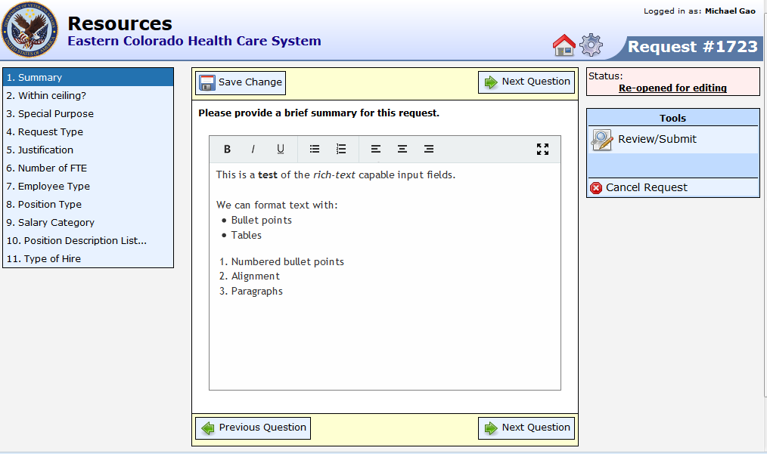
Clean Data Entry
Complex forms can be presented in small and manageable sections
All data fields can be used as search filters

Slide 7
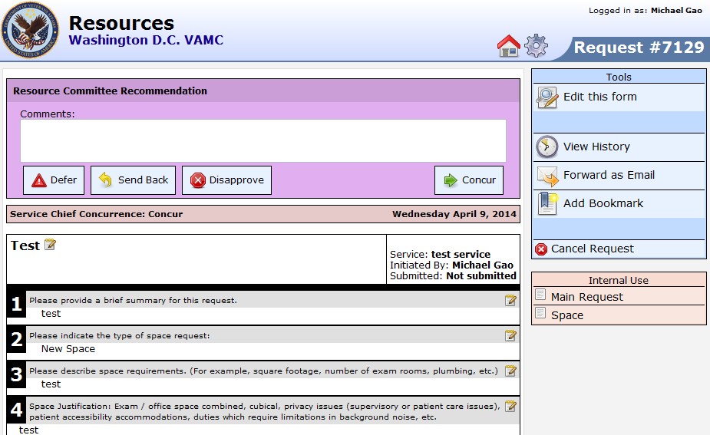
Intuitive Design
Easy to use interface for decision-making
Supports E-mail notifications and other custom events

Slide 8
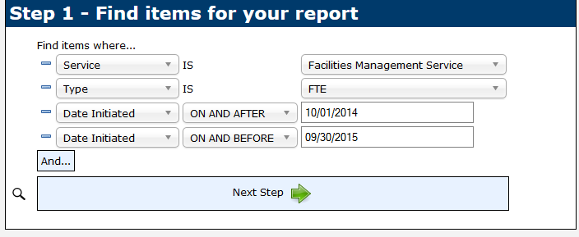
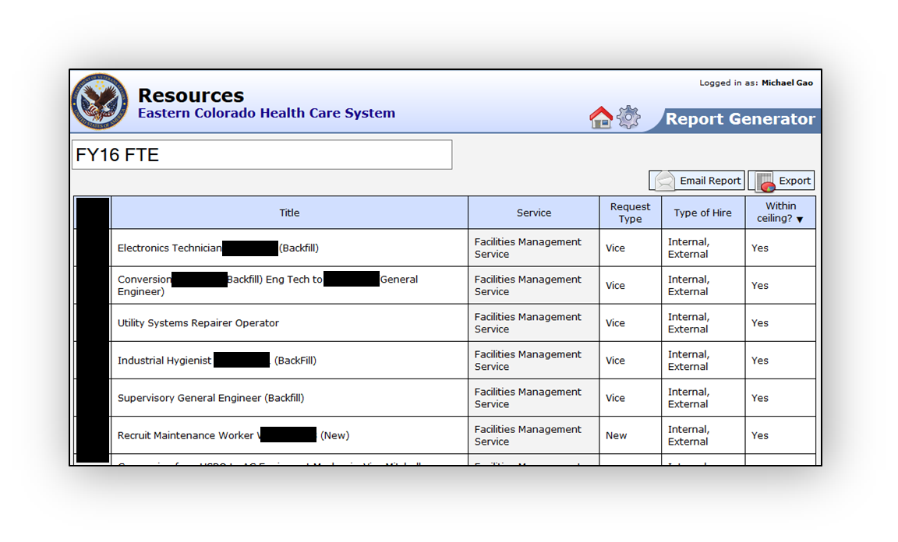
Powerful Report Builder
Build collaborative spreadsheets and dashboards
Always up to date, and easily share reports with others
One-click export to Excel, and JSON API for programmers

Slide 9
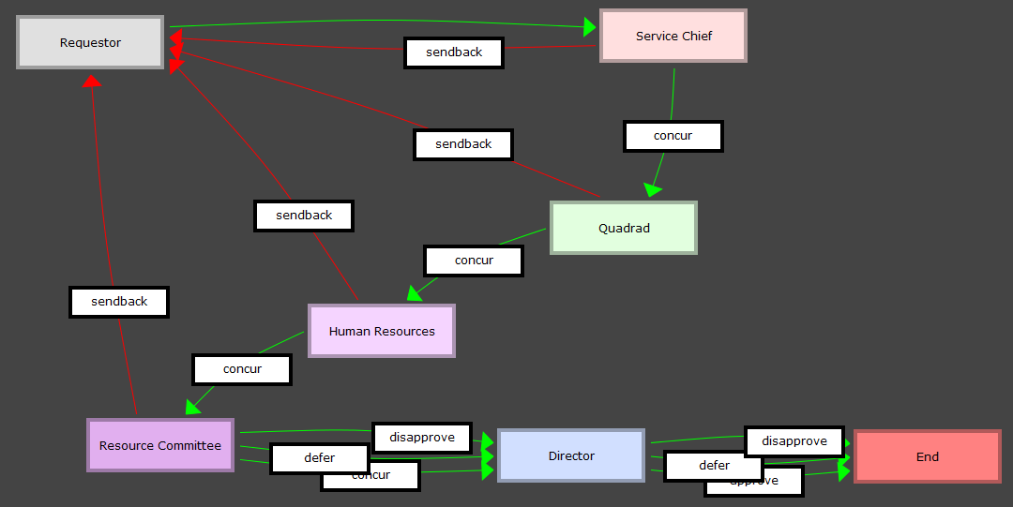
Simple Configuration
Rapid development, iteration, and amendments
Form Library further accelerates implementation
Role-based security identifies authorized users. PIV-card compatible.

Slide 10

Responsibilities
Your Facility
Maintain forms, workflows, privilege groups, and any customizations made
Ensure personnel are apprised of the system
Server maintenance
Backup databases
Fix software issues
Apply software updates

Slide 11
Keys to success
Leadership Buy-in. Inform leadership and obtain buy-in.
Start Small. Start with one specific process in mind.
Project Manager. Technical skills not required. Tech comfort preferred.
Other Key Traits:
Volunteers!
Good communication skills.
Collaborative nature.
Mission: To empower VA employees in digital process improvement.

Slide 12
How to get started
Get started by submitting a request on our Launchpad site:
https://vhav05webrm.v05.med.va.gov/LEAF/launchpad/
Our Launchpad site was built using LEAF!

