Slide 1
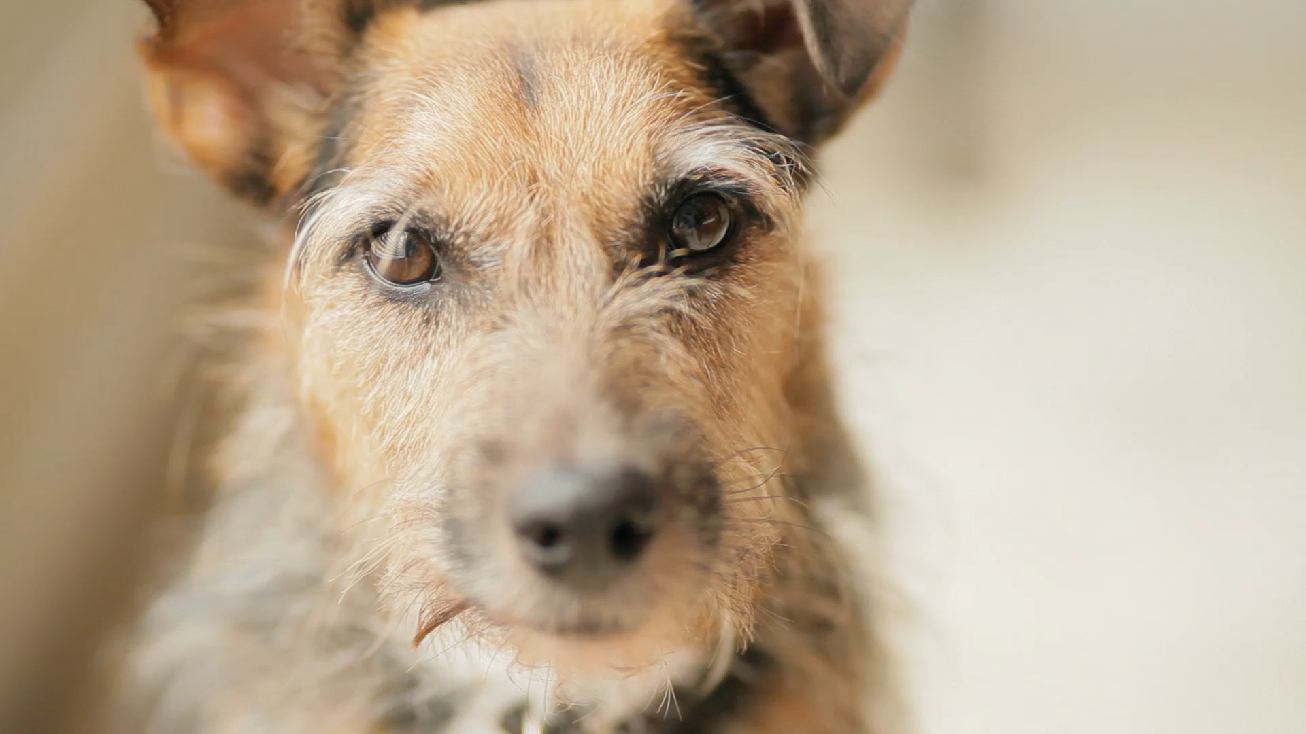
Project 1: Vet Clinic Registration let a human add their dogs to a clinic’s system
daniel shiloh

Slide 2
What Went Right
Wrote outline first
Pseudocoded logic

Slide 3
What Needs Improvement
Time management
Late-stage additions

Slide 4
Risk and Change Management
Added multiple-dog entry
(after setting it up for one dog only)

Slide 5
Actionable Advice
Stick to plan
Set a timer

