Slide 1

Google Fit
App Developer View
Prepared for Personal Analytics Meetup
By Gene Leybzon, Aug 2014

Slide 2
Applications That Can benefit from integration with Google Fit API
Health/Fitness Data Collection
Wearable Sensor-based apps
Health/Fitness Behavior Analytics
Statistical/Personal Analytics

Slide 3
What’s in Google Fit?
Google Fit APIs
Permissions/User Controls
Data Store
Sensor Framework

Slide 4
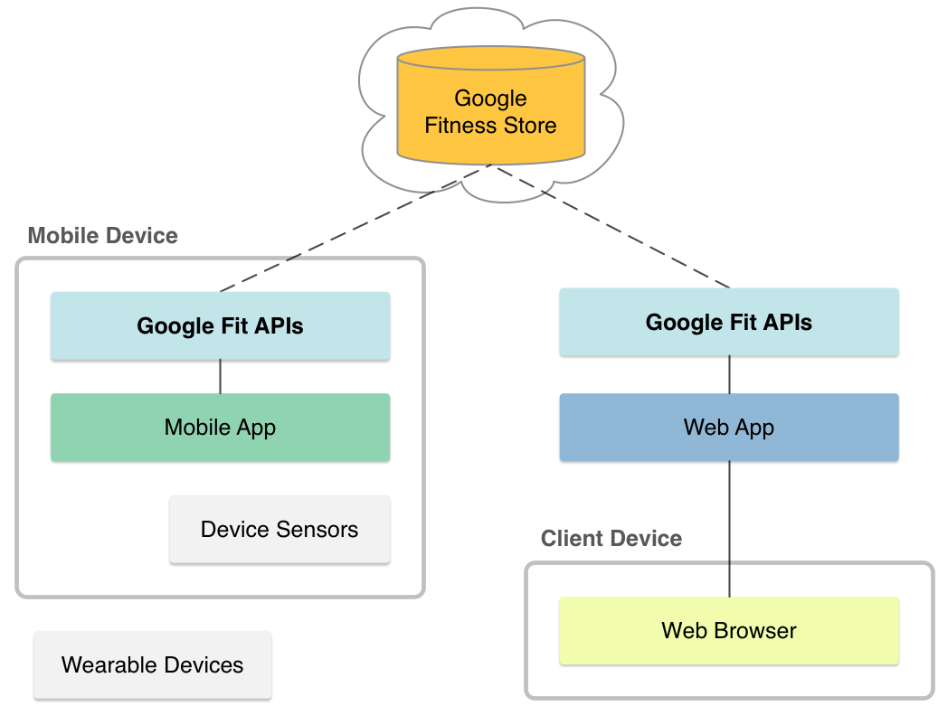
Google Fit Architecture
Notes:
Fitness store is the cloud service

Slide 5
What’s defined in Android APIs?
Sensor APIs
(access to raw sensor data)
Recording APIs
(Subscriptions for data storage)
History APIs
(Bulk operations on recorded data)
Notes:
Google defined two sets of APIs:
- Android APIs
- REST APIs

Slide 6

Data flow from sensor to Fitness Store
Sensors
(Android or BTLE-connected)
Sensor Adapters
Fitness
Recording API

Slide 7
Data Types
Defined by Google
Custom
Custom

Slide 8
Examples of Data Types Defined by Google
Name | Description
com.google.height | User’s height [m]
com.google.speed | User’s speed [m/s]
com.google.heart_rate.bpm | Heart rate [beats per min]
com.google.heart_rate.summary | Max/Min/Average Heart rate [beats per min]

Slide 9
Creating Custom Data Types
Create data type request using data type builder
Invoke request using history API
Check Result (asynchronously)

Slide 10
Working with fitness data
Subscribe to fitness data
List subscriptions
Unsubscribe
Start recording session
Stop Recording session

Slide 11
Working with fitness history
Read historical data
Insert data set
Delete data

Slide 12
Access to the row sensor data
List data sources
Register a new listener
Unregister listener
Scan available BT devices
Claim BT device
Release BT device

Slide 13
What is missing?
Structured data support for more data types
Local storage (on device)
More advanced data aggregation, statistical features
Support for other eco-systems (iOS)

