Slide 1
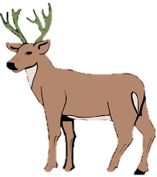
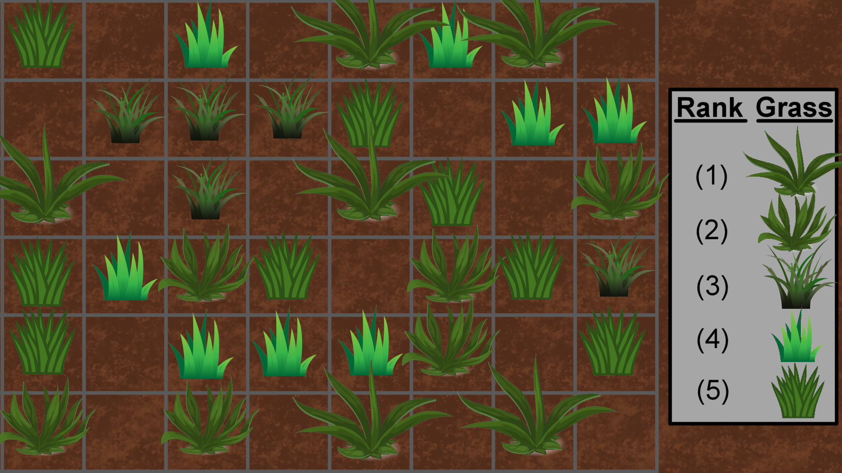

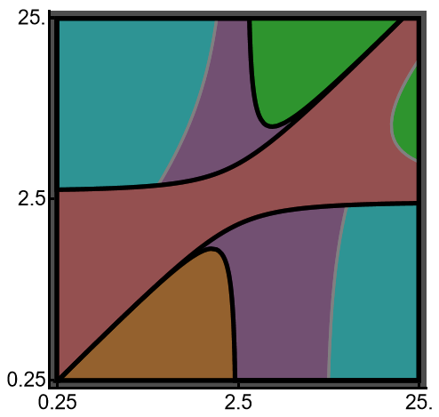
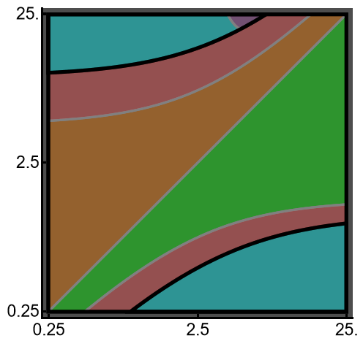





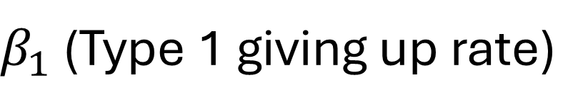
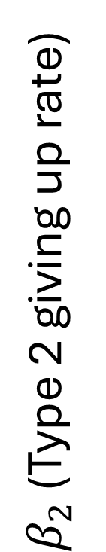
A
Occupied patch
B
$R_{1,E}^{∗}/$ $R_{2,E}^{∗}=1.2$ ; $a_{1}>a_{2}$
$R_{1,E}^{∗}/$ $R_{2,E}^{∗}=1.2$ ; $τ_{1}>τ_{2}$
Type 1 wins
Coexistence
Patch with
Resource
Coexistence
Type 2 wins
Type 2 wins
Coexistence
Type 1 wins
Coexistence
Empty patch
$β_{2}$ (Type 2 giving up rate)
Hawk-Dove
Coexistence
Hawk wins
Hawk-Dove
Coexistence
Competition-
Colonization
$R^{∗}$ Rule
Contested
patch
$R^{∗}$ Rule
Dove wins
Hawk wins
Hawk-Dove
Coexistence
“Submission-
Discovery”
Searching individual
(no resource)
$R^{∗}$ Rule
Dove wins
Hawk-Dove
Coexistence
$β_{1}$ (Type 1 giving up rate)
Notes:
And, finally patches with a resource and 2 consumers that are in a contest for the resource – this is how interference competition in integrated into the model.

