Slide 1
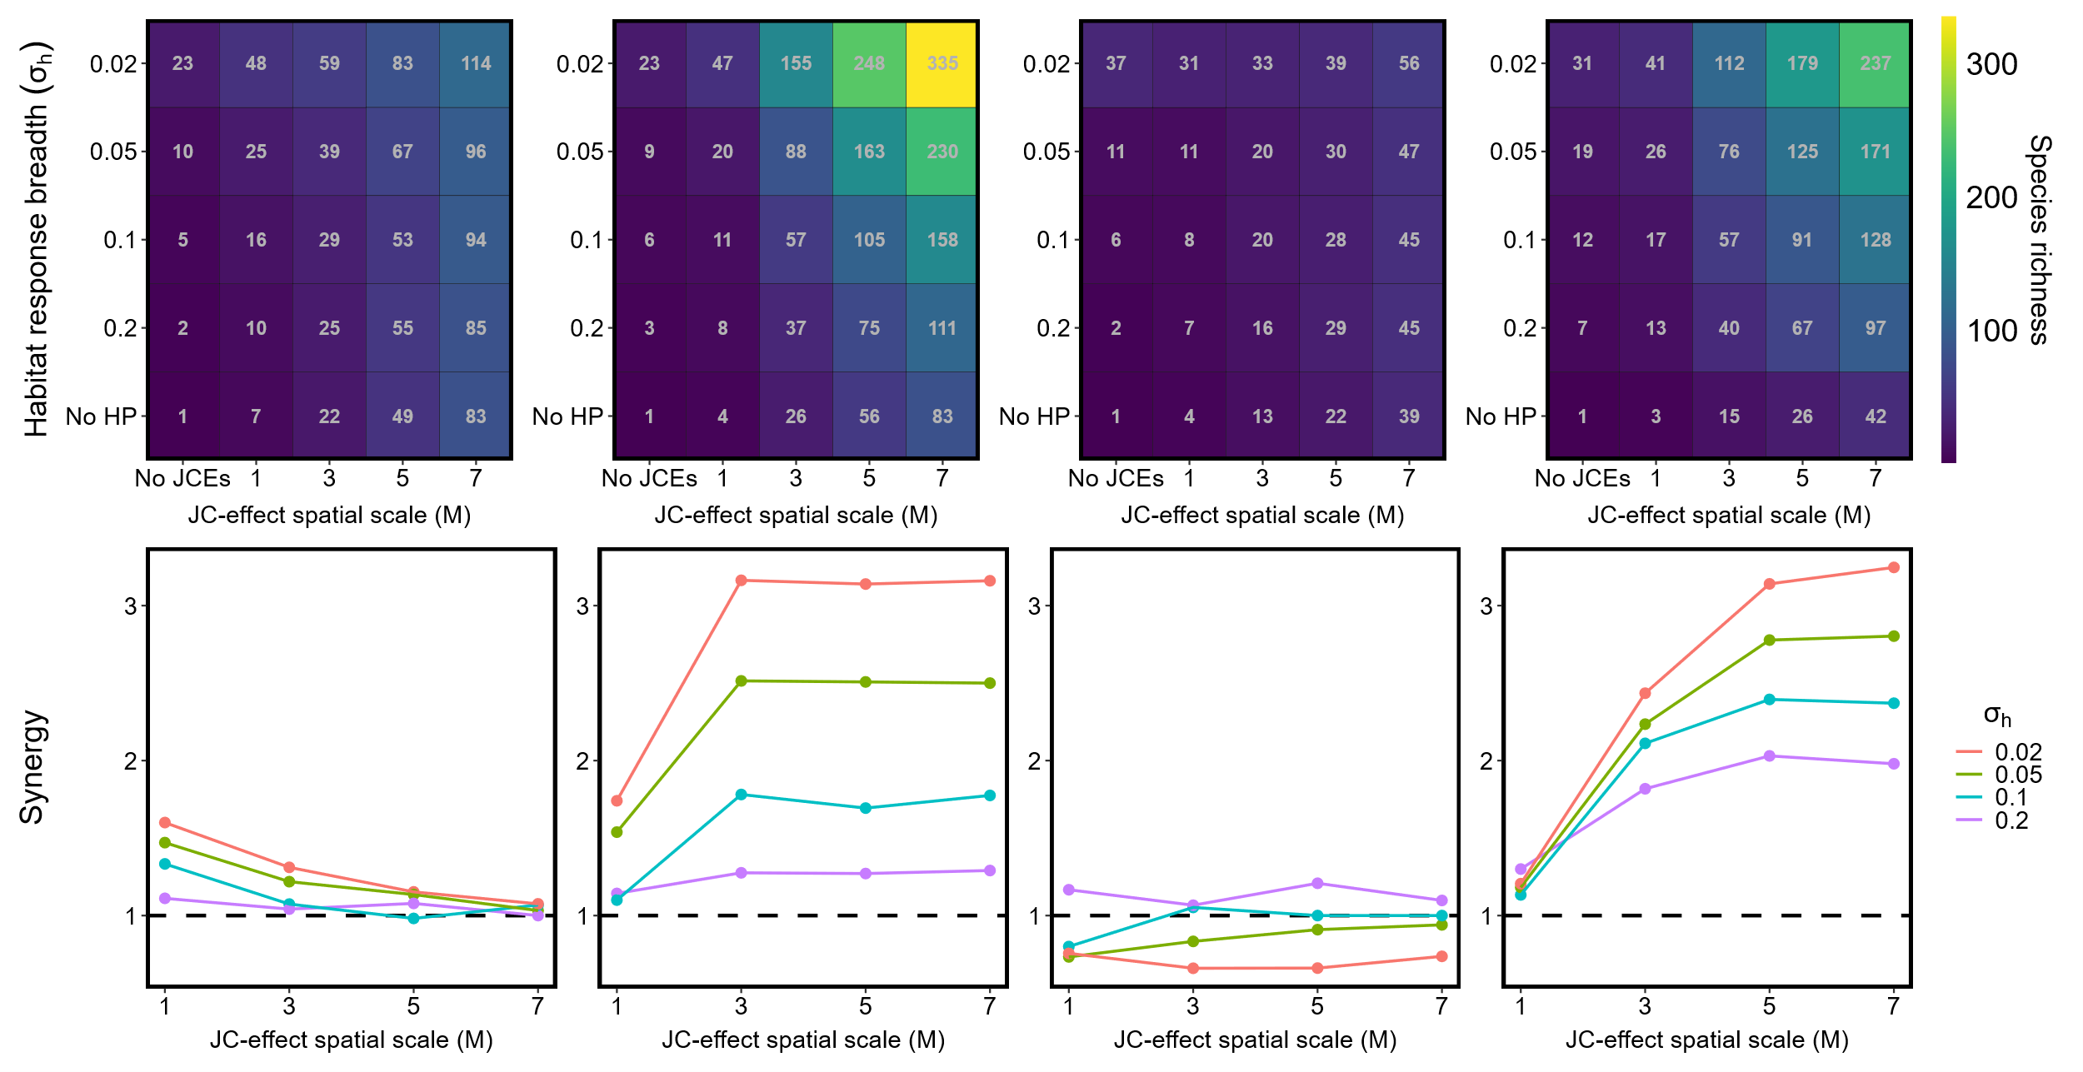




Low autocorrelation; $σ_{D}=∞$
High autocorrelation; $σ_{D}=∞$
Low autocorrelation; $σ_{D}=1.5$
High autocorrelation; $σ_{D}=1.5$
A
B
C
D
E
F
G
H

