Slide 1
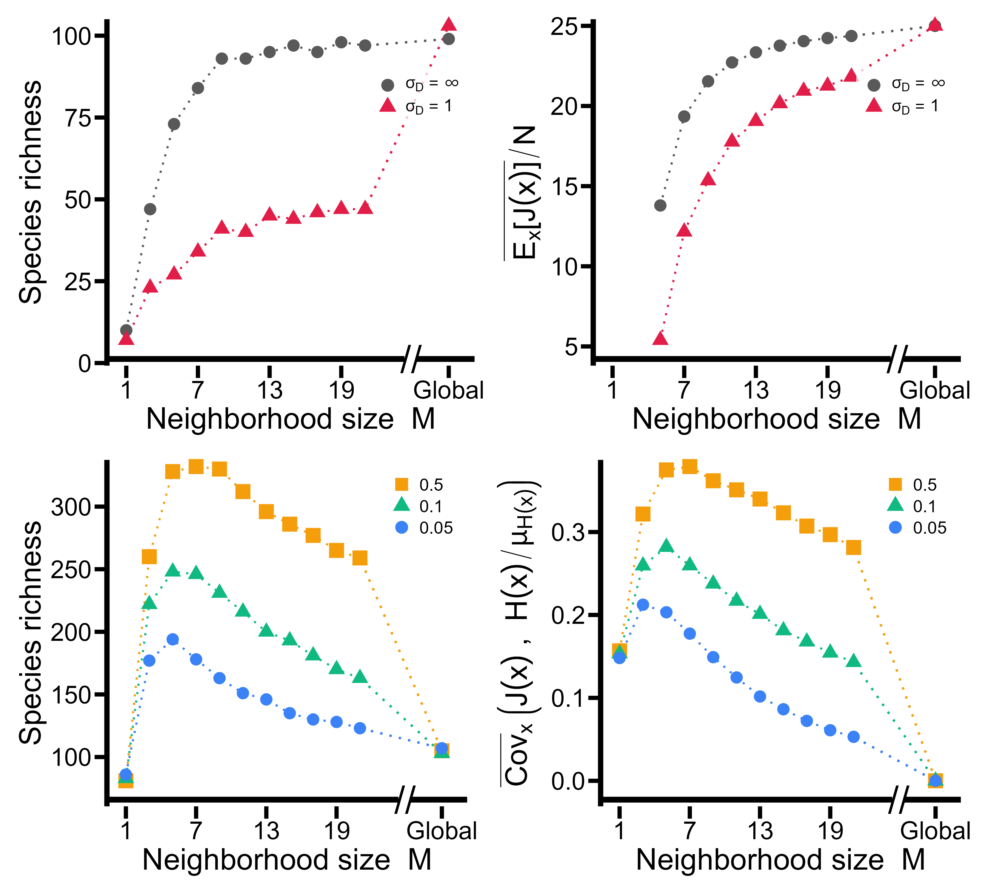
A
B
JC-effects only
C
Range
D
Range
JC-effects and HP

