Slide 1
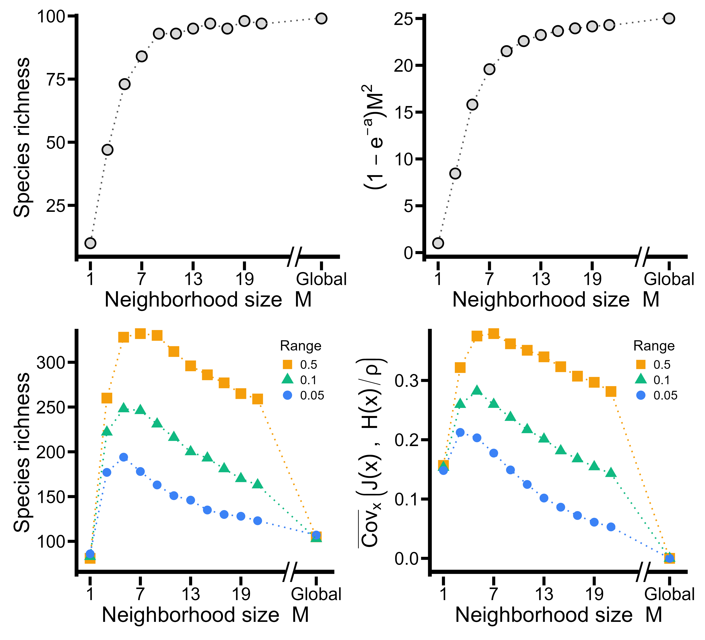
A
B
JC-effects only
C
D
JC-effects and HP

