Slide 1
Bing Maps API Project
Coded by Daniel Spiering

Slide 2
Map Functionality
Search for points of interest in the area
Filter search by a user drawn polygon
Get directions from your location to a chosen point of interest
Log visited locations

Slide 3
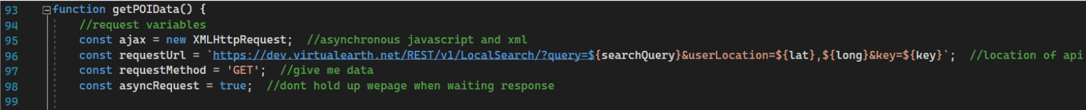
Request Location Data From API

Slide 4
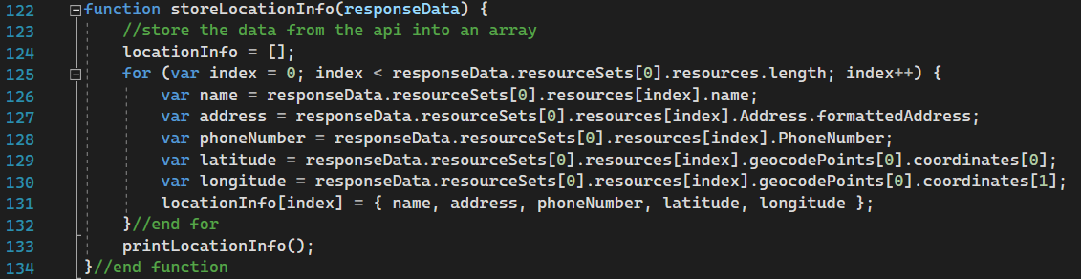
Store Location Data

Slide 5
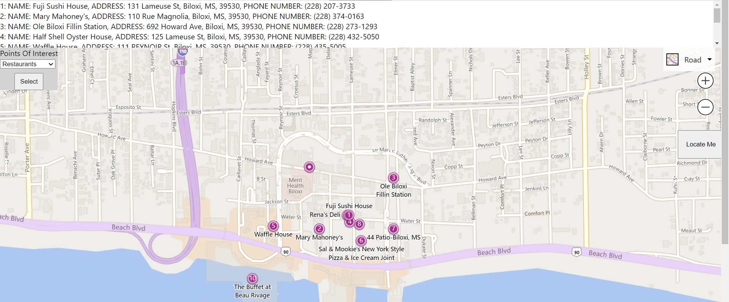
Add Pushpins For Locations To The Map

Slide 6
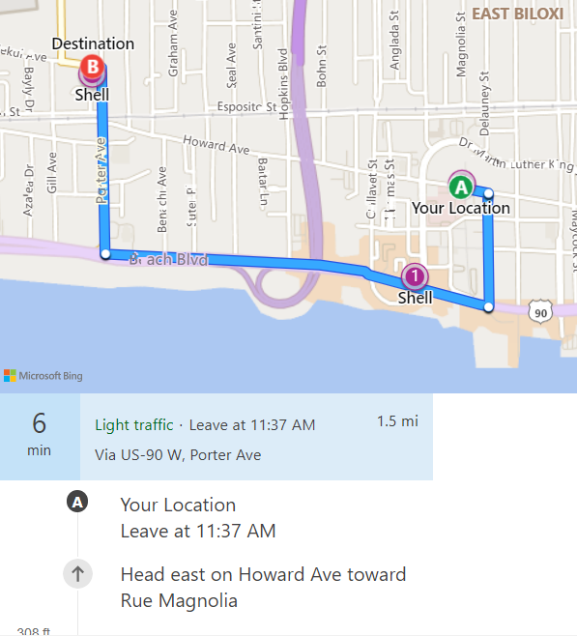
Get Directions To A Location

Slide 7
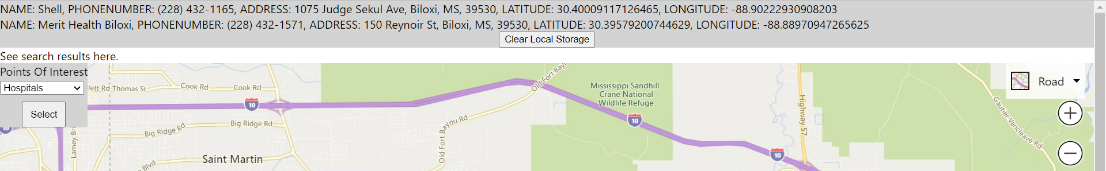
Log and Display Previously Visited Locations

Slide 8
Thanks For Listening
Questions?
Comments?
mapAPI

