Slide 1
Computer Networking
The Datalink Layer and LANS (part b)
Dr Mark Greenwood greenwm1@hope.ac.uk FML312
Drop In Hours
Thursday 12-2pm

Slide 2
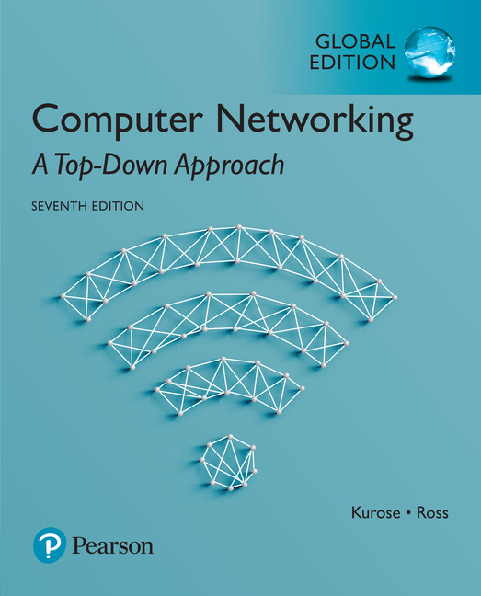

Reading
The course textbook:
Computer Networking: A Top-Down Approach
Seventh Edition
Kurose, J. K., and Ross, K. W.
ISBN 13: 978-1-292-15359-9
Useful additional reading:
Data and Computer Communications
Tenth Edition
Stallings, W.
ISBN 13: 978-9-332-58693-2

Slide 3
Link layer and LANs
our goals:
understand principles behind link layer services:
error detection, correction
sharing a broadcast channel: multiple access
link layer addressing
local area networks: Ethernet, VLANs
instantiation, implementation of various link layer technologies

Slide 4
Link layer, LANs: outline
Introduction, services
Errors
Detection
Correction
Multiple access protocols
LANs
addressing, ARP
Ethernet
switches
VLANS
Link virtualization: MPLS
Data center networking
Another day in the life of a web request

Slide 5
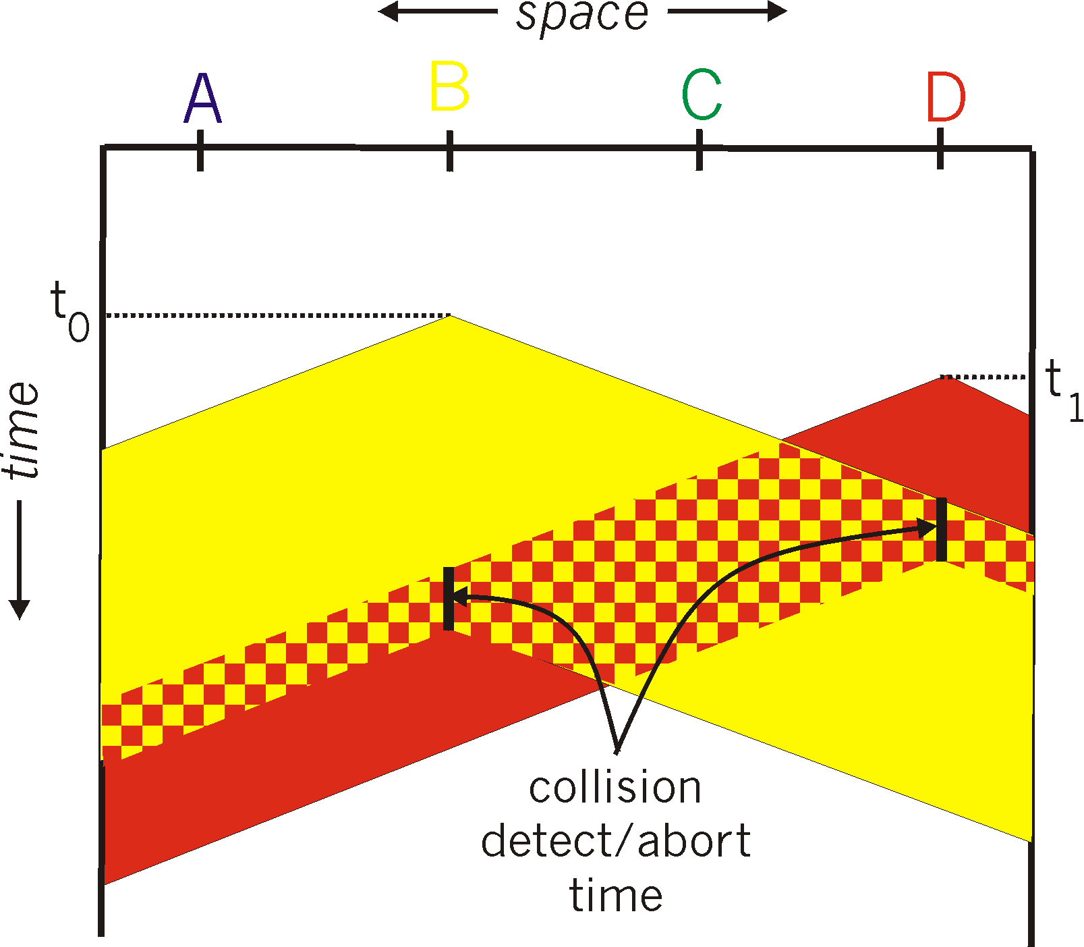

CSMA/CD (collision detection)
spatial layout of nodes

Slide 6
Ethernet CSMA/CD algorithm
1. NIC receives datagram from network layer, creates frame
2. If NIC senses channel idle, starts frame transmission. If NIC senses channel busy, waits until channel idle, then transmits.
3. If NIC transmits entire frame without detecting another transmission, NIC is done with frame !
4. If NIC detects another transmission while transmitting, aborts and sends jam signal
5. After aborting, NIC enters binary (exponential) backoff:
after mth collision, NIC chooses K at random from {0,1,2, …, 2^{m}-1}. NIC waits K·512 bit times, returns to Step 2
longer backoff interval with more collisions

Slide 7
CSMA/CD efficiency
T_{prop} = max prop delay between 2 nodes in LAN
t_{trans} = time to transmit max-size frame
efficiency goes to 1
as t_{prop} goes to 0
as t_{trans} goes to infinity
better performance than ALOHA: and simple, cheap, decentralized!

Slide 8
“Taking turns” MAC protocols
channel partitioning MAC protocols:
share channel efficiently and fairly at high load
inefficient at low load: delay in channel access, 1/N bandwidth allocated even if only 1 active node!
random access MAC protocols
efficient at low load: single node can fully utilize channel
high load: collision overhead
“taking turns” protocols
look for best of both worlds!

Slide 9

“Taking turns” MAC protocols
polling:
master node “invites” slave nodes to transmit in turn
typically used with “dumb” slave devices
concerns:
polling overhead
latency
single point of failure (master)
data
poll
master
data
slaves

Slide 10
“Taking turns” MAC protocols
token passing:
control token passed from one node to next sequentially.
token message
concerns:
token overhead
latency
single point of failure (token)
T
(nothing
to send)
T
data

Slide 11
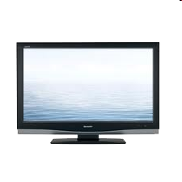


Cable access network
Internet frames, TV channels, control transmitted
downstream at different frequencies
cable headend
…
CMTS
…
splitter
cable
modem
cable modem
termination system
ISP
upstream Internet frames, TV control, transmitted
upstream at different frequencies in time slots
multiple 40Mbps downstream (broadcast) channels
single CMTS transmits into channels
multiple 30 Mbps upstream channels
multiple access: all users contend for certain upstream channel time slots (others assigned)

Slide 12
Cable access network
cable headend
MAP frame for
Interval [t1, t2]
CMTS
Downstream channel i
Upstream channel j
t₁
t₂
Residences with cable modems
Minislots containing
minislots request frames
Assigned minislots containing cable modem
upstream data frames
DOCSIS: data over cable service interface spec
FDM over upstream, downstream frequency channels
TDM upstream: some slots assigned, some have contention
downstream MAP frame: assigns upstream slots
request for upstream slots (and data) transmitted random access (binary backoff) in selected slots

Slide 13
Summary of MAC protocols
channel partitioning, by time, frequency or code
Time Division, Frequency Division
random access (dynamic),
ALOHA, S-ALOHA, CSMA, CSMA/CD
carrier sensing: easy in some technologies (wire), hard in others (wireless)
CSMA/CD used in Ethernet
CSMA/CA used in 802.11
taking turns
polling from central site, token passing
Bluetooth, FDDI, token ring

Slide 14
Link layer, LANs: outline
Introduction, services
Errors
Detection
Correction
Multiple access protocols
LANs
addressing, ARP
Ethernet
switches
VLANS
Link virtualization: MPLS
Data center networking
Another day in the life of a web request

Slide 15
MAC addresses and ARP
32-bit IP address:
network-layer address for interface
used for layer 3 (network layer) forwarding
MAC (or LAN or physical or Ethernet) address:
function: used ‘locally” to get frame from one interface to another physically-connected interface (same network, in IP-addressing sense)
48 bit MAC address (for most LANs) burned in NIC ROM, also sometimes software settable
e.g.: 1A-2F-BB-76-09-AD
hexadecimal (base 16) notation
(each “numeral” represents 4 bits)

Slide 16
LAN addresses and ARP
each adapter on LAN has unique LAN address
1A-2F-BB-76-09-AD
LAN
(wired or
wireless)
adapter
71-65-F7-2B-08-53
58-23-D7-FA-20-B0
0C-C4-11-6F-E3-98

Slide 17
LAN addresses (more)
MAC address allocation administered by IEEE
manufacturer buys portion of MAC address space (to assure uniqueness)
analogy:
MAC address: like Social Security Number
IP address: like postal address
MAC flat address ➜ portability
can move LAN card from one LAN to another
IP hierarchical address not portable
address depends on IP subnet to which node is attached

Slide 18


ARP: address resolution protocol
Question: how to determine
interface’s MAC address, knowing its IP address?
ARP table: each IP node (host, router) on LAN has table
IP/MAC address mappings for some LAN nodes:
< IP address; MAC address; TTL>
TTL (Time To Live): time after which address mapping will be forgotten (typically 20 min)
137.196.7.78
1A-2F-BB-76-09-AD
137.196.7.23
137.196.7.14
LAN
71-65-F7-2B-08-53
58-23-D7-FA-20-B0
0C-C4-11-6F-E3-98
137.196.7.88

Slide 19
ARP protocol: same LAN
A wants to send datagram to B
B’s MAC address not in A’s ARP table.
A broadcasts ARP query packet, containing B's IP address
destination MAC address = FF-FF-FF-FF-FF-FF
all nodes on LAN receive ARP query
B receives ARP packet, replies to A with its (B's) MAC address
frame sent to A’s MAC address (unicast)
A caches (saves) IP-to-MAC address pair in its ARP table until information becomes old (times out)
soft state: information that times out (goes away) unless refreshed
ARP is “plug-and-play”:
nodes create their ARP tables without intervention from net administrator

Slide 20
Addressing: routing to another LAN
walkthrough: send datagram from A to B via R
focus on addressing – at IP (datagram) and MAC layer (frame)
assume A knows B’s IP address
assume A knows IP address of first hop router, R (how?)
assume A knows R’s MAC address (how?)
A
B
R
111.111.111.111
222.222.222.222
74-29-9C-E8-FF-55
49-BD-D2-C7-56-2A
222.222.222.220
1A-23-F9-CD-06-9B
111.111.111.112
111.111.111.110
222.222.222.221
CC-49-DE-D0-AB-7D
E6-E9-00-17-BB-4B
88-B2-2F-54-1A-0F

Slide 21
Addressing: routing to another LAN
A creates IP datagram with IP source A, destination B
A creates link-layer frame with R's MAC address as destination address, frame contains A-to-B IP datagram
MAC src: 74-29-9C-E8-FF-55
MAC dest: E6-E9-00-17-BB-4B
IP
Eth
Phy
IP src: 111.111.111.111
IP dest: 222.222.222.222
A
B
R
111.111.111.111
222.222.222.222
74-29-9C-E8-FF-55
49-BD-D2-C7-56-2A
222.222.222.220
1A-23-F9-CD-06-9B
111.111.111.112
111.111.111.110
222.222.222.221
CC-49-DE-D0-AB-7D
E6-E9-00-17-BB-4B
88-B2-2F-54-1A-0F

Slide 22
Addressing: routing to another LAN
frame sent from A to R
frame received at R, datagram removed, passed up to IP
MAC src: 74-29-9C-E8-FF-55
MAC dest: E6-E9-00-17-BB-4B
IP src: 111.111.111.111
IP dest: 222.222.222.222
IP
Eth
Phy
IP src: 111.111.111.111
IP dest: 222.222.222.222
IP
Eth
Phy
A
B
R
111.111.111.111
222.222.222.222
74-29-9C-E8-FF-55
49-BD-D2-C7-56-2A
222.222.222.220
1A-23-F9-CD-06-9B
111.111.111.112
111.111.111.110
222.222.222.221
CC-49-DE-D0-AB-7D
E6-E9-00-17-BB-4B
88-B2-2F-54-1A-0F

Slide 23
Addressing: routing to another LAN
R forwards datagram with IP source A, destination B
R creates link-layer frame with B's MAC address as destination address, frame contains A-to-B IP datagram
MAC src: 1A-23-F9-CD-06-9B
MAC dest: 49-BD-D2-C7-56-2A
IP
Eth
Phy
IP
Eth
Phy
IP src: 111.111.111.111
IP dest: 222.222.222.222
A
B
R
111.111.111.111
222.222.222.222
74-29-9C-E8-FF-55
49-BD-D2-C7-56-2A
222.222.222.220
1A-23-F9-CD-06-9B
111.111.111.112
111.111.111.110
222.222.222.221
CC-49-DE-D0-AB-7D
E6-E9-00-17-BB-4B
88-B2-2F-54-1A-0F

Slide 24
Addressing: routing to another LAN
R forwards datagram with IP source A, destination B
R creates link-layer frame with B's MAC address as destination address, frame contains A-to-B IP datagram
MAC src: 1A-23-F9-CD-06-9B
MAC dest: 49-BD-D2-C7-56-2A
IP
Eth
Phy
IP
Eth
Phy
IP src: 111.111.111.111
IP dest: 222.222.222.222
A
B
R
111.111.111.111
222.222.222.222
74-29-9C-E8-FF-55
49-BD-D2-C7-56-2A
222.222.222.220
1A-23-F9-CD-06-9B
111.111.111.112
111.111.111.110
222.222.222.221
CC-49-DE-D0-AB-7D
E6-E9-00-17-BB-4B
88-B2-2F-54-1A-0F

Slide 25
Addressing: routing to another LAN
R forwards datagram with IP source A, destination B
R creates link-layer frame with B's MAC address as dest, frame contains A-to-B IP datagram
MAC src: 1A-23-F9-CD-06-9B
MAC dest: 49-BD-D2-C7-56-2A
IP src: 111.111.111.111
IP dest: 222.222.222.222
IP
Eth
Phy
A
B
R
111.111.111.111
222.222.222.222
74-29-9C-E8-FF-55
49-BD-D2-C7-56-2A
222.222.222.220
1A-23-F9-CD-06-9B
111.111.111.112
111.111.111.110
222.222.222.221
CC-49-DE-D0-AB-7D
E6-E9-00-17-BB-4B
88-B2-2F-54-1A-0F

Slide 26
Link layer, LANs: outline
6.1 introduction, services
6.2 error detection, correction
6.3 multiple access protocols
6.4 LANs
addressing, ARP
Ethernet
switches
VLANS
6.5 link virtualization: MPLS
6.6 data center networking
6.7 a day in the life of a web request

Slide 27
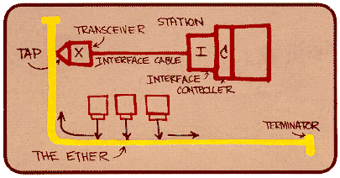
Ethernet
“dominant” wired LAN technology:
single chip, multiple speeds (e.g., Broadcom BCM5761)
first widely used LAN technology
simpler, cheap
kept up with speed race: 10 Mbps – 10 Gbps
Metcalfe’s Ethernet sketch

Slide 28

Ethernet: physical topology
bus: popular through mid 90s
all nodes in same collision domain (can collide with each other)
star: prevails today
active switch in center
each “spoke” runs a (separate) Ethernet protocol (nodes do not collide with each other)
switch
star
bus: coaxial cable

Slide 29
Ethernet frame structure
sending adapter encapsulates IP datagram (or other network layer protocol packet) in Ethernet frame
preamble:
7 bytes with pattern 10101010 followed by one byte with pattern 10101011
used to synchronize receiver, sender clock rates
type
preamble
dest.
address
source
address
data (payload)
CRC

Slide 30
Ethernet frame structure (more)
addresses: 6 byte source, destination MAC addresses
if adapter receives frame with matching destination address, or with broadcast address (e.g. ARP packet), it passes data in frame to network layer protocol
otherwise, adapter discards frame
type: indicates higher layer protocol (mostly IP but others possible, e.g., Novell IPX, AppleTalk)
CRC: cyclic redundancy check at receiver
error detected: frame is dropped
type
preamble
dest.
address
source
address
data (payload)
CRC

Slide 31
Ethernet: unreliable, connectionless
connectionless: no handshaking between sending and receiving NICs
unreliable: receiving NIC doesn't send acks or nacks to sending NIC
data in dropped frames recovered only if initial sender uses higher layer rdt (e.g., TCP), otherwise dropped data lost
Ethernet’s MAC protocol: unslotted CSMA/CD with binary backoff

Slide 32
802.3 Ethernet standards: link & physical layers
many different Ethernet standards
common MAC protocol and frame format
different speeds: 2 Mbps, 10 Mbps, 100 Mbps, 1Gbps, 10 Gbps, 40 Gbps
different physical layer media: fiber, cable
application
transport
network
link
physical
MAC protocol
and frame format
100BASE-TX
100BASE-T2
100BASE-FX
100BASE-T4
100BASE-SX
100BASE-BX
copper (twister
pair) physical layer
fiber physical layer

Slide 33
Next Week
6.1 introduction, services
6.2 error detection, correction
6.3 multiple access protocols
6.4 LANs
addressing, ARP
Ethernet
switches
VLANS
6.5 link virtualization: MPLS
6.6 data center networking
6.7 a day in the life of a web request

