Slide 1
Computer Networking
The Datalink Layer and LANS (part c)
Dr Mark Greenwood greenwm1@hope.ac.uk FML312
Drop In Hours
Thursday 12-2pm

Slide 2
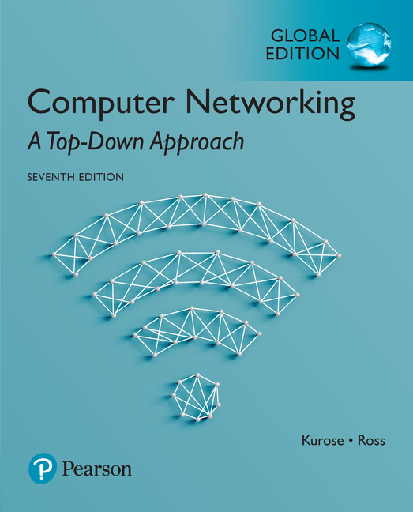
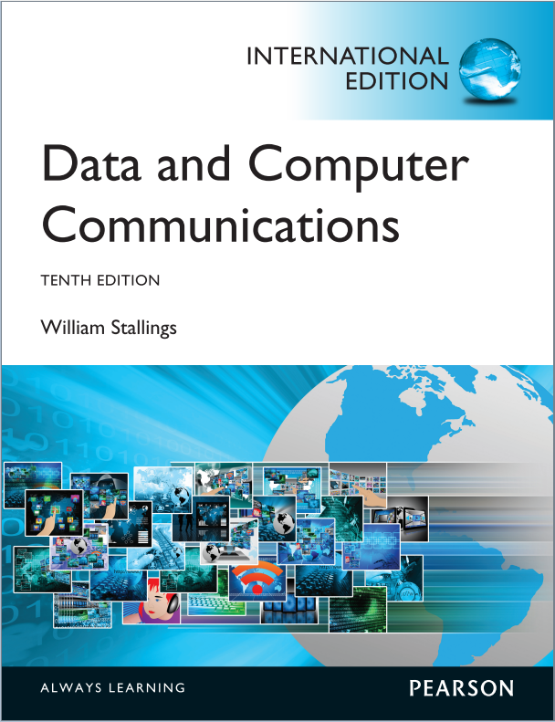
Reading
The course textbook:
Computer Networking: A Top-Down Approach
Seventh Edition
Kurose, J. K., and Ross, K. W.
ISBN 13: 978-1-292-15359-9
Useful additional reading:
Data and Computer Communications
Tenth Edition
Stallings, W.
ISBN 13: 978-9-332-58693-2

Slide 3
Link layer and LANs
our goals:
understand principles behind link layer services:
error detection, correction
sharing a broadcast channel: multiple access
link layer addressing
local area networks: Ethernet, VLANs
instantiation, implementation of various link layer technologies

Slide 4
Link layer, LANs: outline
Introduction, services
Errors
Detection
Correction
Multiple access protocols
LANs
addressing, ARP
Ethernet
switches
VLANS
Link virtualization: MPLS
Data center networking
Another day in the life of a web request

Slide 5
Ethernet switch
link-layer device takes an active role
store, forward Ethernet frames
examine incoming frame’s MAC address, selectively forward frame to one-or-more outgoing links when frame is to be forwarded on segment, uses CSMA/CD to access segment
transparent
hosts are unaware of presence of switches
plug-and-play, self-learning
switches do not need to be configured

Slide 6



Switch: multiple simultaneous transmissions
hosts have dedicated, direct connection to switch
switches buffer packets
Ethernet protocol used on each incoming link, but no collisions; full duplex
each link is its own collision domain
switching: A-to-A’ and B-to-B’ can transmit simultaneously, without collisions
A
C’
B
6
1
2
5
4
3
B’
C
A’
switch with six interfaces
(1,2,3,4,5,6)

Slide 7
Switch forwarding table
Q: how does switch know A’ reachable via interface 4, B’ reachable via interface 5?
A
C’
B
A: each switch has a switch table, each entry:
(MAC address of host, interface to reach host, time stamp)
looks like a routing table!
6
1
2
5
4
3
B’
C
A’
Q: how are entries created, maintained in switch table?
something like a routing protocol?
switch with six interfaces
(1,2,3,4,5,6)

Slide 8
Switch: self-learning
Source: A
Dest: A’
switch learns which hosts can be reached through which interfaces
when frame received, switch “learns” location of sender: incoming LAN segment
records sender/location pair in switch table
A
A A’
C’
B
6
1
2
5
4
3
B’
C
A’
MAC addr interface TTL
A
1
60
Switch table
(initially empty)

Slide 9
Switch: frame filtering/forwarding
when frame received at switch:
1. record incoming link, MAC address of sending host
2. index switch table using MAC destination address
3. if entry found for destination then {
if destination on segment from which frame arrived then drop frame
else forward frame on interface indicated by entry
}
else flood /* forward on all interfaces except arriving
interface */

Slide 10
Self-learning, forwarding example
Source: A
Dest: A’
A
A A’
frame destination, A’, location unknown:
flood
C’
B
destination A location known:
6
1
2
A A’
A A’
A A’
A A’
selectively send
on just one link
A A’
5
4
3
B’
C
A’ A
A’
MAC addr interface TTL
A
1
60
switch table
(initially empty)
A’
4
60

Slide 11

Interconnecting switches
self-learning switches can be connected together:
S₄
S₁
S₃
A
S₂
F
I
B
C
D
E
G
H
Q: sending from A to G - how does S₁ know to forward frame destined to G via S₄ and S₃?
A: self learning! (works exactly the same as in single-switch case!)

Slide 12
Self-learning multi-switch example
Suppose C sends frame to I, I responds to C
S₄
S₁
S₃
A
S₂
F
I
B
C
D
E
G
H
Q: show switch tables and packet forwarding in S₁, S₂, S₃, S₄

Slide 13
Institutional network
mail server
to external
network
router
web server
IP subnet

Slide 14
Switches vs. routers
application
transport
network
link
physical
both are store-and-forward:
routers: network-layer devices (examine network-layer headers)
switches: link-layer devices (examine link-layer headers)
both have forwarding tables:
routers: compute tables using routing algorithms, IP addresses
switches: learn forwarding table using flooding, learning, MAC addresses
datagram
frame
link
physical
frame
switch
network
link
physical
datagram
frame
application
transport
network
link
physical

Slide 15
Link layer, LANs: outline
Introduction, services
Errors
Detection
Correction
Multiple access protocols
LANs
addressing, ARP
Ethernet
switches
VLANS
Link virtualization: MPLS
Data center networking
Another day in the life of a web request

Slide 16


VLANs: motivation
consider:
CS user moves office to EE, but wants connect to CS switch?
single broadcast domain:
all layer-2 broadcast traffic (ARP, DHCP, unknown location of destination MAC address) must cross entire LAN
security/privacy, efficiency issues
Computer
Science
Computer
Engineering
Electrical
Engineering

Slide 17
VLANs
port-based VLAN: switch ports grouped (by switch management software) so that single physical switch ……
Virtual Local
Area Network
1
7
9
15
2
8
10
16
switch(es) supporting VLAN capabilities can be configured to define multiple virtual LANS over single physical LAN infrastructure.
…
…
Electrical Engineering
(VLAN ports 1-8)
Computer Science
(VLAN ports 9-15)
… operates as multiple virtual switches
1
7
9
15
2
8
10
16
…
…
Electrical Engineering
(VLAN ports 1-8)
Computer Science
(VLAN ports 9-16)

Slide 18
Port-based VLAN
router
traffic isolation: frames to/from ports 1-8 can only reach ports 1-8
can also define VLAN based on MAC addresses of endpoints, rather than switch port
1
7
9
15
2
8
10
16
dynamic membership: ports can be dynamically assigned among VLANs
…
…
Electrical Engineering
(VLAN ports 1-8)
Computer Science
(VLAN ports 9-15)
forwarding between VLANS: done via routing (just as with separate switches)
in practice vendors sell combined switches plus routers

Slide 19
VLANS spanning multiple switches
1
7
9
15
1
3
5
7
2
8
10
16
2
4
6
8
…
…
Electrical Engineering
(VLAN ports 1-8)
Computer Science
(VLAN ports 9-15)
Ports 2,3,5 belong to EE VLAN
Ports 4,6,7,8 belong to CS VLAN
trunk port: carries frames between VLANS defined over multiple physical switches
frames forwarded within VLAN between switches can’t be vanilla 802.1 frames (must carry VLAN ID info)
802.1q protocol adds/removed additional header fields for frames forwarded between trunk ports

Slide 20
802.1Q VLAN frame format
type
preamble
dest.
address
source
address
data (payload)
CRC
802.1 frame
type
preamble
dest.
address
source
address
data (payload)
CRC
802.1Q frame
2-byte Tag Protocol Identifier
(value: 81-00)
Recomputed
CRC
Tag Control Information (12 bit VLAN ID field,
3 bit priority field like IP TOS)

Slide 21
Link layer, LANs: outline
Introduction, services
Errors
Detection
Correction
Multiple access protocols
LANs
addressing, ARP
Ethernet
switches
VLANS
Link virtualization: MPLS
Data center networking
Another day in the life of a web request

Slide 22
Multiprotocol label switching (MPLS)
initial goal: high-speed IP forwarding using fixed length label (instead of IP address)
fast lookup using fixed length identifier (rather than shortest prefix matching)
borrowing ideas from Virtual Circuit (VC) approach
but IP datagram still keeps IP address!
PPP or Ethernet
header
IP header
remainder of link-layer frame
MPLS header
label
Exp
S
TTL
20
3
1
5

Slide 23
MPLS capable routers
a.k.a. label-switched router
forward packets to outgoing interface based only on label value (don’t inspect IP address)
MPLS forwarding table distinct from IP forwarding tables
flexibility: MPLS forwarding decisions can differ from those of IP
use destination and source addresses to route flows to same destination differently (traffic engineering)
re-route flows quickly if link fails: pre-computed backup paths (useful for VoIP)

Slide 24
MPLS versus IP paths
R6
D
R4
R3
R5
A
R2
IP routing: path to destination determined by destination address alone
IP router

Slide 25
MPLS versus IP paths
entry router (R4) can use different MPLS routes to A based, e.g., on source address
R6
D
R4
R3
R5
A
R2
IP routing: path to destination determined by destination address alone
IP-only
router
MPLS routing: path to destination can be based on source and destination address
fast reroute: precompute backup routes in case of link failure
MPLS and
IP router

Slide 26
MPLS signaling
modify OSPF, IS-IS link-state flooding protocols to carry info used by MPLS routing,
e.g., link bandwidth, amount of “reserved” link bandwidth
entry MPLS router uses RSVP-TE signaling protocol to set up MPLS forwarding at downstream routers
R6
RSVP-TE
D
R4
R5
modified
link state
flooding
A

Slide 27
MPLS forwarding tables
in out out
label label dest interface
10 A 0
in out out
label label dest interface
12 D 0
8 A 1
10 6 A 1
12 9 D 0
R6
0
0
D
1
1
R4
R3
R5
0
0
A
R2
in out out
label label dest interface
R1
in out out
label label dest interface
6 - A 0
8 6 A 0

Slide 28
Link layer, LANs: outline
Introduction, services
Errors
Detection
Correction
Multiple access protocols
LANs
addressing, ARP
Ethernet
switches
VLANS
Link virtualization: MPLS
Data center networking
Another day in the life of a web request

Slide 29
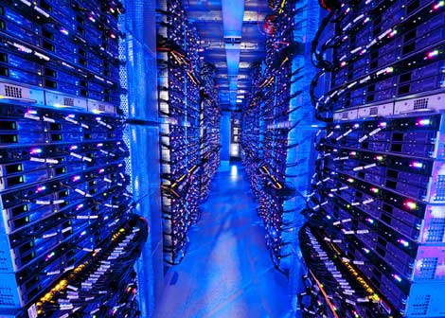
Data center networks
10’s to 100’s of thousands of hosts, often closely coupled, in close proximity:
e-business (e.g. Amazon)
content-servers (e.g., YouTube, Akamai, Apple, Microsoft)
search engines, data mining (e.g., Google)
challenges:
multiple applications, each serving massive numbers of clients
managing/balancing load, avoiding processing, networking, data bottlenecks
Inside a 40-ft Microsoft container,
Chicago data center

Slide 30
Data center networks
load balancer: application-layer routing
receives external client requests
directs workload within data center
returns results to external client (hiding data center internals from client)
Internet
Border router
Load
balancer
Load
balancer
Access router
B
Tier-1 switches
A
C
Tier-2 switches
TOR switches
Server racks
1
2
3
4
5
6
7
8

Slide 31
Data center networks
rich interconnection among switches, racks:
increased throughput between racks (multiple routing paths possible)
increased reliability via redundancy
Tier-1 switches
Tier-2 switches
TOR switches
Server racks
1
2
3
4
5
6
7
8

Slide 32
Link layer, LANs: outline
Introduction, services
Errors
Detection
Correction
Multiple access protocols
LANs
addressing, ARP
Ethernet
switches
VLANS
Link virtualization: MPLS
Data center networking
Another day in the life of a web request

Slide 33
Synthesis: a day in the life of a web request
journey down protocol stack complete!
application, transport, network, link
putting-it-all-together: synthesis!
goal: identify, review, understand protocols (at all layers) involved in seemingly simple scenario: requesting www page
scenario: student attaches laptop to campus network, requests/receives www.google.com

Slide 34
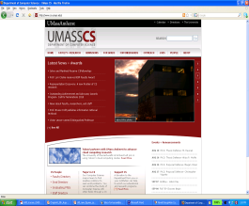


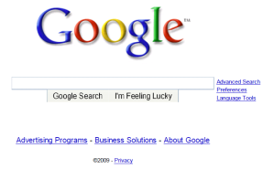
A day in the life: scenario
browser
DNS server
Comcast network
68.80.0.0/13
school network
68.80.2.0/24
web page
web server
Google’s network
64.233.160.0/19
64.233.169.105

Slide 35
A day in the life… connecting to the Internet
DHCP
DHCP
UDP
IP
Eth
Phy
connecting laptop needs to get its own IP address, addr of first-hop router, addr of DNS server: use DHCP
DHCP
DHCP
DHCP
DHCP
DHCP request encapsulated in UDP, encapsulated in IP, encapsulated in 802.3 Ethernet
DHCP
DHCP
UDP
IP
Eth
Phy
DHCP
DHCP
DHCP
DHCP
router
(runs DHCP)
Ethernet frame broadcast (dest: FFFFFFFFFFFF) on LAN, received at router running DHCP server
Ethernet demuxed to IP demuxed, UDP demuxed to DHCP

Slide 36
A day in the life… connecting to the Internet
DHCP
DHCP
UDP
IP
Eth
Phy
DHCP server formulates DHCP ACK containing client’s IP address, IP address of first-hop router for client, name & IP address of DNS server
DHCP
DHCP
DHCP
encapsulation at DHCP server, frame forwarded (switch learning) through LAN, demultiplexing at client
DHCP
DHCP
UDP
IP
Eth
Phy
DHCP
DHCP
DHCP
router
(runs DHCP)
DHCP
DHCP client receives DHCP ACK reply
Client now has IP address, knows name & addr of DNS
server, IP address of its first-hop router

Slide 37
A day in the life… ARP (before DNS, before HTTP)
DNS
UDP
IP
Eth
Phy
before sending HTTP request, need IP address of www.google.com: DNS
DNS
DNS
DNS
ARP
ARP query
DNS query created, encapsulated in UDP, encapsulated in IP, encapsulated in Eth. To send frame to router, need MAC address of router interface: ARP
ARP
ARP reply
Eth
Phy
ARP query broadcast, received by router, which replies with ARP reply giving MAC address of router interface
router
(runs DHCP)
client now knows MAC address of first hop router, so can now send frame containing DNS query

Slide 38
A day in the life… using DNS
DNS
UDP
IP
Eth
Phy
DNS
DNS server
DNS
UDP
IP
Eth
Phy
DNS
DNS
DNS
DNS
DNS
DNS
DNS
DNS
Comcast network
68.80.0.0/13
IP datagram forwarded from campus network into Comcast network, routed (tables created by RIP, OSPF, IS-IS and/or BGP routing protocols) to DNS server
router
(runs DHCP)
IP datagram containing DNS query forwarded via LAN switch from client to 1st hop router
demuxed to DNS server
DNS server replies to client with IP address of www.google.com

Slide 39
A day in the life…TCP connection carrying HTTP
HTTP
HTTP
TCP
IP
Eth
Phy
SYNACK
SYN
SYNACK
SYN
SYNACK
SYN
SYN
to send HTTP request, client first opens TCP socket to web server
router
(runs DHCP)
TCP
IP
Eth
Phy
TCP SYN segment (step 1 in 3-way handshake) inter-domain routed to web server
SYNACK
SYN
SYNACK
SYN
SYNACK
SYNACK
SYN
web server responds with TCP SYNACK (step 2 in 3-way handshake)
web server
64.233.169.105
TCP connection established!

Slide 40
A day in the life… HTTP request/reply
HTTP
HTTP
TCP
IP
Eth
Phy
web page finally (!!!) displayed
HTTP
HTTP
HTTP
HTTP
HTTP
HTTP
HTTP
HTTP
HTTP request sent into TCP socket
router
(runs DHCP)
IP datagram containing HTTP request routed to www.google.com
HTTP
HTTP
TCP
IP
Eth
Phy
HTTP
HTTP
HTTP
web server responds with HTTP reply (containing web page)
HTTP
web server
64.233.169.105
IP datagram containing HTTP reply routed back to client

Slide 41
Data-Link Layer: Summary
principles behind data link layer services:
error detection, correction
sharing a broadcast channel: multiple access
link layer addressing
instantiation and implementation of various link layer technologies
Ethernet
switched LANS, VLANs
virtualized networks as a link layer: MPLS
synthesis: a day in the life of a web request

