Slide 1
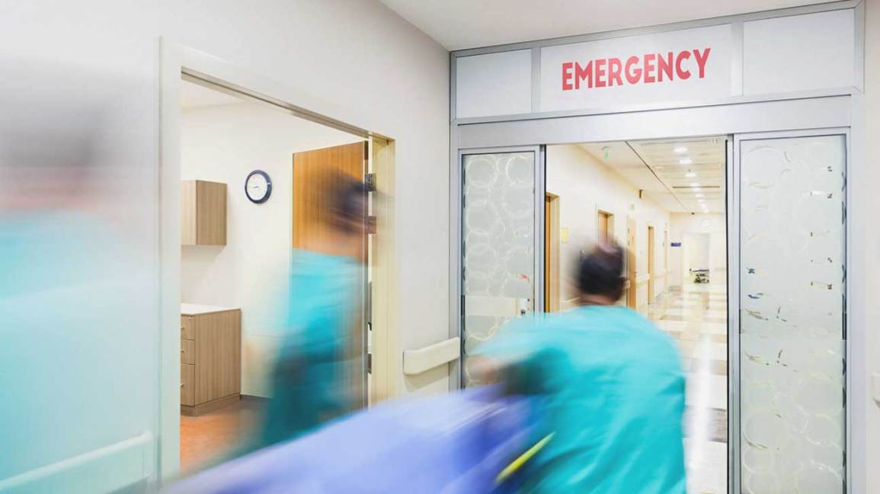
quickER
Daniel Toh, Mario Tanijaya, Matthew Kan

Slide 2
quickER helps patients plan their trip to emergency rooms to receive treatment quickER.

Slide 3
Problem
The Emergency Rooms (ER) of the public hospitals in Singapore are very busy.
The waiting time to see a doctor in the ER can range from 0 mins to 8 hours.
According to the Ministry of Health, waiting times are a major source of complaint and dissatisfaction was highest in the ER.

Slide 4
Problem
Ageing population
More elderly in the future
Vulnerable to illnesses and accidents
Longer waiting times
Better planning needed to facilitate faster treatment times for everyone

Slide 5
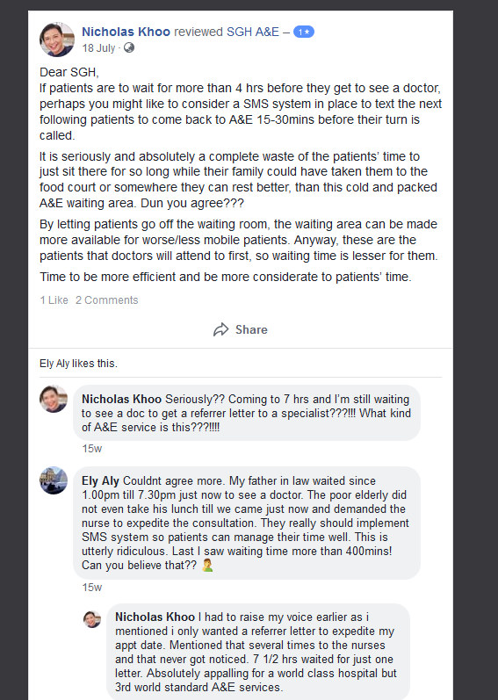
Patients complain on FB about long waiting times of >7 hours to see a doctor in ER

Slide 6
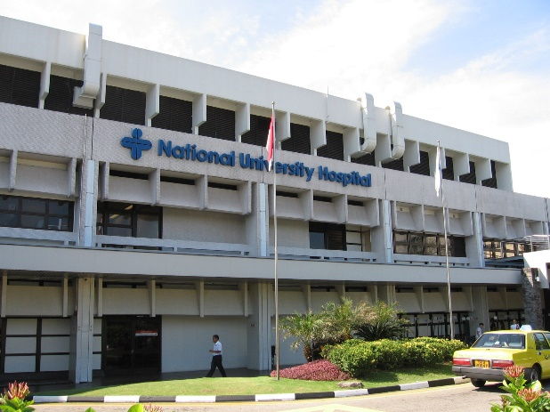
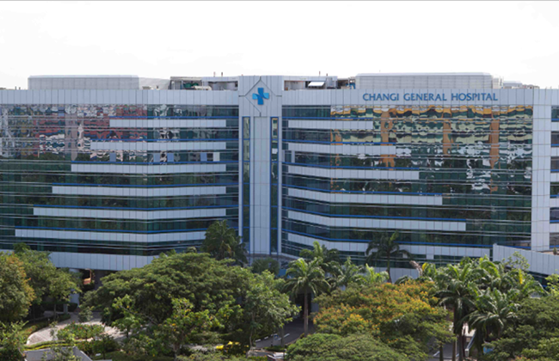
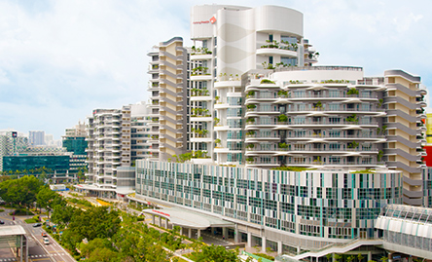
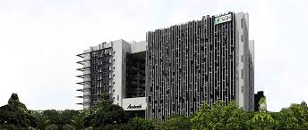
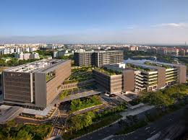
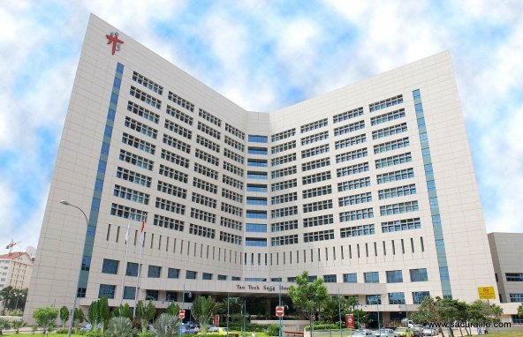
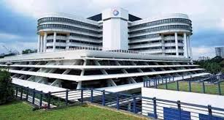
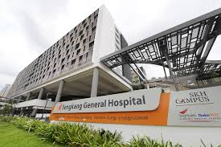
9 Public Hospitals in Singapore
Woodlands Hospital (currently under construction)
National University Hospital (NUH)
Changi General Hospital (CGH)
Ng Teng Fong Hospital (NTFH)
Singapore General Hospital (SGH)
Khoo Teck Puat Hospital (KTPH)
KK Women’s and Children’s Hospital (KKH)
Sengkang General Hospital (SKGH)
Tan Tock Seng Hospital (TTSH)

Slide 7
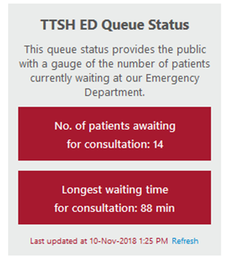
Current Situation
Only Tan Tock Seng Hospital displays its ER waiting time on its website in real time
Ng Teng Fong Hospital has a video image of his waiting area as a visual gauge of the number of patients waiting
KTPH, SGH and SKH have a queue viewer on their websites but the queue viewer is not working.
CGH, KKH and NUH do not have a queue viewer.

Slide 8
Aim of quickER
Display the waiting times for all the ERs in all the public hospitals
Compute the travelling time to all the ERs from the patient’s location
Calculate and display the total time required
Help the patient to make an informed decision about which ER to seek treatment at

Slide 9
How quickER works
Simulated waiting times that change based on time
Travelling times calculated with geometry with latitude and longitude
Displays the sum of times and suggests the hospitals that can treat the patient the quickest.
Also links to Google Maps for directions to the hospital.

Slide 10
Demo of quickER algorithm in C++
The latitude and longitude of this area is ~(1.2992506 103.8459408)

Slide 11
Potential App Prototype Design

Slide 12
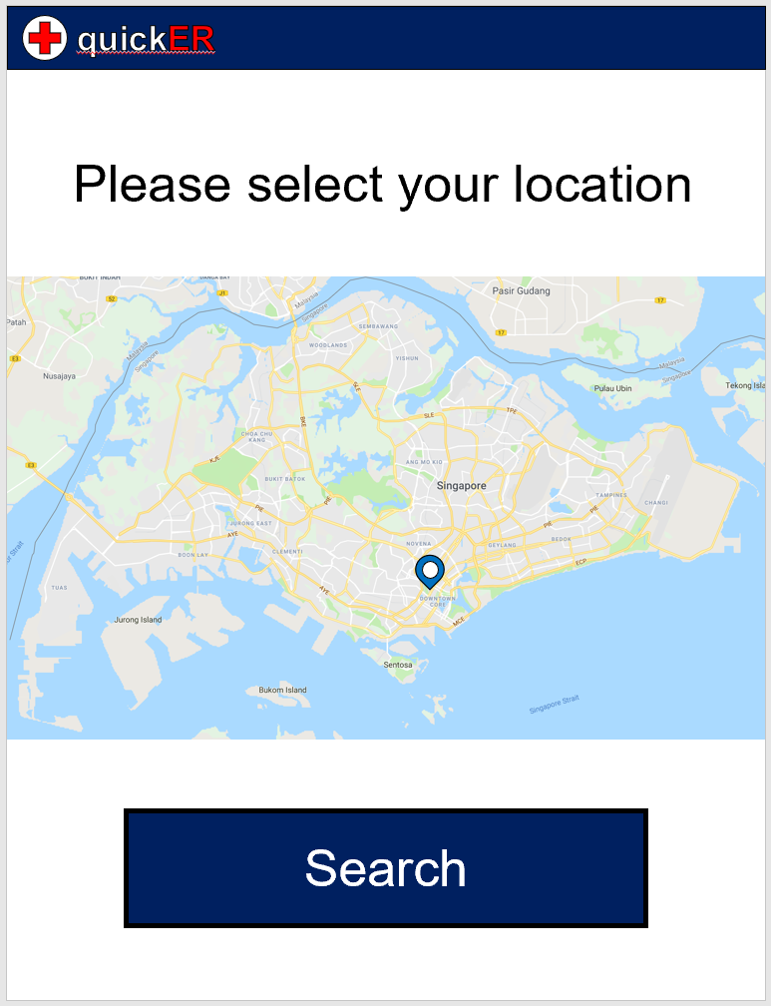
Prompts user to input location

Slide 13
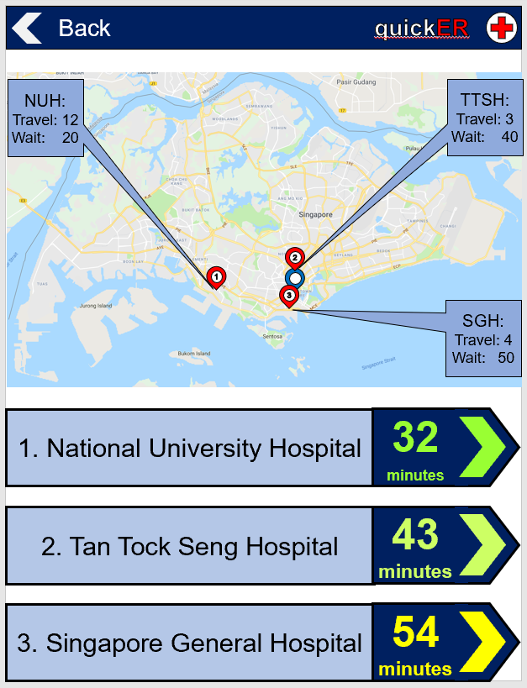
Displays top 3 hospitals according to total time
Links to Google Maps for directions

Slide 14
Future Work / Improvements
Obtain real time ER waiting times for all the public hospitals instead of simulated data
Predict using machine learning based on sample data if real time data is not available
Incorporate Google Maps API for calculating travelling time
Will factor in traffic conditions

Slide 15


Future Work / Improvements
• Incorporate with ride sharing apps and taxis
Using the same algorithm for other facilities (e.g restaurants)
Facilities with a queue/waiting time

Slide 16
Thank you

