Slide 1
Hospital Canteen Ordering and Delivery System

Slide 2
Hospital Canteen Ordering and Delivery System
Purpose:
Target Users:
Hospital Canteen Ordering and Delivery System
Solving the problem:
  People who being too busy to order food in person
  Delivering food to people with disabilities
Hospital patients
Doctors
Nurses
Visitors

Slide 3
PACT - People
Diners:
e.g. Hospital patient, Hospital Staff and Visitor
Characteristics:
Lack of mobility
Variable degrees of exposure to technology
Requirement:
An easy-to-navigate interface where diners can customize choosing their meals -> needs
Restrictions on their diet or language barriers
Hospital Canteen Employee:
e.g. Kitchen manager
Characteristics: Fast-paced environment and processing numerous orders in a very short time
Requirement: A single dashboard for manage the daily result of orders and menu

Slide 4

PACT - Activities
Diners:
  Choose a language and Log in with their accounts
  Provided clean menu for browse
  Add meals to the cart and Edit items in the cart
  Select delivery date and time with specify dietary restrictions
  Submit the order with receiving order number
Employe:
  Admin level Log in, add or remove available meals
  View all pending order details
  Update order status (e.g preparing, ready for delivery, completed)
  Food order history

Slide 5
PACT - Activities
Safety critical
Patient Safety Profile
  Creates a permanent:
    Central record of each patient's specific dietary needs
    e.g., Allergies, Low Sodium, Diabetic
  Eliminates risk of human error:
    Removing the need to manually enter critical health information.
"Smart" Menu Safeguards
  Acts as an automated guard by constantly checking menu items
    Against the patient's saved profile
  Prevents accidental orders of harmful food
    By either hiding unsafe items or displaying a critical warning before the item can be added to the cart.

Slide 6

PACT - Activities
High-Visibility Kitchen Alerts
  Dietary information during food preparation will not miss critical
    For Kitchen staff
  Automatically flags any order with a restriction using prominent visual alerts on the main dashboard
    Guaranteeing it receives special attention
    (e.g., a Red banner)

Slide 7

PACT - Contexts
Physical Context:
User: Patients
Activities will mainly be conducted on the bed in the ward
  Physically restricted - illness;
  The surrounding environment is relatively quiet, noise generated by hospital equipment
  He/She will conduct activities through personal mobile devices or the hospital's own screen
Employes:
Working in noisy workplaces where many things are being processed at the same time
  The nursing station, logistics office, kitchen

Slide 8
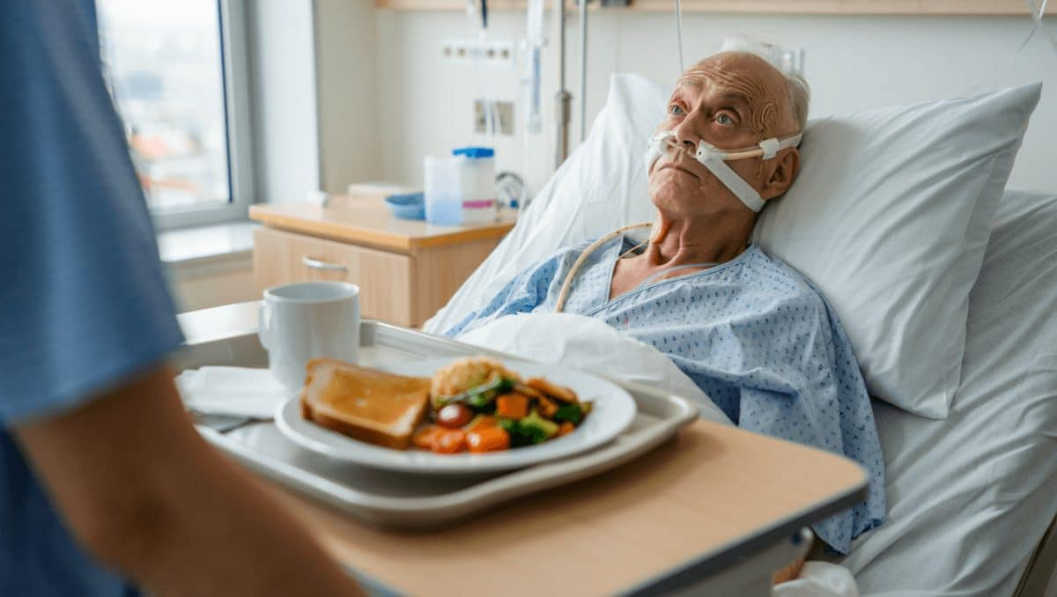
PACT - Contexts
Social Context: User:
While ordering meals may seem like a personal activity
Relatives or even patients present
  Problems: Using the system can turn to people near them for help.
  It should not be complicated to avoid disturbing them.
Employe:
Working within the presence of co-workers
This system has become an important part of his/her daily routine
  It provides a way for communication with the kitchen or any other department.

Slide 9
PACT - Contexts
Organizational Background:
The proposed system is one component of the total service chain for the hospital
Designed to enhance the quality of patient care
  increase the effectiveness of logistics activities
Altered the SOP in the hospital
  Nursing department and food service department
Computerizing the existing manual process for ordering
  With the intention of minimizing human error and manpower savings

Slide 10
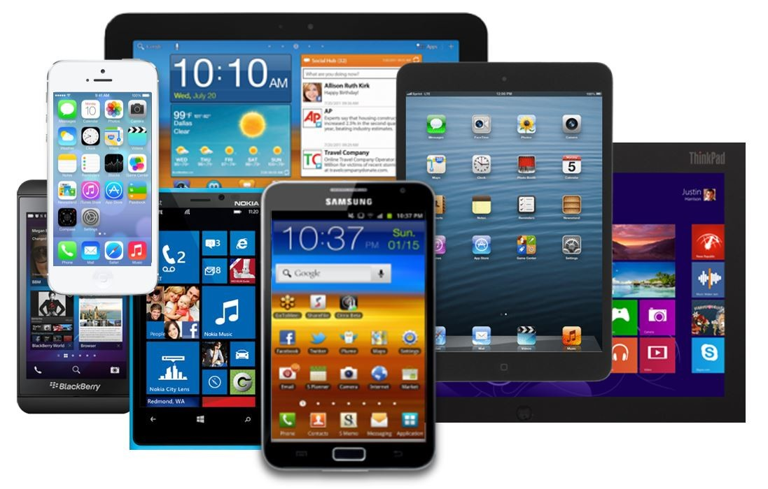
PACT - Technologies
Frontend technologies:
  HTML, CSS, JavaScript
Responsive interface:
  The interface system can adapt to various screen sizes
  For Desktop, Mobile Phone, Tablet
Data storage:
  Data on login credentials, shopping carts:
  Can be stored on the central local servers and database
Multiple language options:
  System provides capabilities languages switching
    Between English, Simplified Chinese, and Traditional Chinese

Slide 11
PACT SUMMARIZE
People:
  Hospital patient, hospital staff, kitchen manager and visitor
  Different language users
  People with disabilities (Blindness, Handless, Deaf, Mute, Speechless, illness)
Activities:
  Checking nutritional, placing or scheduling orders, choosing delivery locations, and making payments.
Contexts:
  The system operates in a busy hospital environment where hygiene, safety, and privacy requirements are strict.
Technologies:
  Combines a web or mobile app, bedside terminals or tablets, and kiosks connected to a central ordering and kitchen management system.

Slide 12

Data Gathering - System
Questionnaires for all patient when they leaving hospital
  Collect a large amount of data
  Collect people‘s opinions on the current canteen model.
  Ordering habits, waiting time, preferred devices, and delivery preferences.
Interview between long term patient
  Able to deeply understand the problem
  Talk to canteen and ward staff, and a few users to learn about operational issues, order handling, and delivery problem
Observation system performance
  Gain a deep understanding of the specific steps, time costs, and potential issues
    In the current manual ordering process
  Ensure the new system can address real-world problems

Slide 13

User Stories
Patient:
“Being a bedridden patient with limited movement, I wish that it would be easy for me to go through the menu and place orders via my tablet so that I wouldn’t always have to wait and disturb the nurses.”
Kitchen Staff:
“Being a kitchen staff member, I wish that I could view the details of new orders on a dashboard immediately in order to effectively organize the sequence of preparing meals.”
System Administrator:
“Being a system administrator, I wish that it would be easy for me to add or delete employee accounts in order to restrict access to those who are authorized.”

Slide 14
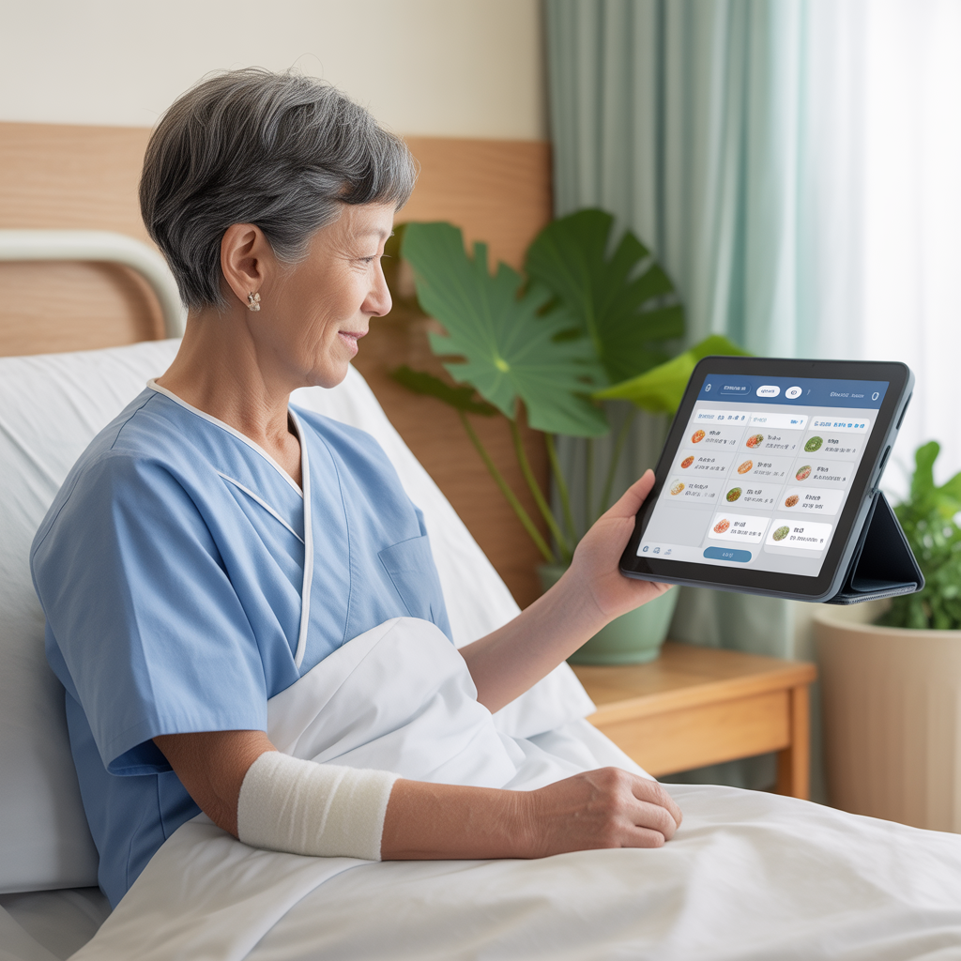
Scenarios & Use Cases
Conceptual Scenario
Meet Mrs. Chen:
  A patient recovering from a broken leg, confined to her hospital bed.
The Daily Struggle:
  Growing weary of identical hospital-issued meals.
A Simple Solution:
  Her nurse introduces the new, intuitive tablet-based ordering system.
Patient Empowerment:
  Mrs. Chen easily browses, selects, and customizes her own lunch for the next day
  E.g., Steamed Fish, with a 'low salt' note.

Slide 15
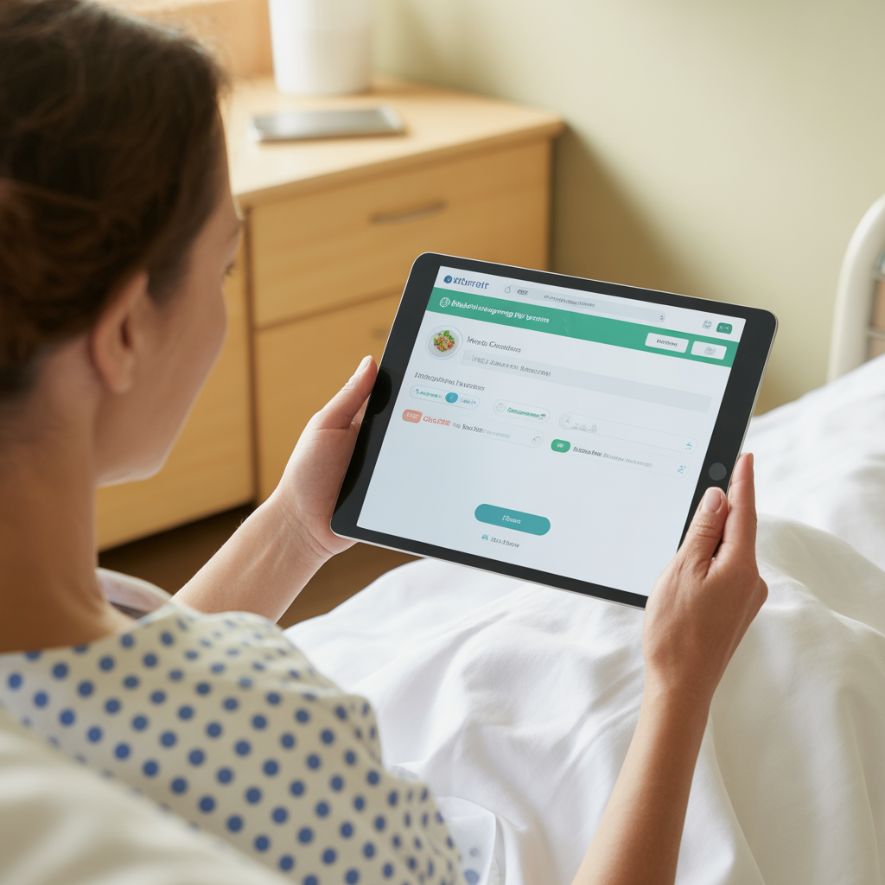
Scenarios & Use Cases
Concrete Scenario - Patient Ordering Food & Use Cases
Access & Login:
  Mrs. Chen opens the app on her bedside tablet and logs in securely.
Browse Menu:
  She navigates to the "Lunch" category to view options.
Select Items:
  She adds "Steamed Fish" and “Vegetable Soup" to her digital cart.
Confirm Details:
  In the cart, she sets delivery for "Tomorrow" and specifies "Low salt."
Submit Order:
  She clicks "Submit" and receives immediate visual confirmation.

Slide 16
User Stories, Scenarios & Use Cases
User stories:
  A Patient want to order his lunch from the canteen of the hospital
    Filter some food to avoid uncomfortable.
  A Nurse can order food and pick up at the canteen for saving their time when emergency.
User Scenarios:
  Patient chooses a suitable meal:
  Patient can enter their dietary restrictions
    The system helps prevent unsuitable food choices by showing clear meal details and availability.
  The patient selects a meal, reviews the order, and submits it.
User Cases:
  Patient browse available menu items, customize orders, and request bedside delivery or pickup.
  Hospital Employee order food via a staff portal and pay seamlessly using an ID badge or payroll deduction integration.

Slide 17
Requirements - Functional
Authentication:
  Users can log into the system using their ID and password.
Menu & Ordering:
  Add multiple food items to a shopping cart.
  View the contents of the shopping cart before purchase.
  Specify a delivery day for the order.
  Enter specific dietary requirements (e.g., "Low salt") for an order.
Order Confirmation:
  Submit the final order to the system.
  Receive an immediate confirmation

Slide 18
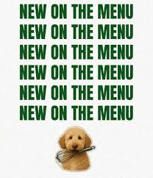
Requirements - Functional
For the Canteen Staff:
  Order Management:
    View a live dashboard of all incoming patient orders
  See key details for each order:
    Order ID patient name, items ordered, and dietary needs
  Update the status of an order
    E.g., from "Pending" to "Preparing" or "Completed"
Menu Control:
  Add new food items to the menu
  Update the price of existing menu items.
  Delete food items from the menu entirely

Slide 19
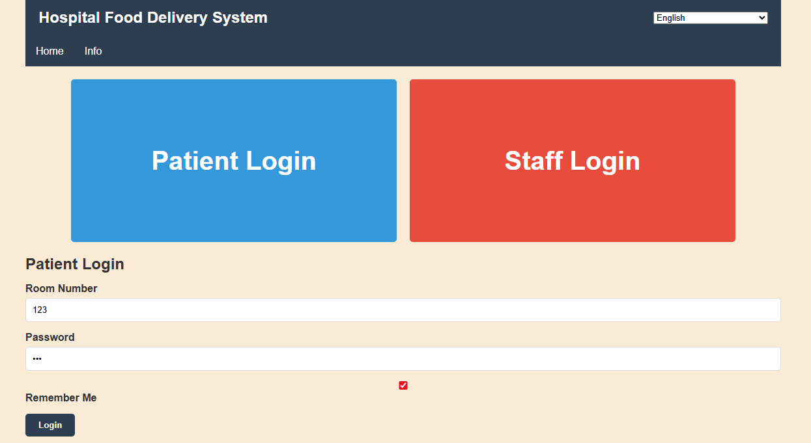
Requirements - Functional
Authentication
  Users can choose their logic types and log into the system using their ID and provided password.
  Users account saved in their browser cookie

Slide 20
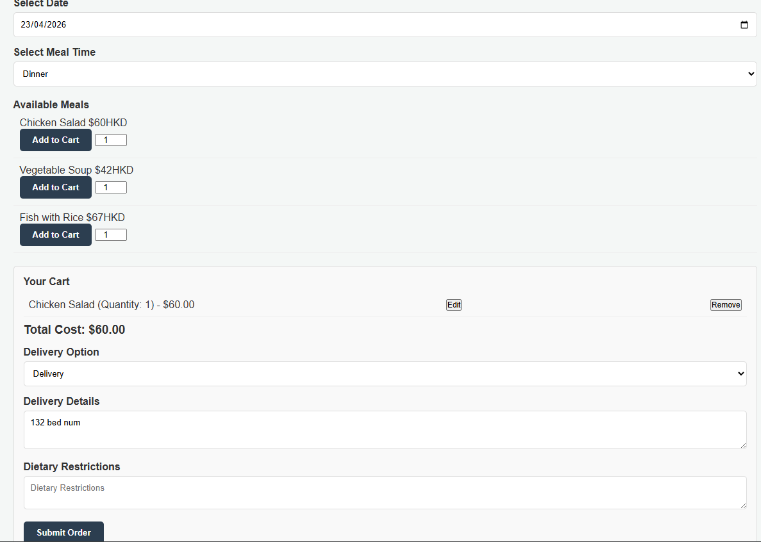
Specify a delivery day for the order
Requirements - Functional
Menu & Ordering
Add multiple food items to a shopping cart.
View the contents of the shopping cart before purchase.
Choose Delivery or Pickup
Delivery Details
Such as bed number or department number
Enter specific dietary requirements (e.g., "Low salt") for an order.

Slide 21
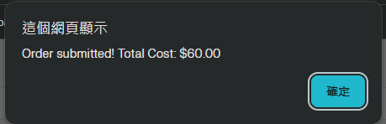
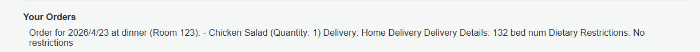
Requirements - Functional
Order Confirmation
  Receive an immediate confirmation
  Submit the final order to the system

Slide 22
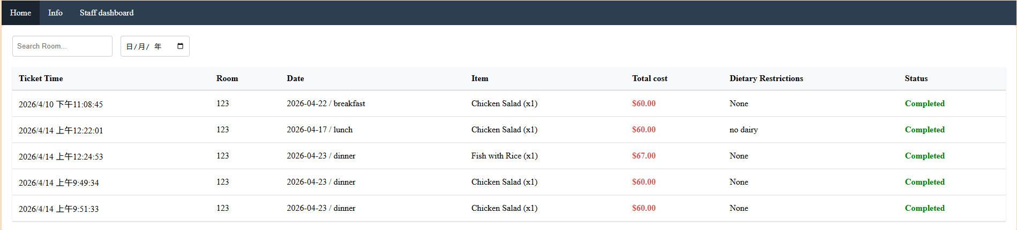
Requirements – Functional
For the Canteen Staff
    View a live dashboard of all incoming patient orders
    See key details for each order
  Update the status of an order

Slide 23
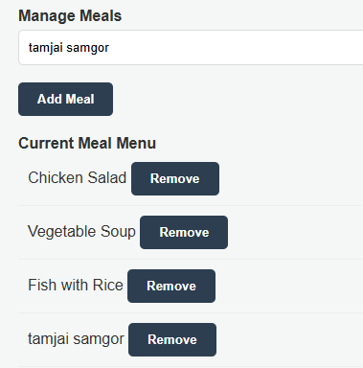

Requirements – Functional
Menu Control
Add new food items to the menu
  Delete food items from the menu entirely
  Update the price of existing menu items.

Slide 24
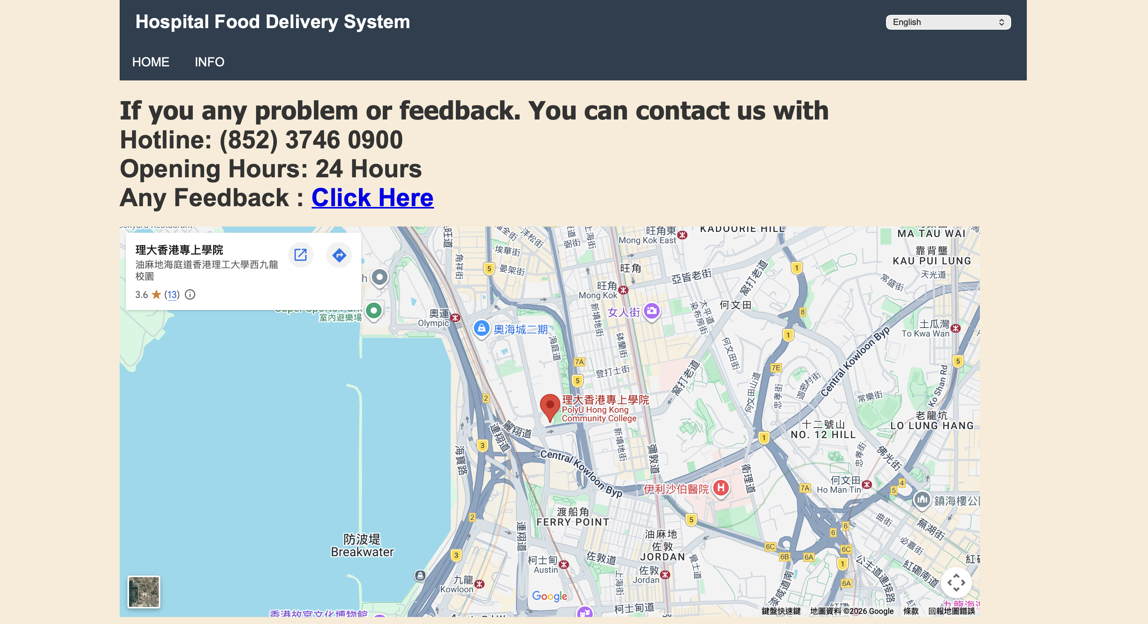
Requirements – Functional
Information & Feedback
Questionnaire to collect opinion of the website
Hospital location map

Slide 25
Requirements
Non-Functional Requirements:
Quality Attribute | Requirments
Performance | The system should load main pages quickly Process menu browsing and order submission to reduce waiting time
Usability | The interface should be simple, clear, and easy to use for users Including patients, staff, and visitors
Accessibility | The system support readable text, clear contrast, large buttons Since hospital users may include elderly people or users with physical limitations, the interface should be easy to understand Portable for mobile devices and desktop computers
Reliability | The system preserve order information correctly even during busy periods Since it provide a clear order record after users submitted the order

Slide 26
Requirements
Non-Functional Requirements:
Quality Attribute | Requirments
Maintainability | The code must be organized into separate: Logical files (HTML, CSS, JavaScript) For each feature, making it easy to update, debug, or add new functionality in the future
Localization | The system is designed to support multiple languages (As indicated by translations.js) Allowing for easy adaptation to different user groups

Slide 27
MoSCoW Prioritisation: Must Have
Must Have: | Why?
Browse the menu, such as food name, prices | Users must be able to see available food and prices to place any order
Choose pickup or delivery when ordering | This feature is critical as it determines the entire logistical workflow for the kitchen and staff
Enter the delivery details such as patient bed number, or department number | Precise delivery details are non-negotiable to ensure food reaches the correct patient
Confirm the order and provide order number | The order number is the essential unique identifier For tracking an order for both patients and staff

Slide 28
MoSCoW Prioritisation: Must Have
Must Have: | Why?
User can add meals to the cart | A fundamental feature required for any modern digital ordering system
Staff can update the order status | This tool is vital for maintaining an accurate menu Preventing orders for unavailable items

Slide 29
MoSCoW Prioritisation: Should Have
Should Have: | Why?
Multiple language options | Allow people from different countries to use the website content -> Avoid language problem
Dietary and allergen information | Users able to view dietary and allergen information for each meal
Staff can track order number order by time | Important for kitchen efficiency -> Ensuring meals are prepared fairly and in the sequence they were received
The system loads the main page quickly | A fast-loading system is crucial for a positive user experience -> Preventing user frustration or abandonment.

Slide 30
MoSCoW Prioritisation: Could Have
Could Have: | Why?
Register and login system | Users account save in their cookie. This is Essential for a Secure, Personalized Experience For linking orders to the correct patient
Staff can track the orders status by order number | This allows staff to quickly find a specific order When a patient makes an inquiry -> Improving Customer Experience
Accessibility features (High Contrast, Large buttons) | Make the app easier to use For patients with visual impairments, but are not essential for the core ordering function.

Slide 31
MoSCoW Prioritisation: Could Have
Could Have: | Why?
Text-to-speech function | Designed for visually impaired users, it reads the text aloud when the user taps on it.
Compatibility | Portable for mobile devices and desktop computers

Slide 32
MoSCoW Prioritisation: Won’t Have
Won’t Have: | Why?
Dietary restriction | Safety feature to prevent serious health incidents in a hospital setting Have dietary and allergen info for each meal already
Support 24/7 service hours | Align system availability with the canteen's actual operating hours to manage project scope Avoid the complexity of supporting off-hour operations

Slide 33
Demonstration
Time

Slide 34


Thank You

