Slide 1

HKCC Music Concert Management system

Slide 2
Table of contents
Introduction
Description of business rule
Conceptual model (ERD)
Logical design
Demonstration
Conclusion
Difficulty

Slide 3

Introduction
A musical or live concert will make multiple data.
Data is essential feedback for future concerts.
Change data to meaningful information.
Every concert has its venue name, number of people participating, cost, and artist name.
This information is a wingman to analysis.
Data will be stored in our database server.
Database is our staff's data source.
They do to need to collect data one by one, which will increase our analysis speed.

Slide 4
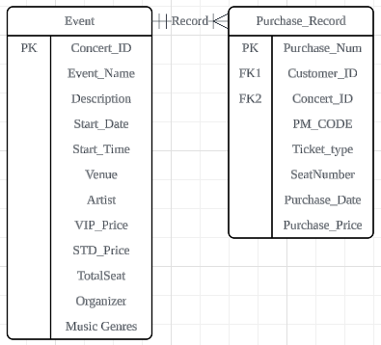
Business Rules 1
An Event records one or many Purchase Record, each Purchase Record are recorded in only one Event only. And the relationship between Event and Purchase Record is one to many .

Slide 5
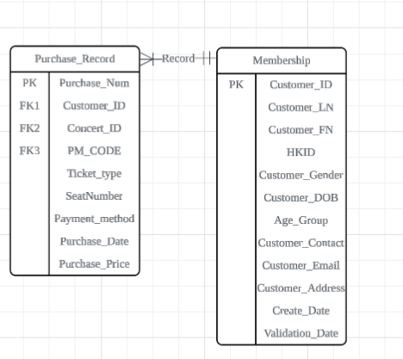
Business Rules 2
Each Purchase Record is recorded by only one Membership, each Membership is written by one or many Purchase Record. Therefore, the relationship between Purchase Record and Membership is 1 to Many.

Slide 6
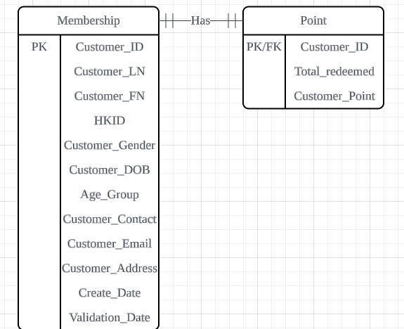
Business Rules 3
A Membership has only one Point records, each Point records record only one Membership . Therefore, the relationship between those entities are one to one relationship.

Slide 7
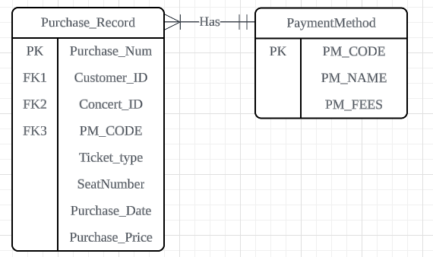
Business Rules 4
A Purchase Record has only one Payment Method, each Payment Method belongs to one or many Purchase Record. And the relationship between those entities is many to one .

Slide 8
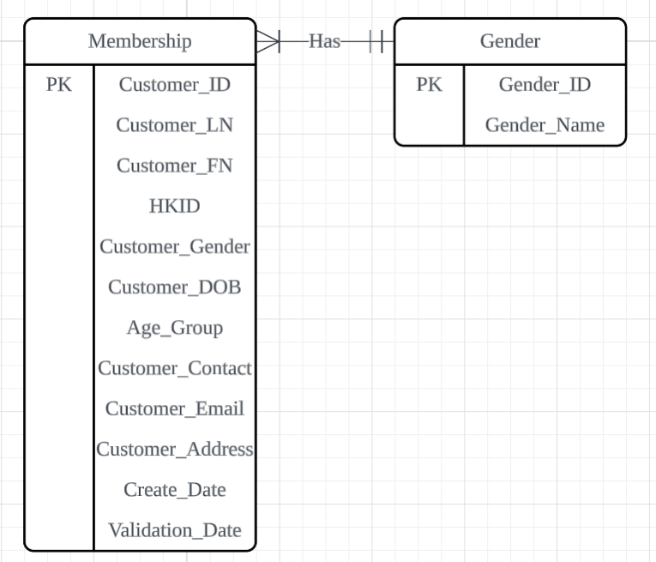
Business Rules 5
A membership has only one Gender, each gender can link to many membership. Therefore, the relationship between membership and gender is one to many.

Slide 9
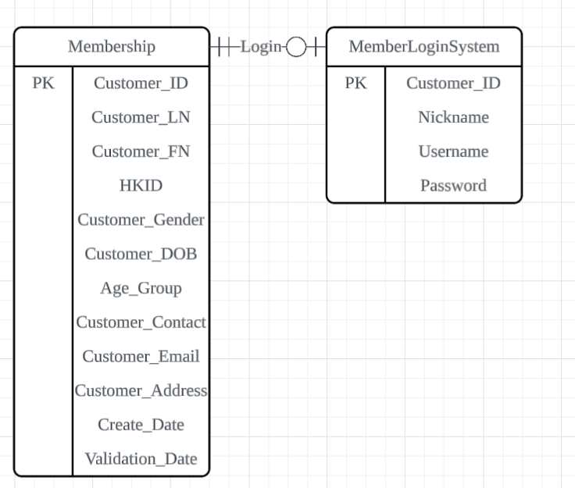
Business Rules 6
A membership may log in to one or zero member login system account, each member login system account is logged by only one membership.

Slide 10
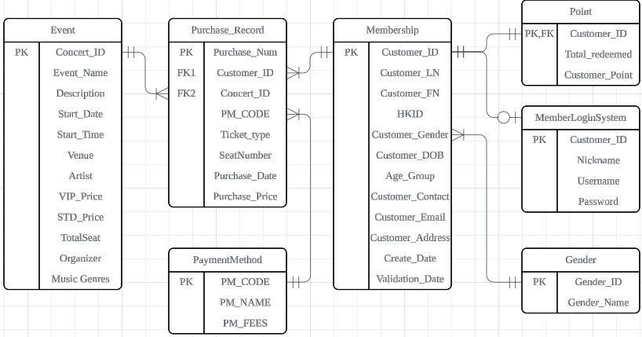
Conceptual model (ERD)

Slide 11
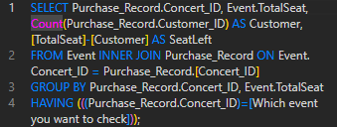
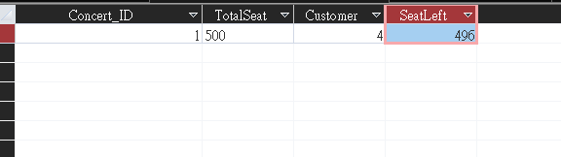
Logical design (1)
Query Name:
Check the total seat left by a concert
This SQL is used to find the concert seat left. It joins 2 table, Event and Purchase_Record.
SQL have counted the Customer_ID from the Purchase_Record table. Then using TotalSeat minus Customer and set the name Seatleft. Next group by the Concert_ID and TotalSeat.
SQL Code
This is the result of using Concert_ID : 1

Slide 12

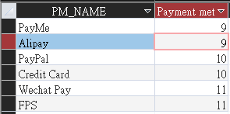
Logical design (2)
Query Name:
Customer payment method
This SQL is used to show the total payment method of customer had used. It joins 2 table, PaymentMethod and Purchase_Record.
SQL have counted the Purchase_num from the Purchase_Record table and named Payment method name. Then join the PM_CODE. Next group by the PM_NAME and order by to count Purchase_Num.
SQL Code
This is the result

Slide 13
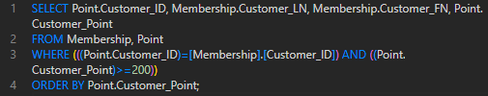
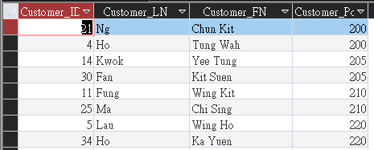
Logical design (3)
Query Name:
Customer points >=200
This SQL is used to list more than 200 membership point. First It joins 2 table, Membership and point.
Customer_ID have joined 2 table (Point and Membership) and the point need to >200. Next Order by the Customer_Point.
SQL Code
This is the result

Slide 14
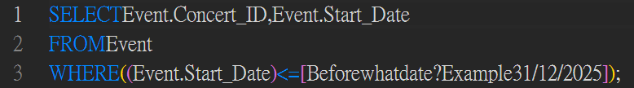
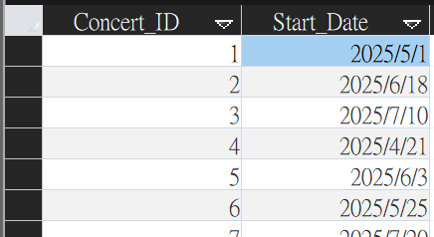
Logical design (4)
Query Name:
Find all the concert before the date you want
This SQL is used to find all the concert before the date that user entered. It joins the Event Table.
SQL has asked the user to enter the date, and it will show the result before that date.
Output Concert that before 31/12/2025.
SQL Code
This is the result

Slide 15

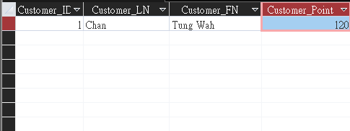
Logical design (5)
Query Name:
Find the point of customer own
This SQL is used to find the customer had own point. It joins 2 table, Point and Membership.
SQL Customer_ID have joined 2 table (Point and Membership) .Then ask the user to Enter Customer_ID. Next order by the Customer_Point.
SQL Code
This is the result of using Customer_ID : 1

Slide 16
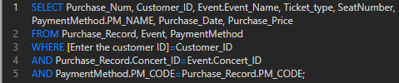
Logical design (6)
Query Name:
Finding Member all info
This SQL is used to find the member all booked result and information. It joins 3 table, Event, Purchase_Record and PaymentMethod.
SQL have asked the user to input Customer_ID from the Purchase_Record table. Then
the Purchase Concert_ID is same as event.
PM_Code with Paymentmethod is same Purchase_record too.
SQL Code
This is the result of using Customer_ID : 1

Slide 17

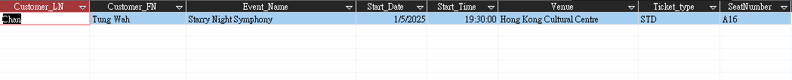
Logical design (7)
Query Name:
For customer find their seat
This SQL is used to find customer seat. It joins 3 table, Membership, Purchase_Record and Event.
The purchase is linked to the correct concert event. Next, Only purchases made by valid members are included.
SQL Code
This is the result of using Membership_ID : 1

Slide 18
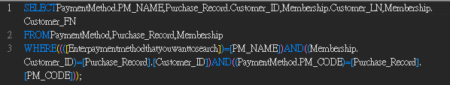
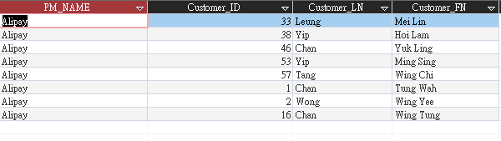
Logical design (8)
Query Name:
List of customer prefer payment method
This SQL is used to list which customer prefer payment method. It joins 3 table, PaymentMethod, Purchase_Record and Membership.
SQL have asked the user to type the which Paymentmethod. Next, use Membership to Ensures purchases are made by valid members.
SQL Code
This is the result of using PM_NAME : Alipay

Slide 19

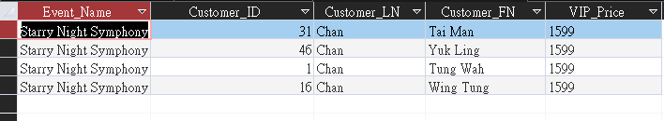
Logical design (9)
Query Name:
The customer list of each concert
This SQL is used to show all the viewer of the selected Event with their price. It joins 2 table, Event, Membership and Record.
SQL have ensured the concert in the Event table matches the concert in the Purchase_Record. Then selected concert with matches the user-selected concert with the concert ID in the Event table.
SQL Code
This is the result of using : event_ID 1

Slide 20

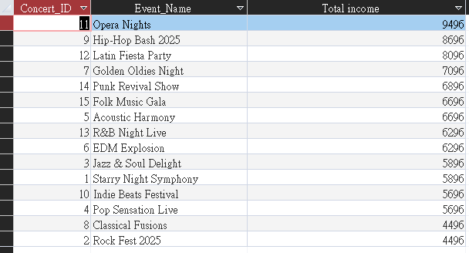
Logical design (10)
Query Name:
The total income for each concert
This SQL is used to show the total income of each concert. It joins 2 table, Event and Purchase_Record.
SQL have related the Concert_ID with Purchase_Record and Event. Next group by the Event_Name and Concert_ID. Also, order by to Sum Purchase_Price with descend.
SQL Code
This is the result :

Slide 21

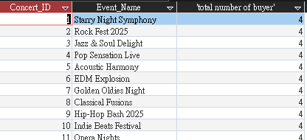
Logical design (11)
Query Name:
Total buyers for each concert
This SQL is used to show the total number of buyer from concerts. It joins 2 table, Event and Purchase_Record.
SQL have counted the Customer_ID from the Purchase_Record table and named Totalnumberbuyer. Then This condition is essential for accurately correlating event information with corresponding purchase data. Next group by the Concert_ID and Event_name.
SQL Code
This is the result :

Slide 22
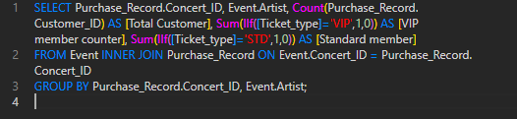
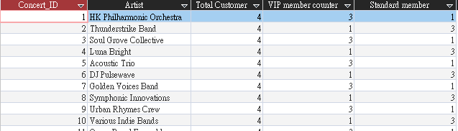
Logical design (12)
Query Name:
VIP/Standard Member of each Concert
This SQL is used to count the Total customer also count the VIP and Standard Member With All Concert. It joins 2 table, Event and Purchase_Record.
SQL have counted the Customer_ID from the Purchase_Record table and named Total Customer. Then Sumif the ticket type with 1 and 0. Next group by the Concert_ID and Artist.
SQL Code
This is the result :

Slide 23

Logical design (13)
Query Name:
Artist search event
This SQL is used list the Artist from the user entered value. It joins Event table.
SQL have asked the user to type their prefer artist name. It will show the selected artist resource on the result.
SQL Code
This is the result of using :Classy Music band

Slide 24

Logical design (14)
Query Name:
Organizer search event
This SQL is used to show and list from the user entered Organizer. It joins Event table.
SQL have asked the user to type which organizer they want. It will show the result of entered value, for example Warmer Limited, 1/5/2025.
SQL Code
This is the result of using : Warmer Limited

Slide 25

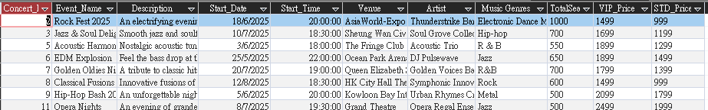
Logical design (15)
Query Name:
Upcoming Event
This SQL is used to let user to list the upcoming event from the user input the date. It joins Event Table.
SQL have asked the user to enter the date. Then query will use the start date > the typed date. Next It will show the after event of date has typed.
SQL Code
This is the result of using : 24/5/2025

Slide 26
Logical design (16)
Query Name:
Using Music Genre to find all concert
This SQL is used to list from the user typed Music_Genres. It selected Event table.
SQL have asked the user which music genres they are looking for. Then it will using the typed genres to show result.
SQL Code
This is the result of using : Jazz

Slide 27
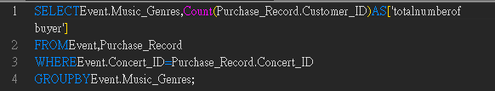
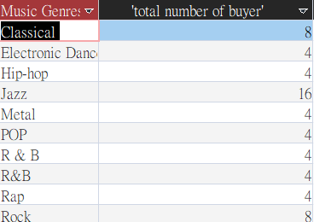
Logical design (17)
Query Name:
The population of each music genres
This SQL is used to Count the Customer_ID As Totalnumber of buyer. It joins 2 table, Event and Purchase_record to ensure the records correspond to the same concert.
It groups the results by Music_Genres to provide a count of buyers for each genre. Then group by the Event and Music_Genres.
SQL Code
This is the result:

Slide 28
demonstration

Slide 29
Conclusion
This database was created to manage and store the information about members and customers who purchased concert tickets, and the information of the concert events.
We created different queries and reports for users to find their wanted data. Those can help customers and administrators manage and analysis their records more easily.
With this database, we can avoid data redundancy and lack of consistency.
Also, our database has a centralized user main page and some preset functions for our users. It will improve users' experience.

