Slide 1
Big Mountain Resort - New Chairlift
By: Daniel Timmermann

Slide 2
Problem Identification
How much should Big Mountain Resort charge for chairlift tickets and should tickets cost more on the weekend or cost the same every day of the week in order to recoup the extra operational costs and maintain a profit margin of 9.2% for next year?
Will higher ticket prices scare off potential customers?
Note: There are other factors that can be explored to increase revenue or reduce costs, but for this problem I have examined the cost of tickets.

Slide 3
Recommendation and Key Findings
Current adult weekend ticket price: $81
Revised adult weekend ticket price: $82.39
I focused in on the adult weekend ticket price, but after a quick analysis of adult weekday ticket price then we can decide if the price should be the same regardless of the day of the week.

Slide 4
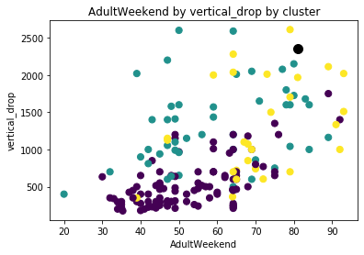
Modeling Results and Analysis
Note: Black dot is Big Mountain Resort and the three different color dots represent clusters.
First, I examined the relation between ticket prices and vertical drop for each resort in the dataset provided by Alesha. From the graph you can see there are other resorts with higher ticket prices, but they have less of a vertical drop.

Slide 5
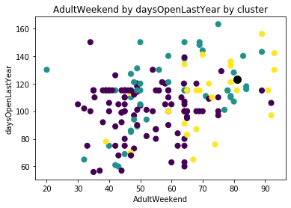
Modeling Results and Analysis (cont.)
Second, I examined the relation between ticket prices and the number of days each resort was open last year. From the graph you can see there are other resorts that were not open as many days and charged higher ticket prices.

Slide 6
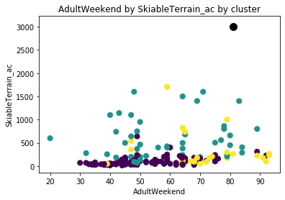
Modeling Results and Analysis (cont.)
Lastly, I examined the relation between ticket prices and the square area of skiable terrain for each resort. From the graph you can see Big Mountain has a significant amount of skiable terrain compared to other resorts and some of the other resorts charge higher ticket prices.

Slide 7
Conclusion
Big Mountain Resort is experiencing a problem with their profit margin due to a new chairlift increasing operating costs for the upcoming season.
Based on the results from the analysis of the ticket price compared to other factors I recommend the price of adult weekend chairlift tickets should be raised from $81 to at least $82.39.
Customers will not be scared off by the increase in price because other resorts offer less amenities to customers, but still charge more than $81.

