Slide 1
Sentiment Analysis
of Movie Reviews
LSTM
GRU
LSTM · GRU · BERT: A Comparative Study
Daniel Wehbe & Rami Aabed
Deep Learning for NLP · April 2026
BERT

Slide 2
Problem Statement
The Challenge
Our Approach
Given a movie review, automatically determine whether the sentiment expressed is positive or negative.
This is a binary text classification task: one of the most fundamental problems in Natural Language Processing.
LSTM
Recurrent + learned embeddings
GRU
Why It Matters
Streamlined recurrent
Product review monitoring at scale
Social media opinion analysis
Customer feedback classification
Brand reputation tracking
BERT
Pre-trained transformer
Same dataset · Same metrics · Direct comparison

Slide 3
Dataset: IMDb Large Movie Review Dataset
50,000
2
50 / 50
Preprocessing
Total Reviews
Classes
LSTM & GRU
Pos / Neg Balance
Remove HTML tags & special characters
Lowercase + whitespace tokenisation
Pad / truncate to 200 tokens
Custom vocabulary: top 20,000 words
Data Splits
Split | Samples | Balance
Training | 22,500 | 50% / 50%
Validation | 2,500 | 50% / 50%
Test | 25,000 | 50% / 50%
BERT
WordPiece subword tokenisation
Automatic [CLS] and [SEP] tokens
Pad / truncate to 256 tokens

Slide 4
Model Architectures
LSTM
GRU
BERT
~3.8M params
~3.5M params
~110M params
Embedding Layer (128-dim)
Embedding Layer (128-dim)
WordPiece Tokenizer
LSTM (128 hidden units)
GRU (128 hidden units)
12 Transformer layers
Dropout (p=0.3)
Dropout (p=0.3)
Dropout on [CLS] (p=0.3)
Linear → 1 output
Linear → 1 output
Linear → 1 output
Uses forget, input & output gates to control long-range memory
Merges gates for efficiency: fewer params, faster convergence
Pre-trained on 3.3B words: fine-tuned end-to-end for classification

Slide 5
Training Process
LSTM & GRU
BERT Fine-Tuning
Optimiser | Adam (lr = 1e-3)
Loss | BCEWithLogitsLoss
Batch size | 64
Max seq len | 200 tokens
Vocab size | 20,000
Epochs | Up to 5
Early stop | Patience = 2
Base model | bert-base-uncased
Optimiser | AdamW (lr = 2e-5)
Loss | BCEWithLogitsLoss
Batch size | 16
Max seq len | 256 tokens
Scheduler | Linear warmup (10%)
Grad clipping | Max norm = 1.0
Epochs | Up to 3

Slide 6
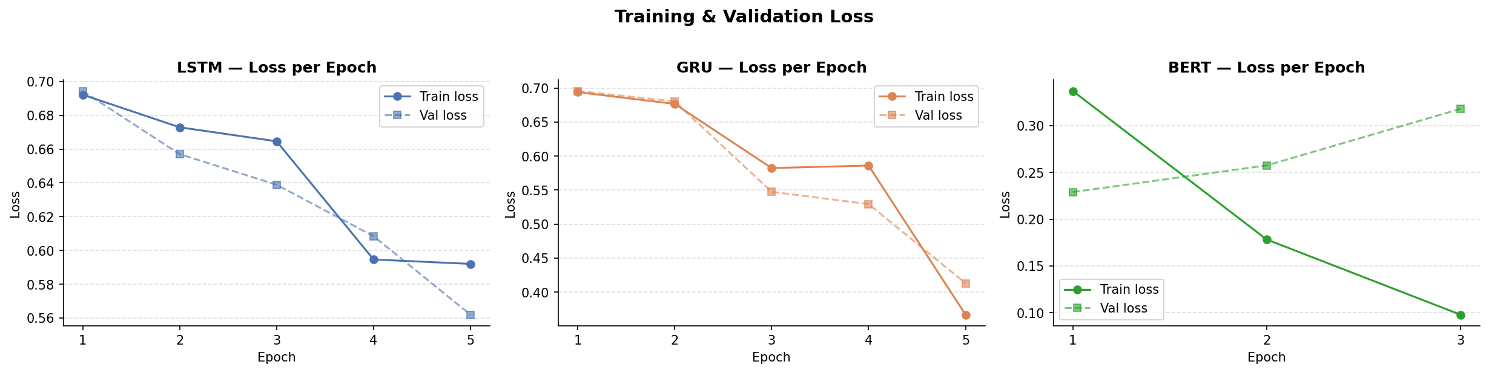
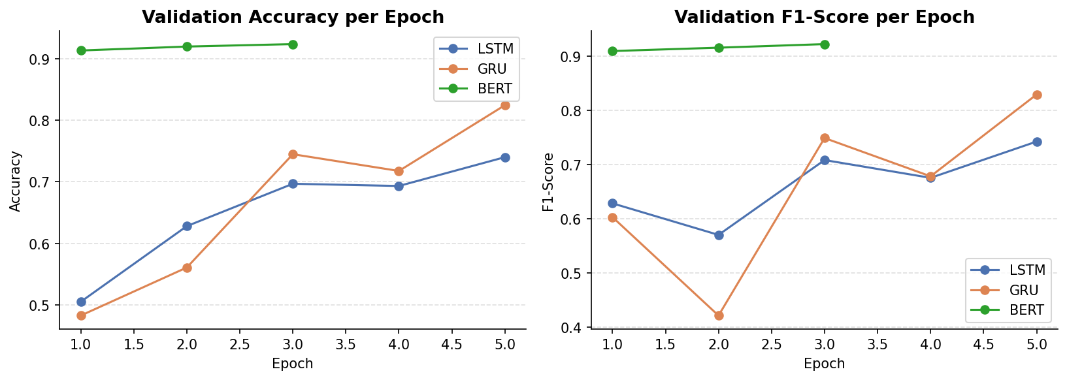
Training Curves
Figure 1: Training & validation loss per epoch for LSTM, GRU, and BERT
Figure 2: Validation accuracy and F1-score per epoch

Slide 7
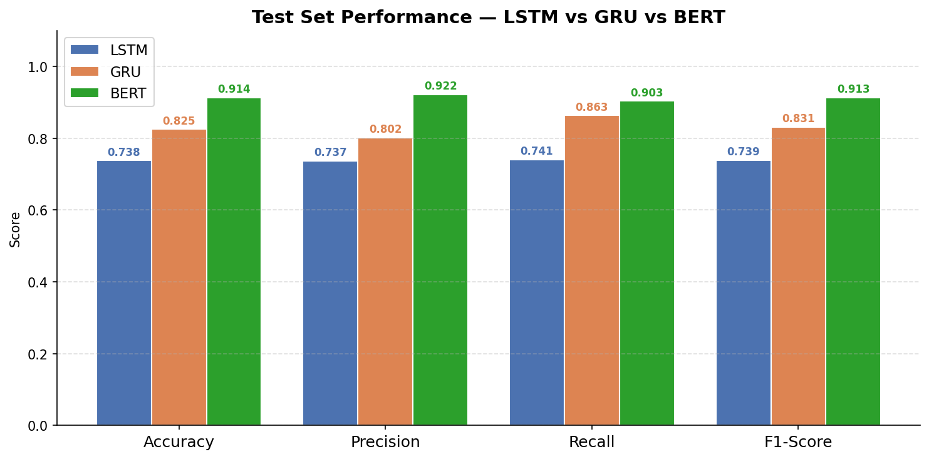
Results: Test Set Performance
LSTM
GRU
BERT
73.8%
82.5%
91.4%
F1: 73.9%
F1: 83.1%
F1: 91.3%
Figure 3: Accuracy, Precision, Recall and F1-Score on the 25,000-sample test set

Slide 8
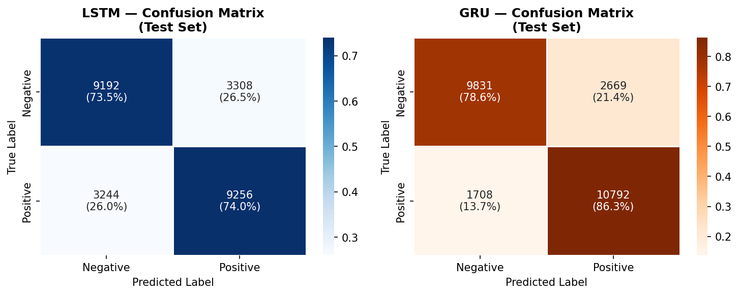
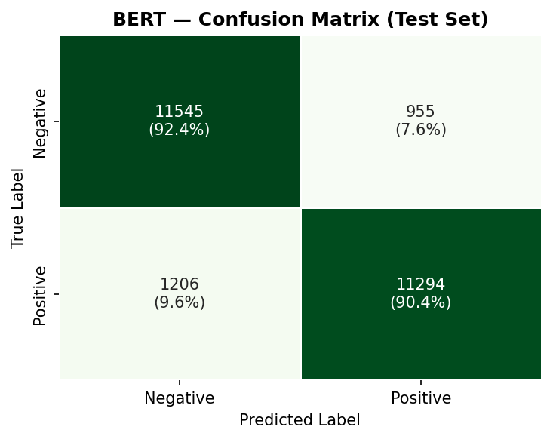
Results: Confusion Matrix Analysis
LSTM (left) · GRU (right)
BERT
Key Observations
LSTM: 6,552 total errors, roughly symmetric between false positives and false negatives.
GRU: 4,377 errors; biased toward false positives (recall 86% > precision 80%).
BERT: only 2,161 errors; near-balanced, precision 92.2% vs recall 90.4%.

Slide 9
Conclusion & Key Insights
01
BERT achieves 91.4% accuracy: outperforming GRU by +9% and LSTM by +18%. Pre-training on 3.3B words gives a decisive advantage.
02
GRU outperforms LSTM despite being simpler. Fewer, more efficient gates generalise better on this task.
03
All models generalise well: the train/test accuracy gap is small, indicating no significant overfitting.
04
Clear trade-off: BERT is ~10× slower to train and requires more memory. Choose based on constraints.

