Slide 1
PHP
Absolute Basics
Object-Oriented Programming

Slide 2


Daniel Kline
Web Developer
@daniel_okc
danielkline19@hotmail.com

Slide 3
Today we will …
Define OOP and explain how it relates to procedural programming
Learn OOP basics using PHP …
Classes vs. objects
Class constants and internal reference
Public vs. private scope
Copying and cloning objects
Create a login API

Slide 4
Procedural Programming is a way of programming where we use two separate concepts to accomplish a task: procedures and data.
Object-Oriented Programming combines these two into one concept called objects. This allows for more complex programming with less code.
Source: http://study.com/academy/lesson/object-oriented-programming-vs-procedural-programming.html

Slide 5
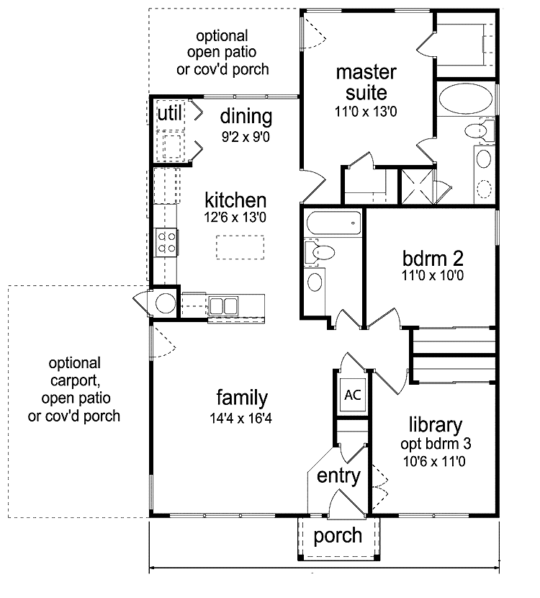
is like a blueprint …
Class
A
Source: http://notbutoh.com/modern-house-blueprints-fresh-with-photo-of-modern-decor-new-in-design/

Slide 6

is like a house …
Object
An
Source: http://www.clipartpanda.com/categories/happy-house-clipart

Slide 7
If we create a class called User, and we want to alter the characteristics of the users in an application, all we have to do is change the User class and when we change the blueprint, the change will be effective for all users.
Variables inside a class are called properties. Defined as public properties, they have read/write privileges outside of the class.

Slide 8
One blueprint … can yield many houses
=

Slide 9
Types of properties can be
Hair color
Shoe size
How tall someone is
Hobby
Musical instrument they play

Slide 10

Source: http://www.popsugar.com/beauty/Sand-Art-Rainbow-Hair-Color-37681502#photo-37681502

Slide 11

Source: http://www.zazzle.com/height+jokes+clothing

Slide 12
Example 1:
Create a class that includes email and password properties and methods for indicating that a user has logged in and logged out.

Slide 13
Procedure
Create a class named User
In an appropriately named file named user.php
Add this code to the file …
<?php
class User {
public $email;
public $password;
}

Slide 14
Let’s create login and logout functions for our user class by adding code to our user class file …
public function login() {
return ‘Logging in …’;
}
public function logout() {
return ‘Logging out …’;
}

Slide 15
Create an index.php file from which we will call our class.
Need to include the user class file
Create an object named $joost
<?php
require ‘user.php’;
$joost = new User();

Slide 16
The user $joost how has an email and a password.
S/he can login and logout. Let’s test the code.
Add to index.php
var_dump($joost);

Slide 17
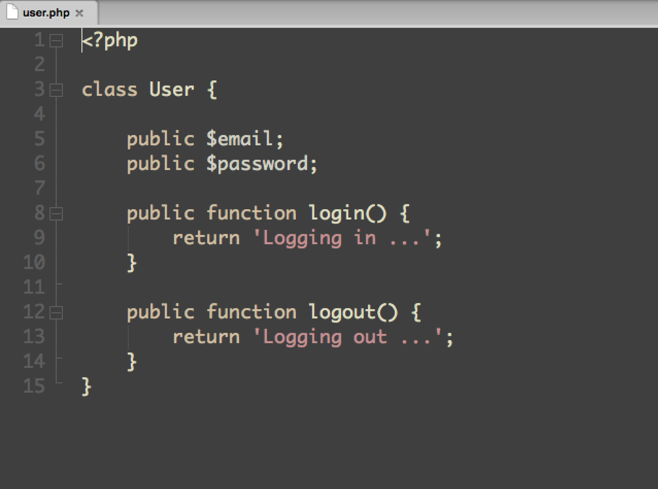
Add to index.php …

Slide 18
Let’s take a look at our code for index.php …
<?php
require ‘user.php’;
$joost = new User();
var_dump($joost)

Slide 19
Let’s run the code and take a look at the output …
object(User)#1 (2) { ["email"]=> NULL ["password"]=> NULL }
Output shows that we have an object named User defined and there are two properties email and password. Since there was not value assigned they have a value of NULL.

Slide 20
This is the assignment operator which means that we want to access a property (on the right side) from the object (on the left).
object_name->property_name

Slide 21
Examples …
$person->haircolor
$person->shoesize

Slide 22
Assign an email address to a variable using procedural programming …
$mail = ‘the@email.com’;
If we wanted to assign an email to the email property of the $joost object, we would do the following …
$joost->email = ‘joost@tutsplus.com’;

Slide 23
Add to the code index.php …
var_dump($joost);
Resulting output …
object(User)#1 (2) { ["email"]=> string(18) "joost@tutsplus.com" ["password"]=> NULL }

Slide 24
Set a password to random gibberish for $joost …
$joost->password = ‘ahj%jk@#’;
Create another user named $nick …
$nick = new User();
$nick->email = 'nick@tutsplus.com';
$nick->password = 'hie@kwi^';
Add to index.php …
var_dump($nick->login());

Slide 25
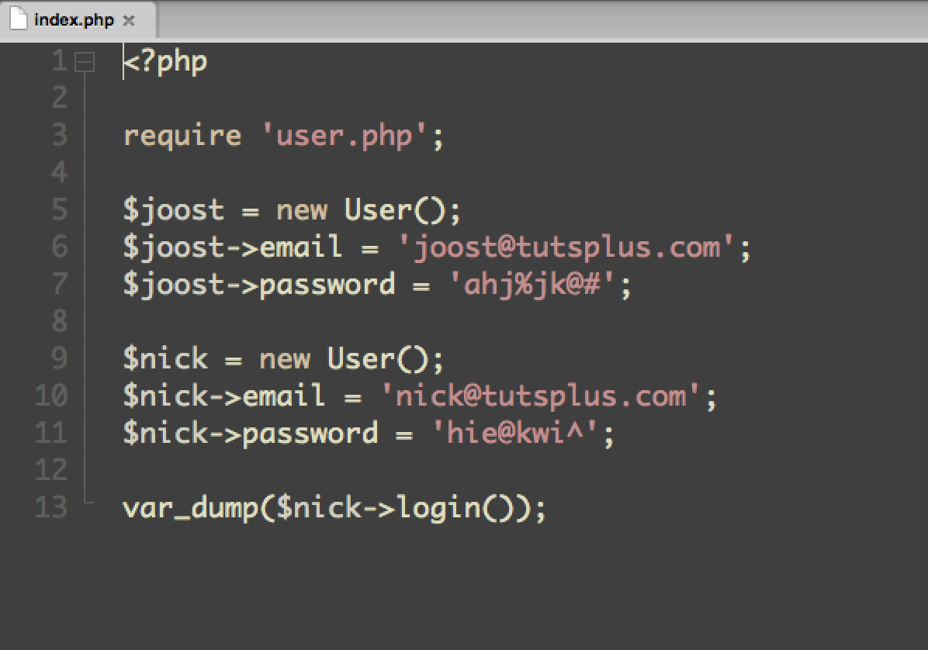

Slide 26
Resulting output …
string(14) "Logging in ..."

Slide 27
Constants and Internal Reference
Constant
Numerical value identifier
Value cannot be changed
Must start with letter or underscore (no ‘$’ sign)
Global across entire script (class)
No name collisions if used another constant with same name is used outside of class
Recommended to use uppercase letters for easy identification

Slide 28
Example 2:
Define the minimum number of characters for a password. If the password is too short, we want to throw an exception.
Assume we have a constant with the name MINCHARS, we access the constant with the following syntax including the keyword self:
self::MINCHARS
The double colon ‘::’ is the scope resolution operator

Slide 29
We could define the constant in the index.php file as such:
define(MINCHARS,8);
Instead, we will make the definition in the user.php file:
const MINCHARS = 8;

Slide 30
Create a method in user.php to set the password:
public function setPassword($string) {
if (strlen($string) < self::MINCHARS) {
throw new Exception('the password
should be at least ' . self::MINCHARS .
' characters long.');
}
}

Slide 31
We need to update index.php in order to make this work:
Remove
$joost->email = 'joost@tutsplus.com';
$joost->password = 'ahj%jk@#';
$nick = new User();
$nick->email = 'nick@tutsplus.com';
$nick->password = 'hie@kwi^';
var_dump($nick->login());
Replace with
$joost->setPassword('asdf');

Slide 32
Let’s see the output …
Fatal error: Uncaught exception 'Exception' with message 'the password should be at least 8 characters long.’
If an error message is thrown due to the scope resolution operator ‘::,’ a message “Paamayim Nekudotayim” will appear. This is Hebrew meaning double colon.

Slide 33
Internal reference. The expression:
$this->password
states that we want to access the password object within the current class. This is the reason for the $this keyword.

Slide 34
This part can be confusing …
self reference constants
this reference properties and methods
If password passes validation, we want to set it to a hash using a cryptographic hash function. Here is the syntax:
$this->password = hash(‘sha256’, $string);

Slide 35
Add the hash to the setPassword method in the User class …
$this->password = hash(‘sha256’, $string);
In index.php, assign a long password and var_dump
$joost->setPassword('ah@94^hjq’);
var_dump($joost);

Slide 36
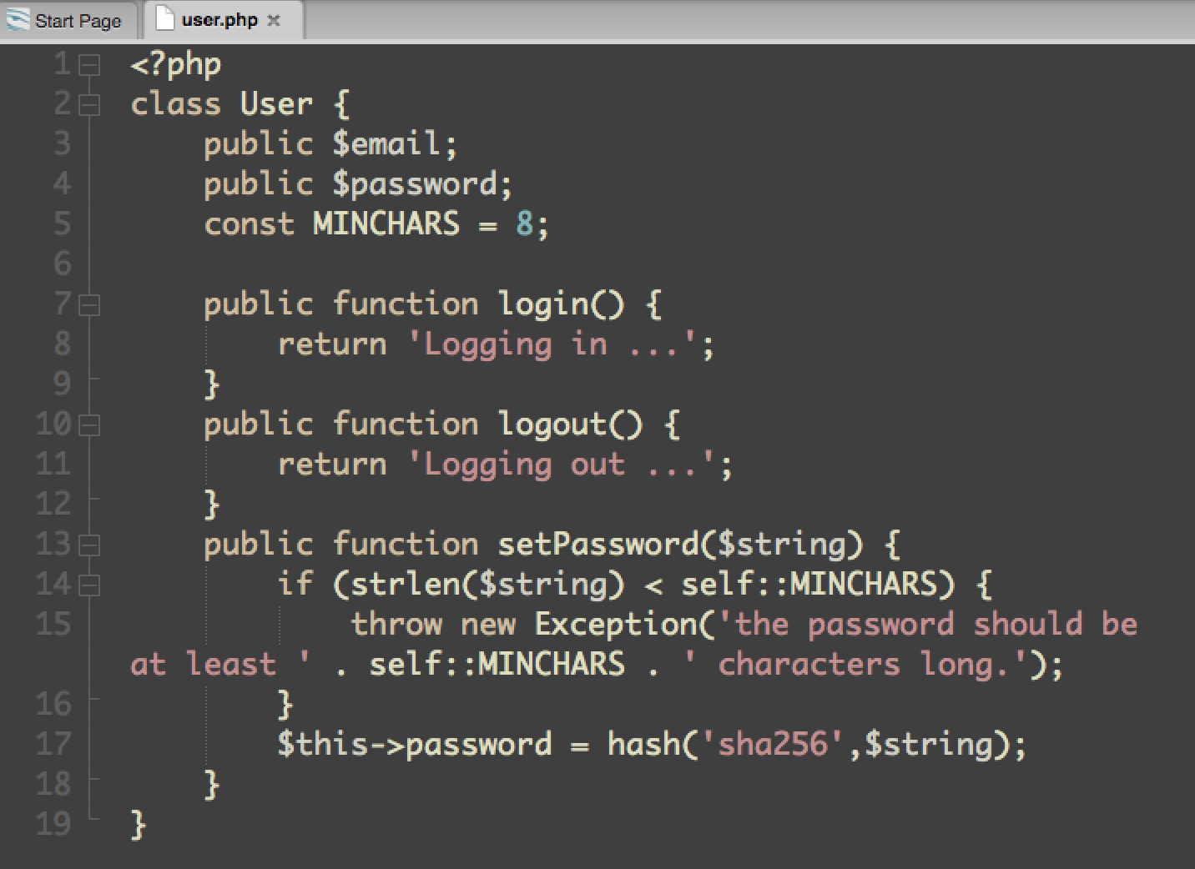

Slide 37
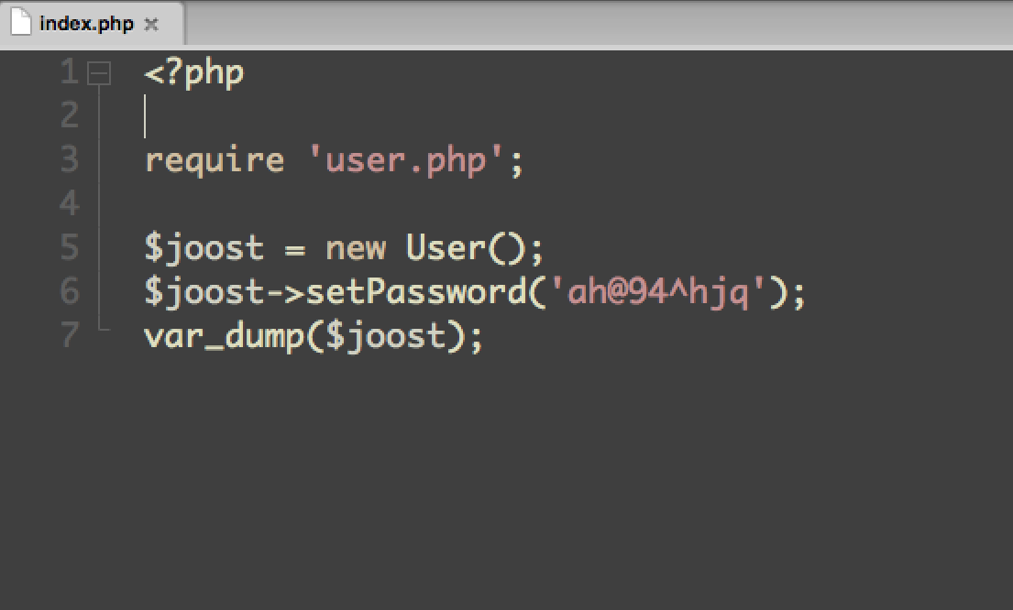

Slide 38
Output …
object(User)#1 (2) { ["email"]=>
NULL ["password"]=> string(64) "4b875365586d5de0e6e4cfd04586b41f560d
9f95ea5faba2278eeaa5fc620205" }
Result of the hashed password is …
"4b875365586d5de0e6e4cfd04586b41f560d
9f95ea5faba2278eeaa5fc620205"

Slide 39
We use Visibility markers to indicate the scope of a property or method. Examples are public, private or protected. We will use the public and private markers in today’s presentation.
Public scope allows the rest of the application to see what we are doing while Private scope does not.
If data is to be secured (i.e., for use as a password), we would want private scope and we could reuse it in the user class and outsiders could not see it.

Slide 40
Change the scope of the password property to private in the User class…
Change public $password;
To private $password;
Dump password for $joost …
var_dump($joost->password);
Output …
Fatal error: Cannot access private property User::$password

Slide 41
Example 3:
Let’s change the password directly from the PHP by modifying index.php code …
Remove: var_dump($joost->password);
Change: $joost->setPassword(‘asdfuioe’);
To: $joost->password = ‘asdfuioe’;
Output …
Fatal error: Cannot access private property
User::$password
Same message as before

Slide 42
One of the goals for OOP is to encapsulate the data within our objects.
An object should be like a black box
The outside world should not be aware of its internal workings
We simply feed parameters into the object and get a response in return and only then can our object act independently from the rest of the application
This way we can change the entire internals for an object and it would not break the rest of our application

Slide 43
Class with 5 properties,
one instance of the object …
email
hair_color
height
shoe_size
password

Slide 44
Two objects from the same class …
email
$mike =
hair_color
height
shoe_size
password
email
$joost =
hair_color
height
shoe_size
password

Slide 45
The outside world has nothing to do with where the value is stored or if it’s filtered or validated in any way
It just needs a way to get and set that property’s value without direct access to the property itself
We already have a perfect example for that in our user class
If somebody outside of our user class weren’t able to change the password for the user directly, s/he could easily make this an unsafe password like ‘1234’

Slide 46
We created the setPassword method to prevent the password from only being stored as plain text
If we want to change the password from the outside, we have to use the following method we already created in the User class
We have to make sure the password is properly validated and hashed before it is stored

Slide 47
Example 4:
Create another method to get the value of the user’s password. This will be an API to set and get a user’s password.
Add code to the User class…
public function getPassword() {
return $this->password;
}
Since we know the password is properly validated and hashed, we can simply return with the statement
return $this->password;

Slide 48
Let’s see it in action …
Add code to index.php …
$joost->setPassword(‘ah@94^hjq’);
var_dump($joost->getPassword());
Result …
string(64) "4b875365586d5de0e6e4cfd04586b41
f560d9f95ea5faba2278eeaa5fc620205”

Slide 49
Example 5:
Let’s do the same for email …
Change the visibility marker for $email to private in User class …
private $email;

Slide 50
Create a public method with validation …
public function setEmail($string) {
if (! filter_var($string,
FILTER_VALIDATE_EMAIL)) {
throw new Exception('Please provide
a valid email.');
}
$this->email = $string;
}
public function getEmail() {
return $this->email;
}

Slide 51
Just like with properties, we can also set the visibility scope of a method to private. We would do this for methods that are for internal use only. We could abstract password validation away from the setPassword method.
To do this create a validatePassword() method …
private function validatePassword($string) {
return strlen($string) < self::MINCHARS ?
false : true;
}
return false if fail
return true if true

Slide 52
Change password to ‘1234’ verify output …
Result Fatal error: Uncaught exception
'Exception’ with message 'the password
should be at least 8 characters long.'
Change to a longer password …
Result
string(64) "b86b2373aa5a777eb535b2Ea25d
bce8bda42844cad7bf418edf69d9ac1fc82e2"

Slide 53
We can leave off the visibility marker for a method meaning that the method would be accessible publicly (default) same as if we prepended it with the word public
Sometimes it may be useful to create an object from a class and then copy it a couple of times. In this case, it is good to know how PHP deals with copying.
By default, objects are copied by reference not by value.
what does this mean exactly?

Slide 54
Example 6:
let’s copy an object by reference …
We already have the user named $joost create a brother for $joost named $mike
index.php
Remove from code …
$joost->setEmail('joost@tutsplus.php');
Add to code …
$mike = $joost;
var_dump($mike);
var_dump($joost);

Slide 55
Output …
object(User)#1 (2) { ["email":"User":private]=> string(18) "joost@tutsplus.com" ["password":"User":private]=> string(64) "0554a5df02ee12f1ae36a51caaef34a31deb9458a48b629da554a2b322466f4a" } object(User)#1 (2) { ["email":"User":private]=> string(18) "joost@tutsplus.com" ["password":"User":private]=> string(64) "0554a5df02ee12f1ae36a51caaef34a31deb9458a48b629da554a2b322466f4a" }

Slide 56
Now see what happens when we change $mike’s email to something different than that for $joost
add to code in index.php …
$mike->setEmail('mike@tutsplus.php');

Slide 57
Result …
object(User)#1 (2) { ["email":"User":private]=> string(17) "mike@tutsplus.php" ["password":"User":private]=> string(64) "b86b2373aa5a777eb535b2ea25dbce8bda42844cad7bf418edf69d9ac1fc82e2" } object(User)#1 (2) { ["email":"User":private]=> string(17) "mike@tutsplus.php" ["password":"User":private]=> string(64) "b86b2373aa5a777eb535b2ea25dbce8bda42844cad7bf418edf69d9ac1fc82e2" }

Slide 58
Both emails have changed to mike@tutsplus.com
Now change $joost’s email to something else.
Add this to the code, without removing the original email assignment for $joost …
$joost->setEmail(‘joost@tutsplus.php’);

Slide 59
Result …
object(User)#1 (2) { ["email":"User":private]=> string(18) "joost@tutsplus.php" ["password":"User":private]=> string(64) "b86b2373aa5a777eb535b2ea25dbce8bda42844cad7bf418edf69d9ac1fc82e2" } object(User)#1 (2) { ["email":"User":private]=> string(18) "joost@tutsplus.php" ["password":"User":private]=> string(64) "b86b2373aa5a777eb535b2ea25dbce8bda42844cad7bf418edf69d9ac1fc82e2" }

Slide 60
Example 7:
What if we wanted to create a copy from a user but only want to change the email address for that specific copy?
In this case we need to copy the object by value.
Do this by using the word clone. This will make $joost and $mike two separate objects
replace
$mike = $joost;
with
$mike = clone $joost;
$mike->setEmail('mike@tutsplus.com');

Slide 61
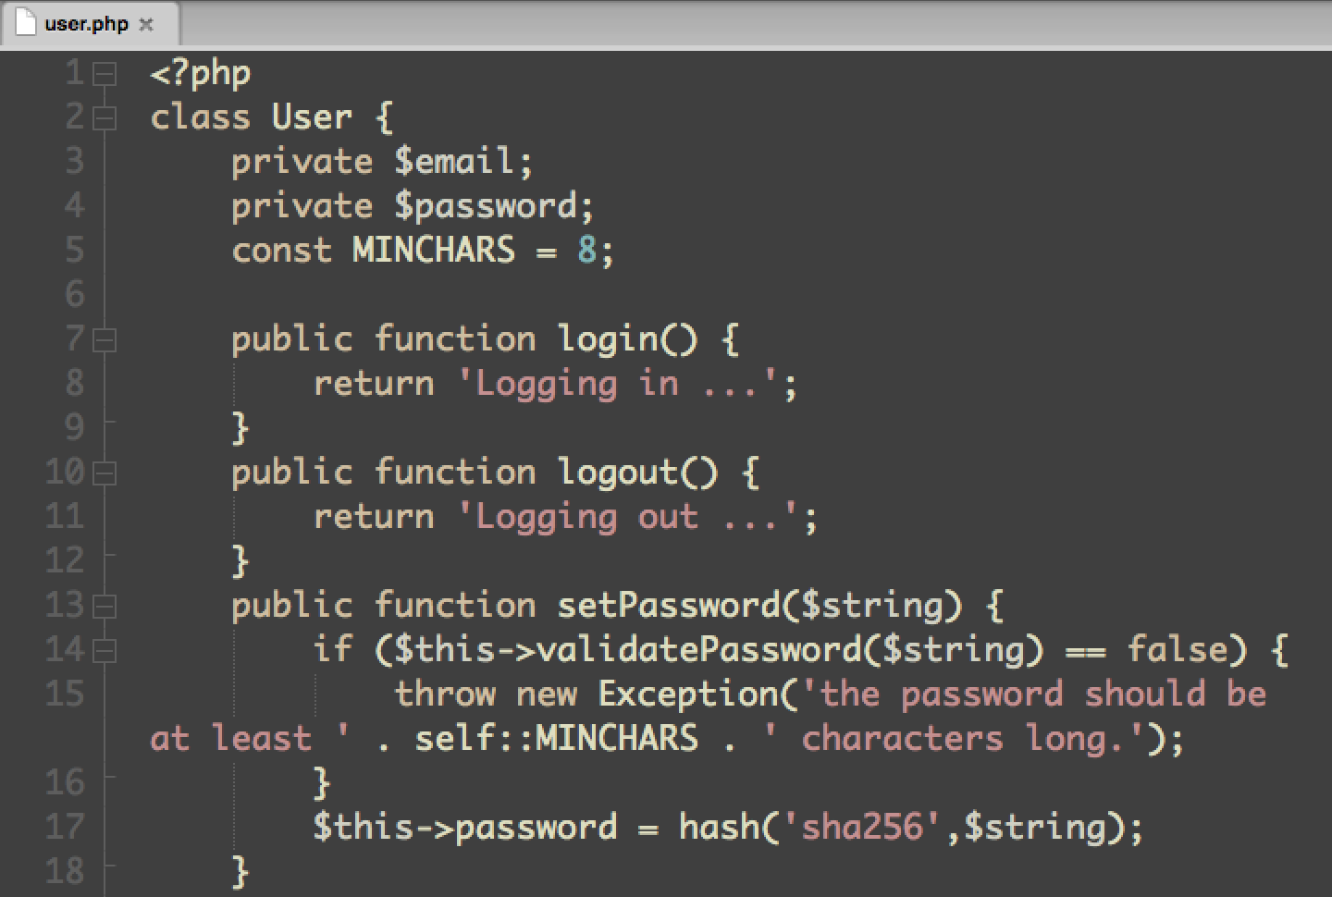

Slide 62
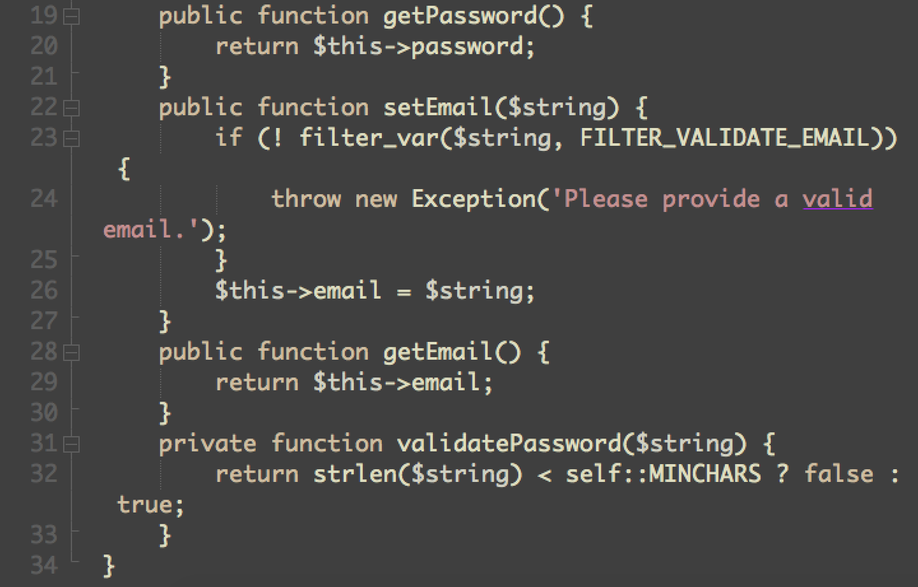

Slide 63
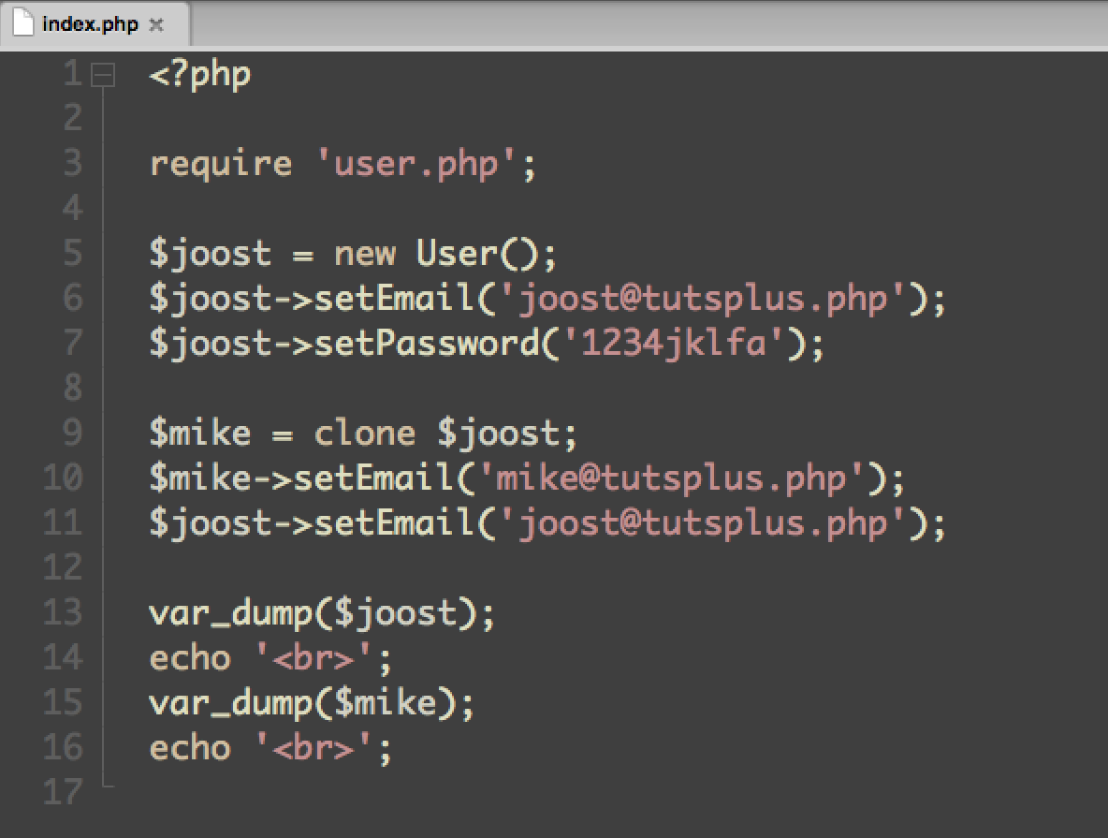

Slide 64
Result …
object(User)#1 (2) { ["email":"User":private]=> string(18) "joost@tutsplus.php" ["password":"User":private]=> string(64) "b86b2373aa5a777eb535b2ea25dbce8bda42844cad7bf418edf69d9ac1fc82e2" } object(User)#2 (2) { ["email":"User":private]=> string(17) "mike@tutsplus.php" ["password":"User":private]=> string(64) "b86b2373aa5a777eb535b2ea25dbce8bda42844cad7bf418edf69d9ac1fc82e2" }

Slide 65
Credits
All code samples from PHP Object Oriented Programming Fundamentals with Joost Van Veen; evantotuts+ (https://tutsplus.com), March 31, 2014

Slide 66
Daniel Kline
Web Developer
@daniel_okc
danielkline19@hotmail.com

Slide 67
PHP
Absolute Basics
Object-Oriented Programming

