Slide 1


Slide 2
WordPress
Plugin Creation
Overview

Slide 3

Daniel Kline
Web Developer
danielkline19@hotmail.com
www.danielklineweb.com

Slide 4
Advanced Subject
Presentation content intended for programmers and not required for those who use WordPress
Creating custom functions with PHP code associated with writing plugins

Slide 5
Topics Discussed
Plugin definition
WordPress execution life cycle
Hooks
Considerations
Code samples
Demonstration

Slide 6
A plugin is set of programming code that extends and expands functionality of WordPress.
There are over 40,000 plugins available from the https://wordpress.org/plugins/ repository.
Plugins provide functions including: spam blocking, analytics, search engine optimization, security, ecommerce, contact forms, website and database backup, image slide shows, etc.

Slide 7
There are many functions that execute in the life cycle of WordPress execution.
These functions will execute whether we have activated a plugin or not.
Plugins add or change the execution of functions by way of a hook.

Slide 8
Hooks: add_action
add_action is triggered by specific events.
Actions are when something happens (e.g., a unit of work is completed)
Examples
Publishing a post
Changing themes
Displaying an administration screen
Write value to the database
Verify the existence of a file

Slide 9

Execution Lifecycle
WP internal
function
Custom
function
Custom
function
WP internal
function

Slide 10
Hooks: add_action
Format:
add_action (‘init’, ‘acme_init’);
Where ‘init’ is the name of the hook for which we want to register our function
‘acme_init’ is a custom function that we create for our plugin
When it is time to execute the ‘init’ function in the WP lifecycle ‘acme_init’ will execute

Slide 11


Slide 12
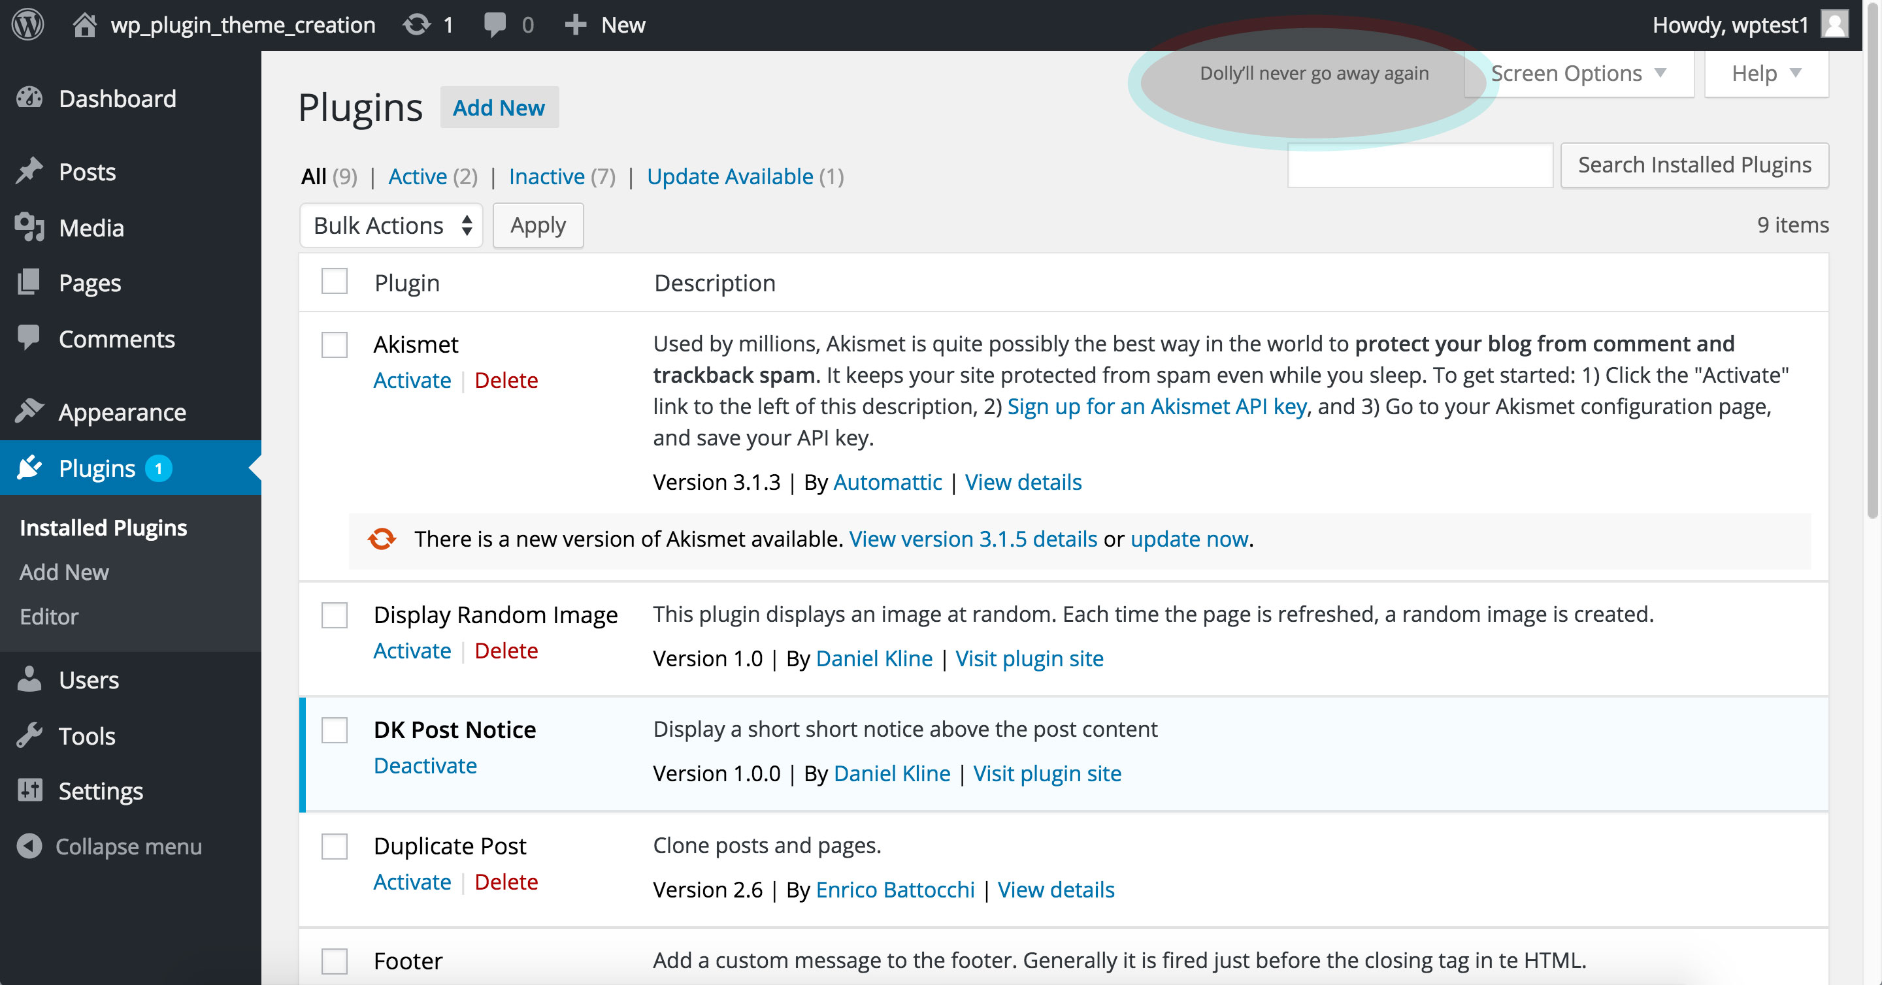

Slide 13
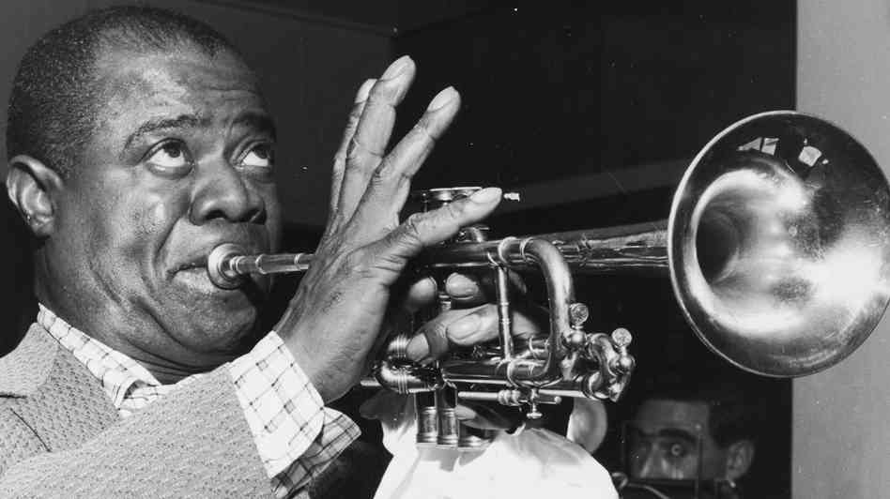

Slide 14
Our Custom Plugin
Name: nt_post_notice
Functions
Display custom message above post
Specify the message in the dashboard
Provide a notice preview

Slide 15
Demonstration
Activate
Admin post page
Public viewing area

Slide 16
Plugin Features
Security: each user has a unique nonce
Permission: only admin users should be able to save the data
Data sanitization: so that hackers cannot perform SQL injection through our editor
Conditions: only execute if post content exists

Slide 17
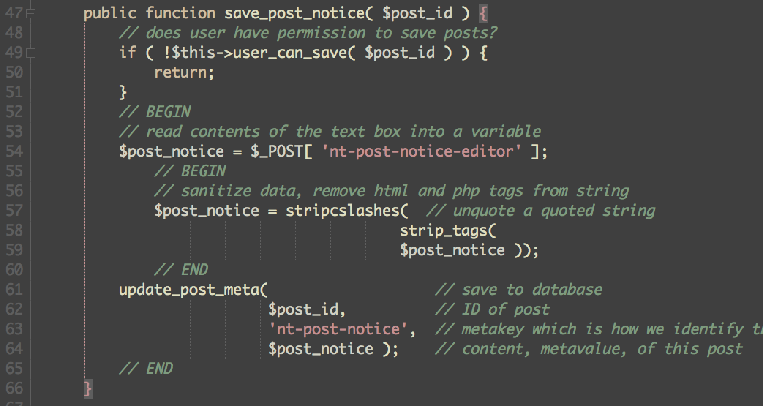
Sanitize data

Slide 18
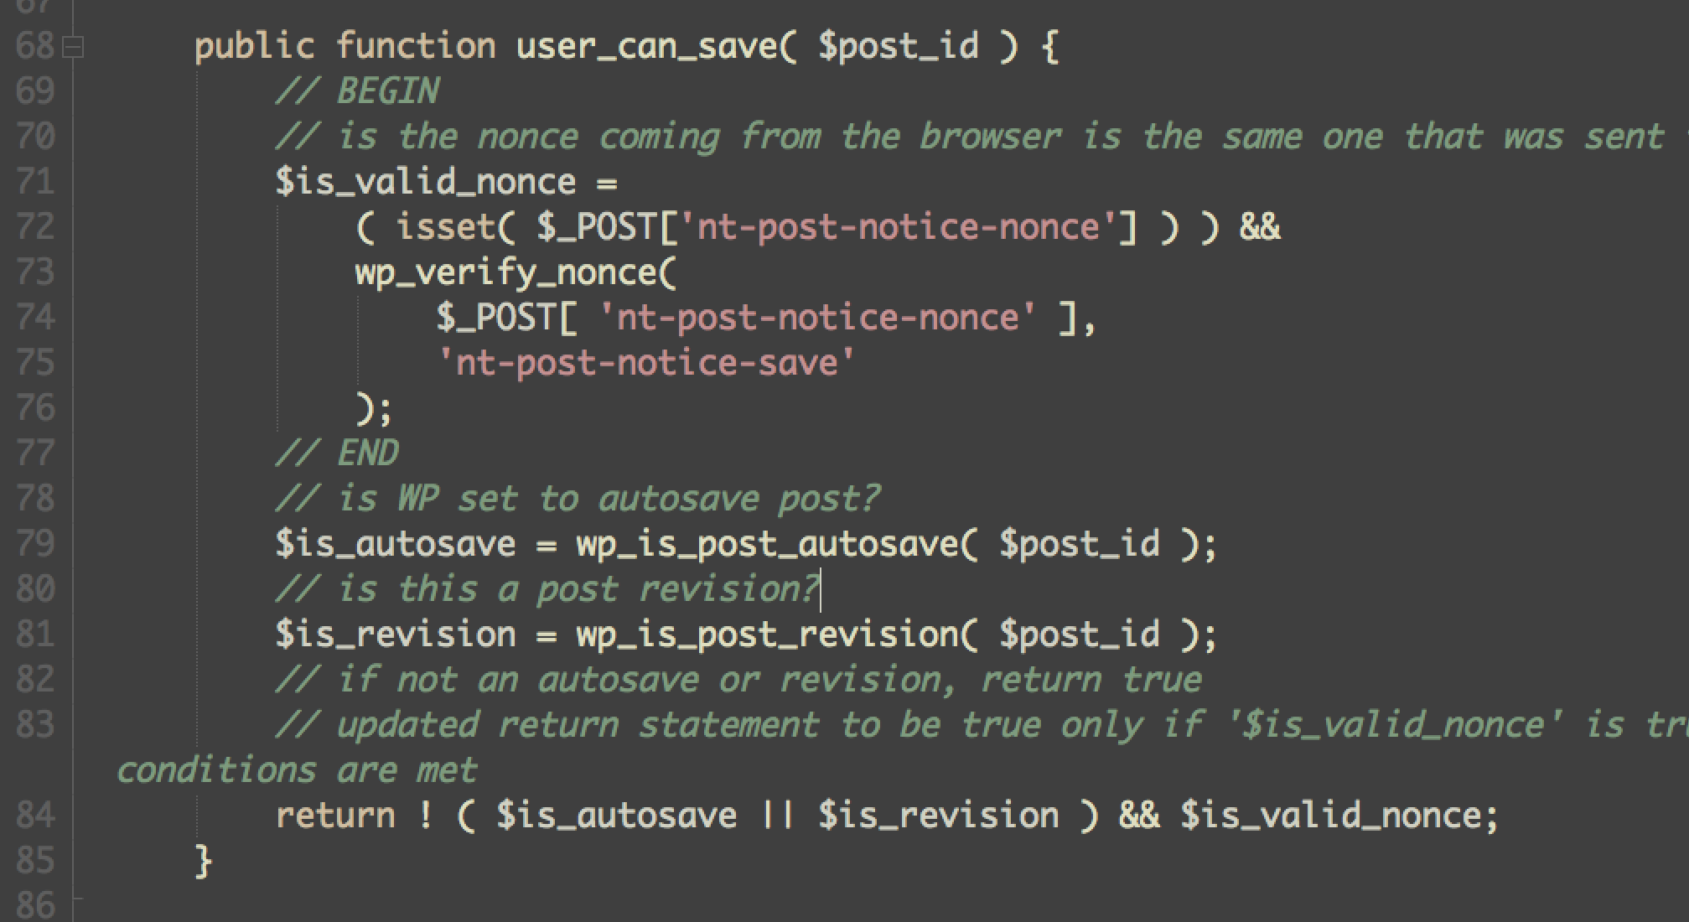
Can admin save data?

Slide 19
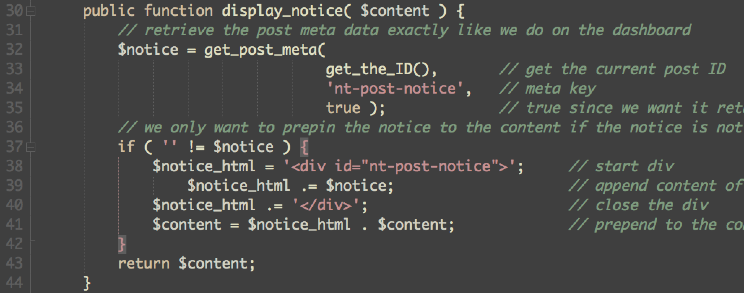
Display if text exists

Slide 20
Daniel Kline
Web Developer
danielkline19@hotmail.com
www.danielklineweb.com

Slide 21
Sources
https://tommcfarlin.com/wordpress-page-lifecycle/WordPress execution
“Hello Dolly” image:http://funminnesota.com/events.cfm?m=02&d=20&y=2015
“Louis Armstrong” image: http://mtviewmirror.com/louis-armstrong-and-the-jazz-age/
Daniel Kline logo, copyright 2012. www.danielklineweb.com

