Slide 1

Introduction to Traceability in Industry 4.0
Intelligent Systems for Supply Chain Management
Bikmetov Daniel 6114-100503D
Krupenskiy Roman 6114-100503D
Sumara, 2025

Slide 2
PRESENTATION OUTLINE
Problem and Goal
Core Idea: Three-Layer Architecture
System architecture: Ontology-Based Modeling
Data Integration: IoT Data Processing
Implementation: Cloud-Based Platform
Key Results: System Capabilities
Key Challenge & Solution
Conclusion
2/12

Slide 3
PROBLEM AND GOAL
Why is intelligent traceability needed?
Industry 4.0 generates massive heterogeneous data (IoT, sensors, CPS)
Supply chains lack real-time transparency and safety assurance
Current systems cannot integrate data from multiple sources
Goal: Create unified, intelligent traceability for product safety
3/12

Slide 4
CORE IDEA: THREE-LAYER ARCHITECTURE
Layer 1 Semantic Ontology-based knowledge representation
Layer 2 Integration Unified data aggregation from heterogeneous sources
Layer 3 Cloud Remote access and query capabilities
4/12

Slide 5
SYSTEM ARCHITECTURE: ONTOLOGY-BASED MODELING
Semantic representation of traceability domain
Classes: Product, Process, Location, Timestamp, Quality
Relations: hasStage, hasQuality, hasLocation
Let O = {C, R, I} where:
C = Concepts (Product, Process, Quality, Location, Agent)
R = Relations (hasStage, hasQuality, hasTrace)
I = Instances (specific products, timestamps)
5/12

Slide 6
SYSTEM ARCHITECTURE: TABLE 1
Aspect | Traditional | Proposed
Data Integration | Manual, error-prone | Automated, ontology-driven
Interoperability | Limited, siloed systems | Full semantic interoperability
Real-time Access | Delayed reports (batch) | Real-time visibility
Quality Assurance | Batch processing | Continuous monitoring
Compliance | Document-based tracking | Automated tracking
Scalability | Fixed capacity infrastructure | Cloud elastic scaling
Error Detection | Post-incident (reactive) | Real-time (proactive)
6/12

Slide 7
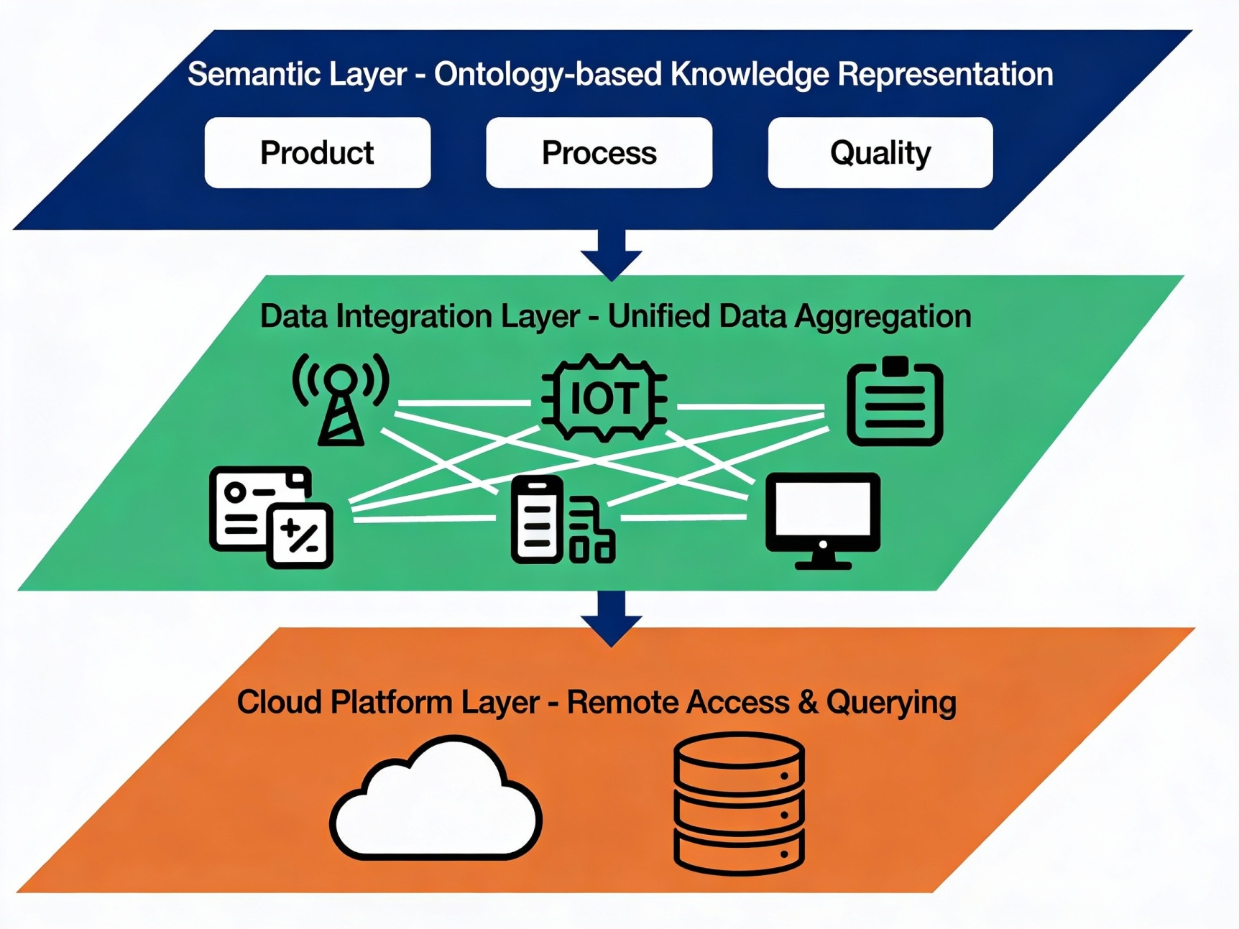
SYSTEM ARCHITECTURE: IMAGE 1
7/12

Slide 8
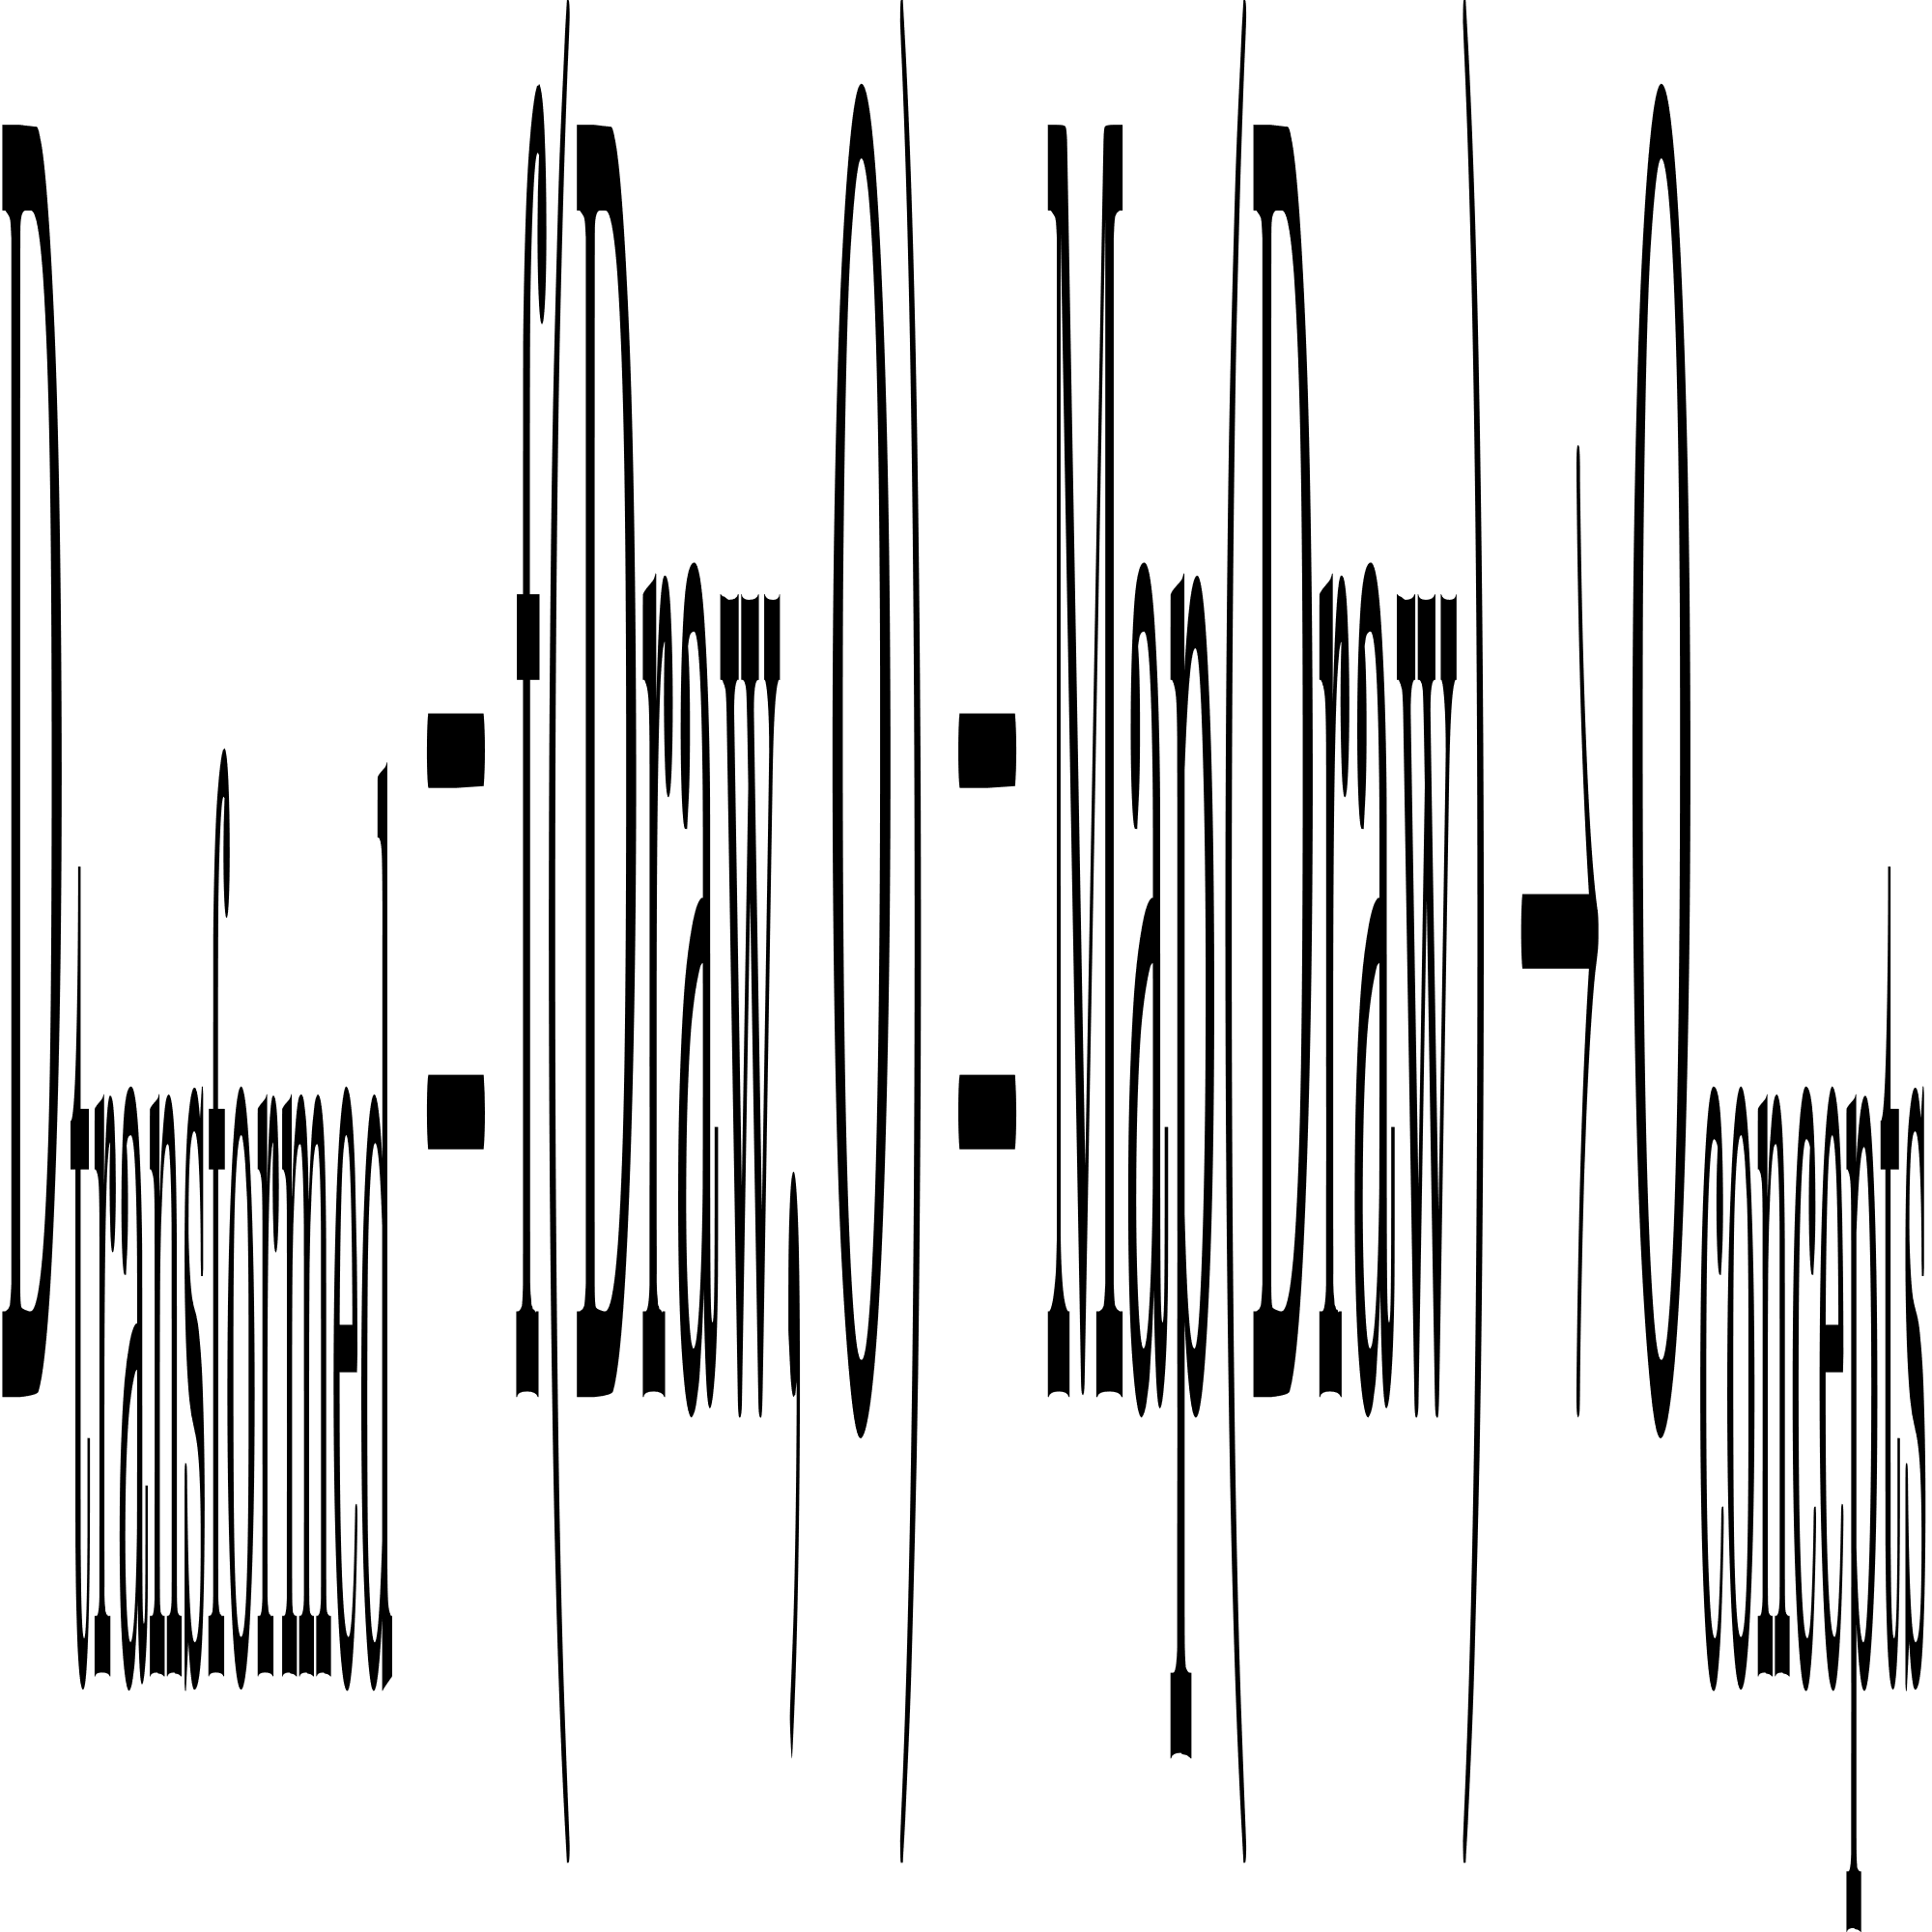
DATA INTEGRATION: IOT DATA PROCESSING
Processing Pipeline
Collection: Real-time data from sensors, smart devices
Normalization: Map heterogeneous formats to ontology
Aggregation: Merge data into unified knowledge base
Data transformation formula
8/12

Slide 9
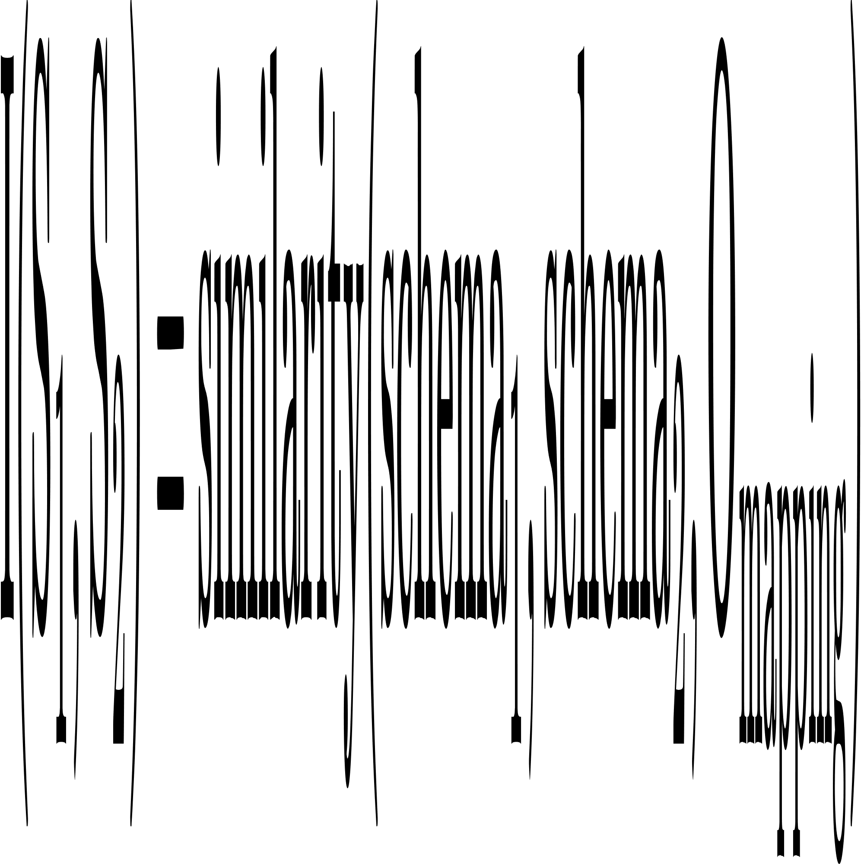
IMPLEMENTATION: CLOUD-BASED PLATFORM
Common knowledge base accessible to all stakeholders
Query interface for trace retrieval and tracking
Real-time synchronization across supply chain
Access control and data privacy mechanisms
Interoperability function
9/12

Slide 10
KEY RESULTS: SYSTEM CAPABILITIES
Achieved Outcomes
Solved interoperability challenges
Automated data integration
Enhanced transparency
Practical Benefits
Real-time product tracking
Quality assurance automation
Compliance monitoring
10/12

Slide 11
KEY CHALLENGE & SOLUTION
Challenge: Data Heterogeneity
Multiple source formats (JSON, XML, sensor streams)
Solution: Semantic Mapping
Ontology defines unified semantic model
Transformation rules map source schemas to ontology
Enables interoperable data exchange
11/12

Slide 12
MY EMAIL: bicmetovdaniel@gmail.com
THANK YOU!
Any questions?

