Slide 1

Introduction to Traceability in Industry 4.0
Bikmetov Daniel
6114-100503D
Sumara, 2025

Slide 2
CONTENTS
Problem and Goal – 3;
Core Idea: Probability on a Deadline– 4;
Bayesian Inference in Real-Time – 5;
RTPP System Architecture– 6;
Algorithm Choice: Accuracy vs Speed–7;
Hardware for Acceleration – 8;
Use Case: Autonomous Vehicle– 9;
Key Challenge & Solution – 10;
Conclusion – 11
<number>

Slide 3
PROBLEM AND GOAL
The Challenge: Determinism vs. Uncertainty
The Mismatch:
Traditional Real-Time (RT) Systems: Assumed to be deterministic;
Real-World Environment: Is uncertain (sensor noise, variable delays, unpredictable events);
Result: Hard timing guarantees (deadlines) conflict with the need to handle probabilities
Presentation Goal
Introduce Real-Time Probabilistic Programming (RTPP) – a framework that:
Explicitly models uncertainty using probability distributions;
Guarantees that all computations respect strict timing constraints
<number>

Slide 4
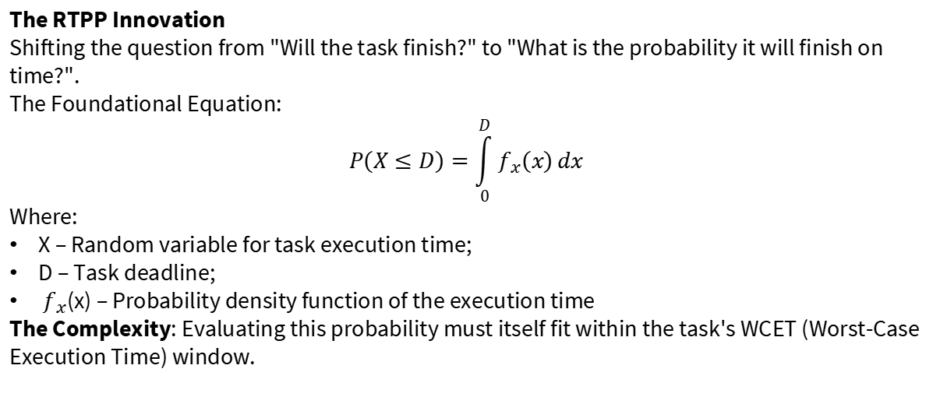
CORE IDEA: PROBALITY ON DEADLINE
<number>

Slide 5
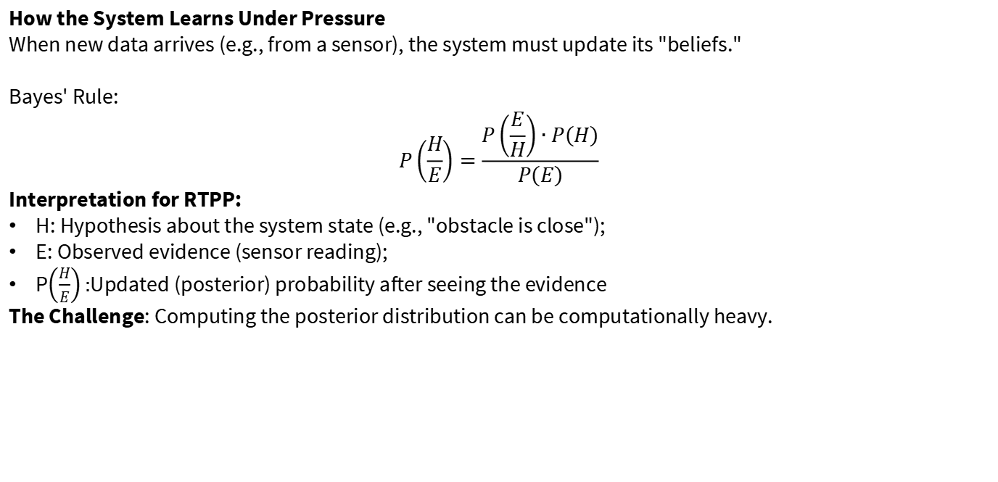
BAYESIAN INFERENCE IN REAL-TIME
<number>

Slide 6
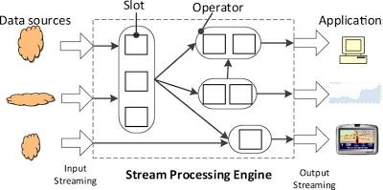
RTPP SYSTEM ARCHITECTURE
Internal Architecture
Key Components:
Probabilistic Model: Specifies uncertainties and temporal constraints;
Real-Time Scheduler: Accounts for probabilistic task characteristics;
Probabilistic Inference Engine: Performs computations with time guarantees;
Execution Platform (Hardware): CPU, GPU, or specialized FPGA/ASIC
Figure 1: High-level architecture of an RTPP system
<number>

Slide 7
ALGORITHM CHOICE: ACCURACY VS SPEED
Not All Inference Algorithms Are Fit for RTPP
Table 1: Comparison of inference algorithms for RTPP
Algorithm | Avg. Accuracy | WCET Bound | Memory Use | RTPP Suitability
Markov Chain Monte Carlo | 95% | Unbounded | High | Low (unpredictable time)
Variational Inference | 85% | 15 ms | Medium | High (bounded WCET)
Sequential Monte Carlo | 92% | 22 ms | High | Medium
Approx. Bayesian Comp. | 78% | 8 ms | Low | Very High (fast, less accurate)
Key Insight: In RTPP, we often trade peak accuracy for temporal predictability.
<number>

Slide 8
HARDWARE FOR ACCELERATION
Choosing the Right Hardware
Table 2: Hardware platforms for RTPP acceleration
Platform | Probabilistic Ops | Determinism Level | Power Use | Flexibility
CPU | Software emulation | High | Medium-High | High
GPU | Parallel sampling | Low-Medium | High | Medium
FPGA | Custom inference engines | High | Medium | Medium
ASIC | Dedicated probability units | Very High | Low | Low
Trend: Specialized FPGAs and ASICs are the future for embedded RTPP systems needing efficiency and predictability.
8

Slide 9
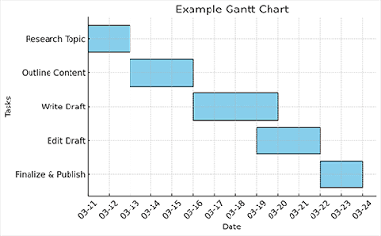
USE CASE: AUTONOMOUS VEHICLE
Application: Real-Time Pedestrian Trajectory Prediction
The RTPP Task:
Acquire data from camera/LiDAR (noisy, incomplete);
Update the probabilistic model of pedestrian trajectory (Bayesian inference);
Compute the optimal response (brake/steer);
Guarantee this entire pipeline meets the critical deadline (e.g., 100 ms)
Outcome: A decision with a confidence estimate (e.g., "Maneuver A is safe with 99.7% probability"), made on time.
Figure 2: Timing diagram with probabilistic task execution times
<number>

Slide 10
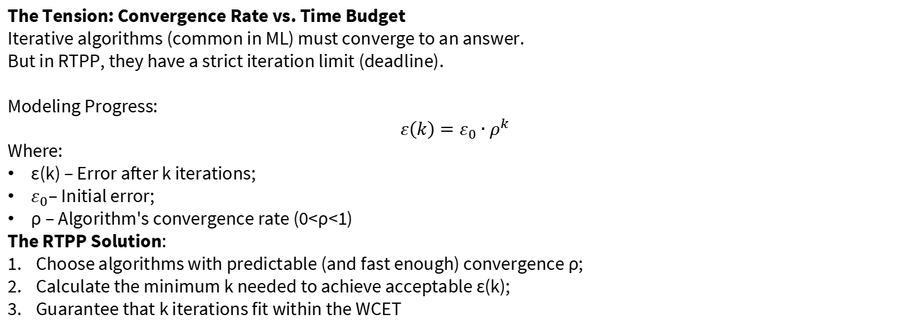
KEY CHALLENGE & SOLUTION
<number>

Slide 11
CONCLUSION
Key Takeaways
RTPP bridges the probabilistic world of uncertainty with the deterministic world of real-time guarantees;
Core Metric: Probability of meeting a deadline P(X≤D);
Involves Trade-offs: Inference accuracy ↔ Temporal predictability;
Spans All Levels: From mathematical models and algorithms to specialized hardware (FPGA/ASIC);
Critical for autonomous systems, robotics, medical devices – where uncertainty exists, but delay is unacceptable
11

Slide 12
THANK YOU!
Any questions?

