Slide 1
KAFKA LAB
2021-03-26
Daniel wIKMAN

Slide 2
aGENDA
A short intro to Apache Kafka
Hacking a producer.
Hacking a consumer.
Hacking some streaming.
Any ideas we can think of…
Questions – ASK whenever you have one...

Slide 3
Prerequisites
Kafka installed locally, for CLI use, you do not need the server running locally.
We will run all code against my Kafka Cluster.
Checkout the base project from GIT:
git@github.com:DanielWikman/cag-labb-kafka.git
https://github.com/DanielWikman/cag-labb-kafka.git

Slide 4
My Kafka
Started using it about 3 years ago.
Mainly used as:
  Serve the same data to multiple targets.
  Circuit breaker for our microservices.

Slide 5
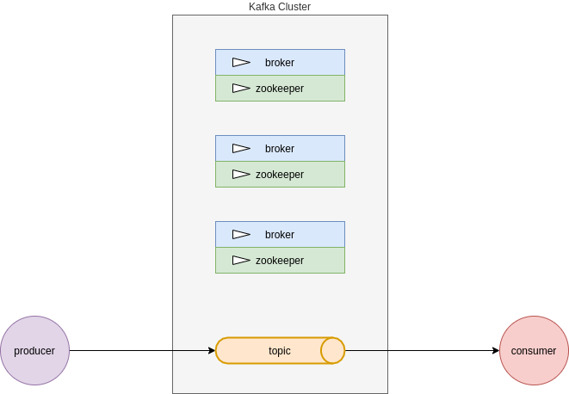
Kafka Overview
Distributed Commit Log
NOT a Message Queue
Brokers
Zookeeper
Topics
Producer
Consumer

Slide 6
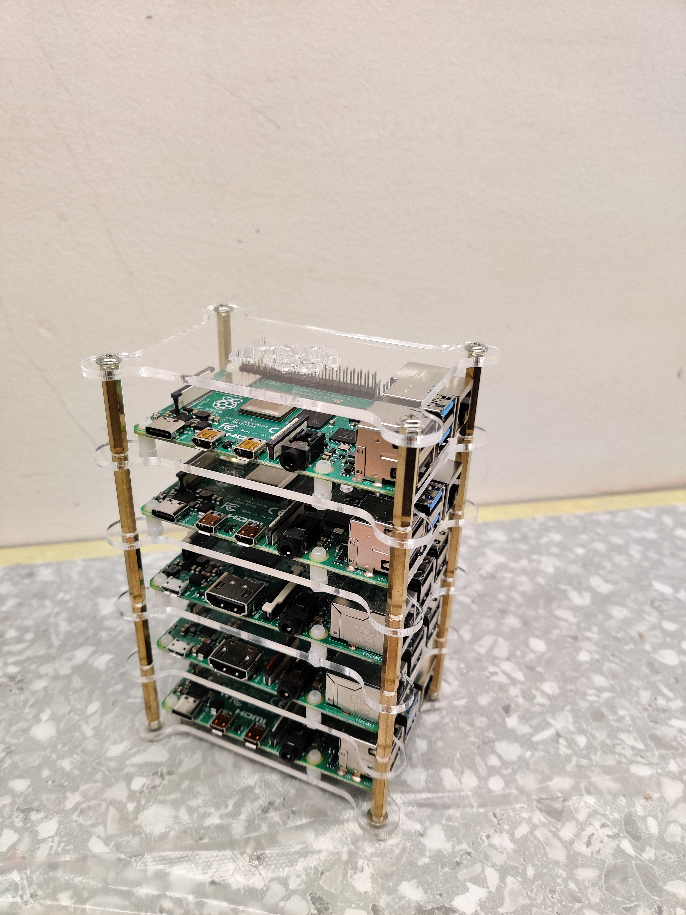
Kafka, verify connection to servers...
Lets check in with kafka…
So follow me…
Notes:
ZOOKEEPER='78.70.35.171:8001,78.70.35.171:8002,78.70.35.171:8003'
KAFKA='78.70.35.171:9001,78.70.35.171:9002,78.70.35.171:9003'

Slide 7
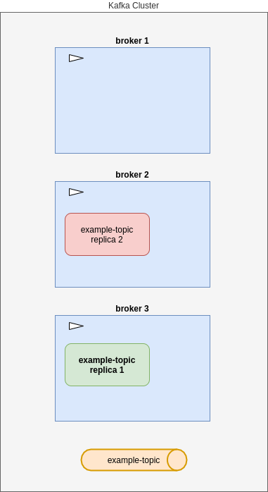
Kafka Topics - Replication
Topic resilience
example-topic created with replication = 2

Slide 8
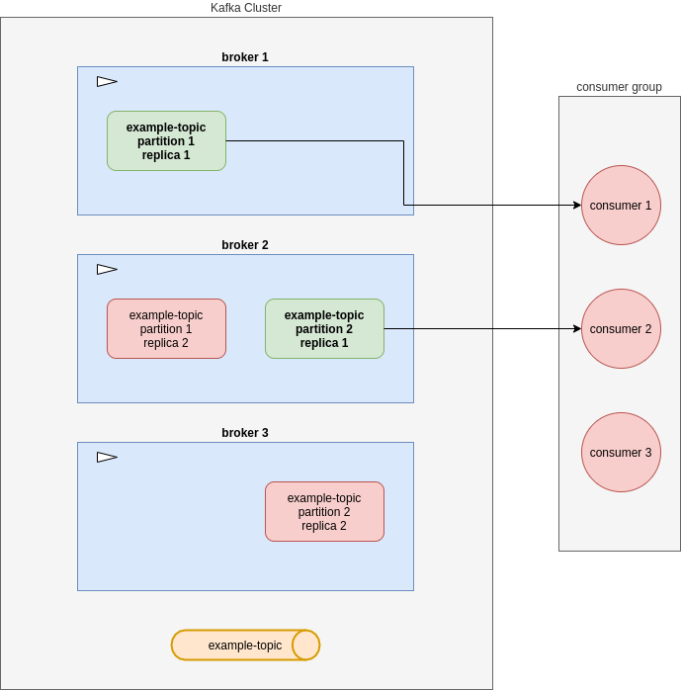
Kafka Topics - Partitions
How many consumers can we have in a consumer group
example-topic created
  Replication = 2
  Partitions = 2

Slide 9
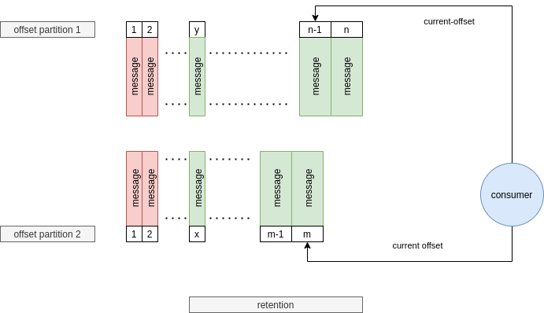
Kafka Topics
Retention
  Time
  Size
Keyed topics

Slide 10
Kafka Producer
Post your data, to a topic.
To a specific partition is possible too.
AckMode:s → none / (leader) / all
send() is async.
  2 versions, one with callback.
  Returns future, use .get() to wait.

Slide 11
Kafka Consumer
Consumer group
Strategies
  Single record
  Multi record
  Continous
  Periodic
Poll timers
Size
Commits

Slide 12
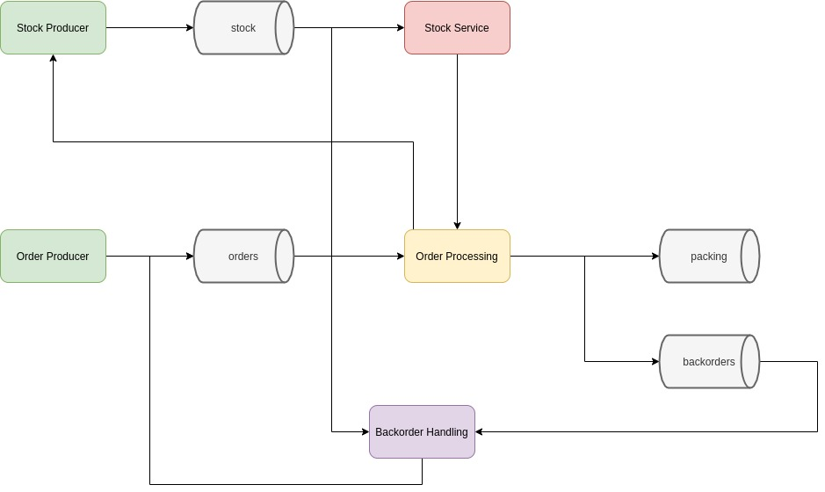
Min Målbild...

Slide 13
Kafka Streaming
Source
Sink
Transforms
KStreamBuilder builder = new KstreamBuilder();
KStream<String, String> textLines = builder.stream(inputTopic);
Pattern pattern = Pattern.compile("\\W+", Pattern.UNICODE_CHARACTER_CLASS);
KTable<String, Long> wordCounts = textLines
.flatMapValues(value -> Arrays.asList(pattern.split(value.toLowerCase())))
.groupBy((key, word) -> word)
.count();
Serde<String> stringSerde = Serdes.String();
Serde<Long> longSerde = Serdes.Long();
wordCounts.to(stringSerde, longSerde, outputTopic);

Slide 14
Confluent som plattform
Confluent Connectors
  Source
  Sink
Confluent Schema Registry
KSQL

Slide 15
Lab Time...

Slide 16
OrDer Producer
Lets write a simple producer
Module is: order-producer
REST Controller...
Producer...
Data Bearers are already done…

Slide 17
Order CONSUMER
Lets write a simple consumer
Project is at:
Module is: order-processor
Consumer just logs data, we will do more with it later :-)

Slide 18
Order STREAMING
Lets rewrite the order processor to stream instead.
Project is at:
Module is:
Consumer just logs data, we will do more with it later :-)

