Slide 1
CS 8395 Assignment 1
Daniel Yan

Slide 2
Introduction
Goal: Predict x and y coordinate for the center of object in image

Slide 3
Rationale
Originally, I tried regression, but achieved poor results
My regression model kept predicting things closer to the center to minimize loss
However, whether my prediction was off by 0.5 or 0.8 didn’t matter to me.
Instead, I made this a classification problem by dividing the x and y space into 20 equal spaces, and setting the label as whichever window the floating point label fell into
By changing this to classification, the prediction was only correct if within a small window
Example: Label 0 was 0.0-0.05, label 1 was 0.05-0.1, etc.
Two separate labels for x and y classes with 20 classes each: not enough training examples for more classes

Slide 4
Network Architecture
FC Layer 1 For X
Input: 55080
Output: 256
FC Layer 2 For X
Input: 256
Output: 20 (classes)
8 Layers, VGG Like (Size 3 kernel, 2 conv layers before maxpool, double channels after maxpool)
FC Layer 1 For Y
Input: 55080
Output: 256
FC Layer 2 For Y
Input: 256
Output: 20 (classes)

Slide 5
Tricks
Preprocessing: Convert floating point coordinates to class labels corresponding to which “window” the coordinate fell in
Postprocessing: Convert labels back to floating point coordinates by choosing the centerpoint of that window
Early Stopping: Always save the model with best validation loss so far
Random Search for hyperparameters

Slide 6
Hyperparameters
Random Search over 50 combinations of learning rate (between 0.0008 and 0.002) and gamma (between 0.7 and 1).
50 epochs with early stopping: save model with best validation loss
Loss: Cross-Entropy
Parameters of Layers:
ReLu Activation
Kernel Size 3
Maxpool of 2 after every 2 conv layers
Double number of channels after each maxpool
Batch normalization between each layer
Dropout of 0.45 after each layer
Softmax activation after 20 output channels each for x and y output
Adam Optimizer
Batch Size: 12 (GPU memory limitations)
OS: Windows
GPU: GTX 970M

Slide 7
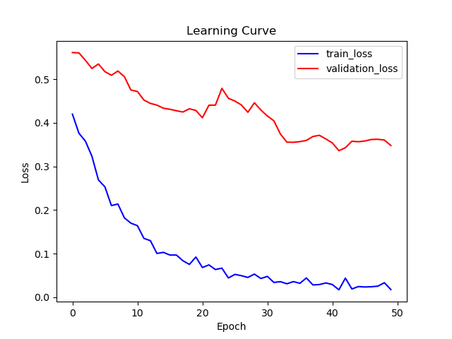
Learning Curve

Slide 8
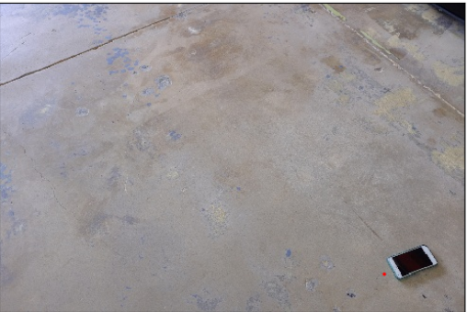
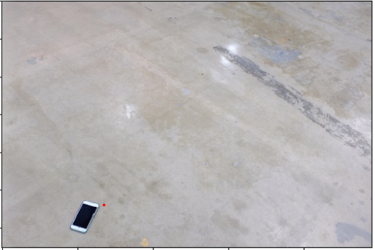
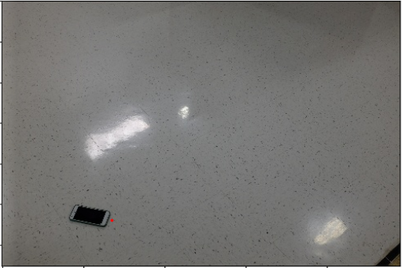
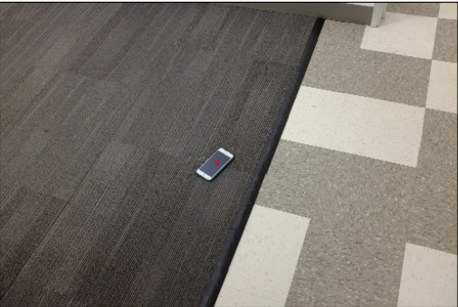
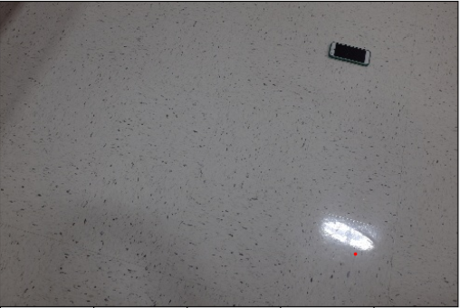
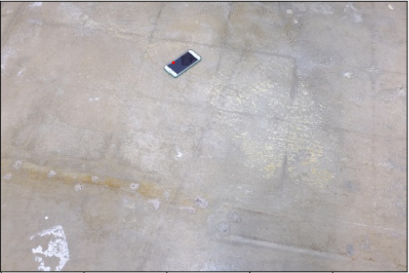
Testing Detection
120.jpg
121.jpg
122.jpg
123.jpg
124.jpg
126.jpg

Slide 9
Table of Predictions
Name | Coordinate 1 | Coordinate 2
120.jpg | 0.825 | 0.875
121.jpg | 0.275 | 0.825
122.jpg | 0.275 | 0.825
123.jpg | 0.475 | 0.525
124.jpg | 0.775 | 0.825
126.jpg | 0.425 | 0.225

Slide 10
Conclusion
Difficulties
Unreliable convergence during training
Small dataset meant some classes were rarely predicted because of low occurrence in original dataset
Overfitting
Limitations
Using classification means that even a “correct” prediction isn’t necessarily at the center of the object

Slide 11
Further Investigation
Data augmentation: more data so classes can be more balanced; also may help with overfitting
Weighing output classes to get prediction that is average of highest confidence classes rather than single class
Custom Loss Function
Larger number of epochs and hyperparameter search combinations (more time required)
Explore different network architectures (maybe simpler) to reduce overfitting

