Slide 1
CS 8395 Assignment 3
Daniel Yan

Slide 2
Introduction
Task: Segment Spleen from CT Scans

Slide 3
Rationale
Torchvision 2D Model: Deeplabv3 with resnet50 architecture
Performance was empirically better than 2D UNet
Large memory usage and amount of time needed for 2D meant 3D would have been even more time consuming/smaller batch size

Slide 4
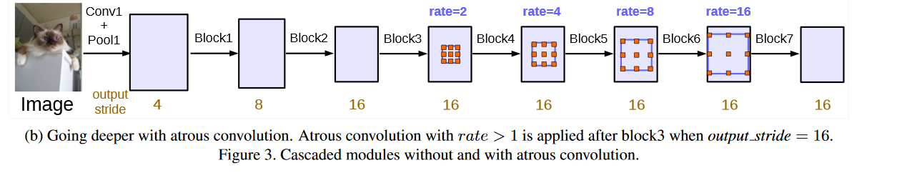
Architecture: deeplabv3
Chen, Liang-Chieh, et al. "Rethinking atrous convolution for semantic image segmentation." arXiv preprint arXiv:1706.05587 (2017).

Slide 5
Input/Output Formatting
80/20 train test split
24 training volumes, 6 validation volumes: 0004, 0023, 0026, 0029, 0031, and 0035
Input: 224x224 2D slice and copied 3 times for 3 channels (3 channels required by Deeplabv3 architecture)
Output: 224x224 single slice for probability of spleen at each pixel. Increase of about 20% dice over 2 outputs with cross entropy (not sure why, maybe incorrect implementation of two outputs?)

Slide 6
Preprocessing
Affine Registration to common space (about 5% dice increase)
Rigid Registration for failed affine registrations (manual inspection)
Crop to 224x224 patch of pixels most likely to have spleen
Create 2D slices on third dimension
Only use about half of slices that have spleen, since most slices do not have spleen
Indices for cropping and slices found by calculating start and end of spleen labels on training set
Divide by 1000 to get values in -1 to 1 range

Slide 7
Postprocessing
Find optimal threshold for positive class using validation set (final threshold at 0)
Register thresholded predictions back to original image space

Slide 8
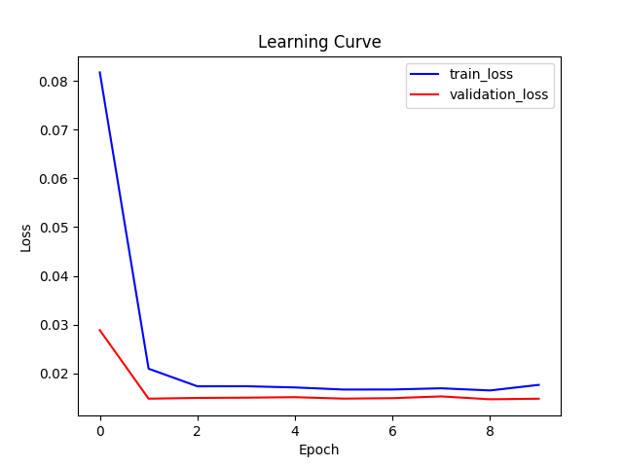
Results: Learning Curve

Slide 9
Results: Validation
80/20 train test split
24 training volumes: 1, 2, 3, 5, 6, 7, 8, 9, 10, 21, 22, 24, 25, 27, 28, 30, 32, 33, 34, 36, 37, 38, 39, 40
6 validation volumes: 4, 23, 26, 29, 31, and 35

Slide 10
Results: Dice
Median: 0.9477
Mean: 0.9375
Standard Deviation: 0.0204

Slide 11
Hyperparameters
Epochs: 15 with early stopping
Batch Size: 8
Learning Rate: 0.001 (Adam Default)
Loss Function: Binary Cross Entropy with Logits
Optimizer: Adam
GPU: Google Colab (Nvidia K80s, T4s, P4s and P100s are all present)

Slide 12
Conclusions
Limitations:
Lack of Domain Knowledge
Small Validation Set (likely overfit validation set)
Future Ideas
Fine tuning failed registrations
Postprocessing: Largest connected component, smoothing, etc

Slide 13
References
Chen, Liang-Chieh, et al. "Rethinking atrous convolution for semantic image segmentation." arXiv preprint arXiv:1706.05587 (2017).

