Slide 1
CS 8395 Assignment 2
Daniel Yan

Slide 2
Introduction
Task: Classify image of skin deformation into one of seven categories

Slide 3
Rationale for Method
Classification using pretrained densenet121: transfer learning
Alternative architectures attempted:
VGG
Resnet
Unsuccessful alternative ideas (similar validation accuracy)
Binary prediction of if image is class 1, then classify remaining 6 classes
Ensemble methods

Slide 4
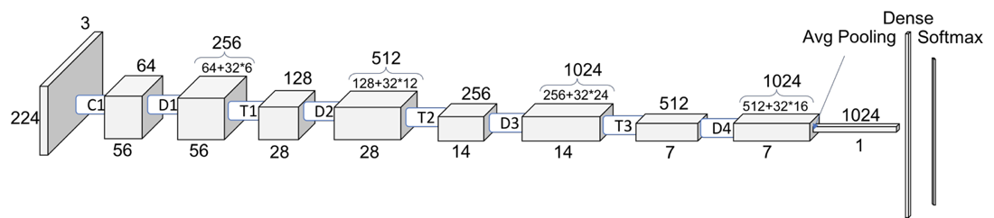
Figure of Network Structure
Figure: https://towardsdatascience.com/understanding-and-visualizing-densenets-7f688092391a
Original Paper: Huang, Gao, et al. "Densely connected convolutional networks." Proceedings of the IEEE conference on computer vision and pattern recognition. 2017.

Slide 5
Input/Output formatting
Training/Validation Split: 10% of training data (~900 images) used for validation
Input: Resized to 224x224 to use pretrained ImageNet model for transfer learning (also I have a laptop GPU)
Output: Seven values for probabilities of each class
Postprocessing: Take maximum probability as prediction

Slide 6
Tricks
Early Stopping: Save and use the model with the lowest validation loss
Useful due to spikes in validation loss during training

Slide 7
Hyperparameters
Epochs | 50 with early stopping
Batch Size | 8
Learning Rate | 0.001 (Default for Adam)
Optimizer | Adam
Loss Function | Cross Entropy
OS | Windows
GPU | GTX 970M
Parameters of Layers | Pretrained DenseNet-121

Slide 8
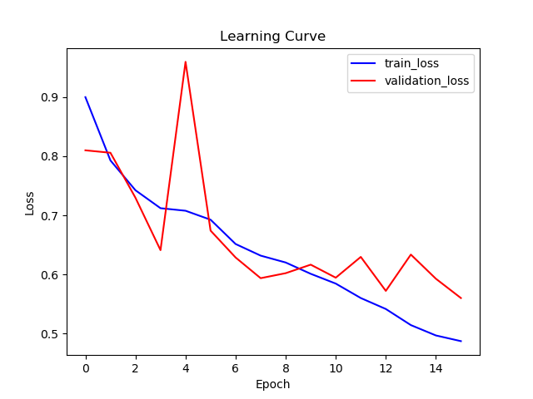
Learning Curve

Slide 9
Test Metrics
Accuracy: 0.691
Precision: 0.518 (sklearn macro weighted)
Recall: 0. 447 (sklearn macro weighted)

Slide 10
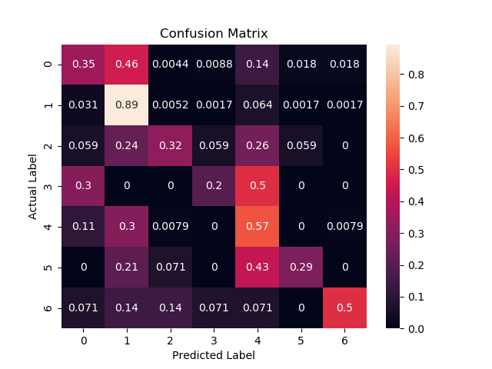
Confusion Matrix

Slide 11
Conclusions
Key Challenge: Different distribution of training/validation and testing sets
Must avoid overfitting testing set
Future Improvements
Explore statistical modeling to make model more robust to different distributions

Slide 12
Acknowledgements
Huang, Gao, et al. "Densely connected convolutional networks." Proceedings of the IEEE conference on computer vision and pattern recognition. 2017.

