Slide 1
Machine Learning on Human Genome Transposable Elements
By Daniel Yan
https://github.com/DanielY1783/te_ml
https://github.com/DanielY1783/ptb_gwas_phewas

Slide 2
Outline
Goal: Explore properties of transposable elements and their intersection with enhancers.
Classify transposable element with enhancer overlap vs transposable element with no enhancer overlap
Fantom enhancers: tfbs as features
Chromhmm enhancers: tfbs as features
Chromhmm enhancers: 6-mers as features
Explore differences between hervs, chromhmm enhancers, herv-enhancer overlap, and random set using 6-mers.
Visualization of different groups using PCA and TSNE.
Classification of groups.

Slide 3
Classify herv with enhancer overlap vs herv with no enhancer overlap

Slide 4
Enhancers: fantom Transposable Elements: hervs Features: Transcription Factors
Random Oversampling
Random Undersampling
 | Predicted No Enhancer | Predicted Enhancer
Actual No Enhancer | 60,031 | 2,994
Actual Enhancer | 326 | 21
 | Predicted No Enhancer | Predicted Enhancer
Actual No Enhancer | 46,367 | 16,666
Actual Enhancer | 94 | 245
 | precision | recall | f1-score | support
0 | 0.99 | 0.95 | 0.97 | 63025
1 | 0.01 | 0.06 | 0.01 | 347
 | precision | recall | f1-score | support
0 | 0.99 | 0.95 | 0.97 | 63025
1 | 0.01 | 0.06 | 0.01 | 347

Slide 5
Enhancers: chromhmm Transposable Elements: all Features: Transcription Factors
Default Parameters
Class Weights = “balanced”
ROC AUC: 0.573
 | Predicted No Enhancer | Predicted Enhancer
Actual No Enhancer | 917,424 | 39,380
Actual Enhancer | 248,936 | 20,343
 | Predicted No Enhancer | Predicted Enhancer
Actual No Enhancer | 880,173 | 77,203
Actual Enhancer | 235,286 | 33,421
 | precision | recall | f1-score | support
0 | 0.79 | 0.96 | 0.86 | 956,804
1 | 0.34 | 0.08 | 0.12 | 269,279
 | precision | recall | f1-score | support
0 | 0.79 | 0.92 | 0.85 | 957,376
1 | 0.30 | 0.12 | 0.18 | 268,707

Slide 6
Enhancers: chromhmm Transposable Elements: hervs Features: 6-mer counts
Control of HERVs vs random length-matched parts of human genome
n_estimators=100
 | Predicted No Enhancer | Predicted Enhancer
Actual No Enhancer | 29,707 | 6,128
Actual Enhancer | 20,054 | 7,950
 | Predicted Random | Predicted HERV
Actual Random | 45,944 | 17,309
Actual HERV | 9,881 | 53,610
 | precision | recall | f1-score | support
0 | 0.60 | 0.83 | 0.69 | 35835
1 | 0.56 | 0.28 | 0.38 | 28004
 | precision | recall | f1-score | support
Random | 0.82 | 0.73 | 0.77 | 63,253
HERV | 0.76 | 0.84 | 0.84 | 63,491

Slide 7
Explore hervs, enhancers, herv-enhancer overlap, and random set

Slide 8
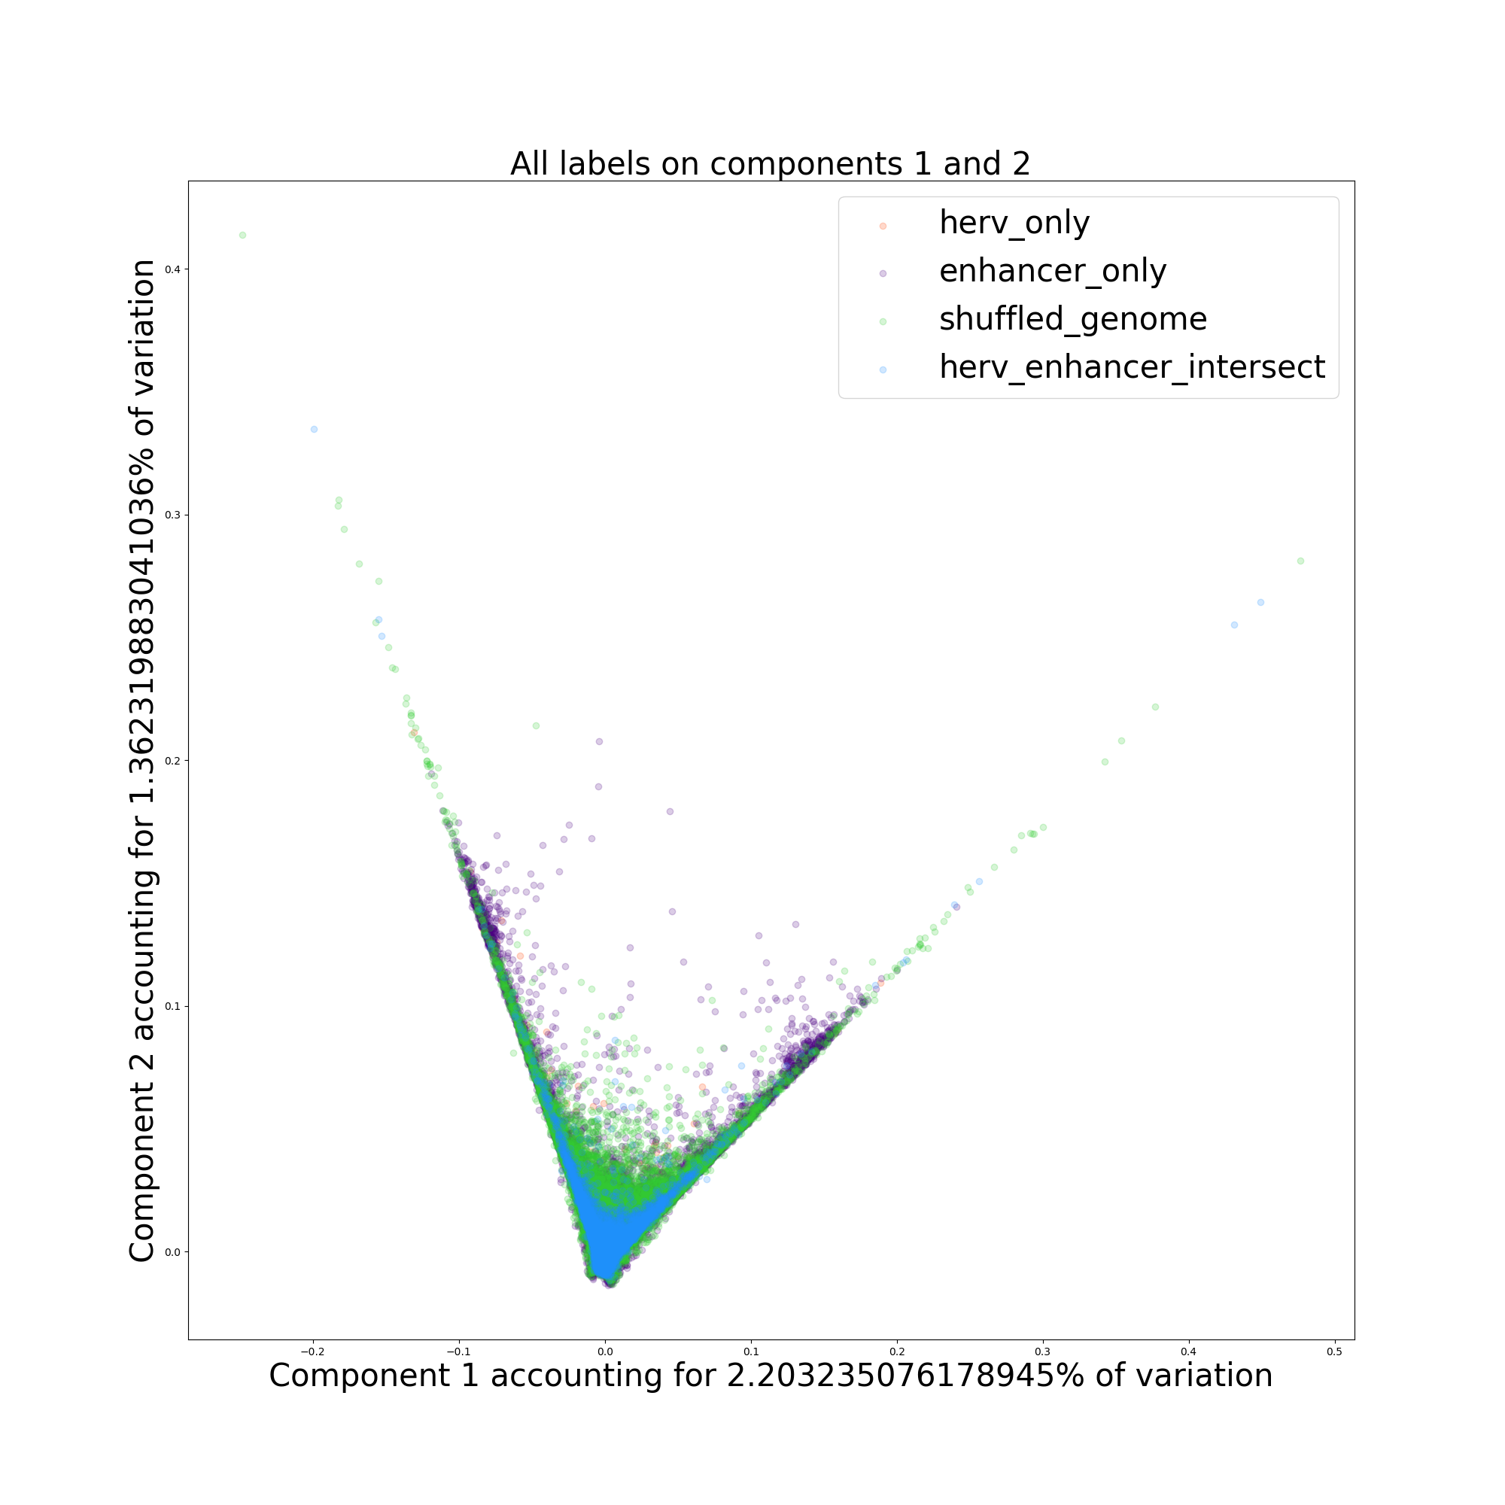
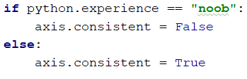
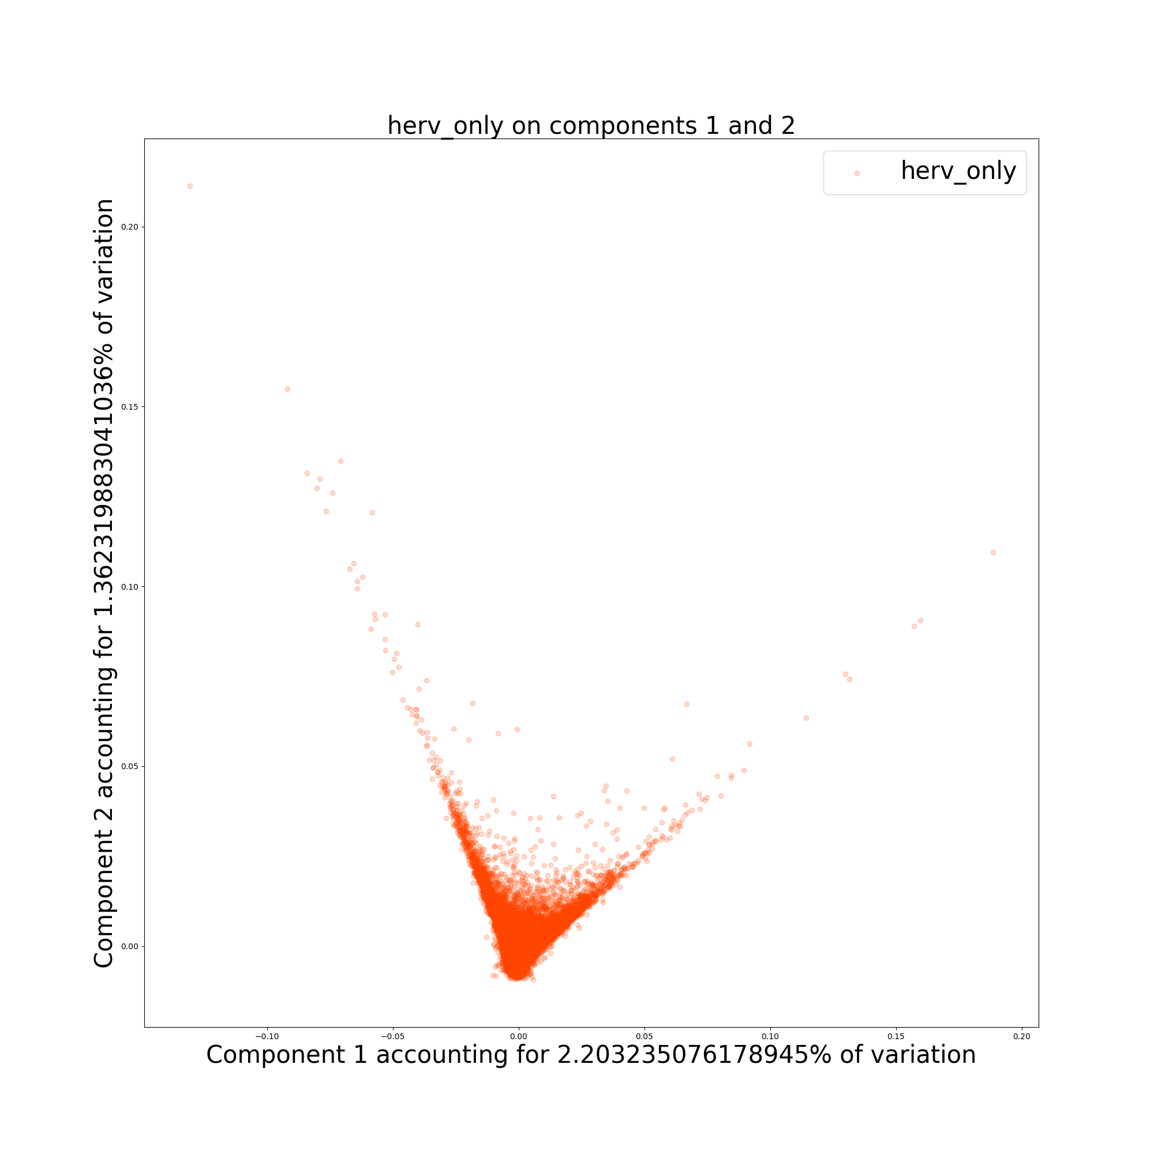
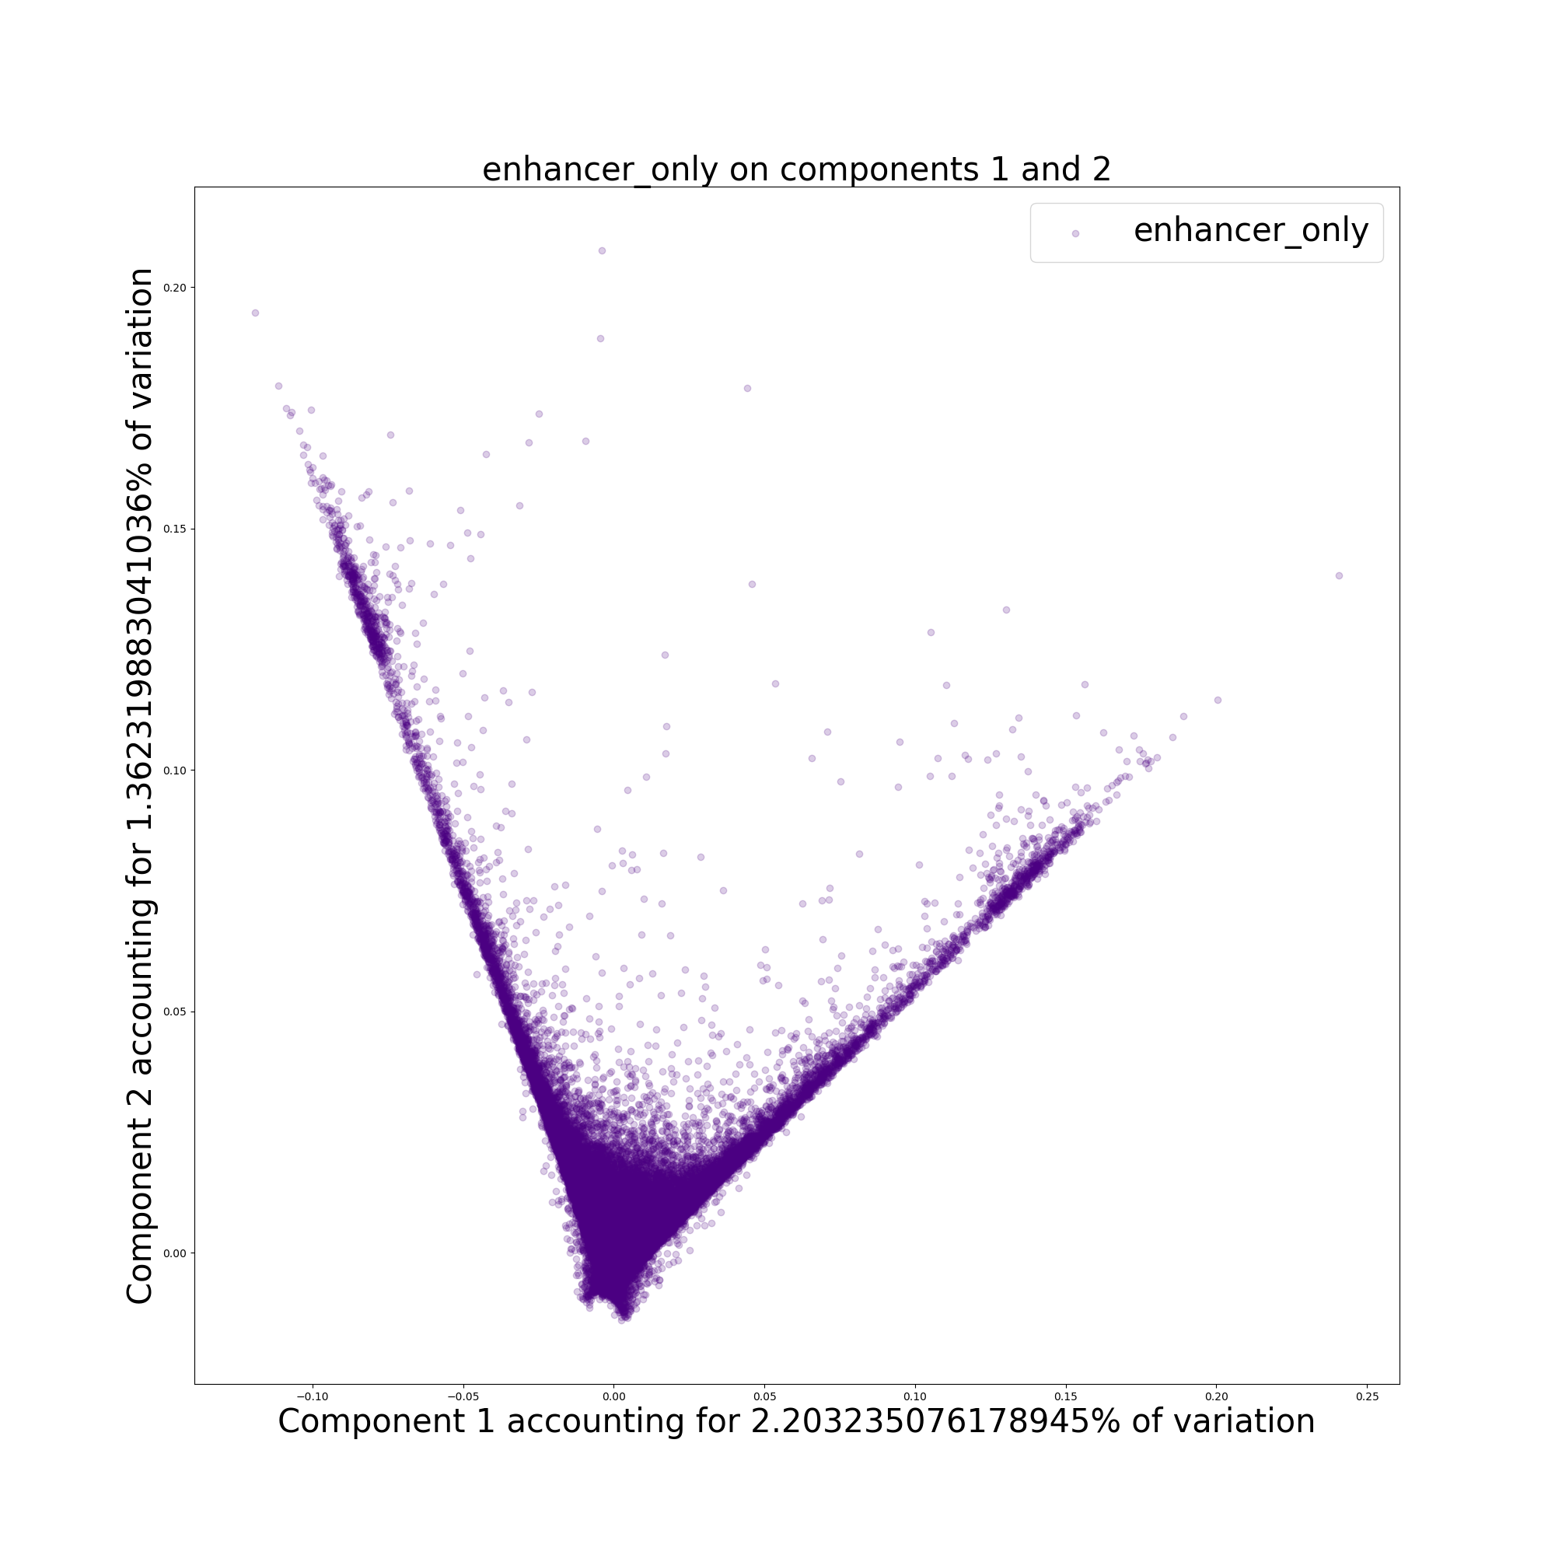
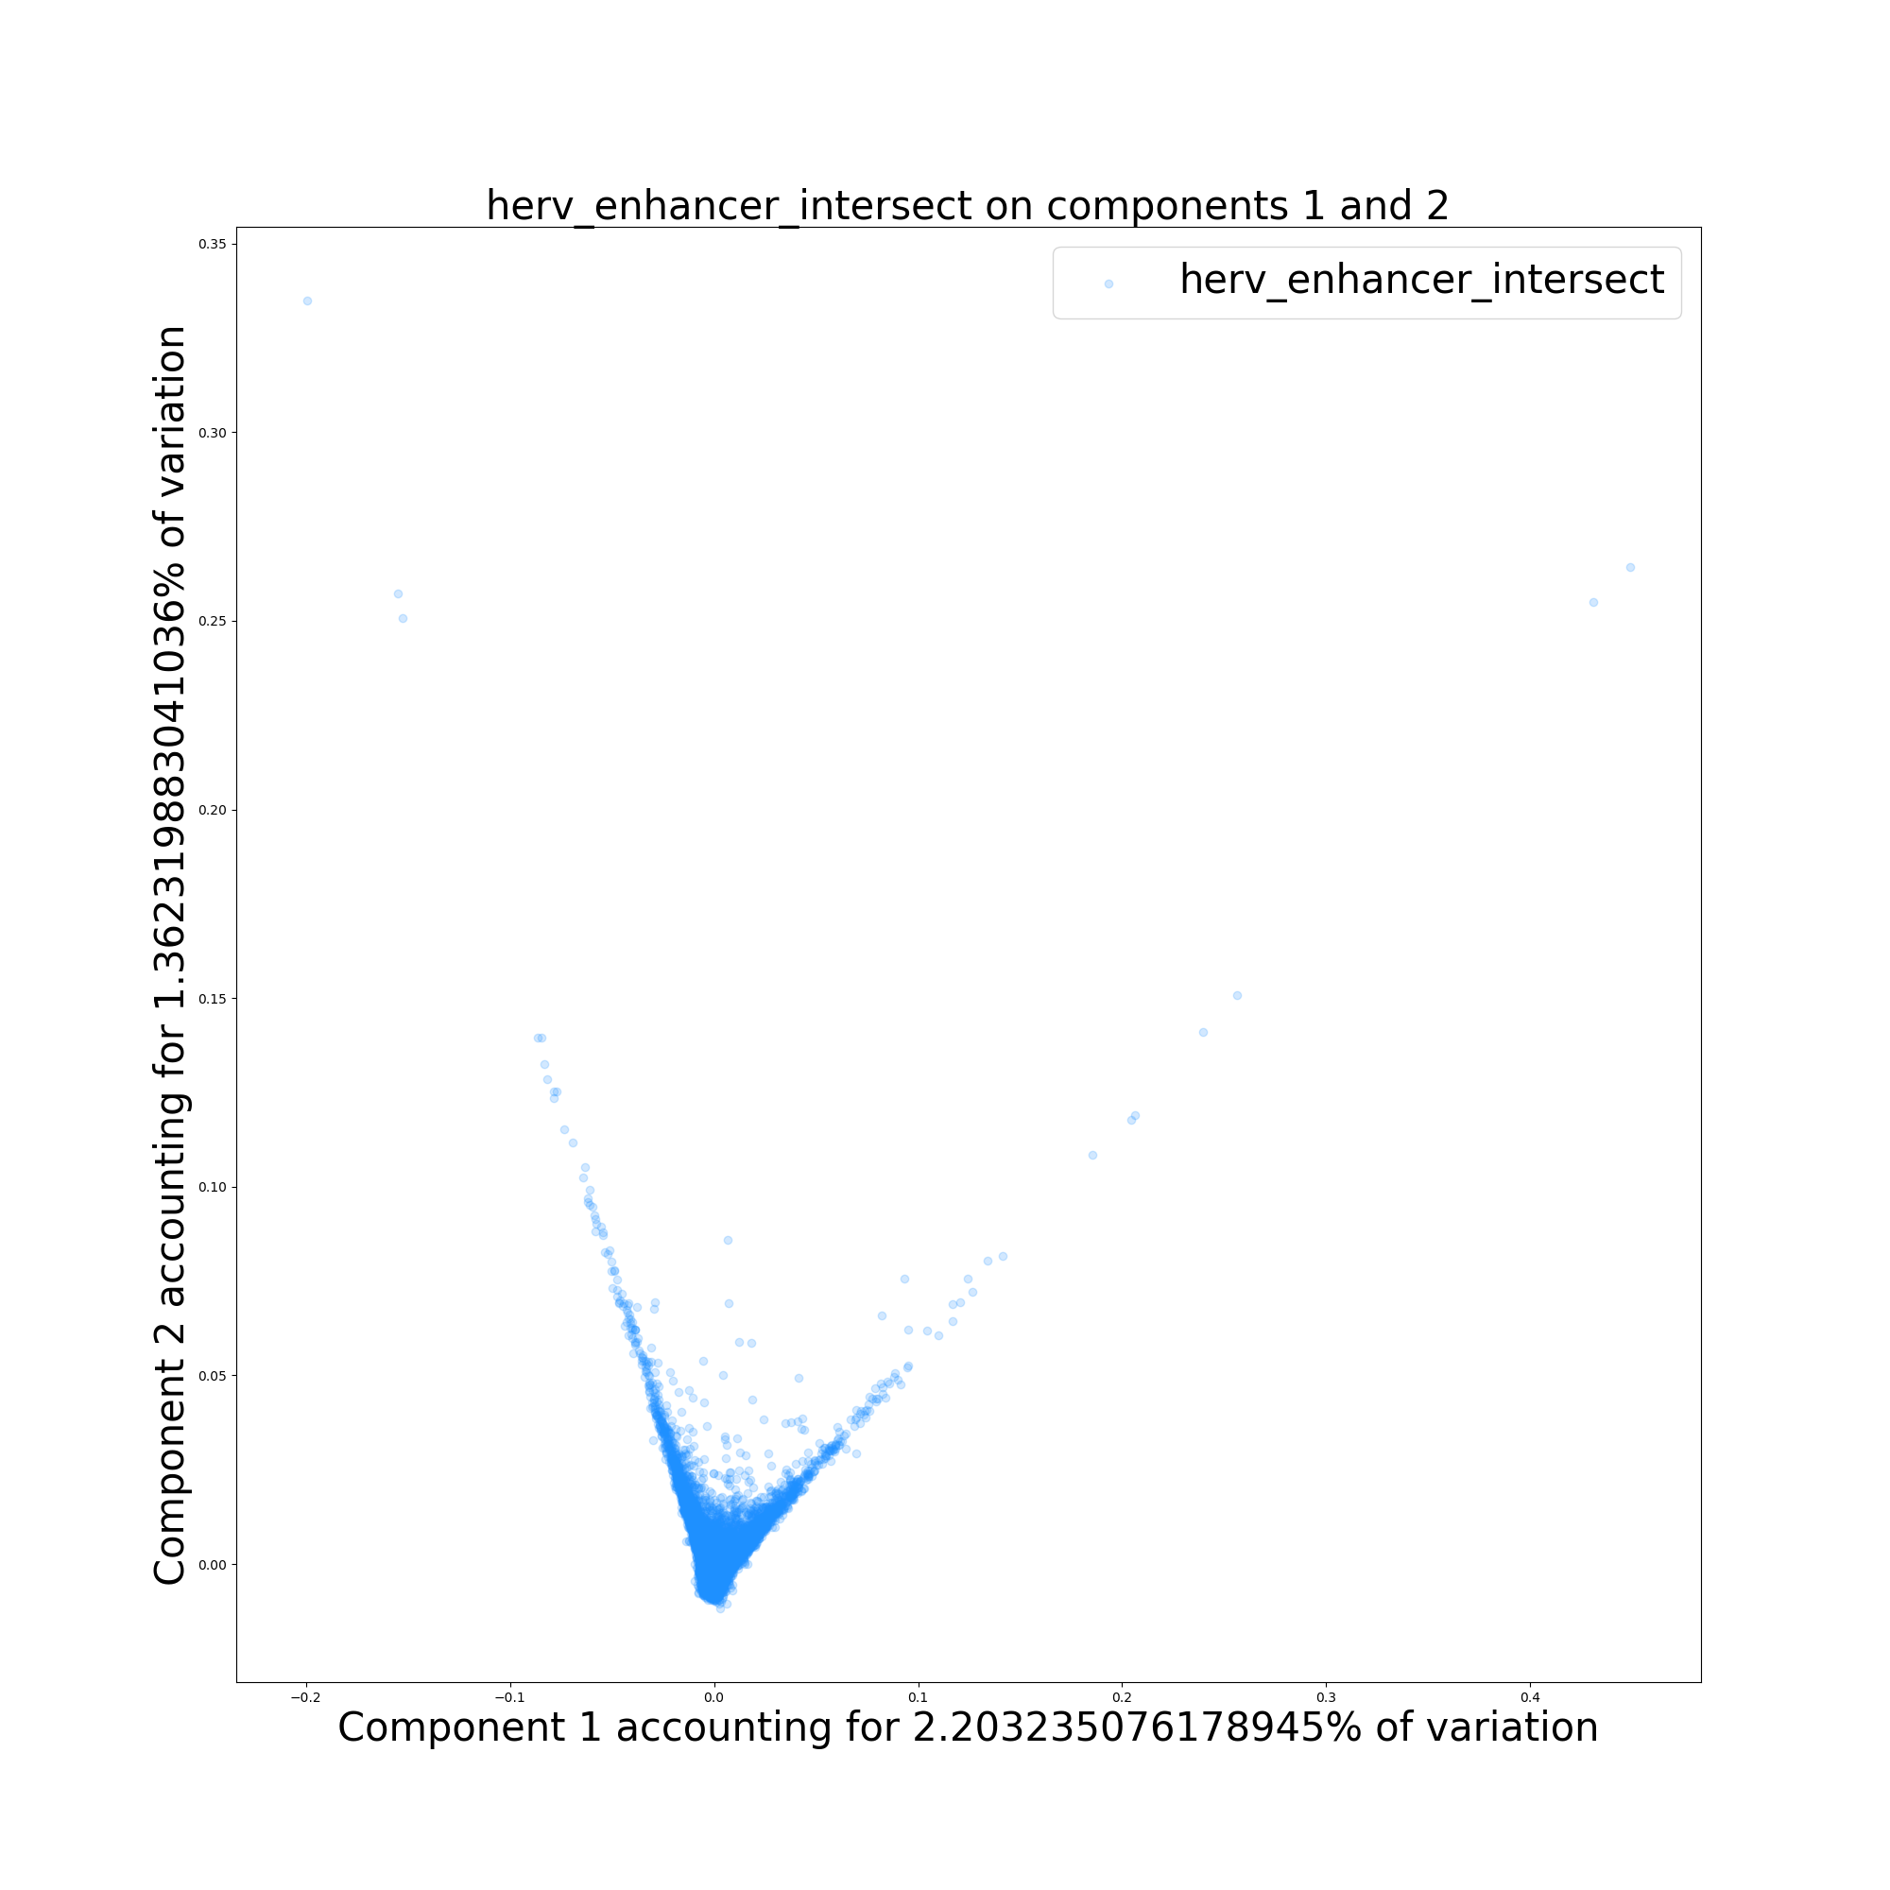
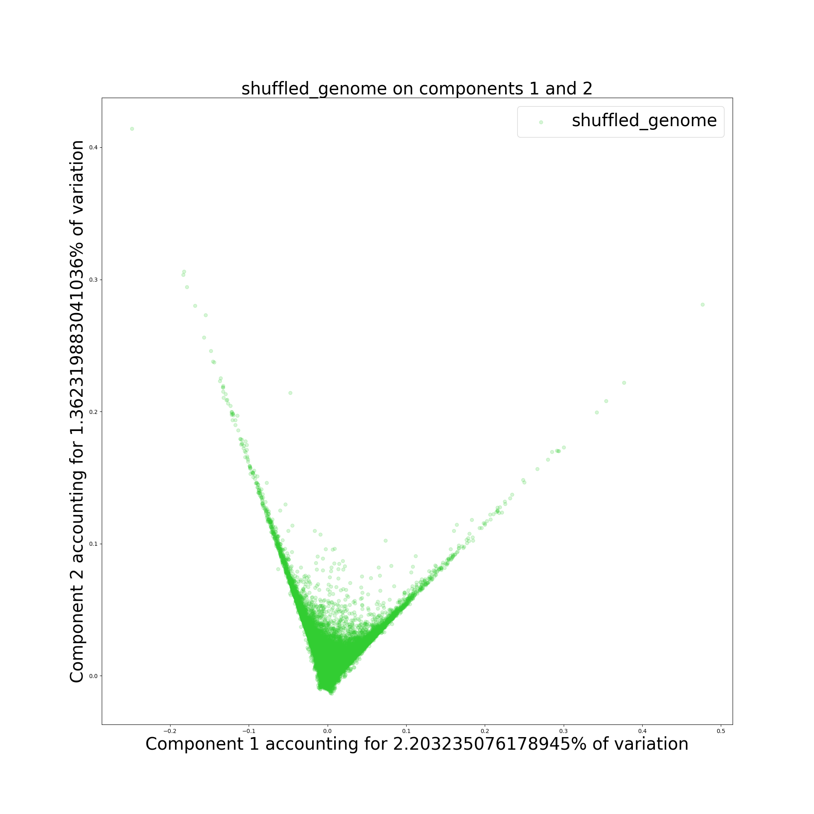
Algorithm: PCA Sample: Full set (~1,000,000 total) Features: 6-mer counts

Slide 9
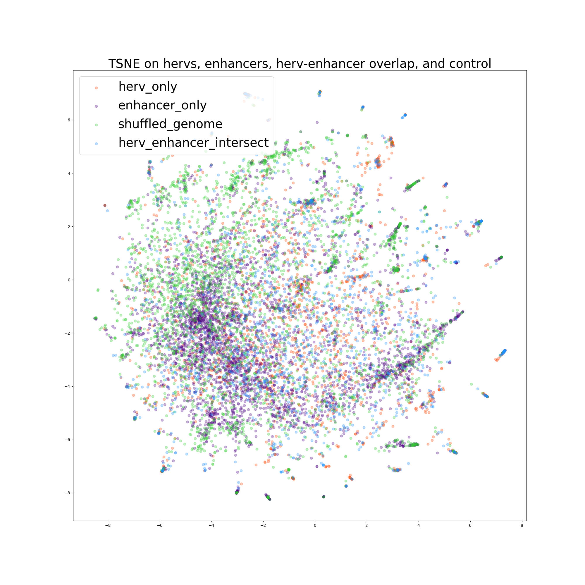
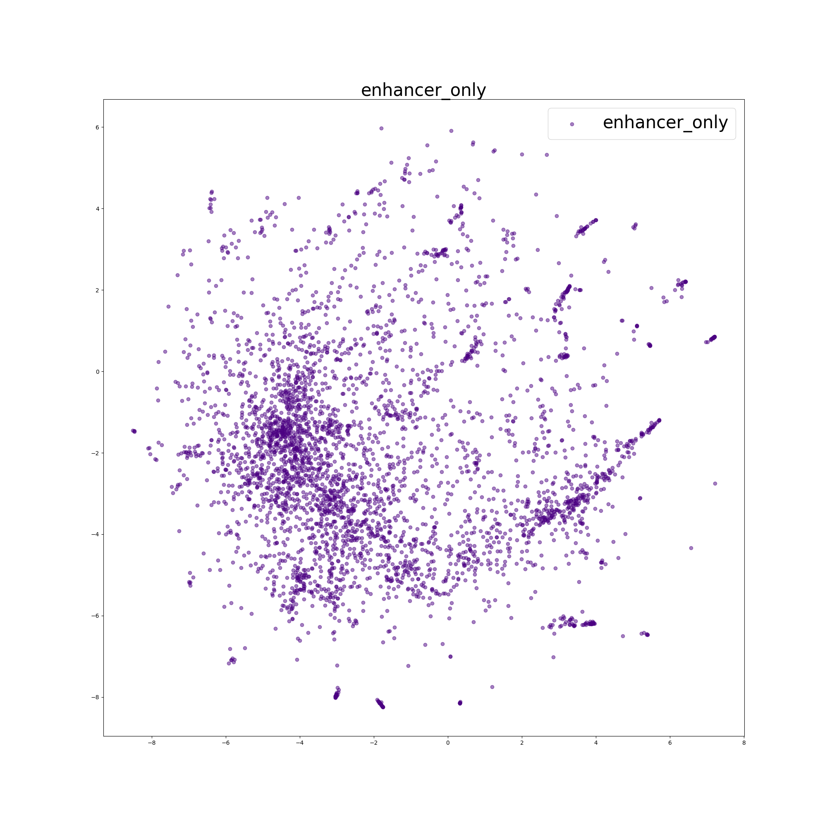
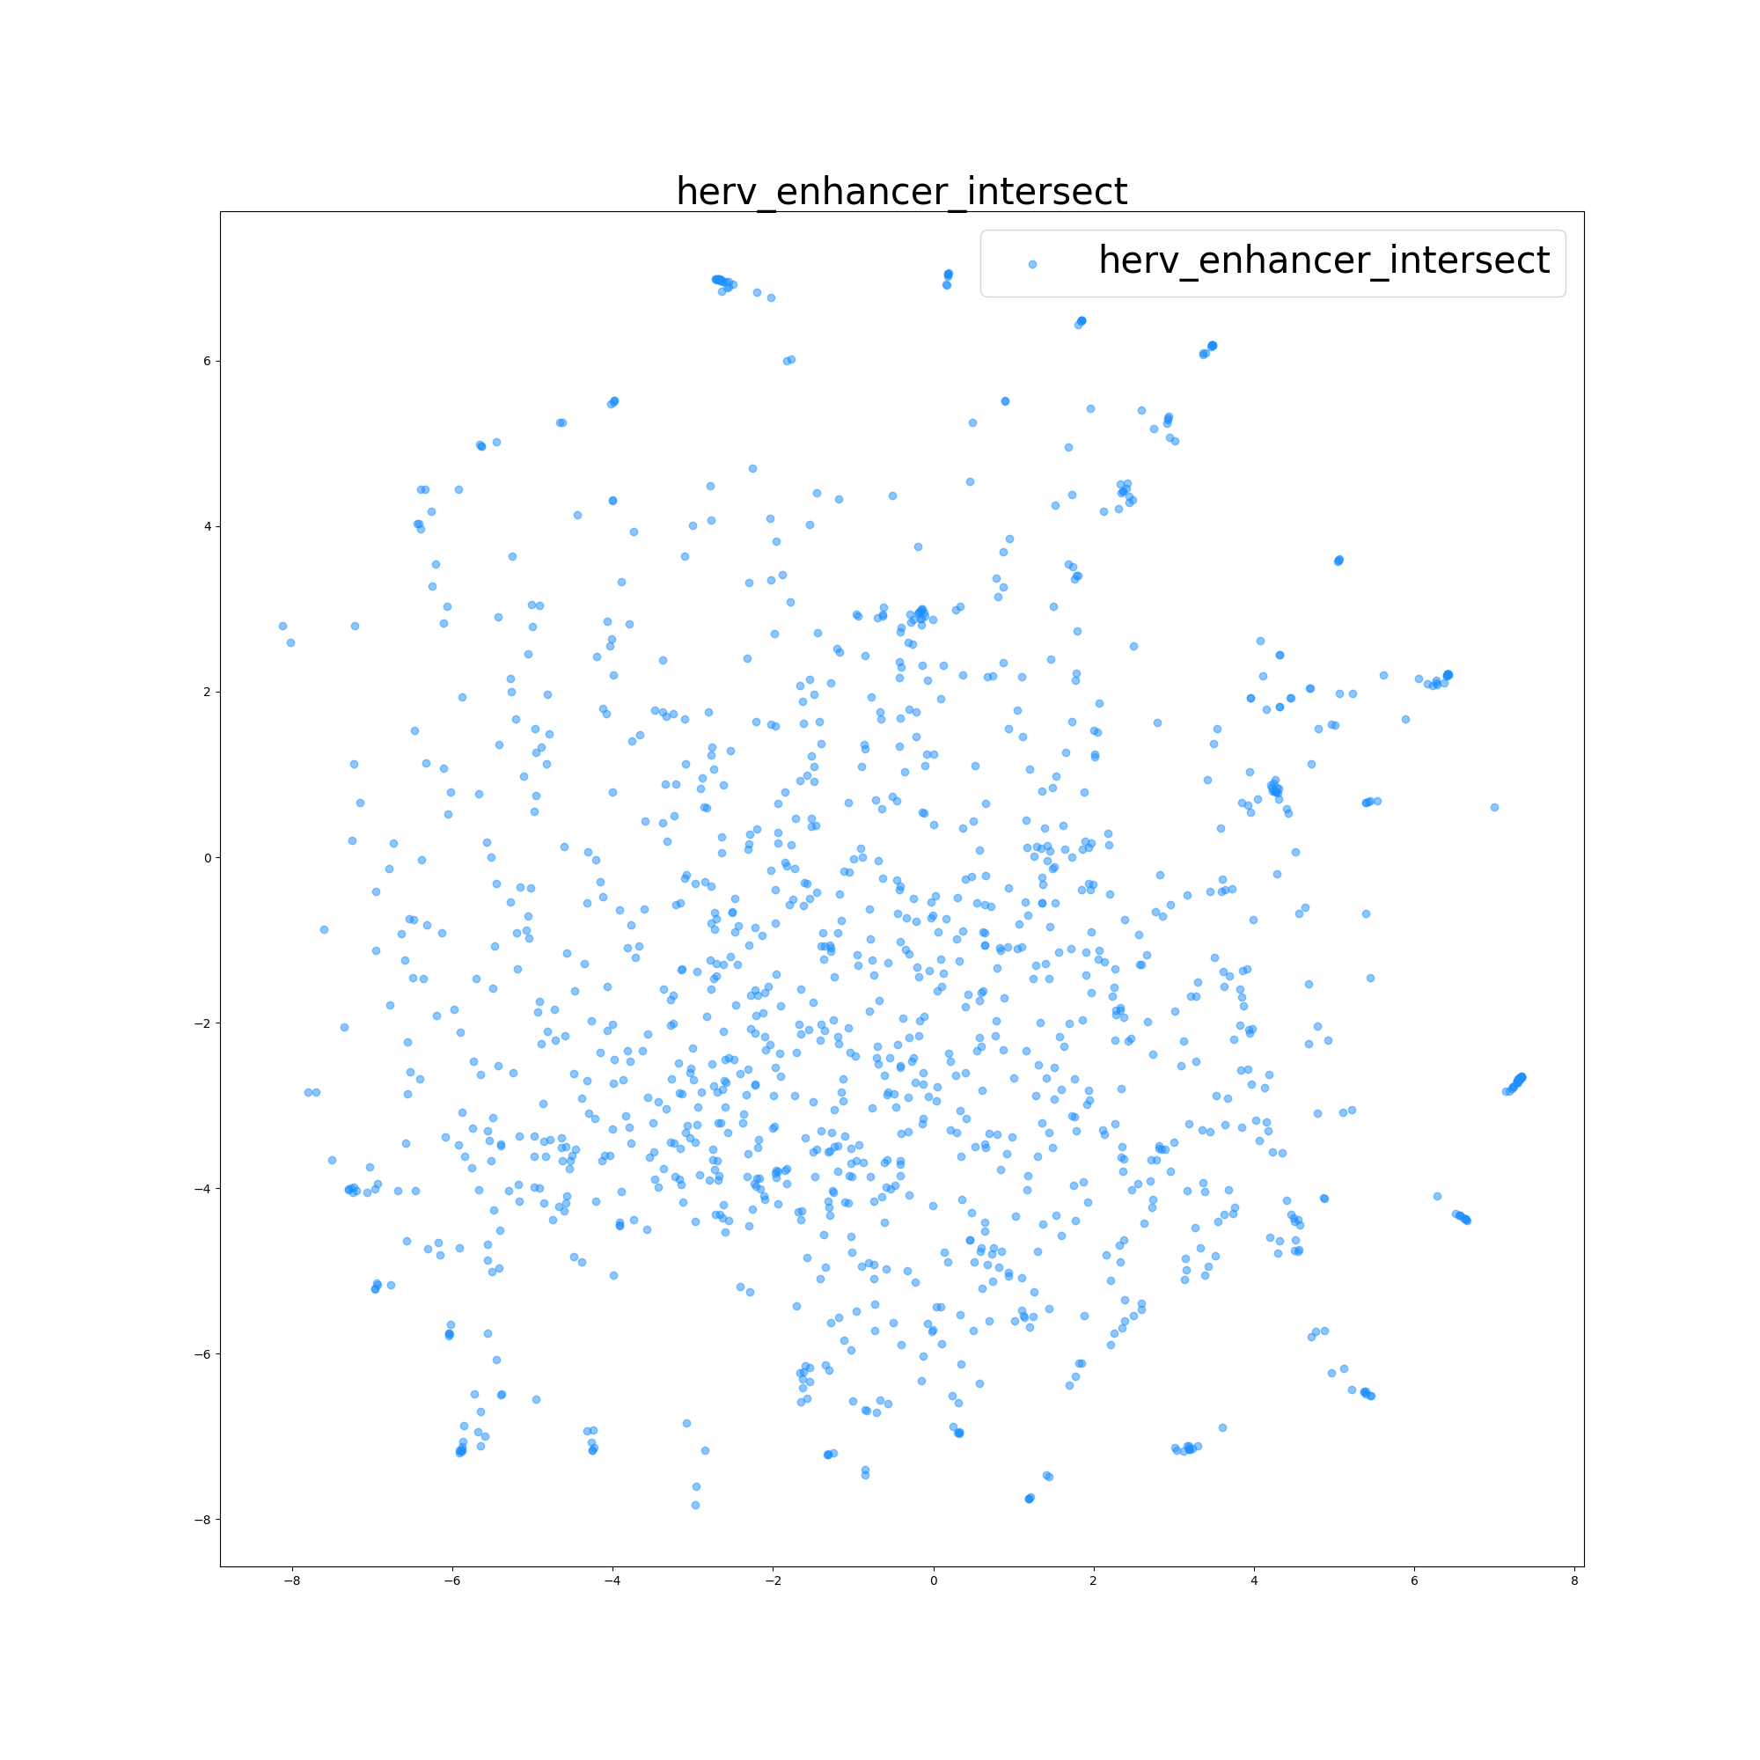
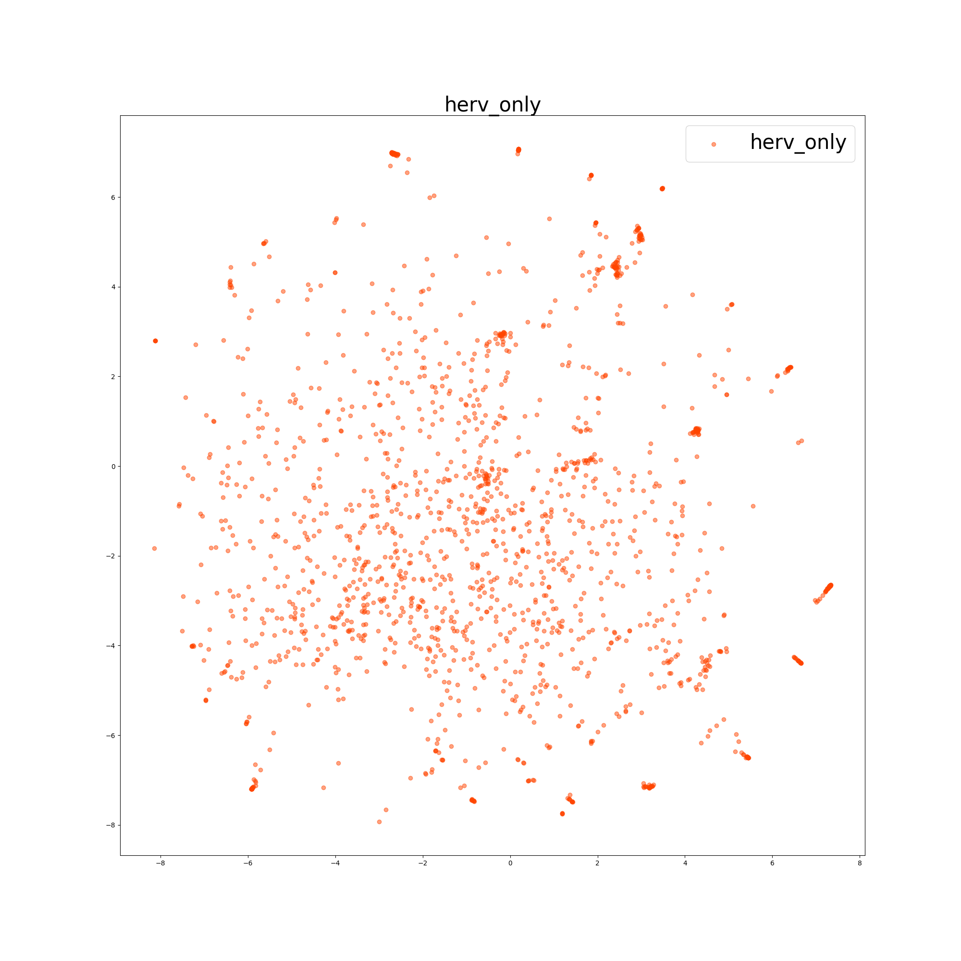
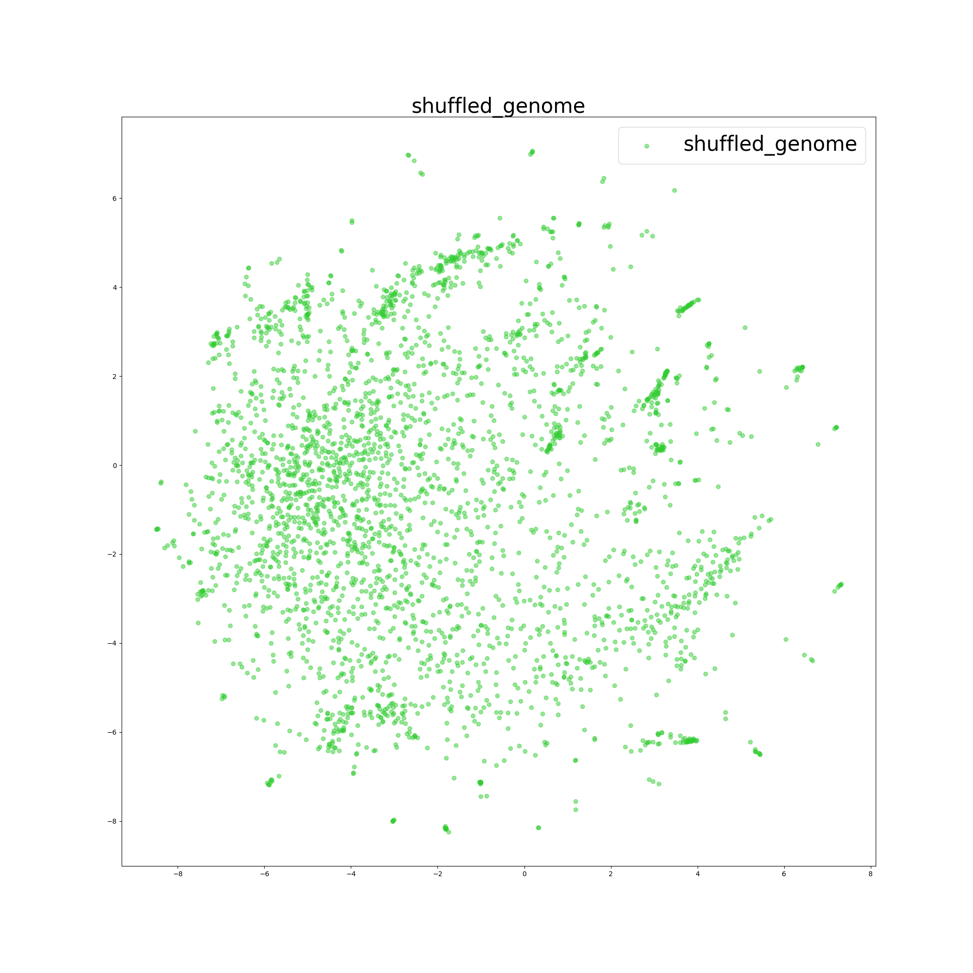
Algorithm: TSNE Sample: 10,000 Features: 6-mer counts reduced to 50 principal components by PCA

Slide 10
Algorithm: Random Forest Classifier Sample: 100,000 Features: 6-mer counts
 | precision | recall | f1 | support
enhancer | 0.69 | 0.82 | 0.75 | 9634
herv-enhancer | 0.44 | 0.25 | 0.32 | 3367
herv | 0.44 | 0.25 | 0.32 | 4349
random | 0.51 | 0.67 | 0.58 | 7650
average | 0.54 | 0.58 | 0.55 | 25000

Slide 11
Future Directions: Distributed Computing
Use custom distance function in tsne
Rerun analysis on full data set where sampled
7-mers or 8-mers as features

Slide 12
Future Directions: Other
Use machine learning classifier for herv-enhancer intersect vs enhancers.
Look for biological features to explain results
More enhancer sets
Run chromhmm and tf analysis on hervs only

Slide 13
Acknowledgements
Dr. Capra: Project ideas and summer internship with interesting topic of machine learning
Abin: Supervision throughout the summer
Everyone in Capra lab: Help through the summer

