Slide 1
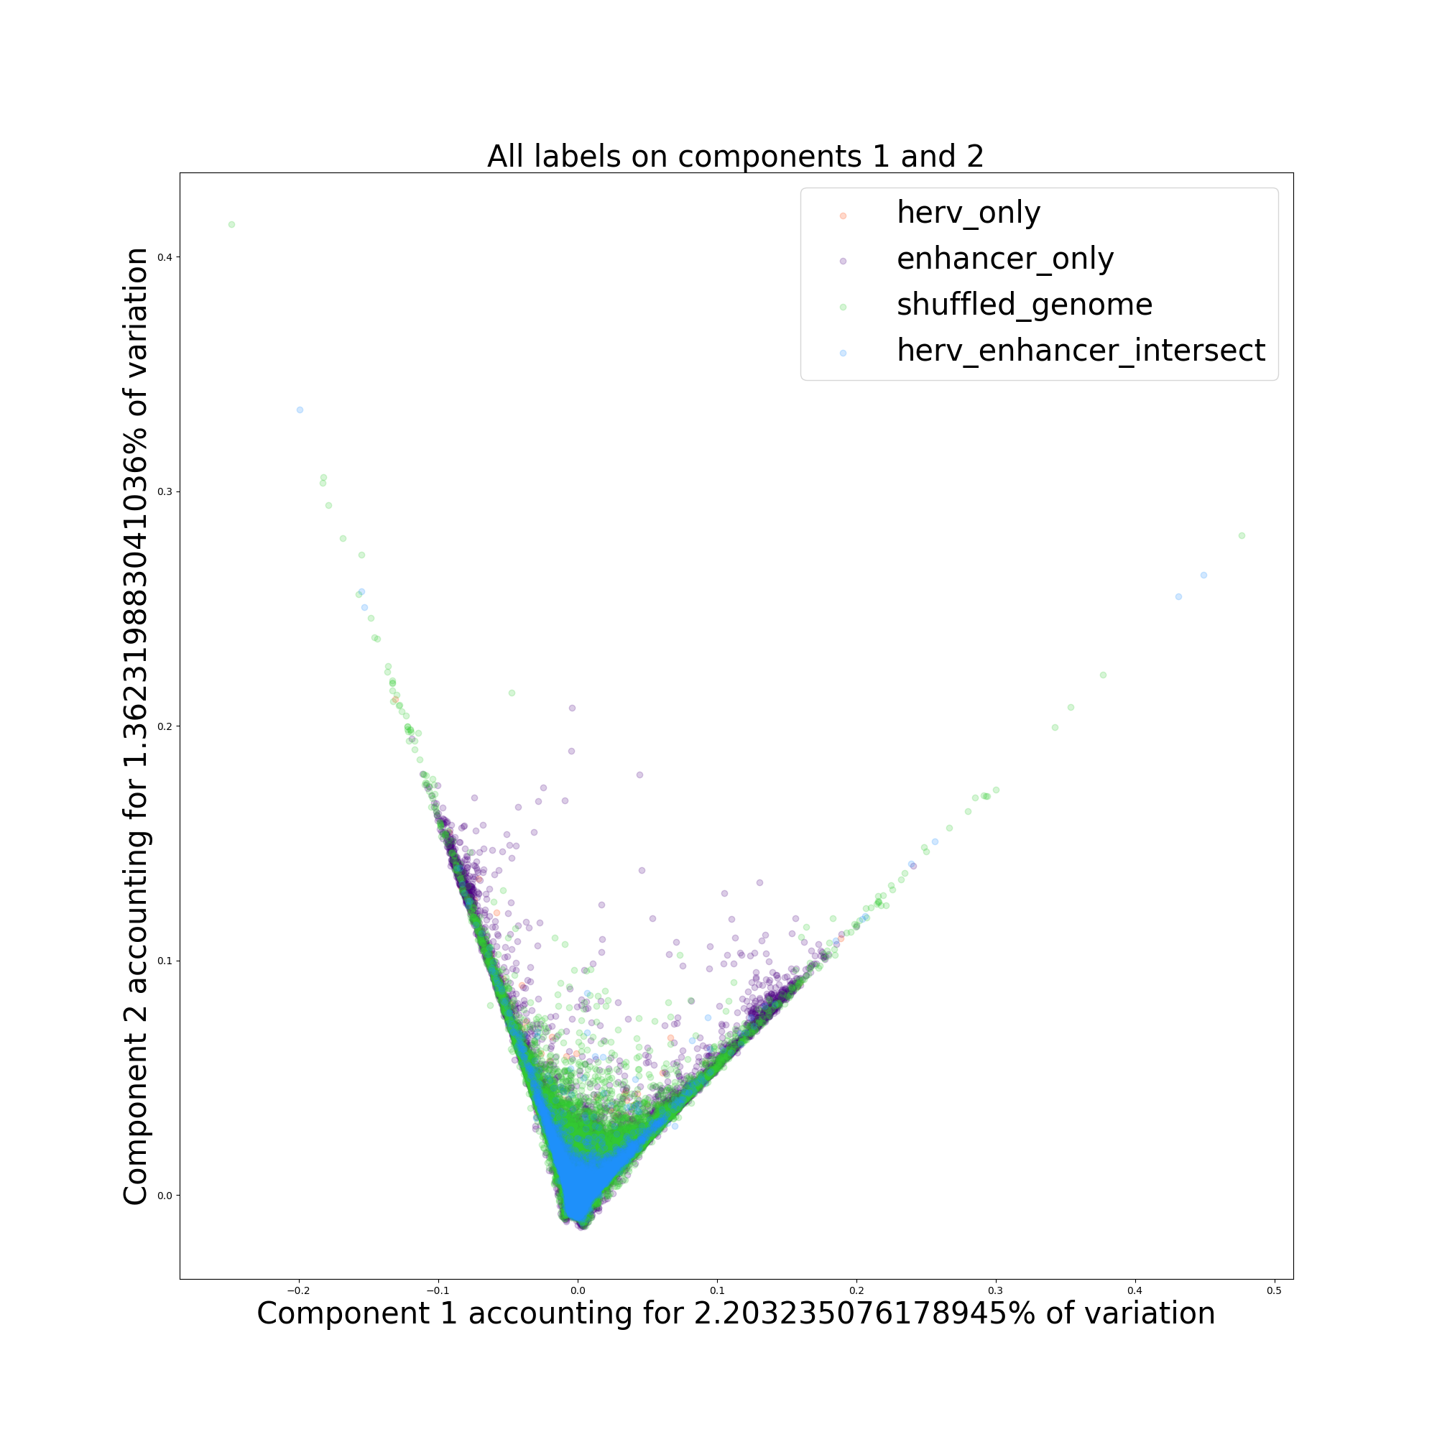
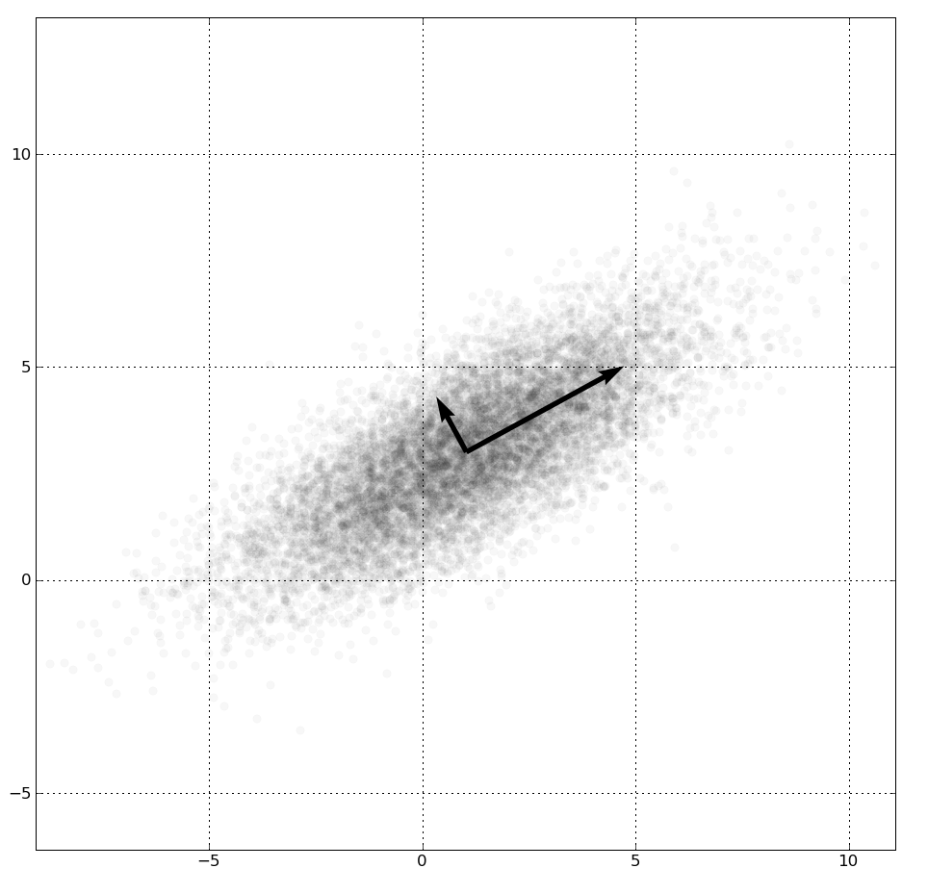
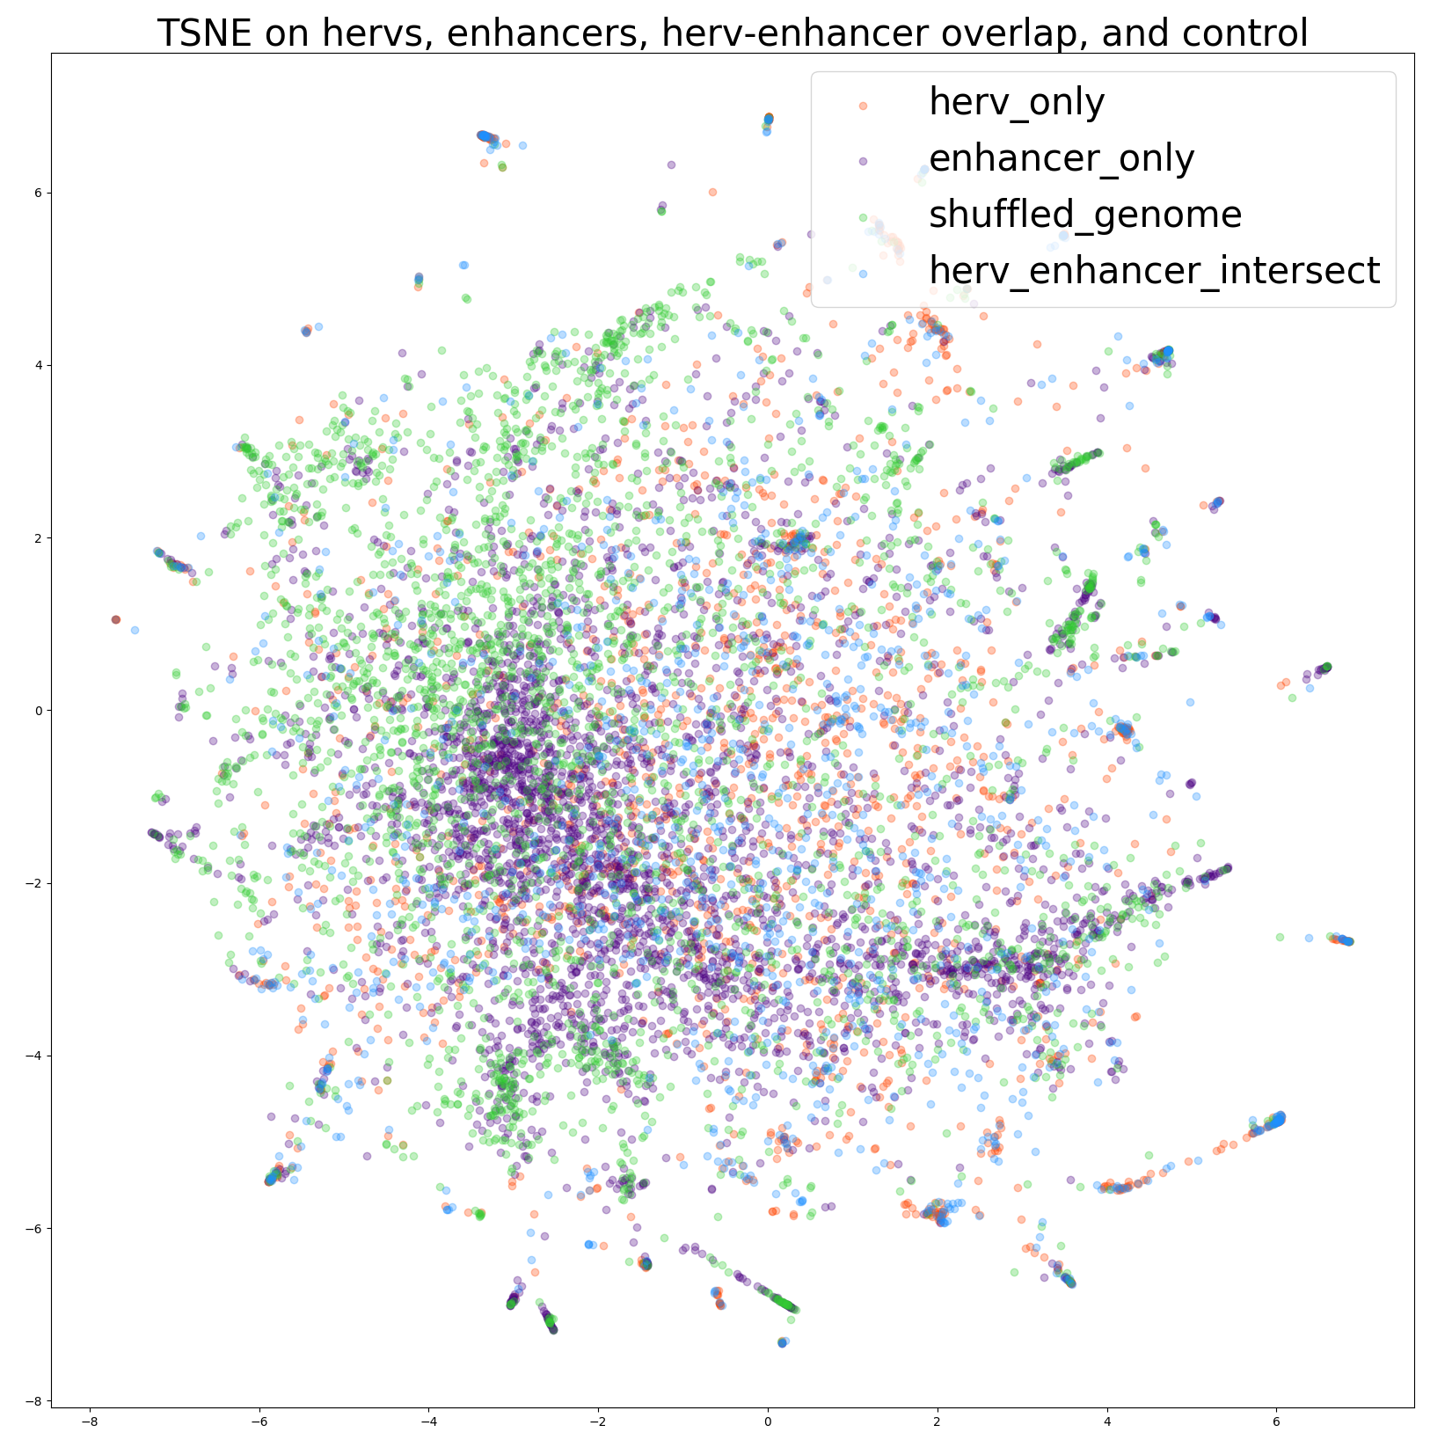
Machine Learning on Human Genome Transposable Elements Daniel Yan¹, Abin Abraham², John A. Capra^{2, 3}
1) Department of Electrical Engineering and Computer Science, Vanderbilt University 2) Vanderbilt Genetics Institute, Vanderbilt University 3). Department of Biological Sciences, Vanderbilt University
Background
Results
Results
Machine Learning: Given a set of inputs, use computer algorithms to predict a set of outputs (supervised learning), or discover patterns (unsupervised learning).
Supervised Learning Example: Use decision trees with a series of yes/no choices to label data—basis of random forest, which combines information from multiple decision trees.
PCA on Hervs, Enhancers, Herv-enhancer Intersection, and Random Set
Decision Tree Example
Trait_1 > 2
No
Yes
Trait_2 > 5
Trait_3 < 9
No
Yes
No
Yes
Class 1
Class 2
Component 2 accounting for 1.63% of variation
Class 2
Class 1
Unsupervised Learning Example: Use linear transformations to capture maximum variance in data with fewer variables—basis of principal component analysis example below [1].
Enhancers and random set seem to be confused with each other than with hervs.
Hervs and herv enhancer intersect are predicted more often when the actual element is from a herv or herv-enhancer intersect.
Component 1 accounting for 2.20% of variation
TSNE on Hervs, Enhancers, Herv-enhancer Intersection, and Random Set
Conclusion
Intersection of hervs and enhancers seems to be more similar to hervs than enhancers.
Hervs and herv-enhancer intersection seems to be a distinct group, while enhancers seem closer to random set.
Future Direction
Transposable elements are repeating non-coding regions within the human genome.
Distributed computing for more resource intensive computations, since many computations failed due to resource limitations.
Examine biological features to explain observations about hervs and enhancers.
Use more enhancer sets for analysis
Run on full data sets where samples were used
Objective
This project examines the relationship between transposable elements and enhancers using machine learning.
Acknowledgements
Methods
ACCRE Scholars Program for funding
VUSRP Program for funding
Use supervised learning to classify transposable elements that overlap enhancers against other sequences of the human genome
Use unsupervised learning methods such as t-distributed stochastic neighbor embedding (TSNE) and principal component analysis (PCA) to visualize differences between hervs (subset of transposable elements), enhancers, herv-enhancer intersection, and a random set constructed by length matching hervs to randomly shuffled parts of the human genome.
References
https://commons.wikimedia.org/wiki/File:GaussianScatterPCA.png

