Slide 1
Designing a Poster
Justin Marinko, Lauryn Luderman, Sierra Palumbos, Melissa Mallon

Slide 2
Use a template
Follow the columns and text size from a template
IMPORTANT: Know size of poster board!
Make your text formatting consistent throughout the entire poster
More figures than text! You will be at the poster the whole time ☺
Templates can be found on the Vanderbilt BRET site as well as phdposters.com
https://medschool.vanderbilt.edu/bret/poster-printing-service-templates

Slide 3
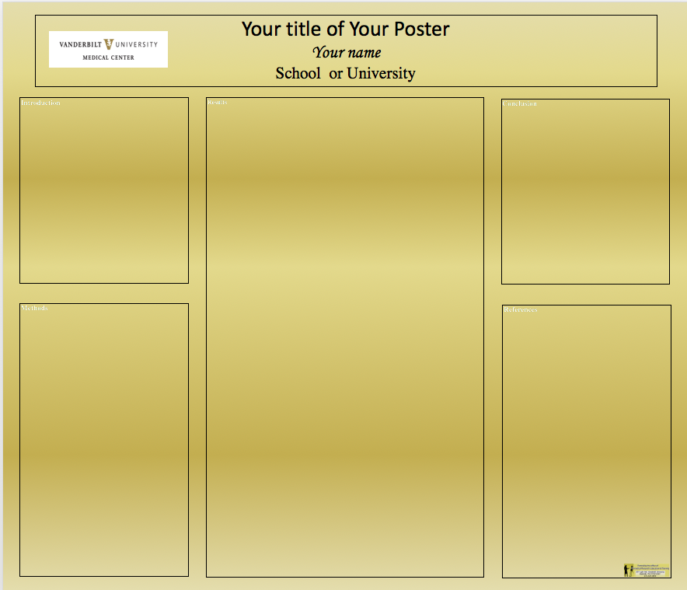

Slide 4
Where to make figures
draw.io
Inkscape
Powerpoint
Affinity designer
Illustrator

Slide 5
Title
Title should be fairly short and be able to stand on its own
Statement of major findings
Your name goes first- underline or star
Include everyone that contributed

Slide 6
Summary- Panel 1
Include a short, abstract-like description of your project
If you have a model or workflow you can put this in instead of text
Include a HYPOTHESIS

Slide 7
Background- Panel 1
Why do we care about your
Can also include new and interesting methods

Slide 8
Results- Panel 2
Predominantly figures
Figure legends- balance between text and figures
Have a title for each box/figure
Make sure your axes are labeled!
Throughout, your grouping of figures should be consistent

Slide 9
Extended Results- Panel 3
Results can continue into panel 3

Slide 10
Conclusions- Panel 3
What is the main point you want people to remember?
Can bring in a model figures

Slide 11
Future Directions- Panel 3
What experiments do you have planned (or experiments another researcher can do) to build on or finish your project?
What is the next logical step?

Slide 12
Acknowledgments- Panel 3
Acknowledge anyone in the lab who helped you perform experiments, helped with data analysis, contributed intellectually, etc.
Acknowledge any and all funding that helped you to complete your research.
You don’t need to acknowledge anyone who’s name is on the poster (i.e your PI)

Slide 13
Common Mistakes
Too much text
Pixelated figures (Don’t use jpg!)
Putting too much on a poster- less can be more effective
Not leaving enough space around edge for printing
Spending too much time on a poster- aim for a 5 minute description
Directly reading poster- your poster is simply a guide you should be making eye contact!

Slide 14

Creating Engaging Posters (While Giving Proper Credit!)
Melissa Mallon | Vanderbilt Libraries
Choose Creative Commons or Public Domain images
Wikimedia Commons - https://commons.wikimedia.org/wiki/Main_Page
Google Images - https://www.google.com/advanced_image_search
TIP: filter to “Free to use” under Usage Rights
Compfight - http://compfight.com/
Things to keep in mind …
Watch out for pixelization on images or charts
Include citations, list of sources, etc. on a handout or website
Utilize social media for audience interaction & crowdsourced feedback
More tools & tips @ http://researchguides.library.vanderbilt.edu/researchproductivity/presentations
Notes:
Public Domain image courtesy of Creative Commons, fixed by Quibik

