Slide 1
Machine Learning on Human Genome Transposable Elements
By Daniel Yan

Slide 2
Machine Learning Introduction 1
Use set of inputs (usually numeric values) to predict an output
Divided between regression (predicting numeric value) and classification (predicting label)
Simple classification example: two groups with two features (values), so you can plot the features with xy coordinates and you draw a line to divide them
A new point here would be predicted as orange
A new point here would be predicted as blue

Slide 3
Machine Learning Introduction 2
When you have hundreds/thousands of features, you can’t visualize that easily as xy-coordinates
However, a computer can still attempt to create a “boundary” between labels—basis for Support Vector Machines
A computer can also create decision trees, which use a series of binary YES/NO questions to choose a label—basis for Random Forests
X > 2
No
Yes
Y > 5
Z > 3
No
Yes
No
Yes
Orange
Blue
Blue
Orange

Slide 4
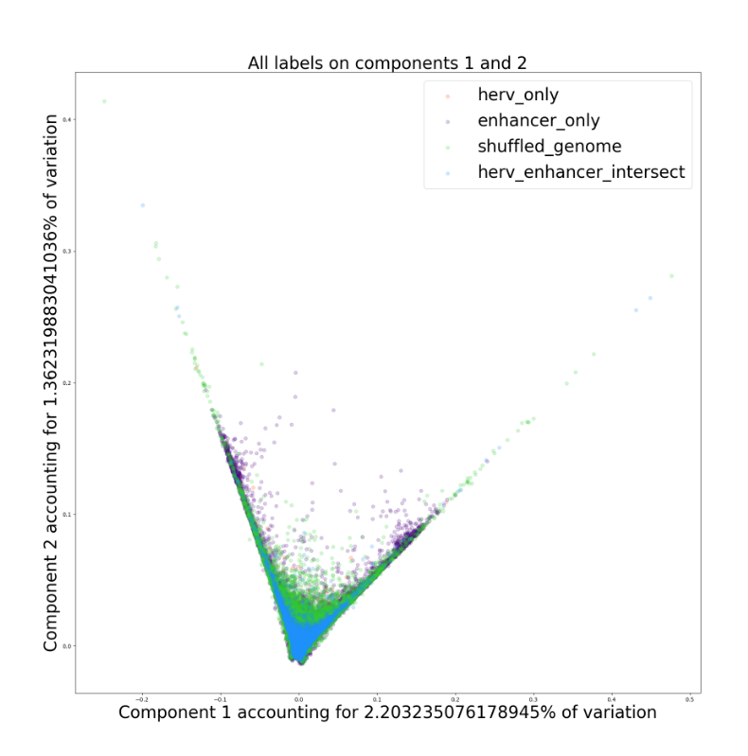
Machine Learning Introduction 3
To visualize higher dimensional data, we can use dimensionality reduction techniques
Principal Component Analysis (PCA): Use linear transformation to capture maximum variance as linear combination (eigenvalues…)
T-distributed Stochastic Neighbor Embedding (TSNE): Probabilistic approximation of which points are “closer” to each other
~4000 features in columns with ~1 million rows
PCA

Slide 5
Transposable Elements
The 9th grade biology I learned was a little too simplistic: the human genome doesn’t just contain base pairs (acgt) that code for proteins.
Transposable elements are one subset of non-coding (wait, are we even sure what coding means….?) base pairs that repeat throughout the human genome.
One hypothesis is that transposable elements contain enhancers, which are supposed to have some regulatory effect on protein production…but what parts of the human genome is enhancers is itself a murky topic…

Slide 6
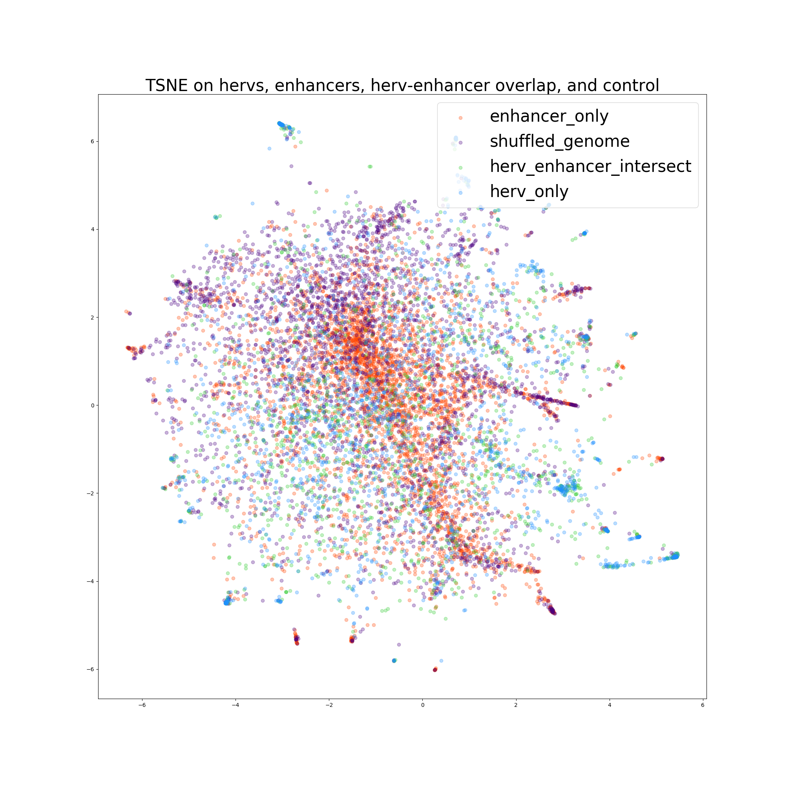
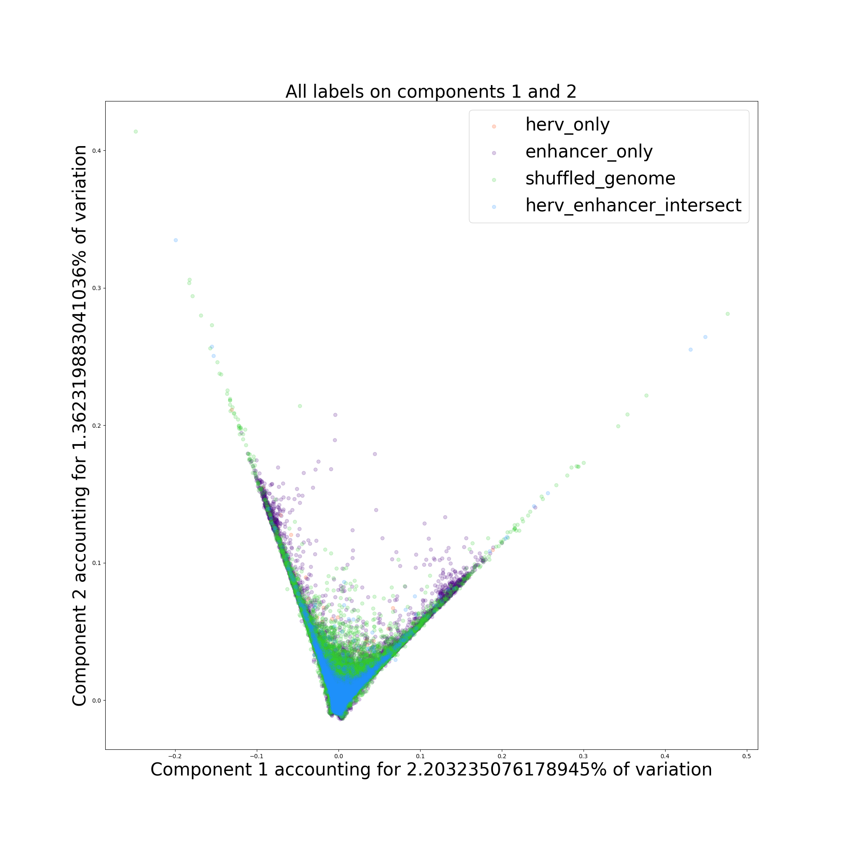
TSNE vs PCA Visualization
TSNE
PCA

Slide 7
Conclusions
The human genome isn’t as simplistic as the “9th grade biology” version
Don’t believe that just because something is “science” it has to be true. As one of my coworkers says, the more uncertain and fuzzy things seem, the more you know you’re at the vanguard...
Machine learning is incredibly powerful, but it isn’t a magic bullet; most of our models on classifying transposable elements did not fare very well
Machine learning isn’t all about creating glamorous algorithms; much of it is processing data so a computer and do mathematical operations
Machine learning and artificial intelligence isn’t some futuristic technology for computer experts, it is already ubiquitous in many fields

Slide 8
Further Investigation
Machine learning using distributed frameworks such as Apache Spark.
Many of our models ran out of resources even on accre, where computers have up to 16 cores and 256 GB of memory.
TSNE had to be reduced from ~4000 features to 50 by PCA (only 17% of variation retained) first, and from ~1,000,000 samples to 10,000 samples to run
Custom definition of distance: “aaaaaa” should be closer to “aaaaat” than “tgctgc”, but a machine doesn’t know unless you tell it

Slide 9
Acknowledgements
Principal Investigator: Tony Capra
Graduate Student Mentor: Abin Abraham
Vanderbilt Advanced Computer Center for Research and Education (ACCRE)
Capra Lab Coworkers:
Mary Lauren Benton
Laura Colbran
Ling Chen
Xiaoyi Dou
Sarah Fong
Maya Johnson
David Rinker
Souhrid Mukherjee
Greg Sliwoski
Keila Velázquez
Kevin Yang

