Slide 1
Gomoku Game
Yubin Fan
Jialu Wang

Slide 2
Management Process Overview
Sprint 1: Main User Interaction
Sprint 2: Offline Mode & AI
Sprint 3: Online Mode
Sprint 4: Optimization & Validation

Slide 3
Project Management
Environment setup
Github
Trello
Android Studio
Agile development
Face to face meeting on daily basis
Pair programming
Github commits: 5 times ; merge: 3 times

Slide 4
Tasks Accomplished
Play board
Restart button
Board click activity
One stone is placed on click event
Black and white stone are placed alternatively
Set the edge of the board as a blocked end

Slide 5
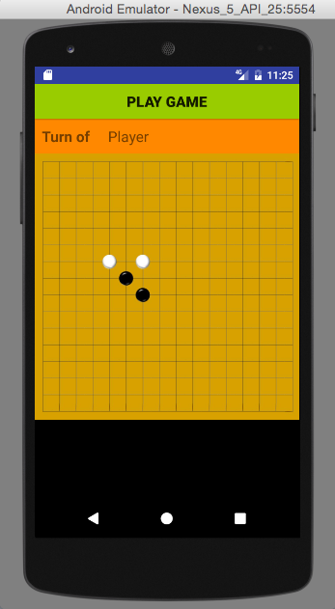
Demo

Slide 6
Next Sprint Plan
Offline Mode
Decision on winning situation
Timer
AI Design and Implementation

Slide 7
THANK YOU!

