Slide 1
MVVM (Model-View-ViewModel)

Slide 2
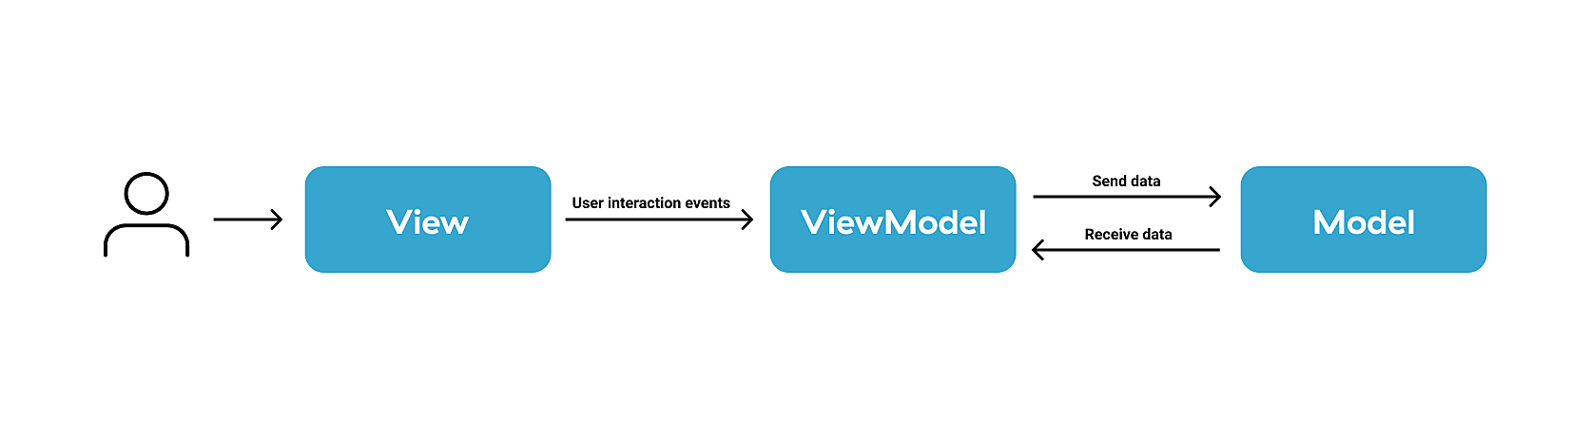
Separation of concerns:
Easier to maintain
Easier to test
Easier to evolve
Better code reuse
Enables developer-designer workflow
Natural to XAML platforms:
Data Binding is key

Slide 3
View
Send notifications
Data Binding
View Model
Model
Updates
Send notifications

Slide 4
The Model
Data model
Business and validation logic
Typically classes
The View
Layout of what is on the screen
Limited code behind, no business logic
Gets data from View Model through bindings or methods
The ViewModel
Intermediary between View and Model
View’s Logic
Provides data from the Model to the View

Slide 5
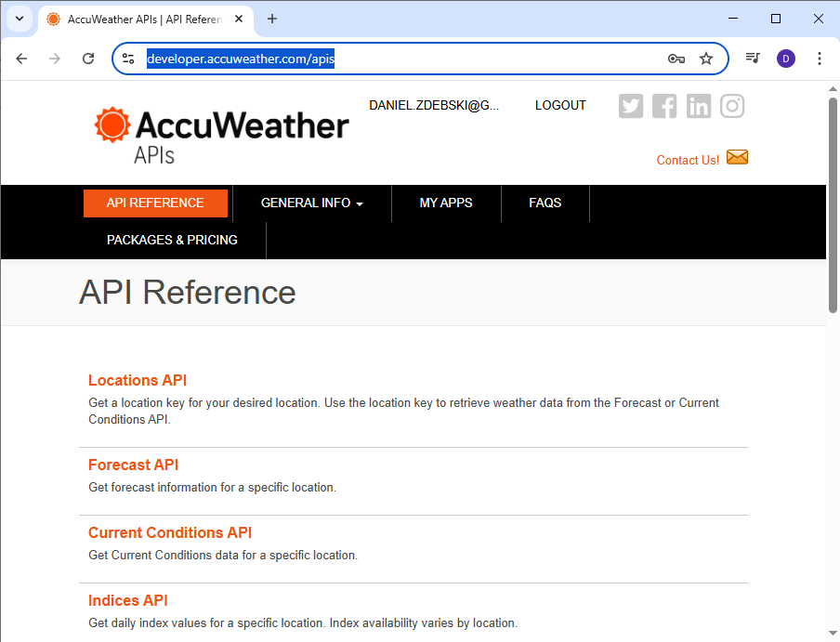
https://developer.accuweather.com/apis

Slide 6
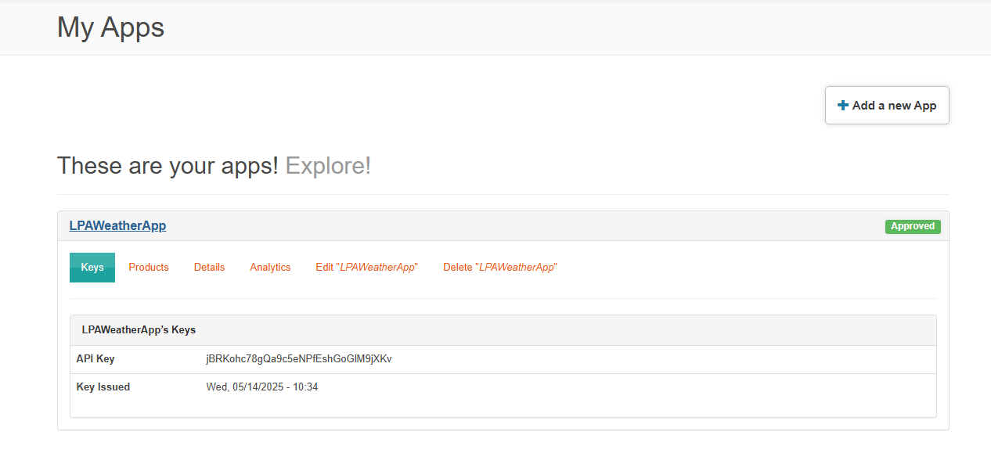
API Key: | jBRKohc78gQa9c5eNPfEshGoGlM9jXKv

Slide 7

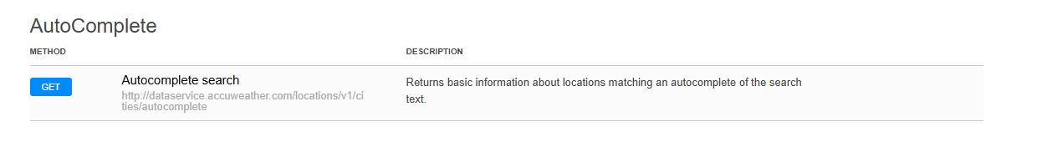

Slide 8
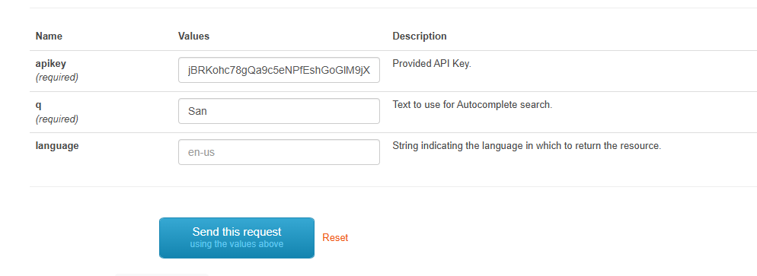
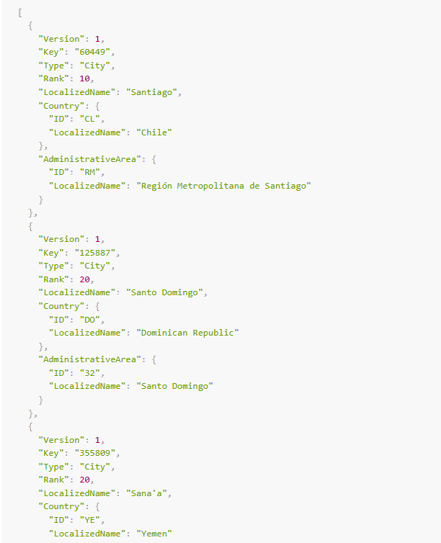
Key is very important

Slide 9



Slide 10
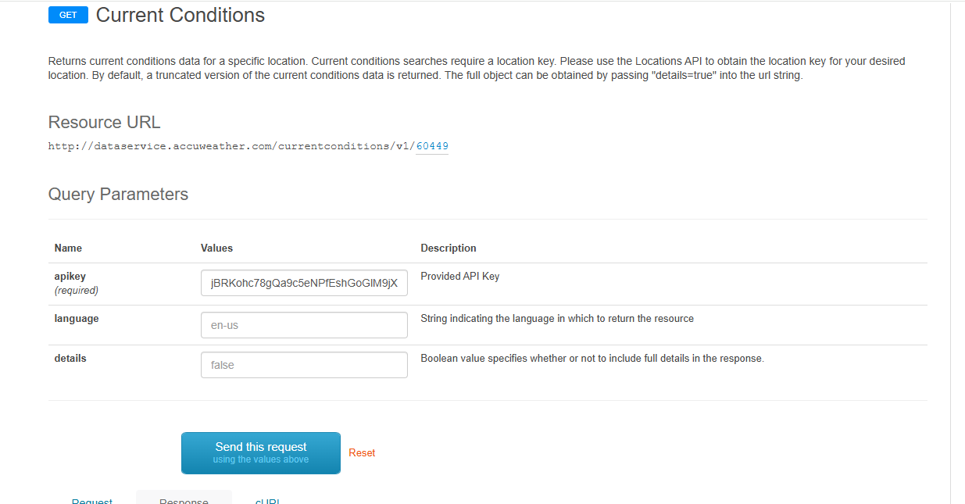
Location key

Slide 11
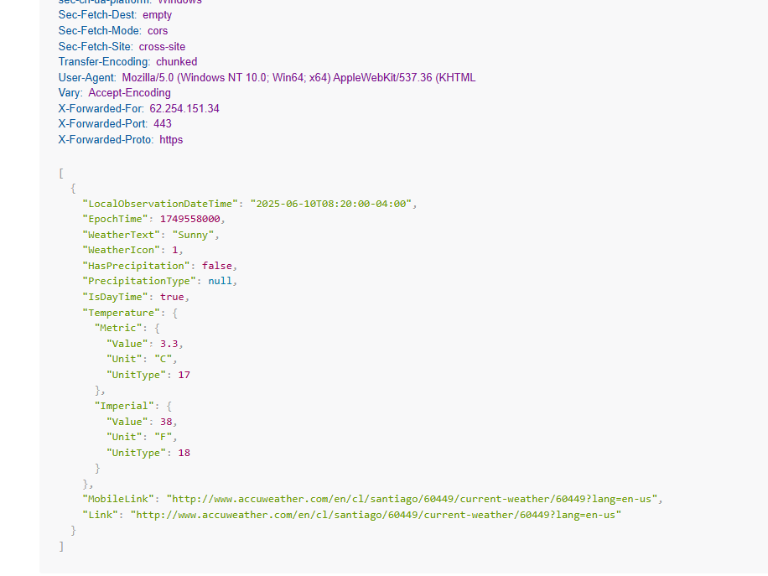

Slide 12
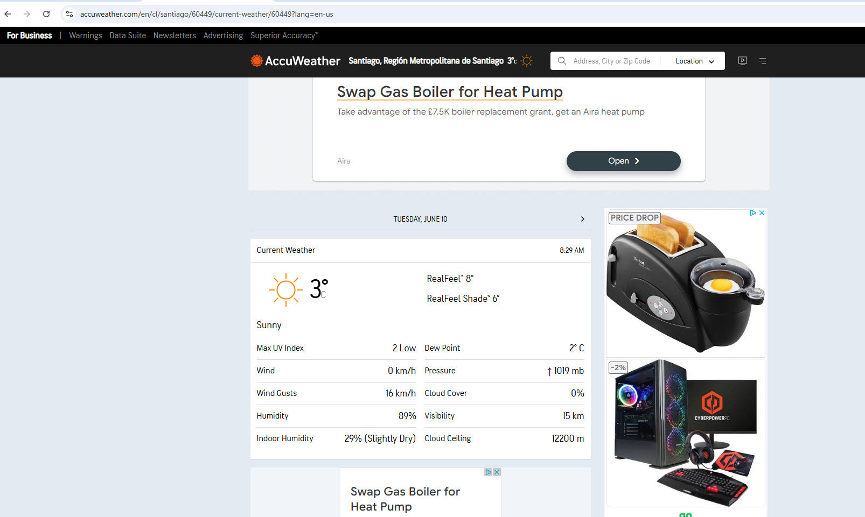

Slide 13
The Model
Classes
Interfaces
Adding methods – if the functionality is working on class only.
Not to use the functionality which is outside of the class. Typically only properties would be in the Model.

Slide 14
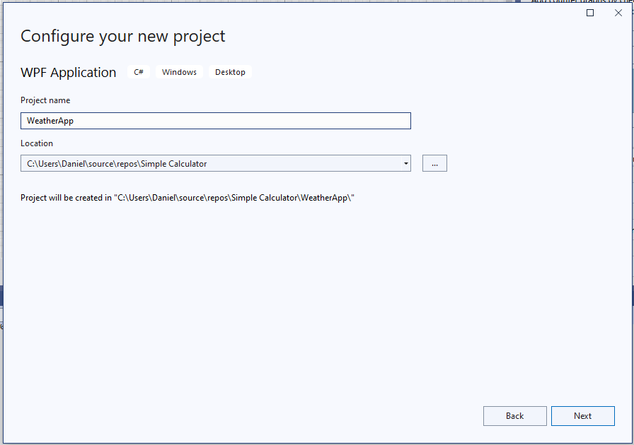
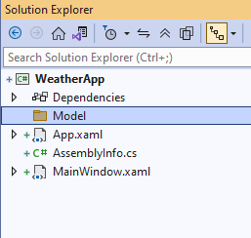
Create a new project: (WPF)
Create Model folder inside the project:

Slide 15
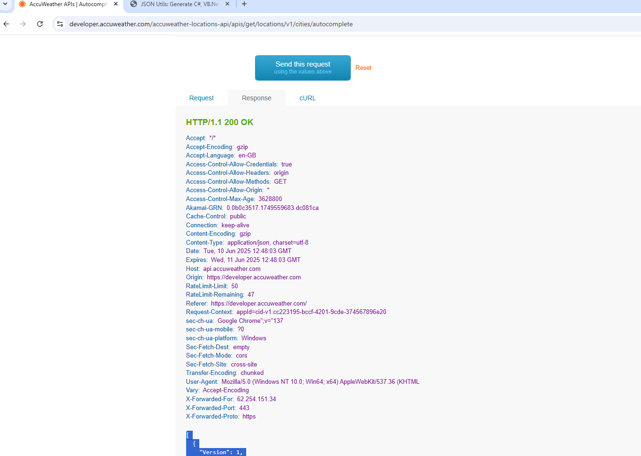
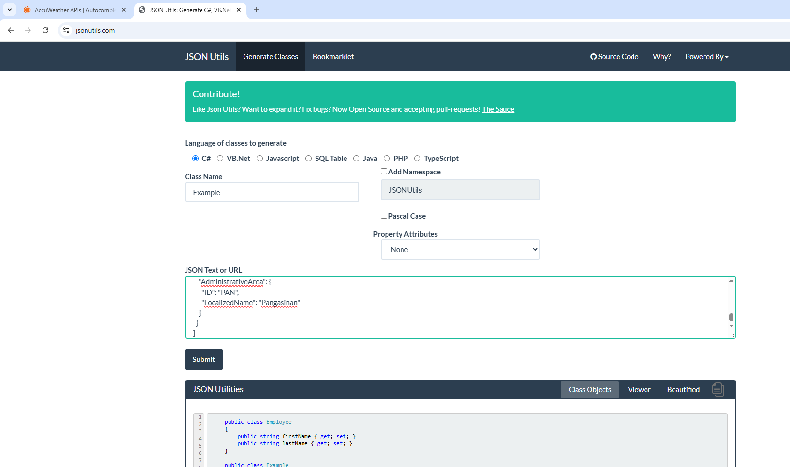
Grab json -> jsonutils.com

Slide 16
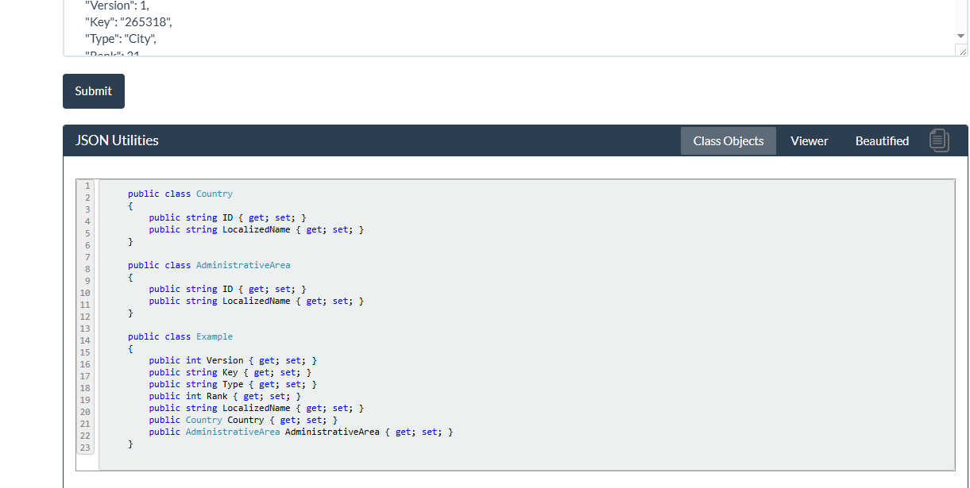
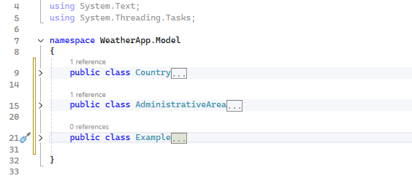
Rename:
Example -> City
Country -> Area
Make sure the references are updated.

Slide 17
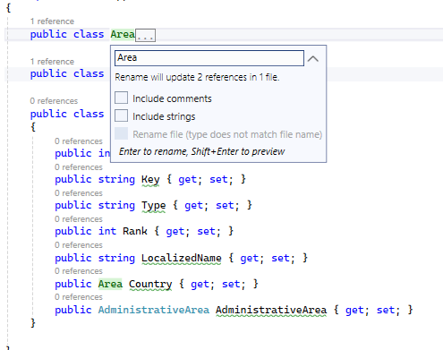
Right click and use “Rename” this will update all code where the class is used.

Slide 18
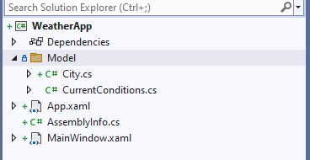
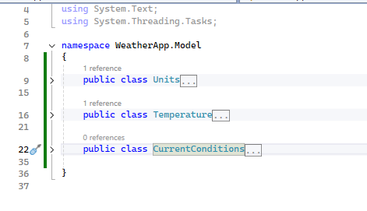
Create other class called: CurrentCondtions.cs
Same way as previously generate the Class code:
Change Example to CurrentConditions,
Remove metric as it is same as imperial
Change Imperial to Units

Slide 19
ViewModel

Slide 20
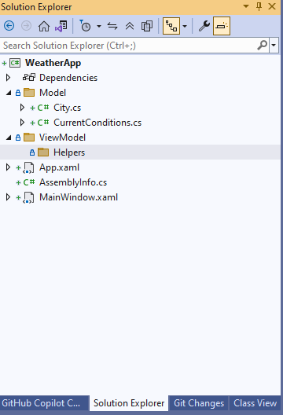

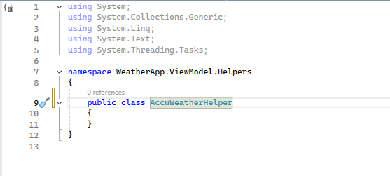
Here shall be placed classes which interact with outside code or website
The class shall be public as it may be used outside of the Assembly

Slide 21
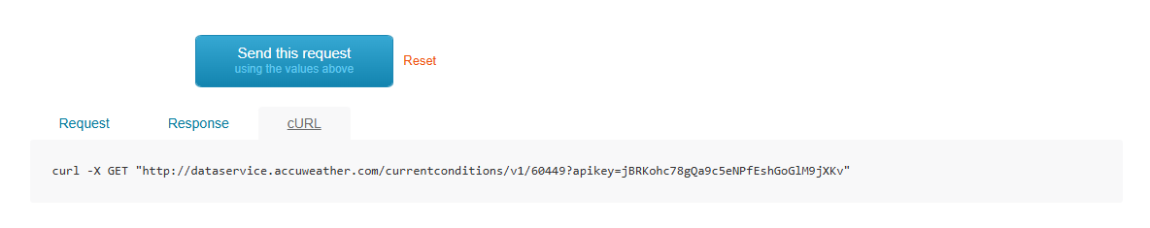
http://dataservice.accuweather.com/currentconditions/v1/60449?apikey=jBRKohc78gQa9c5eNPfEshGoGlM9jXKv

Slide 22
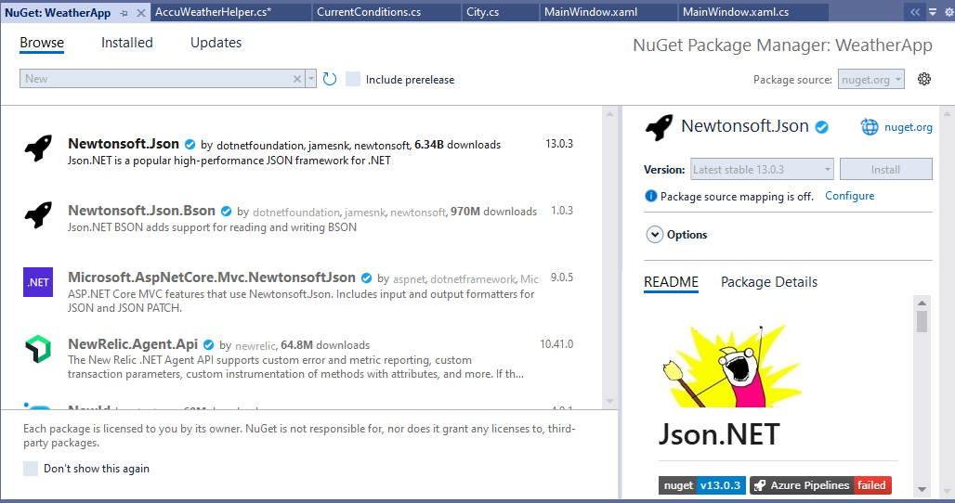
To deserialise the json:

Slide 23
Add strings to be used for the queries:
public const string api_key = "jBRKohc78gQa9c5eNPfEshGoGlM9jXKv";
public const string base_url = "http://dataservice.accuweather.com/";
#region Endpoints
public const string autoComplete_endpoint = "locations/v1/cities/autocomplete?apikey={0}&q={1}";
public const string currentConditions_endpoint = "currentconditions/v1/{0}?apikey={1}";
#endregion
Add a method to get the information from autoComplete:
public static async Task<List<City>?> GetCities(string query)
{
List<City>? cities = new List<City>();
string url = base_url + string.Format(autoComplete_endpoint, api_key, query);
using (HttpClient client = new HttpClient())
{
var response = await client.GetAsync(url);
string json = await response.Content.ReadAsStringAsync();
cities = JsonConvert.DeserializeObject<List<City>>(json);
}
return cities;
}

Slide 24
public static async Task<CurrentConditions?> GetCurrentConditions(string cityKey)
{
CurrentConditions? currentConditions = new CurrentConditions();
string url = base_url + string.Format(currentConditions_endpoint, cityKey, api_key);
using (HttpClient client = new HttpClient())
{
var response = await client.GetAsync(url);
string json = await response.Content.ReadAsStringAsync();
currentConditions = (JsonConvert.DeserializeObject<List<CurrentConditions>>(json)).FirstOrDefault();
}
return currentConditions;
}

Slide 25
View

Slide 26
Instead of event handlers we will be using Command= property in our view.
Binding is going to be done differently too;

Slide 27
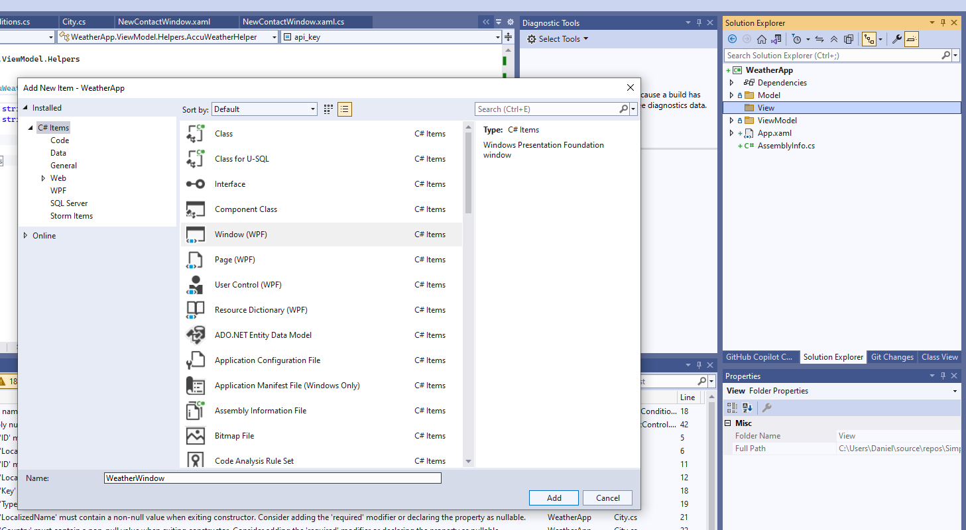
Delete the MainWindow
Create a new folder called: View
Create a new window called: WeatherWindow.xaml
pplication x:Class="WeatherApp.App"
xmlns="http://schemas.microsoft.com/winfx/2006/xaml/presentation"
xmlns:x="http://schemas.microsoft.com/winfx/2006/xaml"
xmlns:local="clr-namespace:WeatherApp"
StartupUri="View/WeatherWindow.xaml">
<Application.Resources>
</Application.Resources>
</Application>

Slide 28
No names, no event handlers!
<Window x:Class="WeatherApp.View.WeatherWindow"
xmlns="http://schemas.microsoft.com/winfx/2006/xaml/presentation"
xmlns:x="http://schemas.microsoft.com/winfx/2006/xaml"
xmlns:d="http://schemas.microsoft.com/expression/blend/2008"
xmlns:mc="http://schemas.openxmlformats.org/markup-compatibility/2006"
xmlns:local="clr-namespace:WeatherApp.View"
mc:Ignorable="d"
Title="WeatherWindow" Height="450" Width="800">
<Grid>
<Grid.RowDefinitions>
<RowDefinition Height="*"/>
<RowDefinition Height="Auto"/>
</Grid.RowDefinitions>
<StackPanel Grid.Row="0" Margin="20">
<TextBlock Text="Search for a city:"/>
<TextBox/>
<Button Margin="0, 10"
Content="Search"/>
<ListView>
<ListView.ItemTemplate>
<DataTemplate>
<Grid>
<TextBlock/>
</Grid>
</DataTemplate>
</ListView.ItemTemplate>
</ListView>
</StackPanel>
<Grid Grid.Row="1"
Background="#4392f1">
<Grid.ColumnDefinitions>
<ColumnDefinition Width="*"/>
<ColumnDefinition Width="Auto"/>
</Grid.ColumnDefinitions>
<StackPanel Margin="0, 10">
<TextBlock Text="San Francisco"
Foreground="#f4f4f8"
FontSize="20"
Margin="20,0"/>
<TextBlock Text=" overcast"
Foreground="#f4f4f8"
FontSize="18"
Margin="20,0"/>
</StackPanel>
<TextBlock Grid.Column="1"
VerticalAlignment="Center"
Text="11 C"
Foreground="#f4f4f8"
FontSize="30"
Margin="20,0"/>
</Grid>
</Grid>
</Window>

Slide 29
INotifyPropertyChanged
- Knowing when the property Value has changed.
When bound together, two properties receive notification:
The view stays updated with the values from the model (OneWay)
The model stays updated with the values from the view (TwoWay)
How it works:
The data model class implements the interface
Changes to a property trigger an event
Bound properties respond to the event
User
Two ways
Name = “”
Email = “”
Password = “”

Slide 30
User
Two ways
Name = “John”
Email = “john@example.co”
Password = “secret”
John
john@example.co
secret

Slide 31
User
Two ways
Name = “John Doe”
John Doe
john@example.co
secret

Slide 32
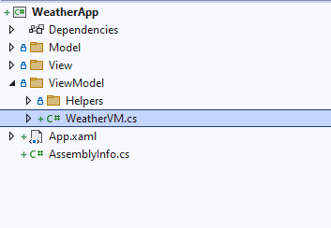
Add a new class called WeatherVM.cs (viewModel)
using System;
using System.Collections.Generic;
using System.ComponentModel;
using System.Linq;
using System.Text;
using System.Threading.Tasks;
namespace WeatherApp.ViewModel
{
public class WeatherVM : INotifyPropertyChanged
{
public event PropertyChangedEventHandler? PropertyChanged;
}
}
Add the INotifyPropertyChanged interface
Implement the interface

Slide 33
public class WeatherVM : INotifyPropertyChanged
{
private string query;
public string Query
{
get { return query; }
set
{
query = value;
OnPropertyChanged("Query");
}
}
public event PropertyChangedEventHandler? PropertyChanged;
private void OnPropertyChanged(string propertyName)
{
PropertyChanged?.Invoke(this, new PropertyChangedEventArgs(propertyName));
}
}
}
Create a new query to check if the property had changed.
Create a method OnPropertyChanged which will Inovke the PropertyChanged

Slide 34
<Window x:Class="WeatherApp.View.WeatherWindow"
xmlns="http://schemas.microsoft.com/winfx/2006/xaml/presentation"
xmlns:x="http://schemas.microsoft.com/winfx/2006/xaml"
xmlns:d="http://schemas.microsoft.com/expression/blend/2008"
xmlns:mc="http://schemas.openxmlformats.org/markup-compatibility/2006"
xmlns:local="clr-namespace:WeatherApp.View"
xmlns:vm="clr-namespace:WeatherApp.ViewModel"
mc:Ignorable="d"
Title="WeatherWindow" Height="450" Width="800">
Create a new namespace linked to the ViewModel

Slide 35
public class WeatherVM : INotifyPropertyChanged
{
private string query;
public string Query
{
get { return query; }
set
{
query = value;
OnPropertyChanged("Query");
}
}
public event PropertyChangedEventHandler? PropertyChanged;
private void OnPropertyChanged(string propertyName)
{
PropertyChanged?.Invoke(this, new PropertyChangedEventArgs(propertyName));
}
}
}
<Window x:Class="WeatherApp.View.WeatherWindow"
xmlns="http://schemas.microsoft.com/winfx/2006/xaml/presentation"
xmlns:x="http://schemas.microsoft.com/winfx/2006/xaml"
xmlns:d="http://schemas.microsoft.com/expression/blend/2008"
xmlns:mc="http://schemas.openxmlformats.org/markup-compatibility/2006"
xmlns:local="clr-namespace:WeatherApp.View"
xmlns:vm="clr-namespace:WeatherApp.ViewModel"
mc:Ignorable="d"
Title="WeatherWindow" Height="450" Width="800">
<Window.Resources>
<vm:WeatherVM x:Key="vm"/>
</Window.Resources>
<Grid>
<Window.Resources>
<vm:WeatherVM x:Key="vm"/>
</Window.Resources>
<Grid DataContext="{StaticResource vm}">
Create a new resource with key vm
<TextBox Text="{Binding Query, Mode=TwoWay}"/>

Slide 36
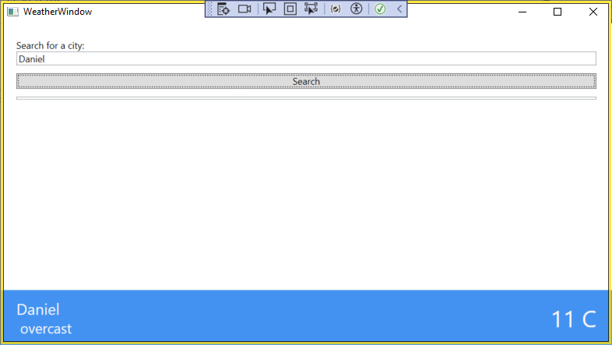
To test:
<StackPanel Margin="0, 10">
<TextBlock Text="{Binding Query}"
Foreground="#f4f4f8"
FontSize="20"
Margin="20,0"/>
<TextBlock Text=" overcast"
Foreground="#f4f4f8"
FontSize="18"
Margin="20,0"/>
</StackPanel>

Slide 37
In the view model implement new property of type CurrentConditions:
private CurrentConditions currentConditions;
public CurrentConditions CurrentConditions
{
get { return currentConditions; }
set
{
currentConditions = value;
OnPropertyChanged("CurrentConditions");
}
}

Slide 38
<Grid Grid.Row="1"
DataContext="{Binding CurrentConditions}"
Background="#4392f1">
<Grid.ColumnDefinitions>
<ColumnDefinition Width="*"/>
<ColumnDefinition Width="Auto"/>
</Grid.ColumnDefinitions>
<StackPanel Margin="0, 10">
<TextBlock Text="City"
Foreground="#f4f4f8"
FontSize="20"
Margin="20,0"/>
<TextBlock Text="{Binding WeatherText}"
Foreground="#f4f4f8"
FontSize="18"
Margin="20,0"/>
</StackPanel>
<TextBlock Grid.Column="1"
VerticalAlignment="Center"
Text="{Binding Temperature.Metric.Value, StringFormat={}{0}{C}}"
Foreground="#f4f4f8"
FontSize="30"
Margin="20,0"/>
</Grid>

Slide 39
private City selectedCity;
public City SelectedCity
{
get { return selectedCity; }
set
{
selectedCity = value;
OnPropertyChanged("SelectedCity");
}
}
<Grid Grid.Row="1"
DataContext="{Binding CurrentConditions}"
Background="#4392f1">
<Grid.ColumnDefinitions>
<ColumnDefinition Width="*"/>
<ColumnDefinition Width="Auto"/>
</Grid.ColumnDefinitions>
<StackPanel Margin="0, 10">
<TextBlock DataContext="{StaticResource vm}"
Text="{Binding SelectedCity.LocalizedName}"
Foreground="#f4f4f8"
FontSize="20"
Margin="20,0"/>
<TextBlock Text="{Binding WeatherText}"
Foreground="#f4f4f8"
FontSize="18"
Margin="20,0"/>
</StackPanel>
<TextBlock Grid.Column="1"
VerticalAlignment="Center"
Text="{Binding Temperature.Metric.Value, StringFormat={}{0}{C}}"
Foreground="#f4f4f8"
FontSize="30"
Margin="20,0"/>
</Grid>

Slide 40
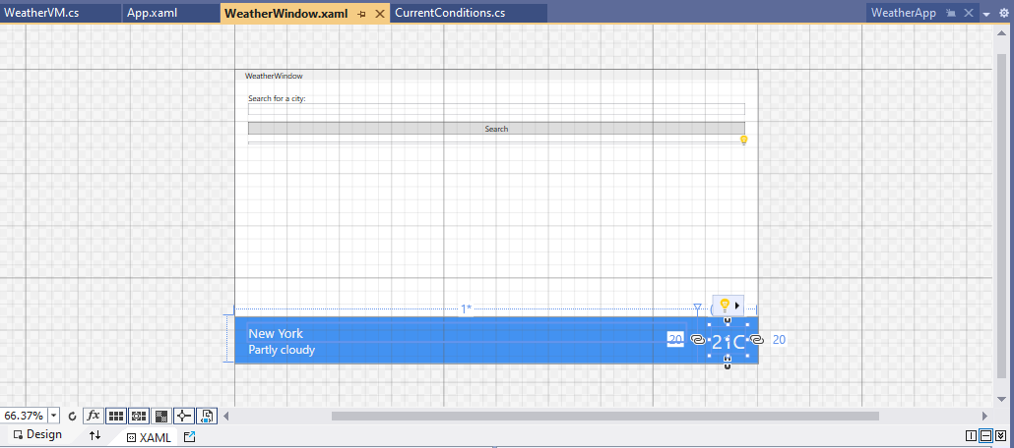
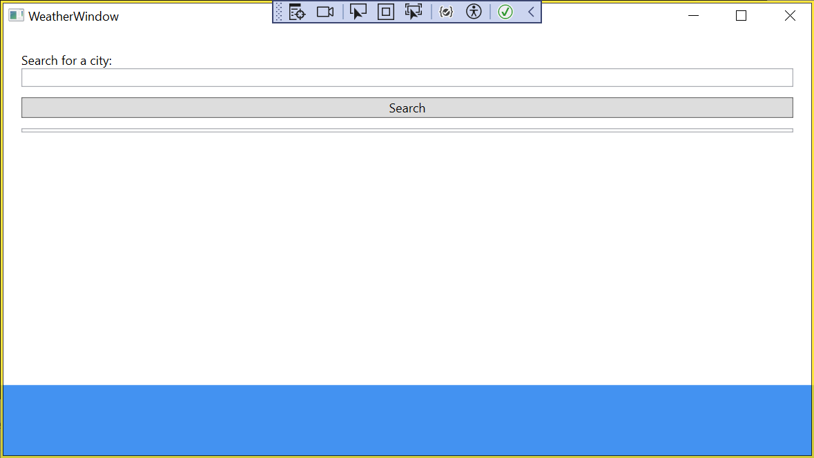
public WeatherVM()
{
// This code is only for DesignMode to view the values.
if(DesignerProperties.GetIsInDesignMode(new System.Windows.DependencyObject()))
{
SelectedCity = new City();
SelectedCity.LocalizedName = "New York";
CurrentConditions = new CurrentConditions
{
WeatherText = "Partly cloudy",
Temperature = new Temperature
{
Metric = new Units
{
Value = 21
}
}
};
}
}

Slide 41
ICommand
Replacing Event Handlers
Why to use it?
Commands can move some of the code behind logic to the View Model
Cleans up the View
Can be reused between Windows
Exist as property of the Buttons
Perfect replacement for Event Handlers
How it works?
The ViewModel implement the ICommand interface
The functionality is added to the Execute member
Optional CanExecute evaluations can be performed
The command is assigned

Slide 42
ICommand
CanExecute? = false
Execute
Login
ICommand
email@ej.co
secret
CanExecute? = true
Execute
Login

Slide 43
Insert new Class called SearchCommand.cs:
Add MakeQuery method in WeatherVM.cs
using System;
using System.Collections.Generic;
using System.Linq;
using System.Text;
using System.Threading.Tasks;
using System.Windows.Input;
namespace WeatherApp.ViewModel.Commands
{
internal class SearchCommand : ICommand
{
public WeatherVM VM { get; set; }
public event EventHandler? CanExecuteChanged;
public SearchCommand(WeatherVM vm)
{
VM = vm;
}
public bool CanExecute(object? parameter)
{
return true;
}
public void Execute(object? parameter)
{
VM.MakeQuery();
}
}
}
public async void MakeQuery()
{
var cities = await
AccuWeatherHelper.GetCities(Query);
}

Slide 44
Binding the SearchCommand to the Button
In WeatherVM create a new property SearchCommand:
public SearchCommand SearchCommand { get; set; }
Then initialise the new SearchCommand in the constructor:
public WeatherVM()
{
// This code is only for DesignMode to view the values.
if(DesignerProperties.GetIsInDesignMode(new System.Windows.DependencyObject()))
{
SelectedCity = new City();
SelectedCity.LocalizedName = "New York";
CurrentConditions = new CurrentConditions
{
WeatherText = "Partly cloudy",
Temperature = new Temperature
{
Metric = new Units
{
Value = 21
}
}
};
SearchCommand = new SearchCommand(this);
}
}

Slide 45
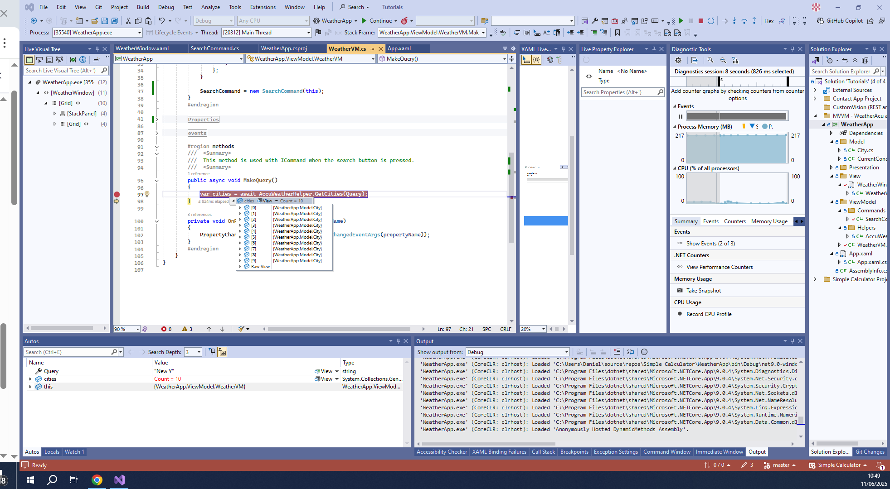
Binding the command to the Button:
<Button Margin="0, 10"
Command="{Binding SearchCommand}"
Content="Search"/>

Slide 46
In SearchCommand modify the evaluation of the textbox query:
public bool CanExecute(object? parameter)
{
string query = (string)parameter;
if (string.IsNullOrEmpty(query))
return false;
return true;
}
This will enable the query to be executed on every change of the property
Default is on LostFocus
<Button Margin="0, 10"
Command="{Binding SearchCommand}"
CommandParameter="{Binding Query}"
Content="Search"/>
<TextBox Text="{Binding Query, Mode=TwoWay, UpdateSourceTrigger=PropertyChanged}"/>

Slide 47
I also need to update the event handler CanExecuteChanged. This is to pass the object to CanExeute method.
public event EventHandler? CanExecuteChanged
{
add { CommandManager.RequerySuggested += value; }
remove { CommandManager.RequerySuggested -= value; }
}

Slide 48
ObservableCollection<T>

Slide 49
Why to use it:
Updates with insertions
Updates with deletions
How it works:
A class inherits from the ObservableCollection<T>
That class already implements INotifyCollectionChanged
Binding source is established
Changes update the UI

Slide 50
Element 1
--------------------------
Element 2
--------------------------
Element 3
--------------------------
List
Element 1
Element 2
Element 3
Element 1
--------------------------
Element 3
--------------------------
Element 4
--------------------------
List
Element 1
Element 2
Element 3
Element 4

Slide 51
In WeatherVM.cs create a new property of type ObservableCollection<City>
public ObservableCollection<City> Cities { get; set; }
Next initialise the Cities property.
public WeatherVM()
{
// This code is only for DesignMode to view the values.
if(DesignerProperties.GetIsInDesignMode(new System.Windows.DependencyObject()))
{
SelectedCity = new City();
SelectedCity.LocalizedName = "New York";
CurrentConditions = new CurrentConditions
{
WeatherText = "Partly cloudy",
Temperature = new Temperature
{
Metric = new Units
{
Value = 21
}
}
};
}
SearchCommand = new SearchCommand(this);
Cities = new ObservableCollection<City>(); // Initial the new observable collection of City.
}
Populate it:
public async void MakeQuery()
{
List<City> cities = await AccuWeatherHelper.GetCities(Query);
Cities.Clear(); // First clear the observable collection Cities.
foreach (var city in cities)
Cities.Add(city);
}

Slide 52
Binding:
<ListView ItemsSource="{Binding Cities}">
<ListView.ItemTemplate>
<DataTemplate>
<Grid>
<TextBlock Text="{Binding LocalizedName}"/>
</Grid>
</DataTemplate>
</ListView.ItemTemplate>
</ListView>

Slide 53
<ListView ItemsSource="{Binding Cities}"
SelectedValue="{Binding SelectedCity}">
<ListView.ItemTemplate>
<DataTemplate>
<Grid>
<TextBlock Text="{Binding LocalizedName}"/>
</Grid>
</DataTemplate>
</ListView.ItemTemplate>
</ListView>
private async void GetCurrentConditions()
{
Query = string.Empty;
Cities.Clear();
CurrentConditions = await AccuWeatherHelper.GetCurrentConditions(SelectedCity.Key);
}
This is needed so the Cities is not cleared in design mode.
public City SelectedCity
{
get { return selectedCity; }
set
{
selectedCity = value;
OnPropertyChanged("SelectedCity");
if (!DesignerProperties.GetIsInDesignMode(new System.Windows.DependencyObject()))
GetCurrentConditions();
}
}

Slide 54
IvalueConverter

Slide 55
Why to use it?
Changing from the Model to what the View needs
Changing View inputs into Model data
How it works?
A class implements the interface
The Convert cast Model to View
The ConvertBack casts View to Model
Class
Converter
DateTime = 2018-03-01T06:14:35.486Z
Return = “two hours ago”

Slide 56
Class
Converter
IsLoggedIn = false
Return = “Visibility.Collapsed”

Slide 57
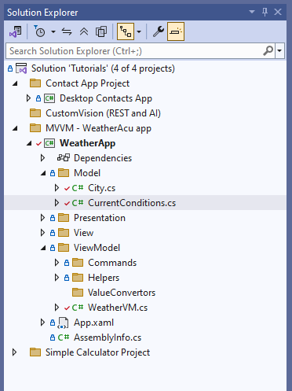
<StackPanel Margin="0, 10">
<TextBlock DataContext="{StaticResource vm}"
Text="{Binding SelectedCity.LocalizedName}"
Foreground="#f4f4f8"
FontSize="20"
Margin="20,0"/>
<TextBlock Text="{Binding WeatherText}"
Foreground="#f4f4f8"
FontSize="18"
Margin="20,0"/>
<TextBlock Text="{Binding HasPrecipitation}"
Foreground="#f4f4f8"
FontSize="18"
Margin="20,0"/>
</StackPanel>
Add a new textBlock and bind it to HasPrecipitation.
This is currently a bool.
Create a new folder for ValueConvertors

Slide 58

Create a new Class: BoolToRainConverter.cs

Slide 59
using System;
using System.Collections.Generic;
using System.Globalization;
using System.Linq;
using System.Text;
using System.Threading.Tasks;
using System.Windows.Data;
namespace WeatherApp.ViewModel.ValueConvertors
{
class BoolToRainConverter : IValueConverter
{
public object Convert(object value, Type targetType, object parameter, CultureInfo culture)
{
throw new NotImplementedException();
}
public object ConvertBack(object value, Type targetType, object parameter, CultureInfo culture)
{
throw new NotImplementedException();
}
}
}

Slide 60
using System;
using System.Collections.Generic;
using System.Globalization;
using System.Linq;
using System.Text;
using System.Threading.Tasks;
using System.Windows.Data;
namespace WeatherApp.ViewModel.ValueConvertors
{
class BoolToRainConverter : IValueConverter
{
public object Convert(object value, Type targetType, object parameter, CultureInfo culture)
{
bool isRaining = (bool)value;
if (isRaining)
return "Currently raining";
return "Currently not raining";
}
public object ConvertBack(object value, Type targetType, object parameter, CultureInfo culture)
{
string isRaining = (string)value;
if (isRaining == "Currently raining")
return true;
return true;
}
}
}

Slide 61
<Window x:Class="WeatherApp.View.WeatherWindow"
xmlns="http://schemas.microsoft.com/winfx/2006/xaml/presentation"
xmlns:x="http://schemas.microsoft.com/winfx/2006/xaml"
xmlns:d="http://schemas.microsoft.com/expression/blend/2008"
xmlns:mc="http://schemas.openxmlformats.org/markup-compatibility/2006"
xmlns:local="clr-namespace:WeatherApp.View"
xmlns:vm="clr-namespace:WeatherApp.ViewModel"
xmlns:converters="clr-namespace:WeatherApp.ViewModel.ValueConvertors"
mc:Ignorable="d"
Title="WeatherWindow" Height="450" Width="300">
<Window.Resources>
<vm:WeatherVM x:Key="vm"/>
<converters:BoolToRainConverter x:Key="boolToRain"/>
</Window.Resources>

