Slide 1
FINAL PROJECT · VIBE CODING CEDIA 2026
Ruta PRISMA
PRISMA 2020 systematic reviews, step by step, for graduate work
Daniela Fernández (UTE, Veterinary Medicine) · José Romero (UTPL, Education)
Project guide 10
Narration generated with an AI voice (ElevenLabs) and reviewed by the authors.
Vibe Coding CEDIA 2026 · Universidad UTE · UTPL
1 / 10
Notes:
COVER
SCRIPT
Ruta PRISMA guides a systematic review step by step, following the PRISMA two thousand twenty statement.
We are Daniela Fernández, from U T E, and José Romero, from U T P L.
This is our final project.

Slide 2
FINAL PROJECT · VIBE CODING CEDIA 2026
The problem
A systematic review requires 27 items, several databases and two reviewers.
A CONCRETE EXAMPLE
600 records, 5 databases, figures that don't match.
Vibe Coding CEDIA 2026 · Universidad UTE · UTPL
2 / 10
Notes:
SCRIPT
A systematic review cannot be done in an afternoon.
It needs a precise question and rules fixed before reading.
It needs searches in several databases, each one documented.
Two reviewers decide record by record.
In the end the flow diagram has to add up.
Picture a master's student with six hundred records from five databases.
If one figure does not match, she cannot tell where it went wrong.
This case is illustrative.
Anyone doing a first review can face it.

Slide 3
FINAL PROJECT · VIBE CODING CEDIA 2026
The tool
WHO USES IT
WHAT GOES IN
WHAT COMES OUT
Graduate students and instructors
Question, protocol and records
Excel, diagram, checklist and PDF
Vibe Coding CEDIA 2026 · Universidad UTE · UTPL
3 / 10
Notes:
SCRIPT
Ruta PRISMA is designed for graduate students, thesis writers and instructors.
It takes in the research question, the protocol and the records exported from each database.
It delivers four products that a supervisor can review.
An Excel workbook for screening with two reviewers.
The flow diagram.
The twenty seven item checklist.
And a P D F report that documents the whole process.
We built it from project guide number ten of the course.

Slide 4
FINAL PROJECT · VIBE CODING CEDIA 2026
How it works
1 · INPUT
2 · AI
3 · REVIEW
4 · RESULT
PICO question
Suggests, never decides
Two reviewers decide
Excel, diagram, PDF
People always decide.
Vibe Coding CEDIA 2026 · Universidad UTE · UTPL
4 / 10
Notes:
SCRIPT
The workflow has four steps.
First the person frames the question with a model such as PICO and sets the protocol.
Next the person imports the records from each database.
The tool flags duplicates and keeps count at every stage.
The A I plays two roles.
It answers methodology questions.
It also suggests whether to include, exclude or flag each record as unsure.
That suggestion is only support.
A person always decides whether a study is included, how its quality is rated and what the synthesis says.
Finally the person exports the Excel workbook, the diagram and the report.

Slide 5
FINAL PROJECT · VIBE CODING CEDIA 2026
Evidence that it works
8/10
3/3
10/10
duplicates caught
kappa matches
funnel boxes match
60 synthetic records. AI not yet tested.
Vibe Coding CEDIA 2026 · Universidad UTE · UTPL
5 / 10
Notes:
SCRIPT
We tested the tool with sixty synthetic records and no real personal data.
We planted ten duplicates.
The tool caught eight and did not merge any two different studies.
We calculated Cohen's kappa three ways in three scenarios.
All three results matched to the fourth decimal place.
We also compared the funnel with a count done by hand.
All ten boxes matched in the diagram, the Excel workbook and the P D F report.
The quality of the A I suggestions has not been tested yet.

Slide 6
FINAL PROJECT · VIBE CODING CEDIA 2026
Limits and responsible use
WHAT IT DOES NOT DO
DATA AND PRIVACY
NEXT STEP
Misses different-year duplicates
No server of its own
Expert review
Vibe Coding CEDIA 2026 · Universidad UTE · UTPL
6 / 10
Notes:
SCRIPT
Ruta PRISMA also has limits.
It misses a duplicate when the year changes or the title has a typo.
The A I suggestions have not been validated yet.
Projects are stored in the browser or in the Claude account, not on a server of our own.
Our next step is to have experts in systematic reviews validate it against the PRISMA checklist.

Slide 7
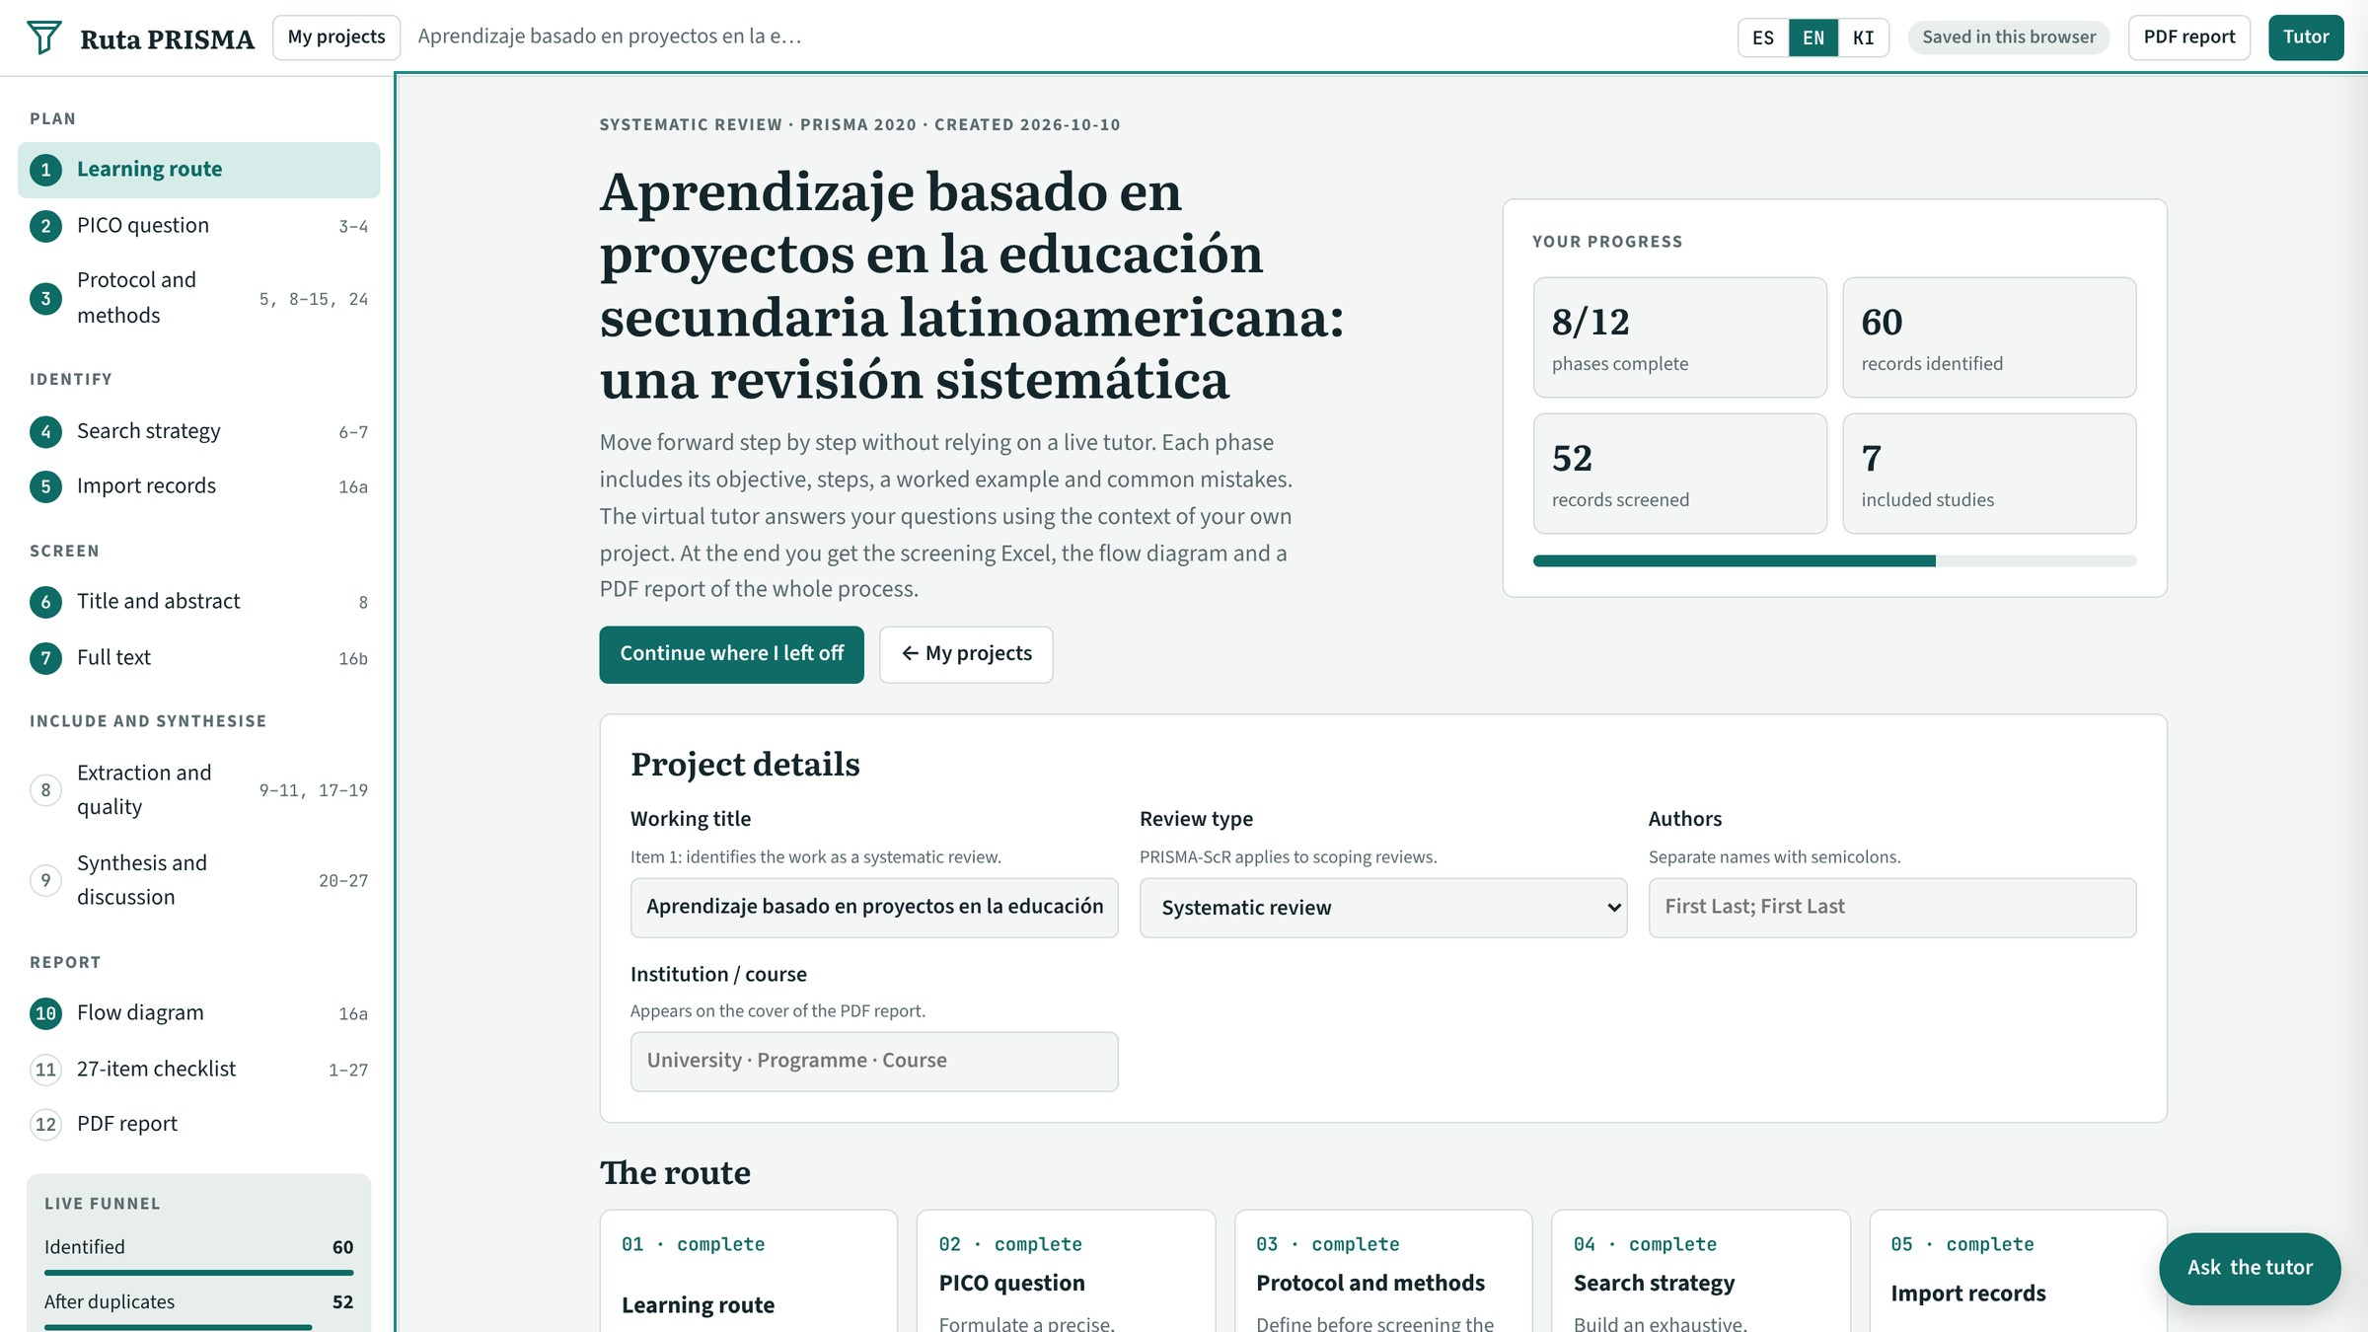
FINAL PROJECT · VIBE CODING CEDIA 2026
Demo · Input
Project start: details, 12-phase route and live funnel
Vibe Coding CEDIA 2026 · Universidad UTE · UTPL
7 / 10
Notes:
SCRIPT
Let us look at the tool.
This is the start screen of a sample project.
The person enters the working title, the type of review and the list of authors.
The route shows twelve phases grouped into five stages.
Each phase explains what to do and includes a worked example and common mistakes.
The live funnel on the left updates with every decision.
That way the person always knows where the review stands.

Slide 8
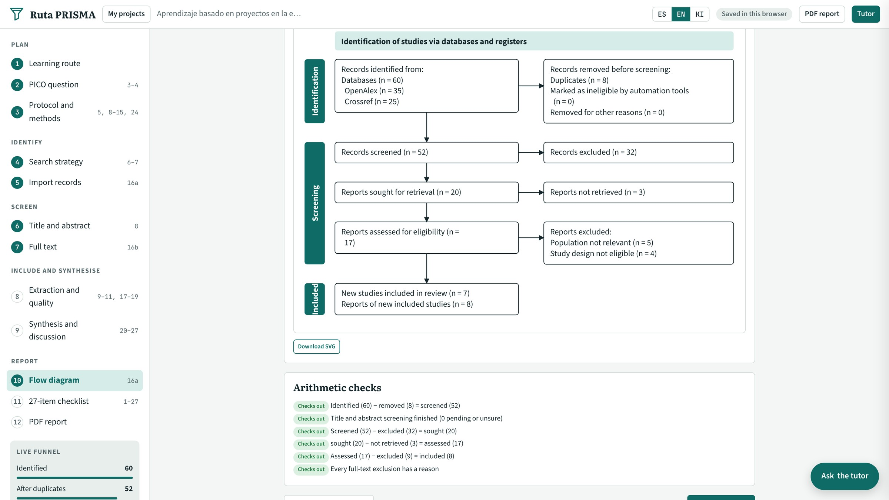
FINAL PROJECT · VIBE CODING CEDIA 2026
Demo · Result
PRISMA 2020 flow diagram built from the recorded decisions
Vibe Coding CEDIA 2026 · Universidad UTE · UTPL
8 / 10
Notes:
SCRIPT
This is the central result.
It is the PRISMA flow diagram of our test project.
At the top are the sixty records identified in two databases.
On the right are the eight duplicates removed.
Next come the fifty two records screened and the twenty reports sought at full text.
At the bottom are the seven included studies.
Every figure comes from the recorded decisions and not from a manual count.
Below the diagram the arithmetic checks confirm that each step adds up.

Slide 9
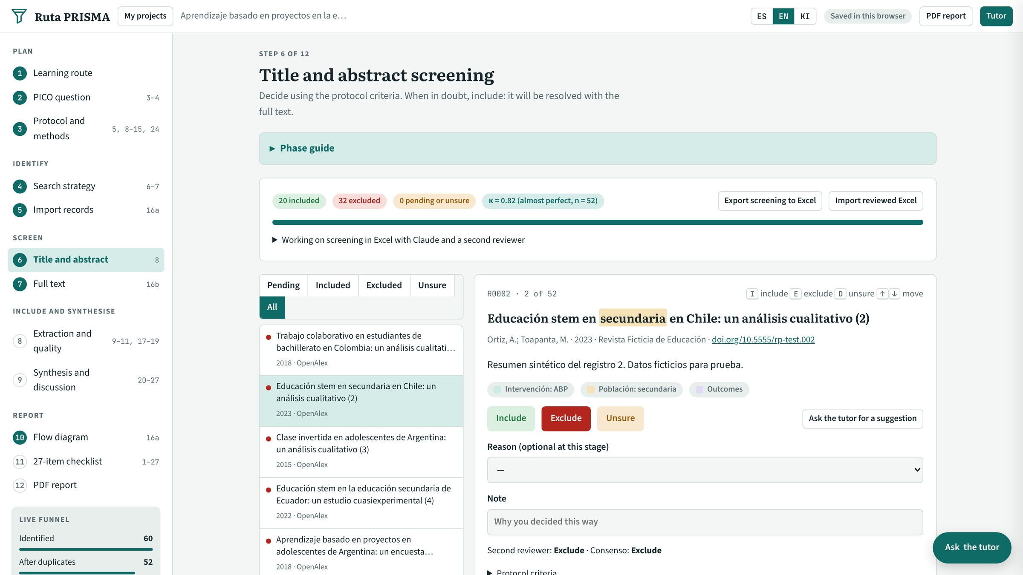
FINAL PROJECT · VIBE CODING CEDIA 2026
Demo · Review and delivery
Screening with two reviewers, consensus, kappa and Excel export
Vibe Coding CEDIA 2026 · Universidad UTE · UTPL
9 / 10
Notes:
SCRIPT
This is where the work is reviewed and delivered.
Each record shows the first reviewer's decision, the second reviewer's decision and the consensus.
Next to them is the A I suggestion button, but the person decides.
Screening can be exported to Excel and imported back once reviewed.
The kappa indicator summarizes agreement between both reviewers.
At the end the tool produces a P D F report with the same figures.

Slide 10
FINAL PROJECT · VIBE CODING CEDIA 2026
Every decision recorded, every figure traceable
Next step: expert validation.
joesystemas.github.io/ruta-prisma
Daniela Fernández (UTE, Veterinary Medicine) · José Romero (UTPL, Education)
Vibe Coding CEDIA 2026 · Universidad UTE · UTPL
10 / 10
Notes:
SCRIPT
Ruta PRISMA brings together a process that is usually spread across loose spreadsheets.
It keeps every decision on record and every figure traceable.
For us it changes how we support someone through a first review.
We invite you to try it with your own question and tell us what to improve.
The link is on the screen.
Thank you for your attention.

