Slide 1

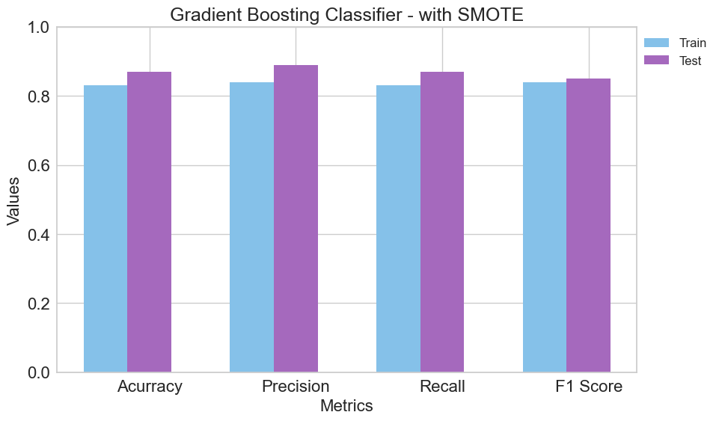

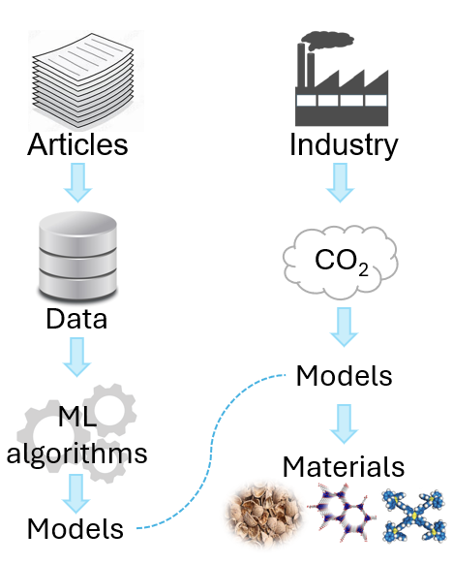
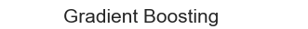
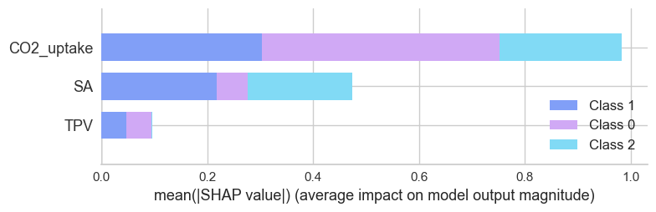
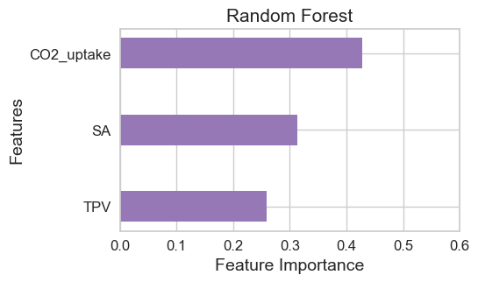


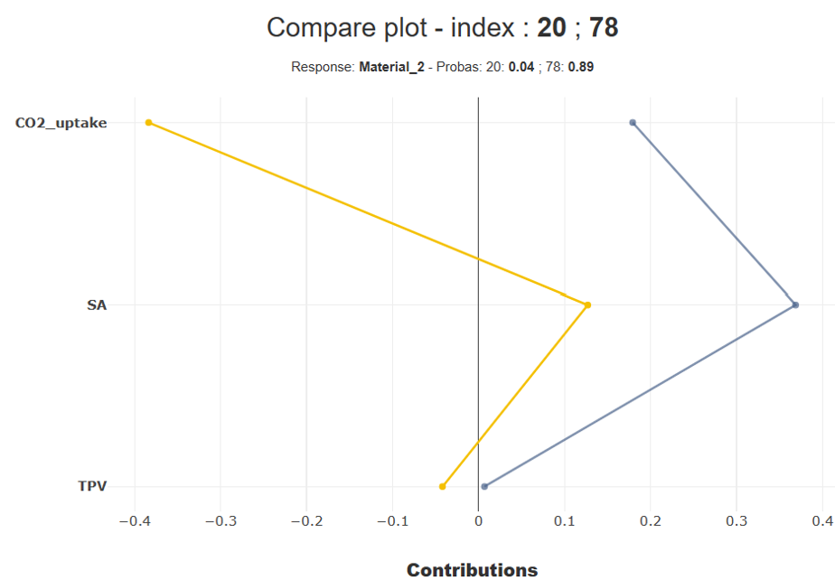




APPLIED MACHINE LEARNING MODELS TO ESTIMATE MATERIAL TO ADSORB CO₂
Daniela Mariano Barreto, May 2024
Introduction
Findings
The increase in carbon dioxide (CO₂) in the atmosphere started decades ago, and this problem persists today, potentially explaining climate change due to the greenhouse effect. Consequently, there is a growing recognition among industries of the urgent need to adopt sustainable business practices, implementing measures to reduce and capture CO₂.
Gradient Boosting Classifier
Random Forest Classifier
Decision Tree Classifier
Business Understanding
General goal
Assess the performance of various machine learning models to find the best ones capable of identifying the most suitable material for capturing CO₂, considering a predetermined amount of the gas.
SMOTE
Stratified K-Fold
Random Search
CO₂
SA
TPV
Generalization
Success Criteria
Most influential feature
CO₂
CO₂
Success criteria
Minimum 0.80
Recall - Precision
True Positive instances
SA
0.87 and 0.89
TPV
Conclusions
The three models used were capable of making predictions for materials, possibly due to their robustness, which is associated with satisfactory training using SMOTE and Stratified K-Fold, as well as the selection of appropriate hyperparameters. However, there is a need to increase recall and precision values, as well as improve the representation of the minority class.
Technologies
Libraries
SciPy
Scikit-learn
Yellobrick
imbalanced-learn
SHAP
shapash
Machine learning algorithms
Ada Boost Classifier
Gradient Boosting Classifier
Random Forest Classifier
Decision Tree Classifier
k-Nearest Neighbors Classifier
Gaussian Naive Baye
C-Support Vector Classification
Challenges
Comparable experimental conditions → 25°C and 1 bar
Imbalance class → ↑ Carbon-based + SMOTE
Shap - Gradient Boosting → KernelExplainer
Hyperparameter tuning and cross-validation
Random Search
Stratified K-Fold
References
Dziejarski, B., Serafin, J., Andersson, K. and Krzyżyńska, R. (2023). CO₂ capture materials: a review of current trends and future challenges. Materials Today Sustainability, 24, p.100483. doi:https://doi.org/10.1016/j.mtsust.2023.100483.
Müller, A. C. and Guido, S. (2017). Introduction to machine learning with Python: a guide for data scientists. 1st ed. United States of America. O’reilly Media.

Slide 2
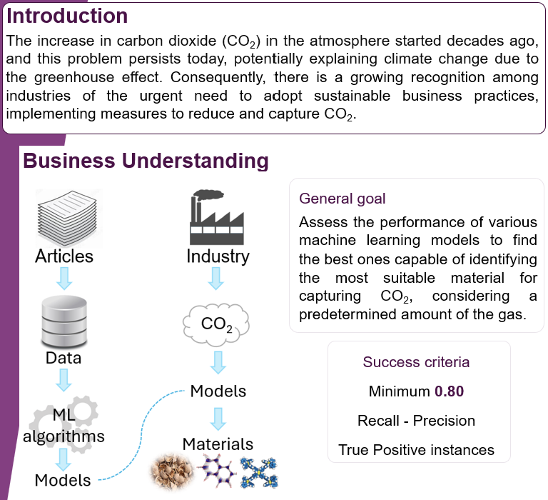

Slide 3
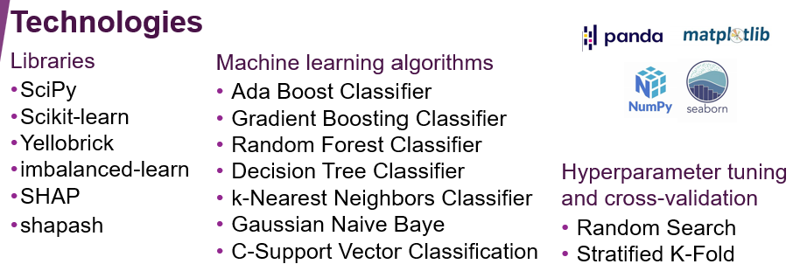

Slide 4
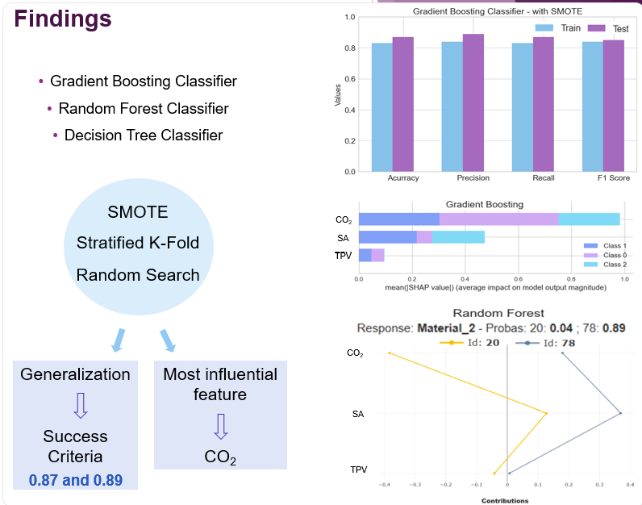

Slide 5
