Slide 1

TEA SHOP
“In fiecare ceasca de ceai exista cate o calatorie imaginara.”
(Catherine Douzel)
Project Presentation
by Daniela Morda
Mentor: Alin Grigorescu

Slide 2
About TeaHi
Pleasure for Tea
Passion for IT

Slide 3
What`s Next
Project Info
Concepts used
Pages
Functionalities & Improvements

Slide 4
Project Info
.
Products list
Tea Shop with online order
1.TeaHi (Tea benefits)
2.Ceai (All our products)
3. Contact (Send us a message)
Structure
5. Cosul meu
( Products to buy)
4. Admin
(Add or Modify a product)
Structure

Slide 5
CONCEPTS USED
Creation
Communication
Stylization

Slide 6
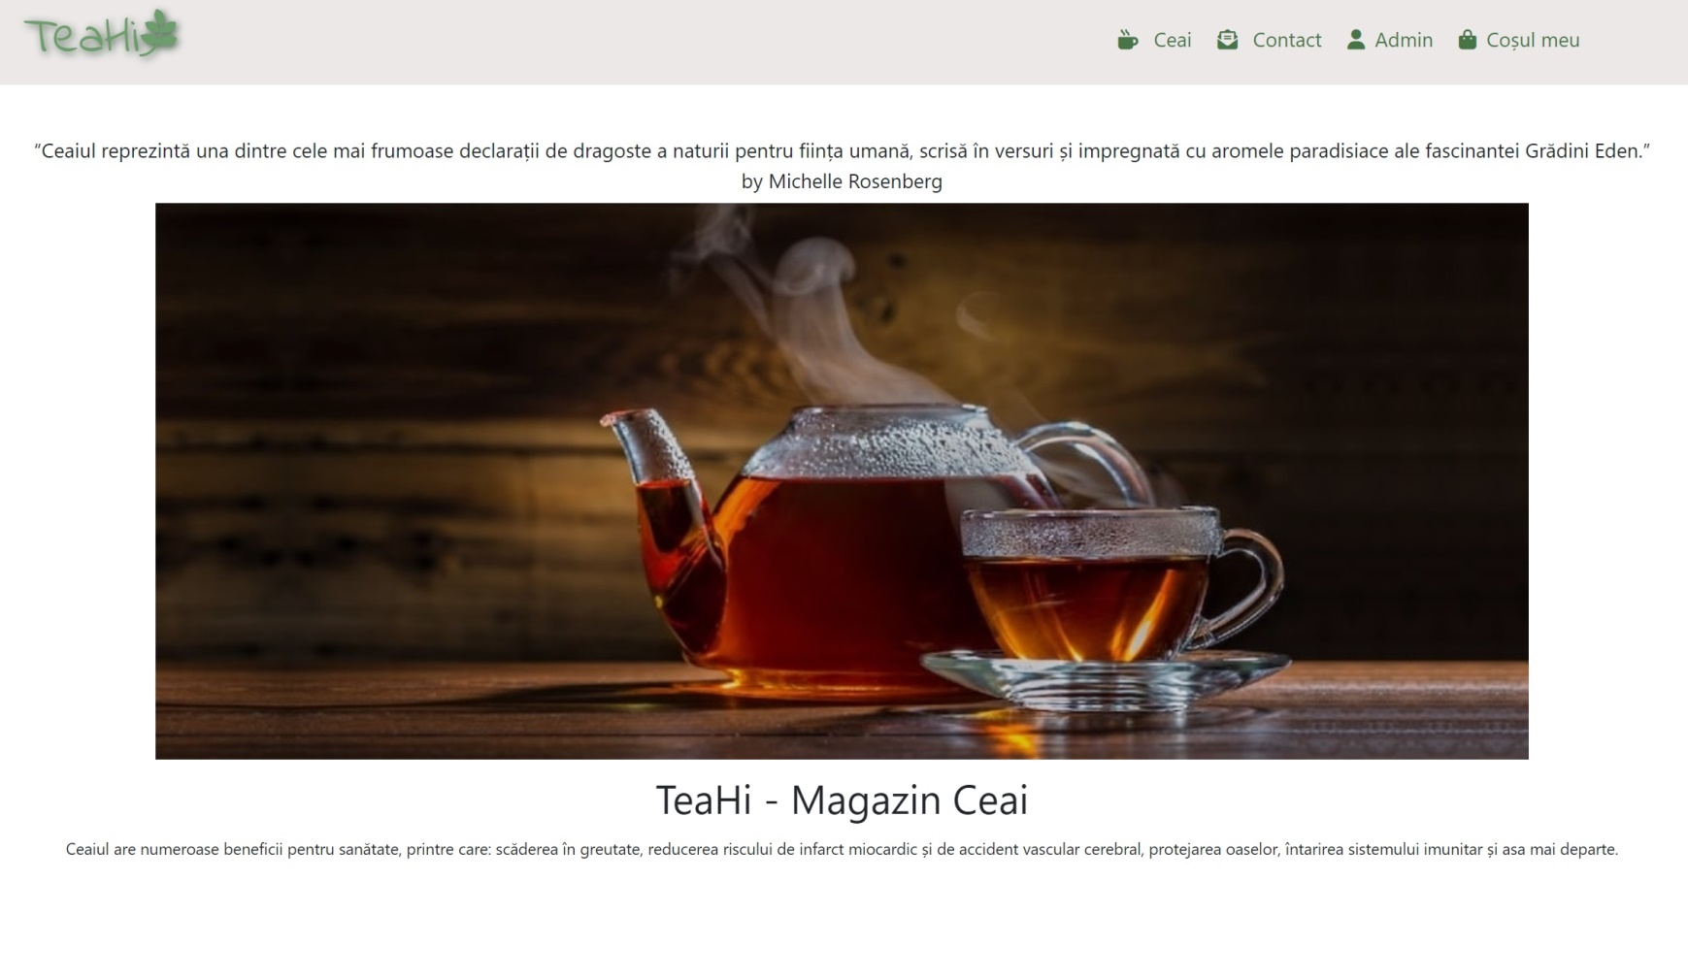
TEAHI (Home page)

Slide 7
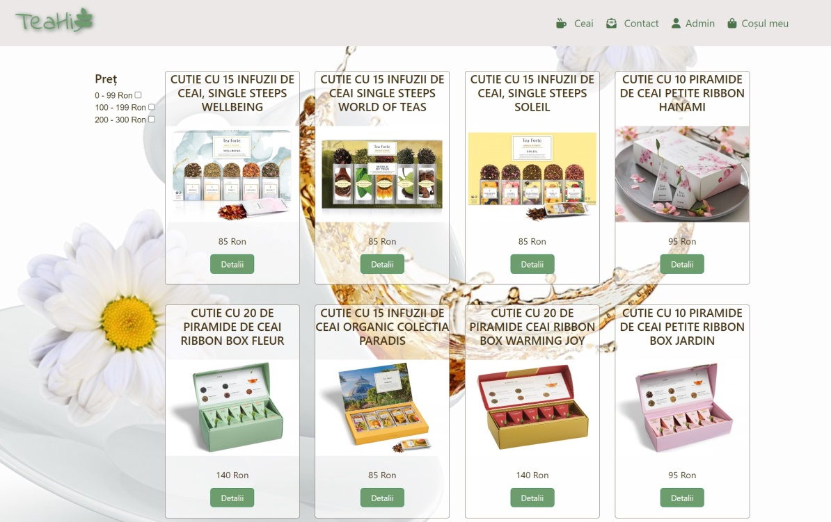
Ceai
This page contains
different types of tea such as:
Green
Black
White
Fruits
Plants
And it also has a price filter.

Slide 8
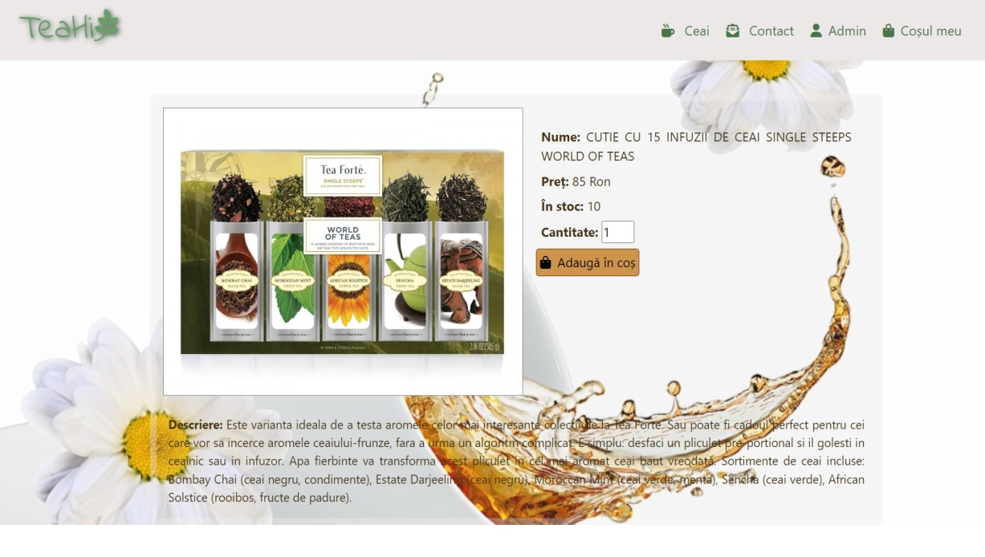
Detalii produs
This page presents the products and includes:
product`s picture
the price
the products in stock
the quantity
add in cart button
the description of the tea

Slide 9
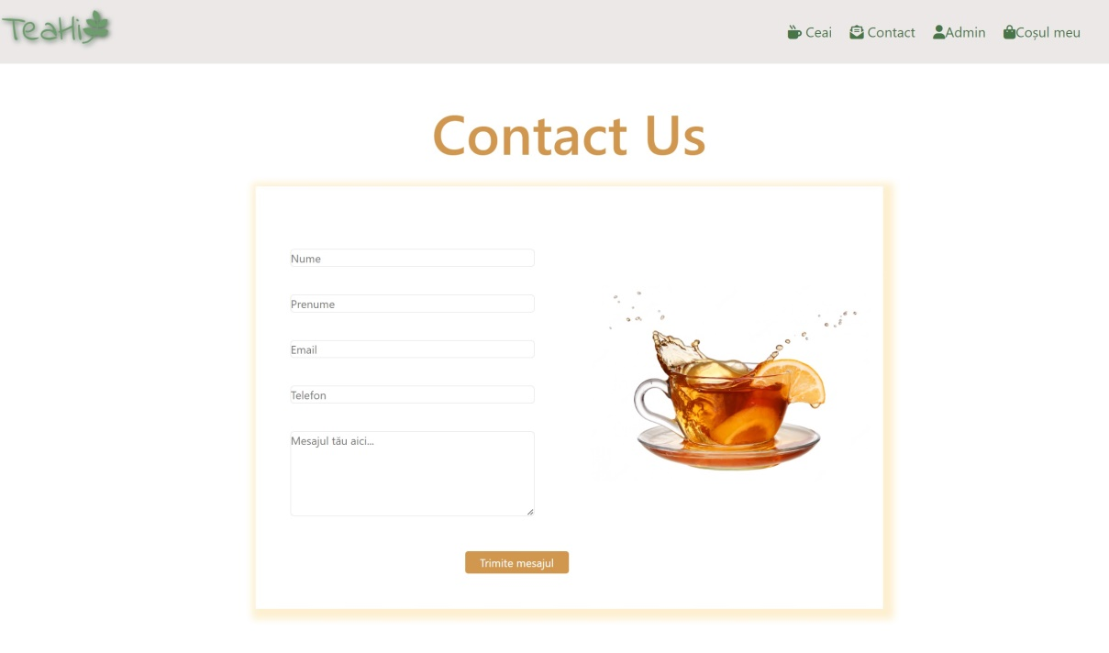
Contact
The customers can send us messages using this contact form.

Slide 10
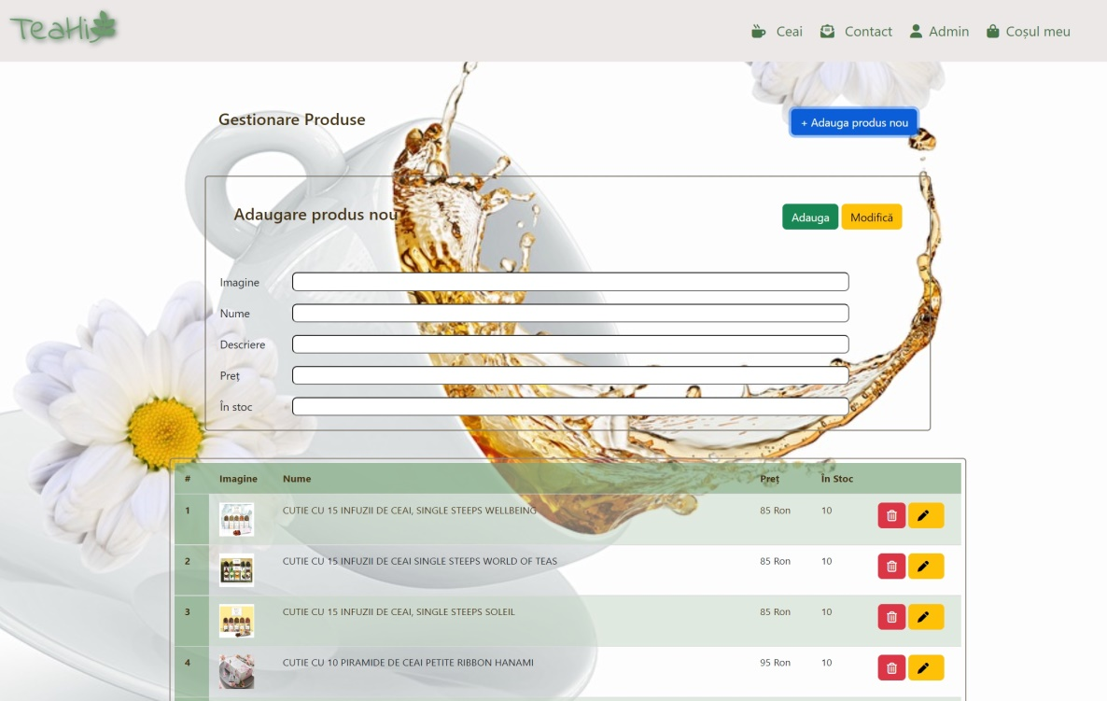
Admin
This page is for admin only. Here he can add, modify or delete products.

Slide 11
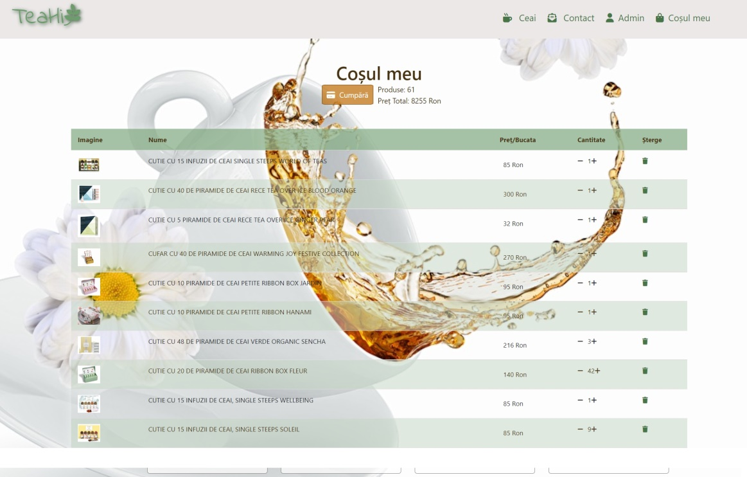
CoȘul meu
The customer has the possibility to increase or decrease the quantity of the products, or to delete them.
He can also see the number of products in cart and their total value.

Slide 12
Bugs & Improvements
Bugs
I can add more products to the basket that are actually in stock (details page).
Improvements
Products added to the basket to be deducted from the stock.
By clicking on the “adauga” button, a new product will be added even if no fields have been filled (admin page).
Make it responsive for both tablet and mobile.

Slide 13

Thank you for your attention!

