Slide 1


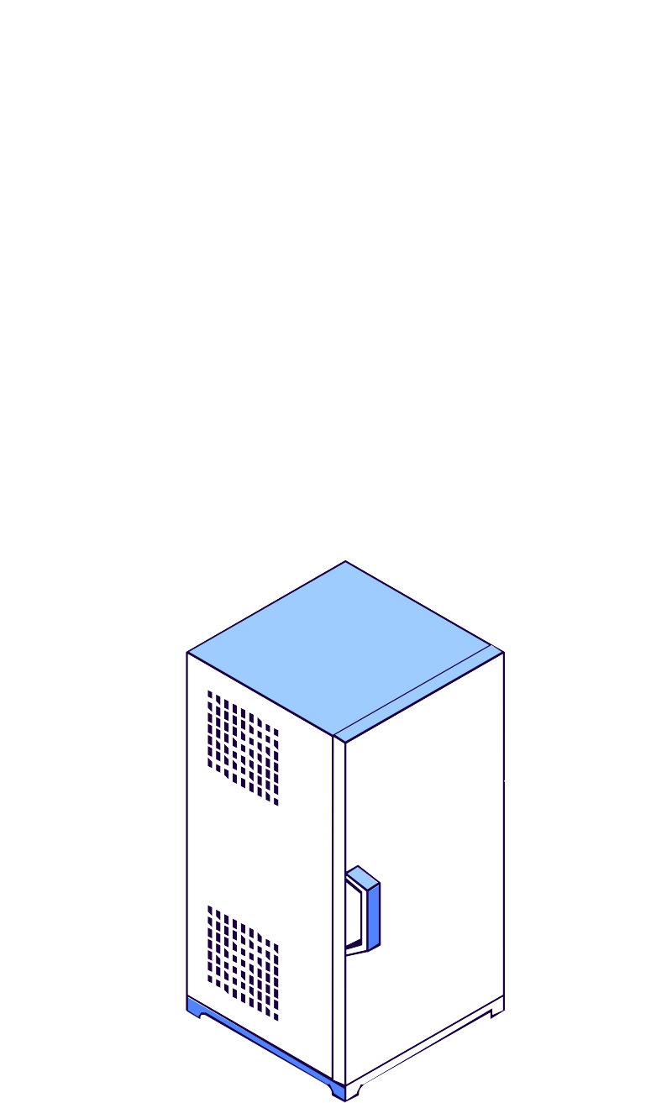



MessagIST
S I R S - 2 0 2 4 / 2 0 2 5
Group: A34
Daniela Camarinha ist1112265 Sofia Du ist1104195
Tomás Gouveia ist1103793

Slide 2




Table of Contents
Build Infrastructure
Protecting Communications
Secure Document Library
Database
Security Challenge - A
Demo
Conclusion
Questions
Attacker Model

Slide 3
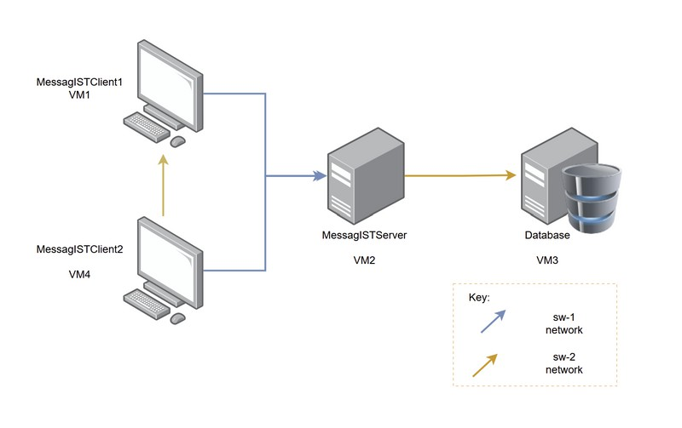


Build Infrastructure

Slide 4

Protecting Communications
Communications are made through SSL/TLS over TCP:
No messages can be lost in (TCP)
Messages are encrypted (TLS)
transit
Each component maintains its own dedicated KeyStore and TrustStore.
One-way authentication (server is authenticated, client is not - same in web browsers)

Slide 5
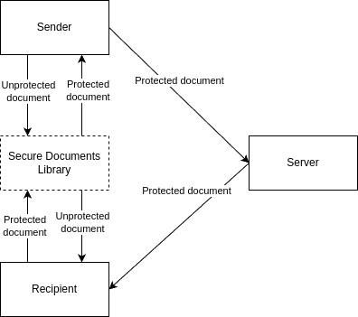


Secure Document Library
Provides these operations: Protect document
Check integrity of document Unprotect document

Slide 6
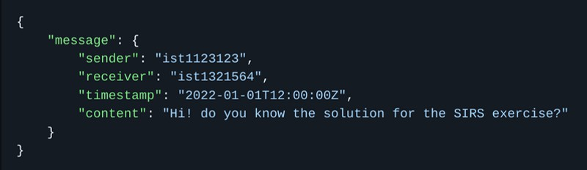


Secure Document Library

Slide 7






Secure Document Library
Sender private key (RSA)
Content
Encrypted content
Signature
Encrypted key for receiver
Random secret key (AES)
Receiver public key (RSA)

Slide 8
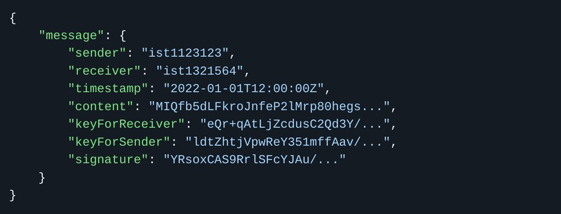


Secure Document Library

Slide 9
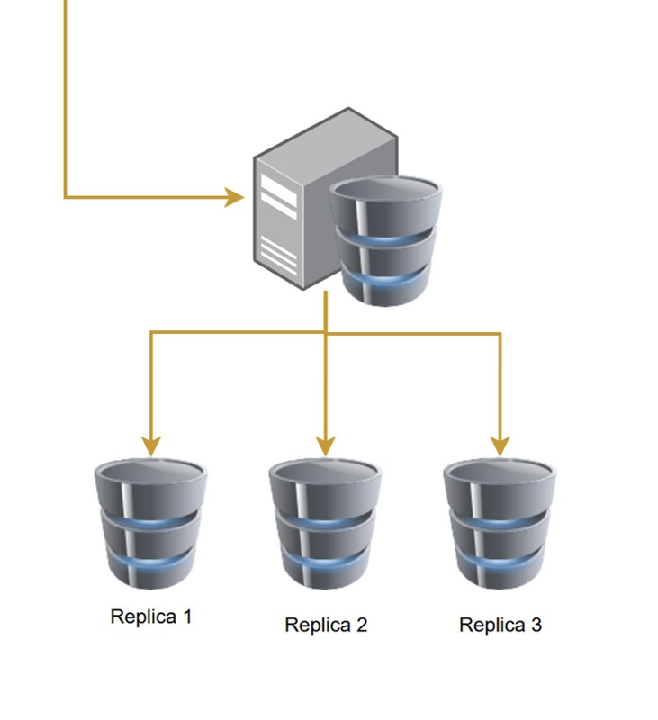


Database
Database is trusted by the Server and: Is an in-memory database
Should be replicated to ensure availability and reliability
Scheduled Backup Service is executed every 14 days.
Only responds to server-side requests, never accessed directly by the client.
Sanitization of user input is done through the use of PreparedStatements

Slide 10
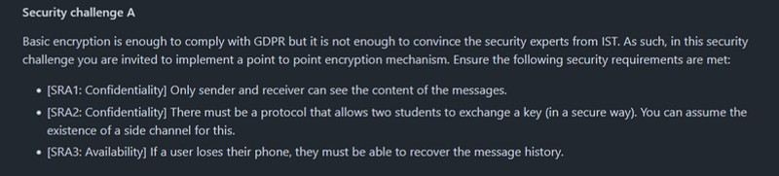


Security Challenge A

Slide 11


Security Challenge A

Slide 12
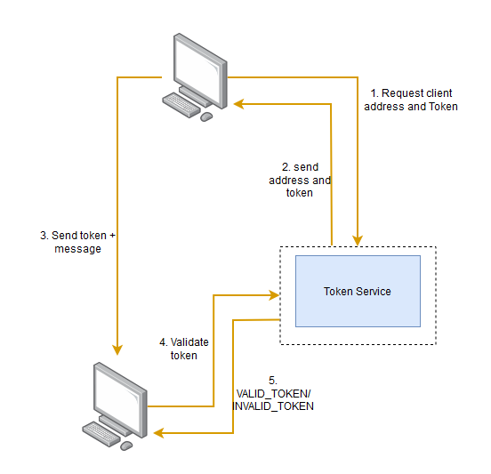


E2E - End-to-End Communication

Slide 13
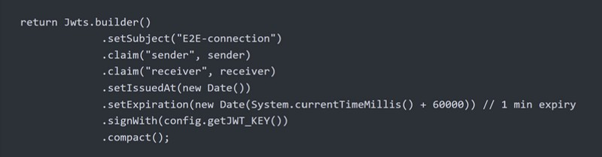


E2E - End-to-End Communication
Can only be validate by the server.
Expiry date secures against replay attacks

Slide 14





Password Derivation Service
1.

Slide 15

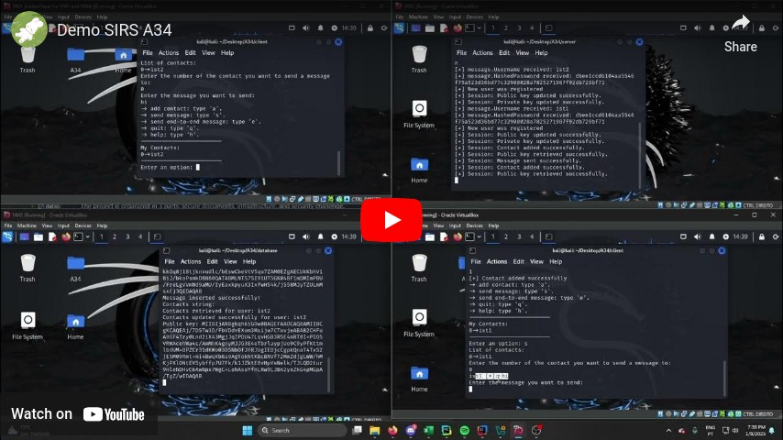

Demo

Slide 16


Conclusion

Slide 17

Questions

Slide 18

Attacker Model
Assumptions:
What attacker can do:
Setup virtual machine with own IP on the network to: Use wireshark and try to sniff packets
Connect to the Server and try to send malicious playload
What attacker cannot do:
Have knowledge of Runtime information of any of the Server machines, hence not being able to check the data stored by the Database.

