Slide 1
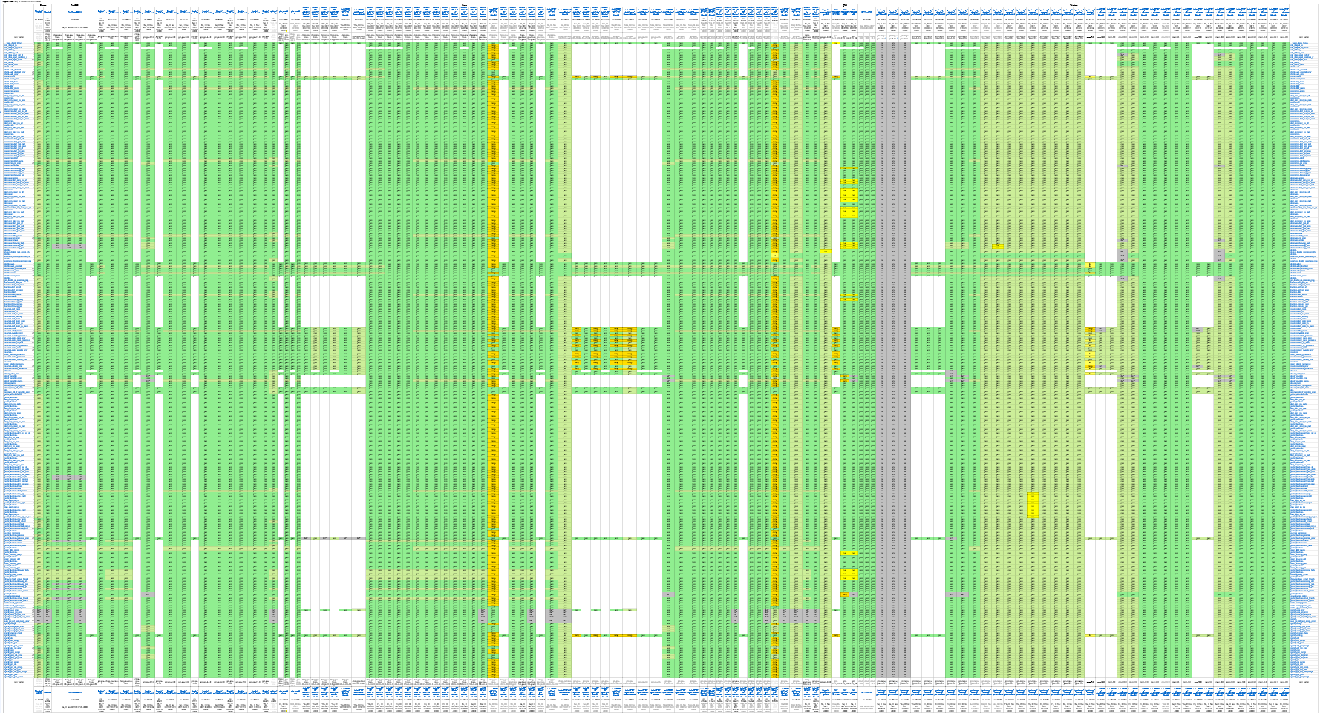
OLD
Oct 30
No lambdas
_NOEXCEPT error in <ostream>
Asked boost…
OLD
Nov 5-6
Boost.Optional
EXPECTED MSVC 7.1 is too old…
EXPEXTED
GCC 8 new & not yet rel
OK
Fixed itself in Nov 12 re-run
EXPECTED QNX un_ex always false
OLD
Nov 6
Boost.Optional (QNX)
EXPECTED
no mingw gcc 6.1 rel

